Slide 1
MUTHOOT FINANCE
And the Gold Loan Business
-Aritra Pal

Slide 2
Overview
One of the Oldest organized Gold Loan company – since 1939
India’s Largest Gold Finance Lender:
Pan India presence:
  29 States/UTs
  4500+ Branches – largest dedicated gold loan network
  25,000+ employees
  8+ mn. loan accounts
  176 tonnes gold held as collateral (≈60% of the reserves held by RBI in India)

Slide 3
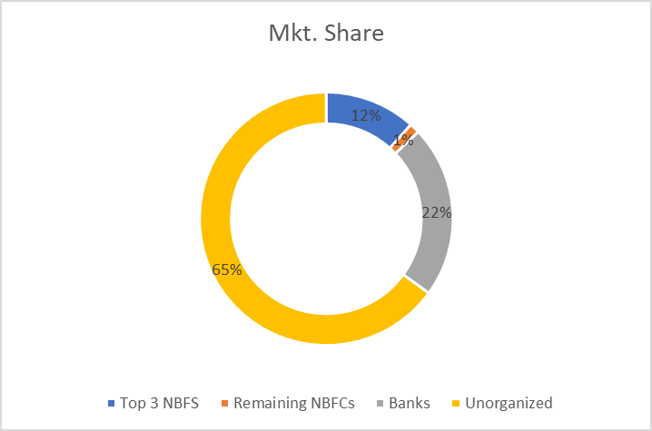
Why is Gold Based Lending Unique?
Collateral-based lending, based on the accurate appraisal of jewelry
No true NPAs - Most secure Lending businesses
Acyclic – not impacted by Economic crisis
Interest Rates:
  Banks – 7.5% - 10.05%
  NBFCs – 12% - 24%
  Unorganized – 25% - 50%
Short Ticket Sizes – Rs. 35,000 – 40,000
Intense Operating Cost Business
Avg. Maturity – 4.5 months
Loan in less than 15 mins.
Serves as a means of emergency/bridge financing
Mostly caters to Semi-urban/Rural
Primary use – MSMEs, small traders(working capital), distress loans

Slide 4
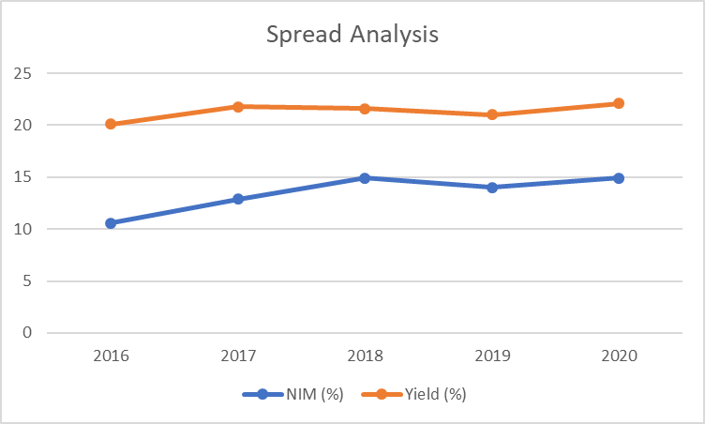
Why is Muthoot a Great Business?
Growing AUM – even in tough times
With Improving NIM & Yield Margins

Slide 5
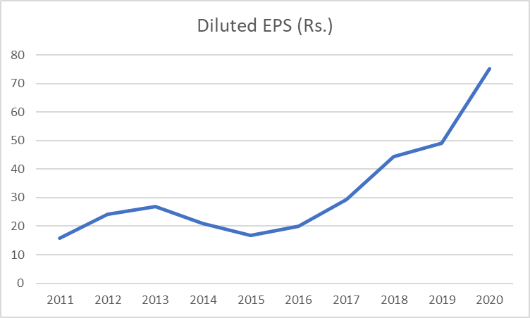
Why is Muthoot a Great Business? (Contd..)
Highest Gold Loan AUM – 2.4 times loan book than next largest player
Promoter Shareholding – 74%
  Total Equity Capital Raised – 1,700 Crs.
  Total Dividends paid – 3,049 Crs.
  Current Networth – 12,589 Crs.
Exceptional ROE
  Avg. ROE of 27% with min. of 14% in FY15
  Last 5 yrs. ROE of 22%
  Generating High ROE despite low D/E – Extremely Profitable Business

Slide 6


Muthoot – Moats
Brand Matters -
  Only Lending category where the borrower needs to trust the lender
  Established & Trusted Brand Benefit
  New player cannot grow without high marketing spends
  Perceived as the most reasonable Gold Loan NBFC among customers
Pricing Power
  Passes on higher cost of funds to customers to maintain margins at 9-9.5%
Lowest Cost of Operations due to Operating Leverage
  Highest Gold Loan per Branch (2.4x times of Manappuram)
  Lower Op. Cost per Branch (despite having 30% larger branches)
  Largely Fixed Cost business – high operating leverage
Creating Markets & Capturing the same

Slide 7
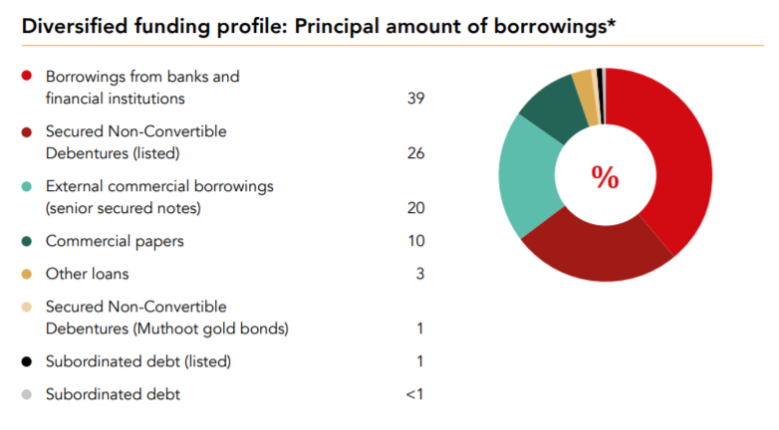
Muthoot – Moats (Contd..)
Lower Borrowing Costs
  Than other NBFCs (Manappuram, IIFL, SCUF)
  Banks have lower borrowing costs but much higher operating expenses
Specialized & Focused - Banks cannot match
  Dedicated personnel to ascertain gold value and disburse loan within 10 mins.
High level of Semi-urban and rural presence
  2/3rd of India’s gold holdings with rural

Slide 8
Comparative Analysis – What do the numbers convey?
2.4 times gold loan AUM per branch
Lower Borrowing Cost (Higher Retail deposits)
Lower Cost-to-Income
High Fixed Cost nature of business
Higher Gold Loan Share of Total AUM (Gold Loan having highest margin)
Higher EPS (4.5 times)
Higher ROA
Higher ROE

Slide 9
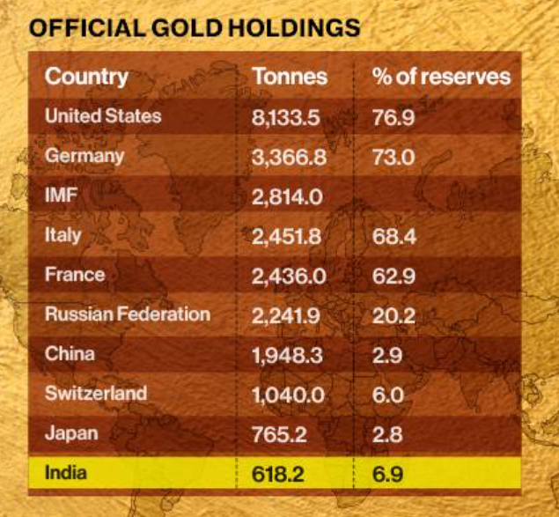
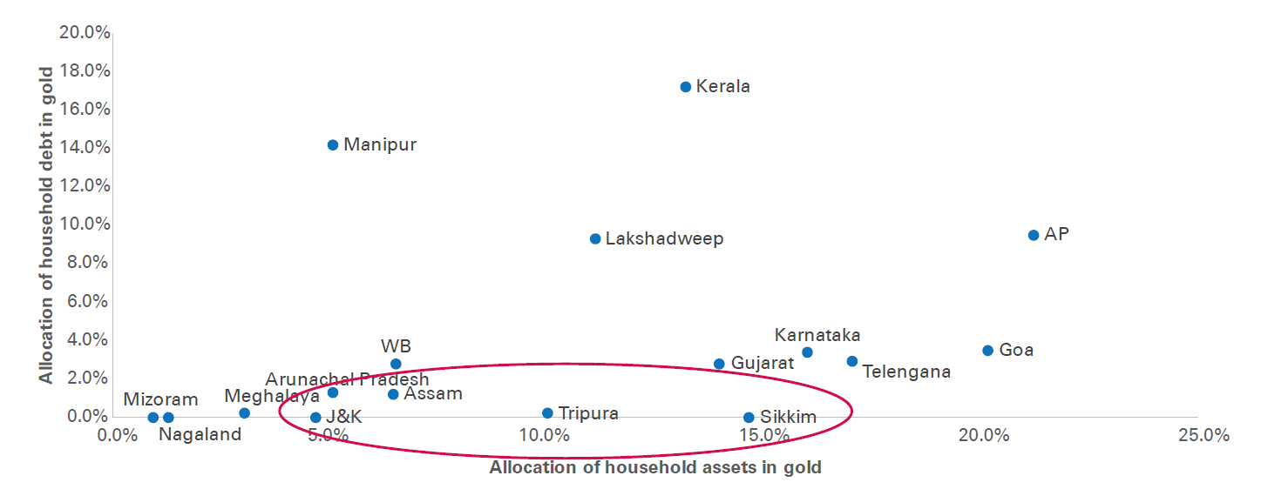
Future Growth
Huge availability of gold with households, but…
  Very low penetration - Total gold loans outstanding in organized sector is estimated at 5.5.% of the total household gold holdings in India
Unorganized Sector at a staggering 65%
Very Low penetration, esp. in East, North & West

Slide 10
Future Growth (Contd..)
Upliftment of rural class – ~70% of gold demand from rural India(Muthoot’s mkt.)
Unique schemes/models to promote adoption – doorstep gold loan disbursal, gold locker facility and option of taking a loan
Higher adoption by the urban class, evident by digital adoption
  18.5% of active Muthoot gold loan customers transact online
  One of the Gold Loan firms witnessed its online gold loan share surging from 1% to 39% of its AUM over a period of 4 years
Good growth in Muthoot’s subsidiaries – Operating Leverage should kick in

Slide 11
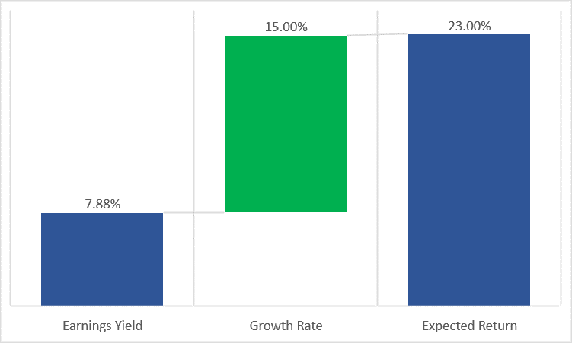
Is Muthoot still available at a Discount?
P/E – 12.60
P/BV – 3.46

Slide 12
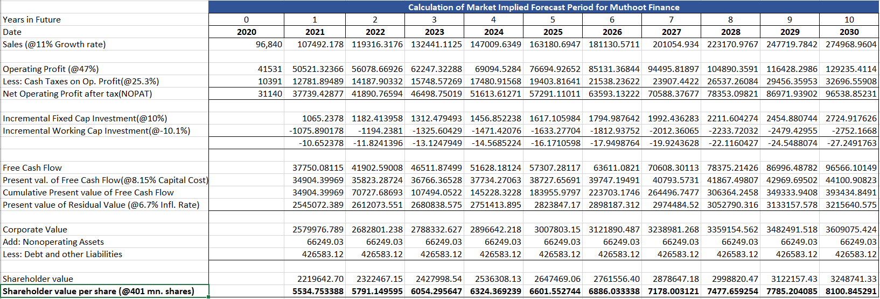
Is Muthoot still available at a Discount?(Contd..)
High chance of re-rating:
  COVID has made it tighter for other lending firms to grow at 20-25% rate
  MSCI Index Prospect – Due to rally in Muthoot Finance shares
PIE based Pricing:

Slide 13
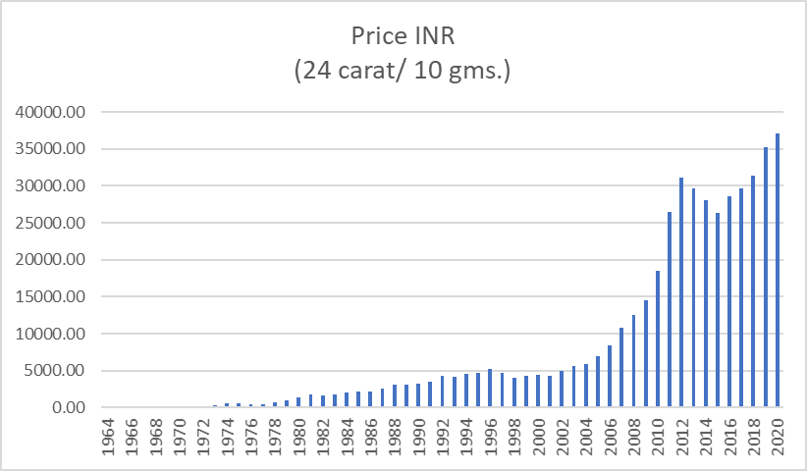
Risks
Gold Price Risk
  Only 9 times gold prices fell in the last 55 years
  Avg. Loan Maturity is just 4.5 months
  Incentives for faster payments

Slide 14
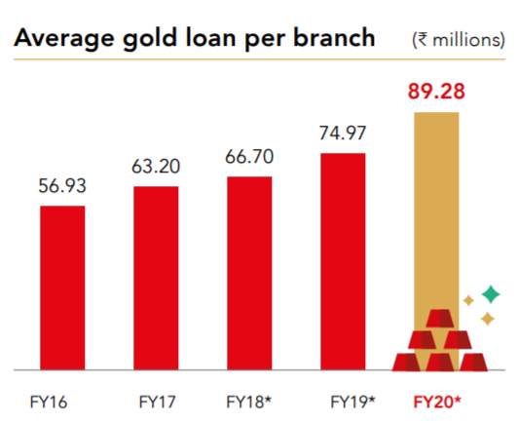
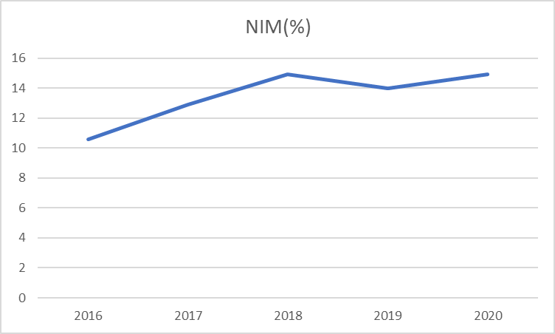
Risks (Contd..)
Threat from Unsecured Lending
  Different customer segment & purpose
  Very few players in rural & semi-urban mkt.
  Per Branch AUM is growing
Regulatory Risk – increase to 90% for banks
  LTV increase, unlike decrease in 2013
  Erodes margin of safety
Competitive Intensity
  NIMs may compress – but opposite is happening
  Expanding mkt
  Govt. to encourage gold monetization –
    Focus on product based reforms vs. Institution based

Slide 15
Questions??

