Slide 1
Home To The World’s Largest
Community For Women

Slide 2
OUR STORY
IncNut Digital began in the searing summer of 2014 under a small team with a big, burning obsession: to deliver compelling, useful and pertinent information to a specific demographic – to today’s modern women.
Two office spaces, hundreds of recruits, fundamental changes in the market and digital spheres and a little over two years later, our vision remains the same.
Our position and vision are reflected in our properties.

Slide 3
IncNut Digital is a venture funded digital media company that owns several successful digital properties
www.Stylecraze.com
www.MomJunction.com
www.TheBridalBox.com
www.StylecrazeTV.com

Slide 4
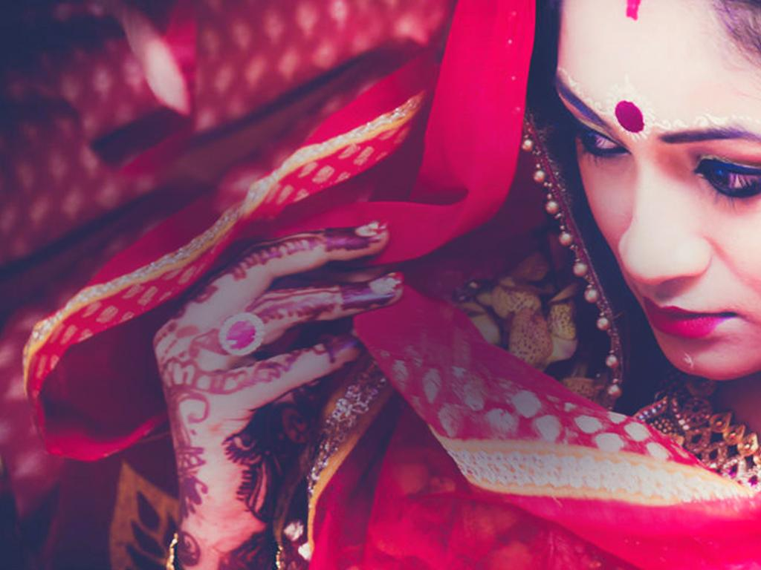
India’s Largest Wedding Website

Slide 5
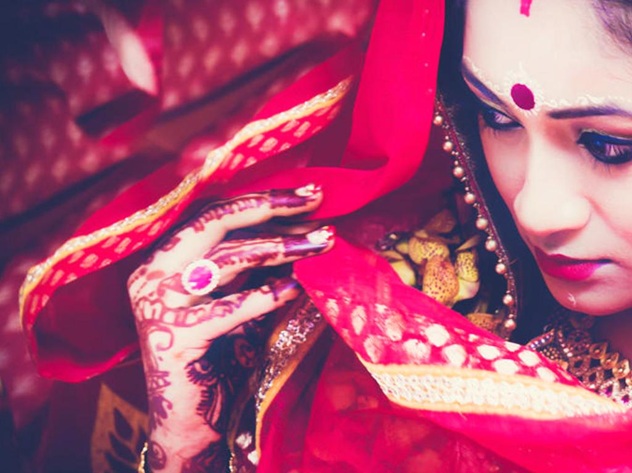
The Bridal Box Metrics
Monthly Visitors - 1 Million
1.2 Million Fans
% of Women Visitors: 85%
Top Age Groups: 19-35

Slide 6
CASE STUDIES

Slide 7
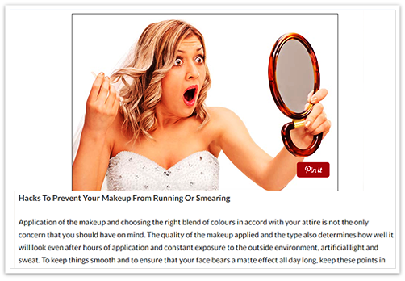
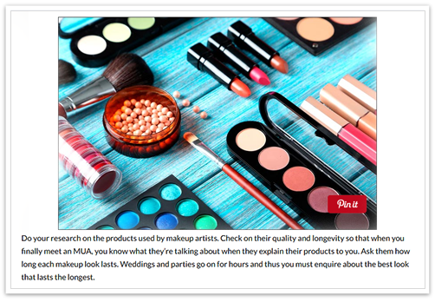
Bride Contest Lakme
Display advertising and series of sponsored articles on Lakme & Brides:

Slide 8
DIGITAL OFFERINGS

Slide 9
Digital Offerings
Sponsored Content: Series of sponsored content (text/ video) where we weave the brand into the content
Community Partnerships: Opportunities for
brands to build communities on
our websites
Display & Text Ads: Banner & native ads
Lead Generation

Slide 10
Why Work With Us?
30 Million monthly visits from women and growing on a month on month basis.
Innovative and integrated content, goal-oriented strategy to enhance brand recall and consumer engagement.
Original and useful content created by in house writers, bloggers and industry experts.
Strong social; media presence across all popular platforms:
Facebook, Instagram, Twitter and Pinterest.

Slide 11
Client List

Slide 12
Natasha Garyali
natasha@incnut.com
VP, Sales & Marketing +91-9871095552
PARTNER WITH US.
PARTNER WITH US

