Slide 1
GODREJ PROPERTIES
-Aritra Pal

Slide 2
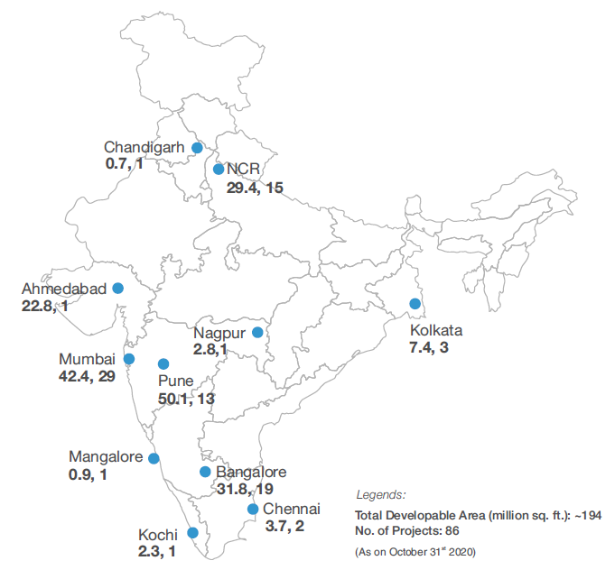
Overview
Established in 1990
~194 million sq. ft. of developable area across India
3 types of engagement models:
Development Model
Joint Venture
Outright Land Purchase
Key Mkts: Greater Mumbai(Thane/Navi Mumbai), Pune, Bengaluru & NCR
Primary Focus is on Residential Property
Asset Light Business

Slide 3
Moats
India’s largest publicly listed developer by booking value over last five years - Gained Mkt. Share over the years, esp. in the micro-markets where future growth potential exists the most
Strong Brand Pull – “Godrej”
JV partner of choice - Given strong brand, robust financial capacity and strong execution capabilities. Tie-up for landbanks at client-centric locations
GPL differentiation vs peers - Focuses on land parcels, which have a quick turnaround and shorter go-to-market time, rather than pooling long-term strategic landbank inventory
One of the shortest production time from land acquisition to approvals to launches and sales – Pre-Cast Construction reduces construction time
Unique central theme based project launches – 5 tier Security in Noida, Reducing pollution etc.
One of the very few Pan-Indian players

Slide 4
Peer Analysis
Pan-India, Residential Focus vs. Localized, Diversified Asset Class
Pan-India presence allows ramp-up in sales – GPL largest player by volumes

Slide 5
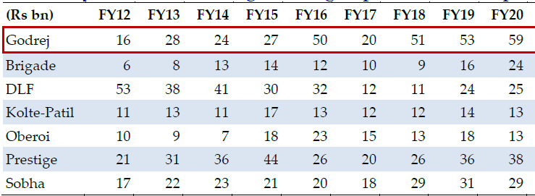
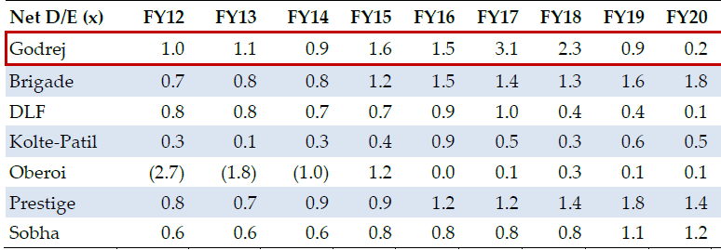
Peer Analysis (Contd.)
Largest Pan-Indian developer by Pre-Sales value - Pan-India presence allows GPL to quickly ramp up launches and pre-sales
Comparatively Better Financial Position

Slide 6
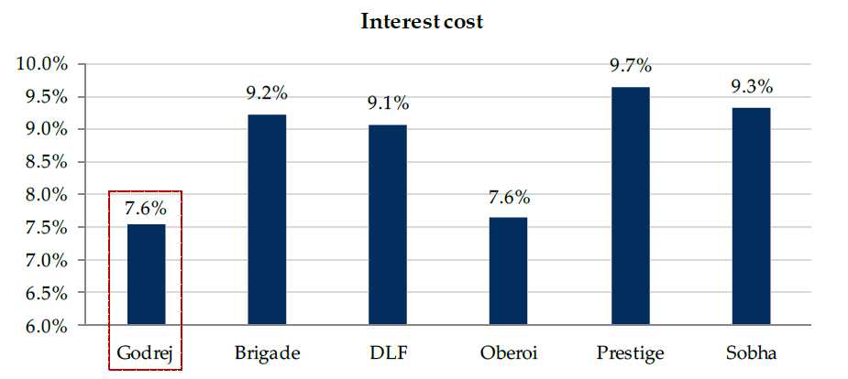
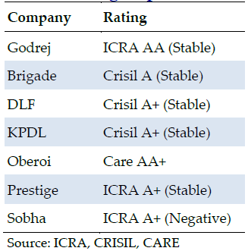
Peer Analysis (Contd.)
Lowest borrowing cost, at 7.6% interest rate
GPL enjoys sectors best credit rating – a notch below Oberoi Realty

Slide 7
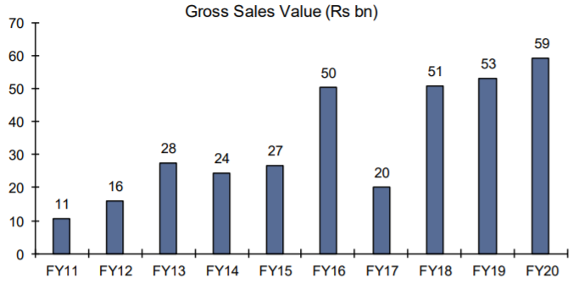
Key Themes–Industry Consolidation helps GPL
Number of developers shrink by 51% over CY11-19 with consolidation is more pronounced in Gurugram, Noida (both part of NCR) and Chennai
Uptick in GPL’s sales due to consolidation driven by RERA & GST. Ongoing funding crisis for majority of unlisted developers further accelerated this consolidation

Slide 8
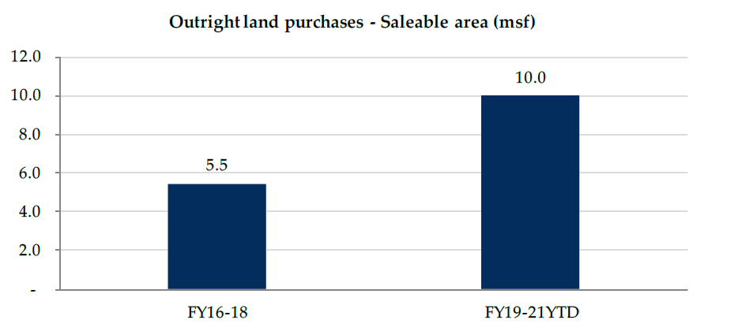
Key Themes - Conscious shift away from pure development management
Focus has shifted to increase share of 100% owned projects, which is visible from the new acquisitions by GPL
Regulatory overhauls, favouring large developers, have potentially increased risk appetite of GPL
GPL has de-risked from pure DM projects, given the inherent challenges in executing such projects

Slide 9
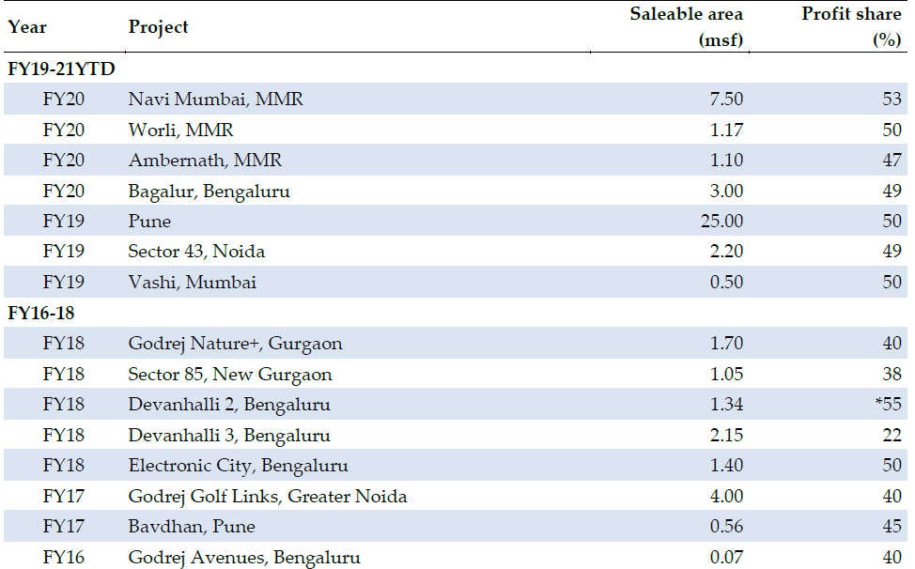
Key Themes - Conscious shift away from pure development management (Contd.)
Higher profit share in the recent joint development transactions
This is apparent from the deals done over FY19- 1HFY21 (profit share >47% in all deals)
Market condition favouring large players has allowed GPL to demand a higher share of profits in JVs

Slide 10
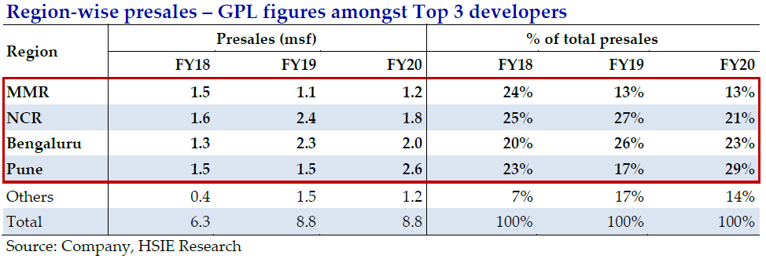
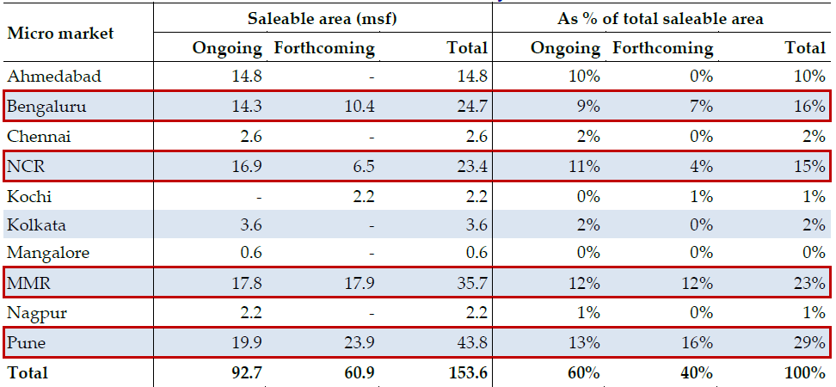
Key Themes - GPL emerging a key player in Top 4 micro-markets
With more than 1 msf of presales in each of the four key micro-markets for three consecutive years over FY18-20, GPL has established itself as key challenger in these geographies
GPL is, perhaps, the only player to have significant presence and figures in top three in the four key markets
Market share of GPL is likely to increase in coming years as 83% of saleable area is concentrated in the four key markets

Slide 11
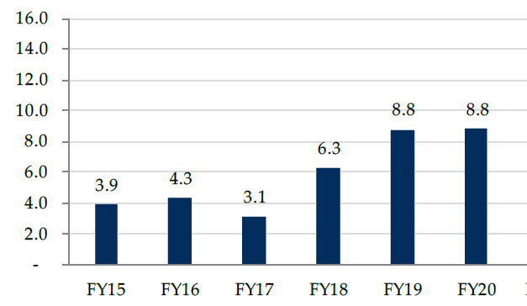
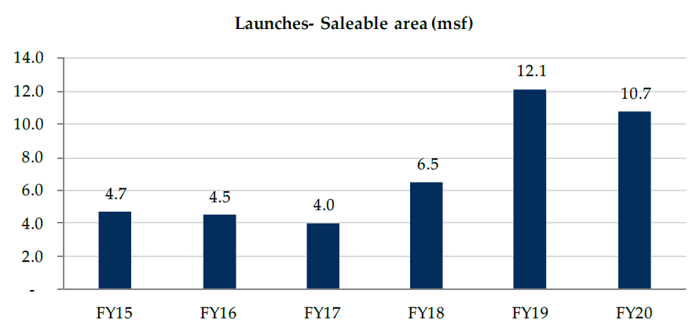
Key Themes - Robust launches in FY18-20 to support sales in FY21-23
GPL plans to double its presales value over the next 3-4 years
Pre-sales volumes have grown 2x over FY16-20 (8.8 msf in FY20 vs 4.3 msf in FY16), backed by market share gain on strong brand recognition and execution track record
Presales ramp-up to be backed by robust launch pipeline

Slide 12
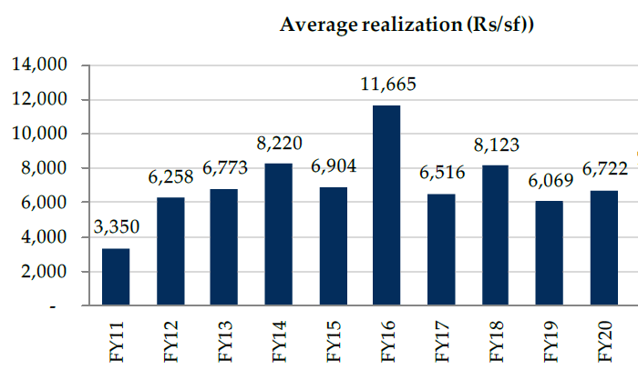
Key Themes - Robust launches in FY18-20 to support sales in FY21-23(Contd.)
GPL had an estimated 6% launch market share in FY20. GPL to inch closer to a double-digit share with a war chest of over INR 15 bn. to aggressively pursue more value-accretive land deals over the next 2-3 years in a stressed market
Presales value – a mix of mid-income and affordable luxury
Counter-cyclical business development strategy

Slide 13
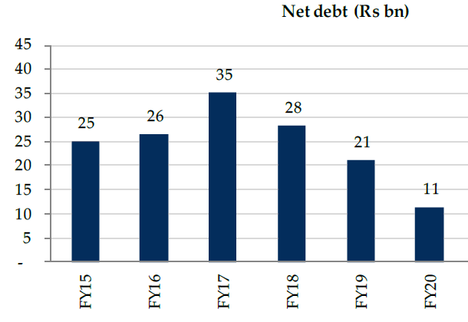
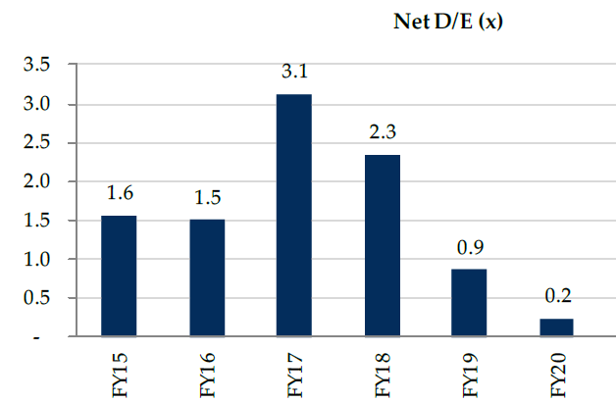
Key Themes – Healthy Balance sheet to support Growth
Significant reduction in debt over FY17-20
GPL is targeting net D/E of 1x over the next few years
GPL target of 20% ROE over net 3-4 years

Slide 14
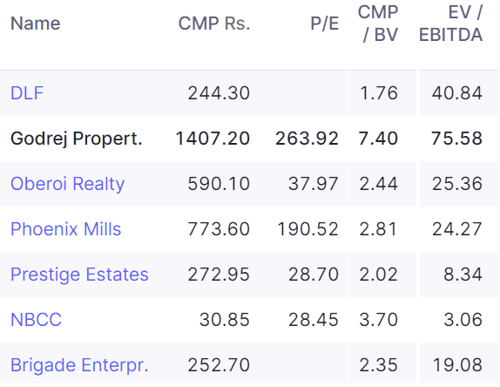
Risks
Subject to Regulatory Approvals & Clearance
Significant Equity dilution – ~56 Cr. of Equity Capital Raised over FY11-20
No Dividend payout since FY16
Working Capital Intensive
Cash flow to remain mostly negative, BD opportunities to lead to debt build out
Perhaps Over-priced – P/E: 264, P/BV: 7.4

