Slide 1
Kilpest: Emerging Leader

Slide 2
Business
Agrochemicals: Kilpest standalone
Diagnostic testing kits: 3B Blackbio Biotech (WOS)

Slide 4
Incremental Business Direction- Totally 3BBB
Reverse merger of Kilpest with 3BBB, will rename listed entity to 3BBB
Segment Wise Cap. Emp./FY | 16 | 17 | 18 | 19 | 20 | 21 | 22
Diagnostic Kits (Health Care) | 1 | 1 | 4 | 8 | 17 | 129 | 152
Agrochemicals | 10 | 10 | 16 | 16 | 21 | 23 | 24
Total Cap. Emp. | 11 | 11 | 20 | 24 | 38 | 152 | 176
Incremental Cap Emp |  | 0 | 9 | 4 | 14 | 114 | 24
DK Incremental Cap Emp |  | 0 | 3 | 4 | 9 | 112 | 23
% of Incremental Cap Emp to DK |  |  | 33.33 | 100.00 | 64.29 | 98.25 | 95.83

Slide 6
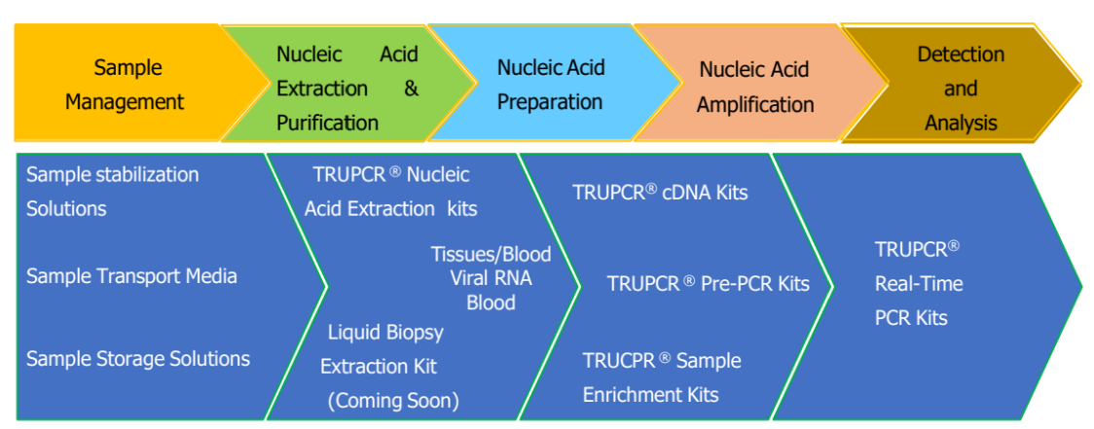

Slide 8
GTrends- Covid has accelerated non-Covid business?

Slide 9
Scale Up + Cross/Up Selling

Slide 11
Not just acute, but chronic (onco) too

Slide 13
Low volume, high value…

Slide 14
…leading to industry-wide high fixed asset turns
Company | FY21 NFAT (approx)
Kilpest | 50x
Co-Diagnostics | 60x
Seegene | 20x

Slide 15
Intangibles…

Slide 16
Intangibles…

Slide 19
Cash Deployment

Slide 20
Acqn of HS Biolabs

Slide 22
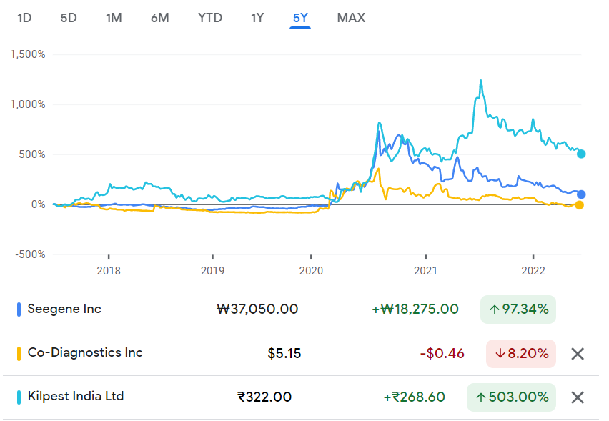
Variant Perception
Base effect
Still viewed as agrochem biz, ignorant to changes
‘Too hard’ pile for most people
Perceived as ‘Covid proxy stocks’

Slide 23
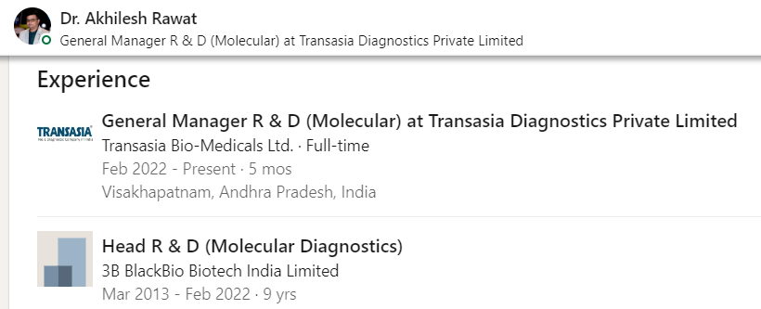
Risks/Negatives
Entity called Mithala Laboratories
20.3 Cr sales routed through Vivid Global Industries (KMP entity)
Manufacturing in Europe- loss of Indian cost advantage
R&D Head (Dr Akhilesh Rawat) quit to join Transasia

Slide 24
Valuations (EV=130 Cr)
EV/(Non-Covid Sales)=5x [Non-Covid Sales=26.5 Cr]
EV/(Non-Covid EBITDA)=10x [assuming 50% EBITDA, historic pre-covid is 60% EBIT, so 13 Cr Non-Covid EBITDA]
EV/(Non-Covid OCF)=13x [assuming 80-85% cash conversion, same as historic, so 10 Cr Non-Covid OCF]
Optionalities:
Zero valuation to agrochem (which has 16 Cr sales)
Zero valuation to Covid business

