Slide 1
L&T Technology Services: Near Leader

Slide 2
Engineering Services Outsourcing
Product lifecycle management:
Design- simulations
Development
Testing
Shortens turnaround time, quicker go-to-market

Slide 3
Large Size Of Opportunity

Slide 4
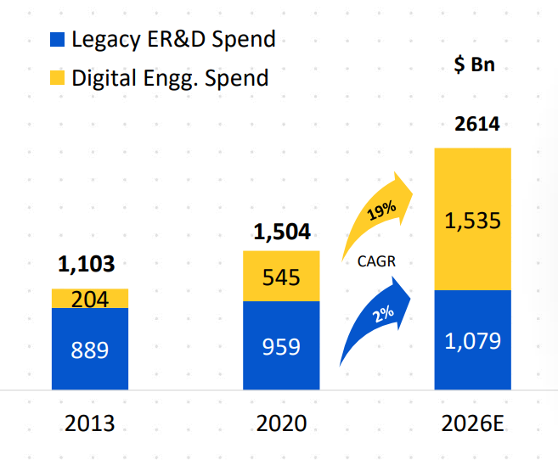
ER&D Industry Structural Change

Slide 5
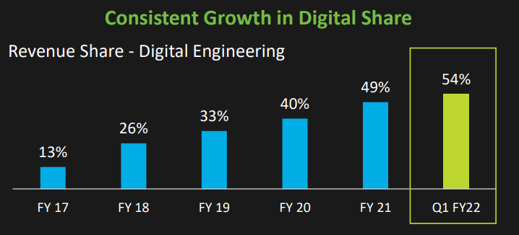
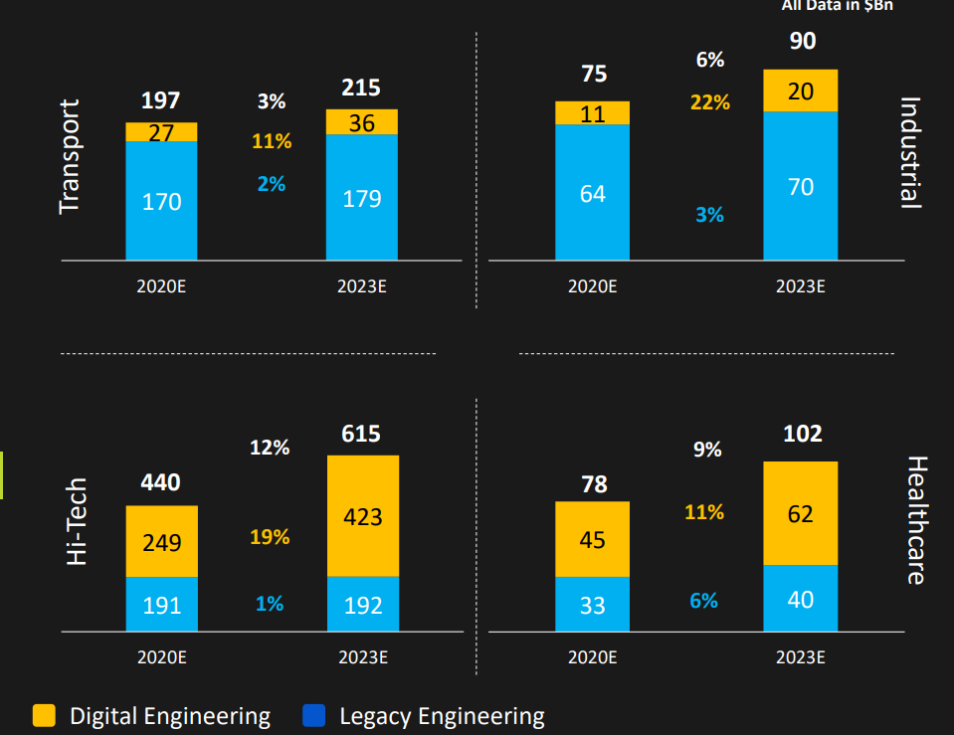
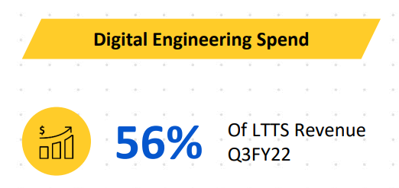
LTTS

Slide 6
Transportation
Electric Vehicles- ePowertrain
CASE
Infotainment systems
Software becoming larger part
of vehicle
Software non-core to auto OEMs

Slide 7
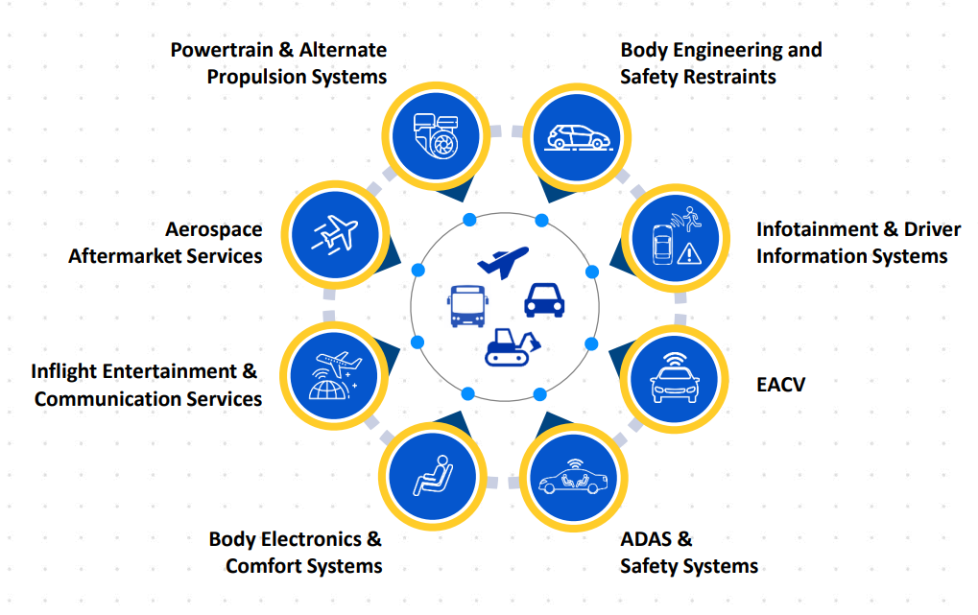

Slide 8
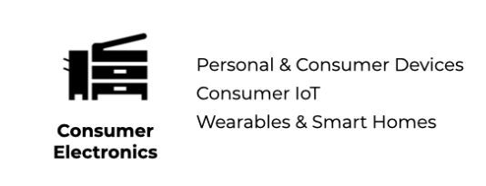
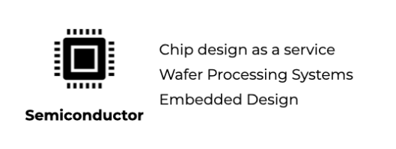
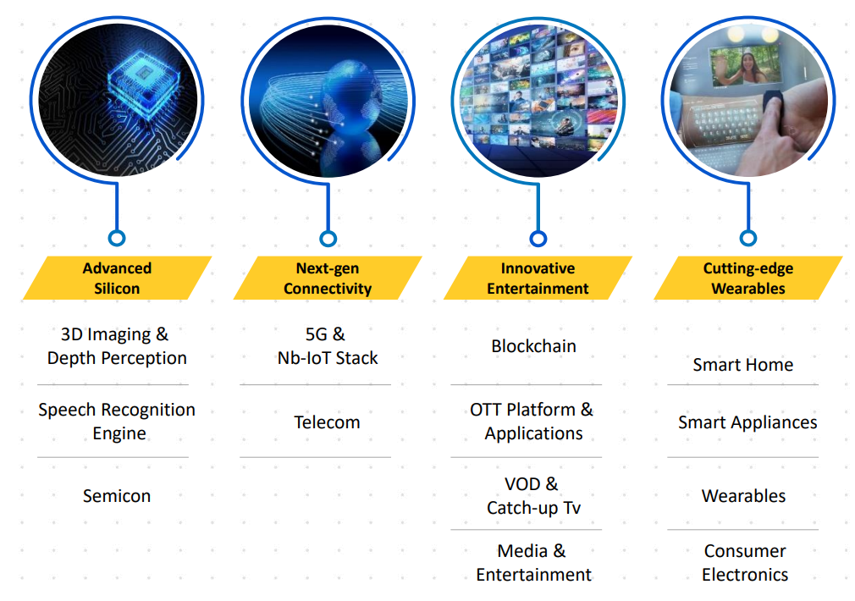
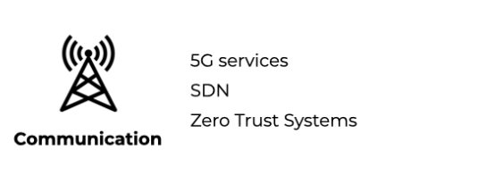
Telecom and Hi-Tech
5G, Consumer electronics, semiconductor
Media and entertainment

Slide 9
Plant Engineering
Beneficiary of capex cycle

Slide 10
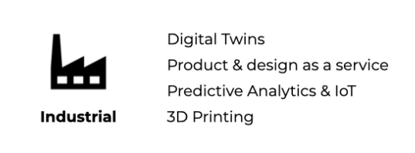
Industrial Products
IIoT
Avertle: Predictive analytics for equipment failure- condition based monitoring and maintenance (CBM)
Sensors collect data -> Central processor -> Spots pattern variations -> Flags off potential breakdowns -> Alarm mechanism
Data is pressure, temperature, sound, load, vibrations

Slide 11
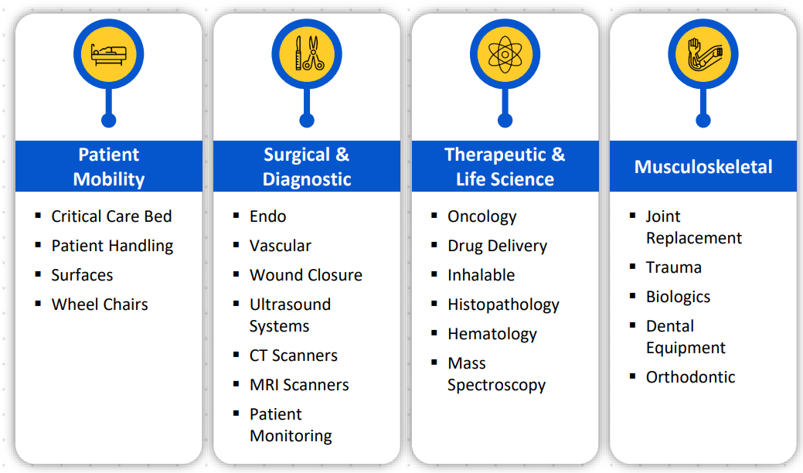
Medical Devices
Remote medical care
MIoT

Slide 12
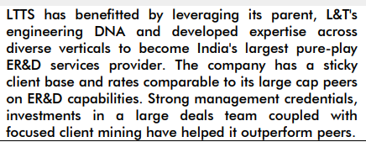
Moat
L&T Parentage- client acquisition (POC)
Presence across industries- reusability/cross-sell
Demonstration effect
Pure-play

Slide 13
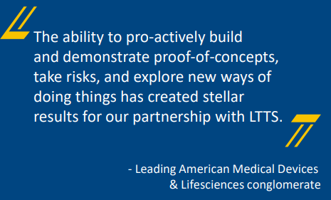
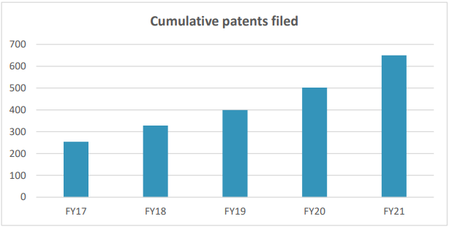
L&T Parentage
Core engineering DNA- POC
RFI vs selling

Slide 14
Cross Pollination

Slide 15
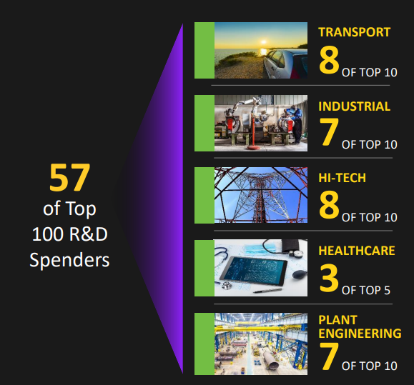
Demonstration Effect

Slide 16
Pure-Play Effect (?)

Slide 17
Scaling while de-risking: decreasing fragility

Slide 18
OPM rising despite rising T&M

Slide 19
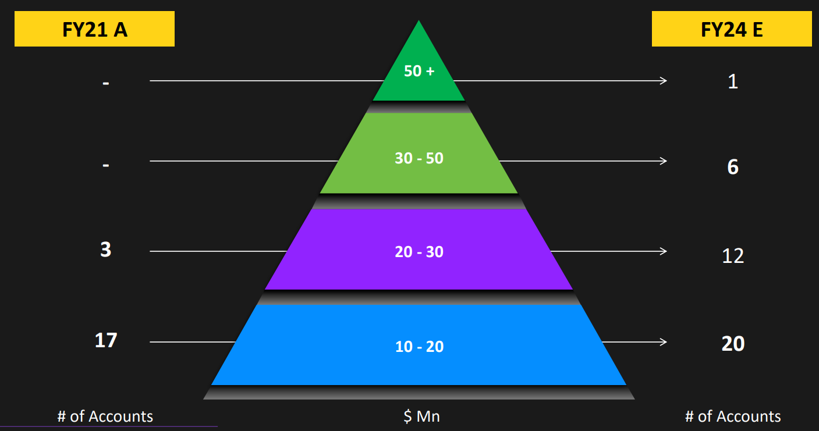
Growth Drivers

Slide 20
Recent Event

Slide 21
Overall ER&D Ratings

Slide 22
Digital ER&D Ratings

Slide 23
Risks: Attrition and In-House Preference
Domain expertise needed in ER&D
17% LTM attrition

Slide 24
Gross Total Leverage- Lollapalooza Effect
Economic leverage: Outsourced Digital ER&D growing faster than nominal GDP
Temporal leverage: Near leadership -> market share gains
Operating leverage: Reusability, mining
Financial leverage: Debt-free

Slide 25
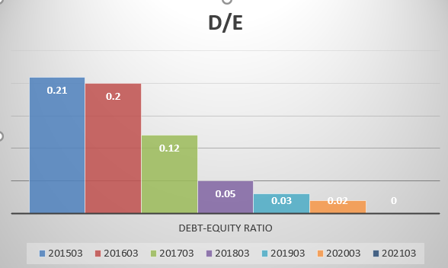
Return Ratios and D/E (Capitaline)-Consolidated
 | 201503 | 201603 | 201703 | 201803 | 201903 | 202003 | 202103
ROCE (%) | 29.39 | 42.92 | 40.81 | 37.83 | 45.28 | 38.91 | 26.21
RONW (%) | 83.72 | 61.19 | 33.31 | 29.61 | 34.8 | 31.34 | 21.36
 | 201503 | 201603 | 201703 | 201803 | 201903 | 202003 | 202103
Debt-Equity Ratio | 0.21 | 0.2 | 0.12 | 0.05 | 0.03 | 0.02 | 0

Slide 26
Other Companies
Tata Elxsi- Transportation, Telecom, Healthcare
KPIT Technologies- Only automobiles
Cyient- Transportation, Telecom, Utilities
Integrated- TCS, Wipro, HCL Tech
Autoline Design Software

