Slide 1
Indian Railways
Investment Case
By-
Animesh Killa
Prateek Dugar
Yash Jain
Pinaki Deb
** For Education Purpose only… not to be considered as investment advice … please consult your financial advisor **

Slide 2
Indian Railways
4th Largest Network in the World
70,000 kms
21,000 trains
3 million tonnes freight / day
Current Share of Freight: 26%
Planned:
35% by 2030
45% by 2050

Slide 3
Growth Plans (from Railways Budget 2022-23)
The Indian Railways is prepared to witness its highest Capex of Rs. 2.45T (1.37T from general revenues, 1.08T from internal and extra-budgetary resources-IEBR and 200Cr from the Nirbhaya fund) for 2022-23
400 new generation Vande Bharat trains will be manufactured in the next 3 years
6 freight corridors to be built across the country
2 projects currently under construction viz. the MAHSR and NCR-RRTS, the cumulative project exceeding Rs. 1 trillion
2000 km of network will be indigenous to use world class technology
100% electrification of Broad Gauge Routes by the year 2023
Redevelop 123 stations to convert them into Railopolis or 24x7 multi-modal hubs. The first phase of redevelopment covers 50 stations at an estimated cost of Rs 50,000 crore
2.45 T Capex
6 Freight Corridors
Redevelop 123 Stations
400 New Trains

Slide 4
Areas of Interest
Engines, Coaches, Wagons
Infrastructure
Ancillaries (Bearings, Generators, Batteries, Control Systems etc)
Project Execution

Slide 5
Companies of Interest
Titagarh, Texmaco, Jindal Rail Infra, Jupiter - Wagons
BHEL - Engines
HBL – TCAS, TMS
TD Power Systems - Generator
Kalpataru – Power Transmission
Timken, SKF - Bearings
ELGI - Compressors
ABB, KEC, L&T, Siemens, IRCON - Projects
IRCTC – Passenger Care

Slide 6
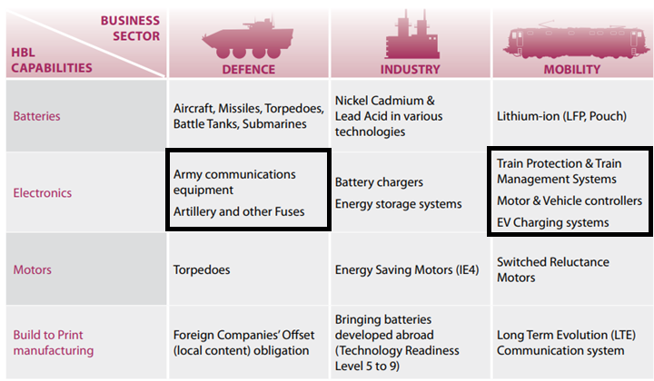
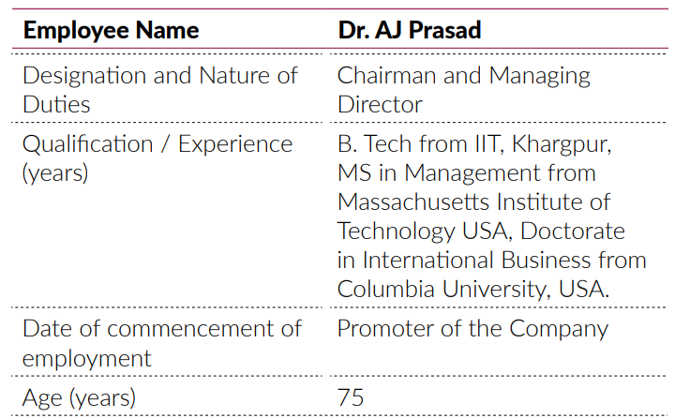
HBL Power – The Business and Promoter
Battery Vertical (~76% of revenues) |Railway Electronics Vertical (~11% of revenues)|Defense Vertical (~11% of revenues)

Slide 7
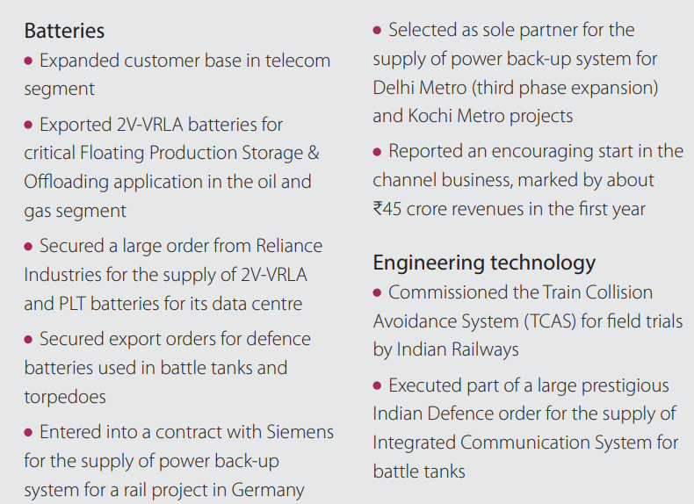
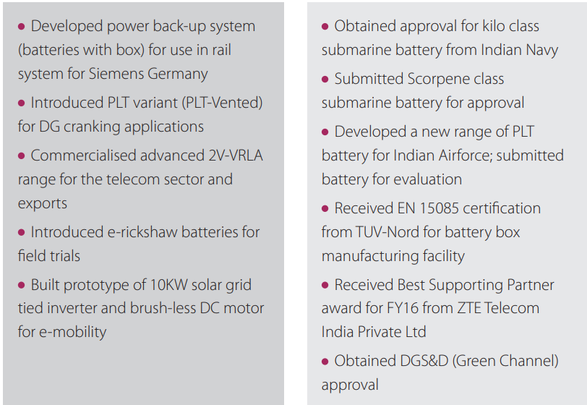
HBL Power – Investment Thesis
Changing Product Portfolio (De-risking from exposure to telecom sector by focusing on niche applications)
Lead Acid | Ni-Cd | NCPP | PLT | 2V- VRLA | Lithium
Telecom | Aviation | Railways | Data Center | Defence | E- Mobility

Slide 8
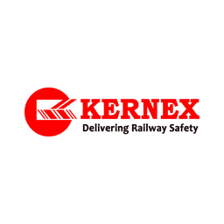
HBL Power – Investment Thesis
Entry into an Oligopolistic large opportunity market with decade long research and proven capability
RDSO TCAS Booklet – Apr 21 (HBL is first successful implementer)
RDSO Approved Vendors :
RDSO Approved Datalogger (HBL is sole vendor among below 3)

Slide 9
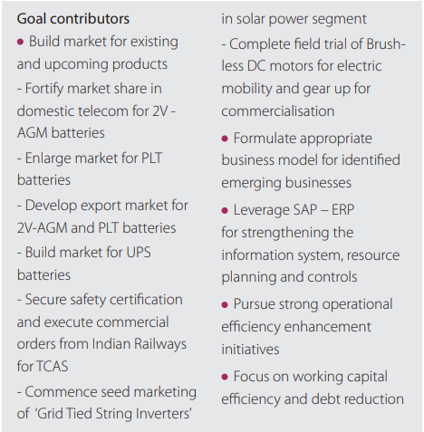
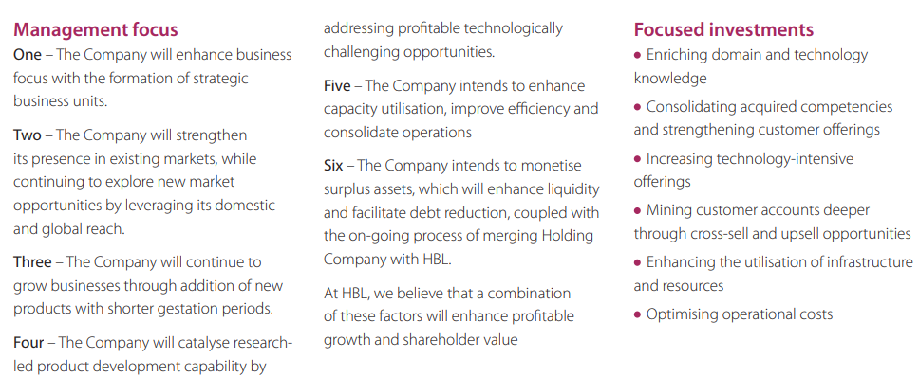
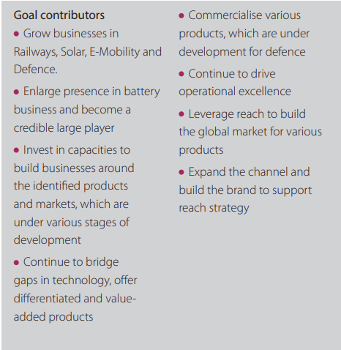
HBL Power – Investment Thesis
Balance sheet clean up | Delivering on the guidance | Focus & Transformation

Slide 10
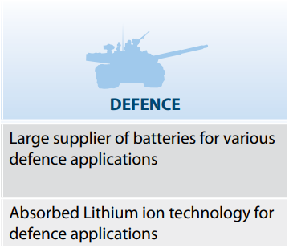
HBL Power – Growth Areas
RAILWAYS DEFENCE
The Company has recently won a contract in North Central Railway for installation of TCAS as part of Mission Raftar to upgrade the speed of trains to 160 kmph. This is a healthy start for the Company which will help in securing larger tenders over a period of time.
The Company has participated in a large 10 years tender for supply of rockets and artillery fuses to the Indian Army. If the Company is successful, this tender will provide large volumes for a period of ten years. This facility will also cater to export requirements, beyond domestic needs.

Slide 11
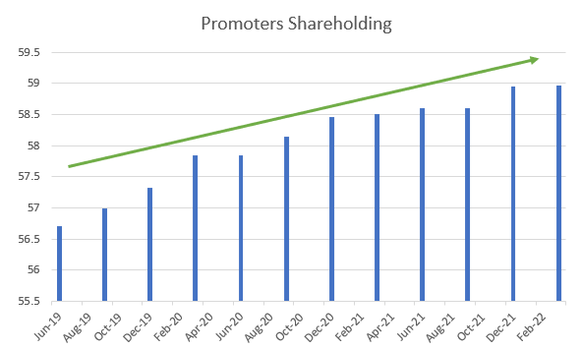
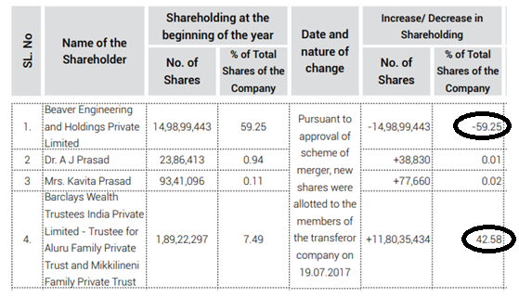
HBL Power – Shareholding and Reverse merger
The rationale behind the merger was to enable shareholders (larger investors and promoters) of Beaver to hold listed shares of HBL (a listed entity), simplify the Group structure, de-leverage the financial statements and enhance floating stock of shares (public holding increased from 26% to 44%), which would facilitate increase in shareholder value over the medium term. In exchange for equity shares held and conversion of debt given by Beaver to HBL, equity shares of HBL were allotted, which resulted in net increase in equity shares by 2,41,94,946.

Slide 12
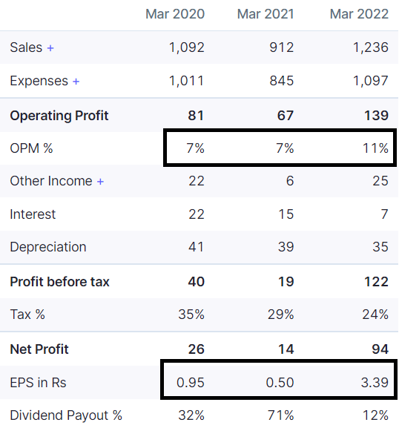
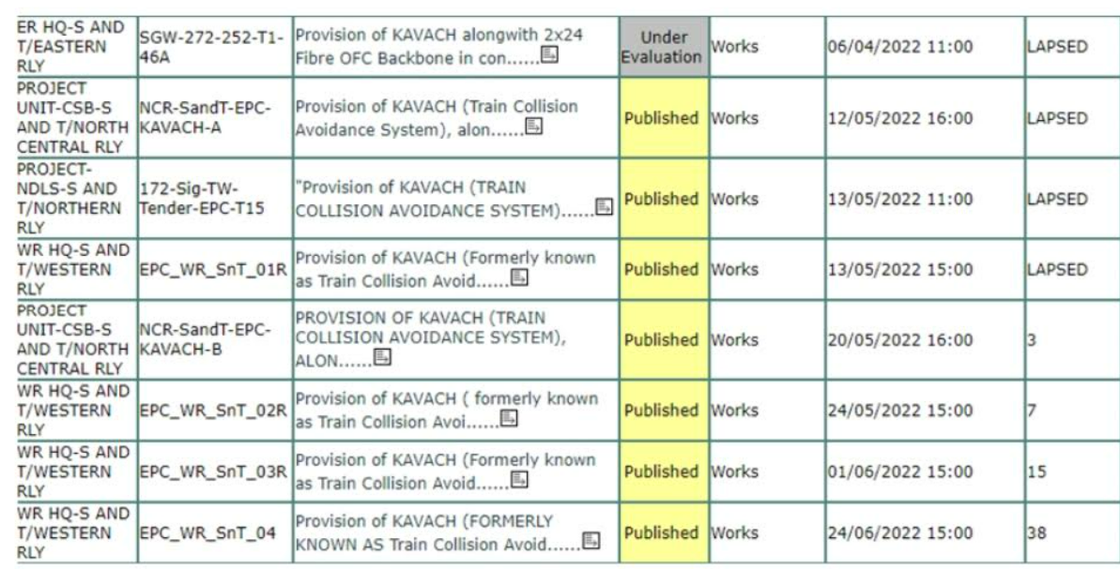
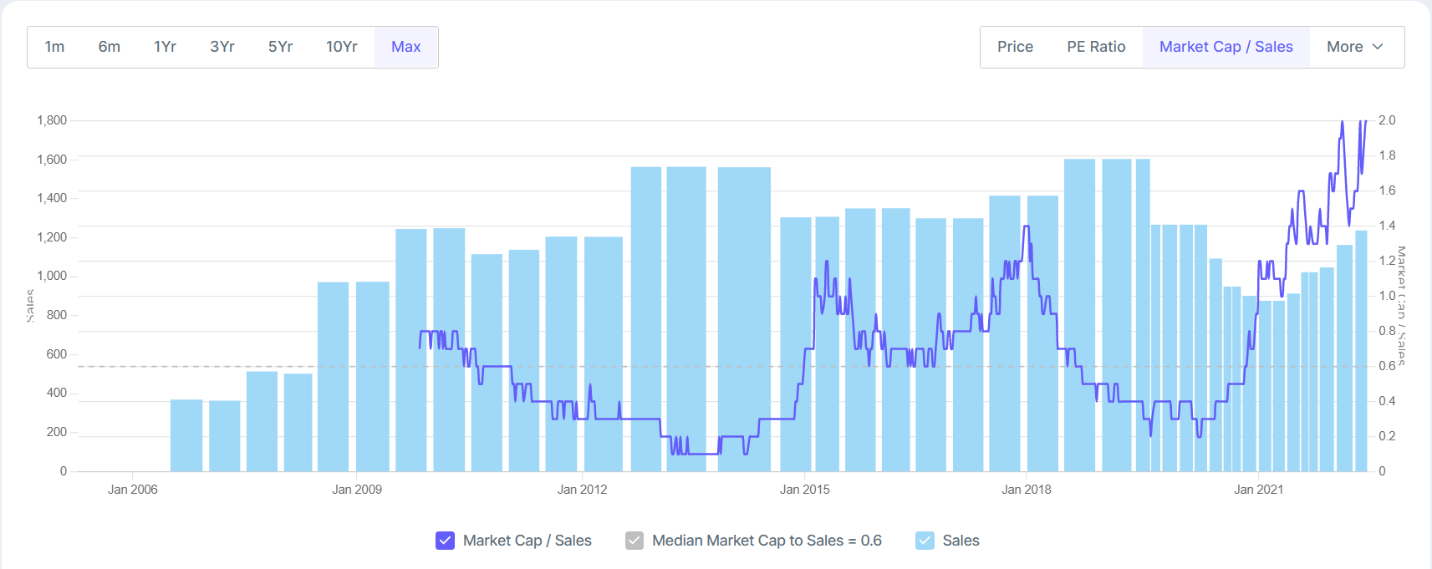
HBL Power – Valuation
Metrics | FY - 22 | FY - 25 | Assumption
HBL P/S | 1.96 | 1.55 | Conservative Estimate
HBL Battery Revenue | 939.36 | 1319.733 | 12% CAGR
HBL Electronics Revenue | 296.64 | 1201.152 | 10% of TCAS Opportunity +TMS + Integration+ 15%CAGR
Total Sales | 1236 | 2520.886 | 26% CAGR
Mcap | 2420 | 3907.373
Share Price | 87.3 | 140.956 | 61% Return | 17% CAGR

Slide 13
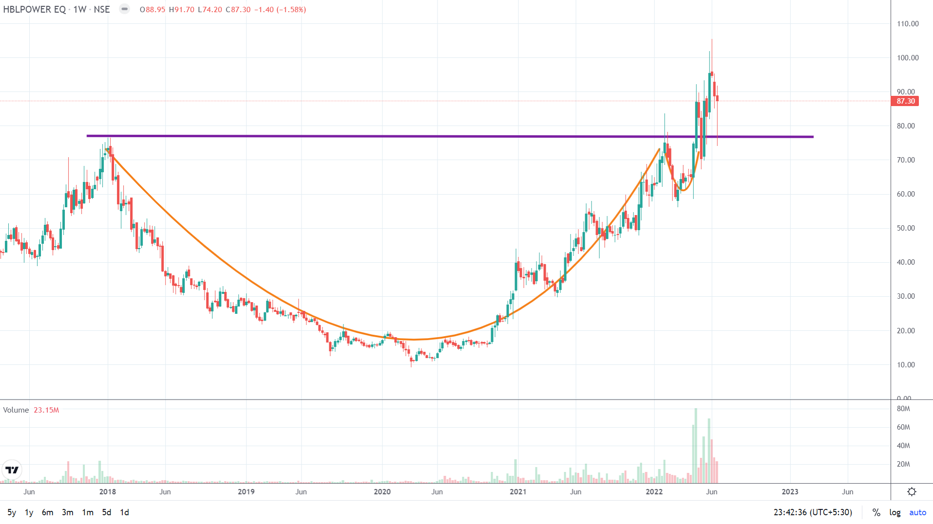
HBL Power – Technicals
TP – 140
CMP – 87.3
RP – 60%

Slide 14
HBL Power – Risks
Management has failed to deliver on its guidance multiple times in the past – although it has acknowledged its mistakes, they may mess up on execution again
Key Managerial Person (A J Prasad) is now 75 years old
He was accused of conspiring with former KGB officer to try to obtain information about a U.S. Strategic Defense Initiative and was jailed

Slide 15
HBL Power – Risks
TCAS Tenders have been delayed since FY-16 they have picked up pace now but still delay in award of tenders may put pressure on the top line
Management keeps trying to enter new avenues and commits capital without proper research which has hurt the company in the past
Price to sales metric used for valuation is double the median value for the ratio in the past
Customer for TCAS is Indian Railways (Govt. Enterprise) and project have long Working Capital cycle
Integration of TCAS with other signaling systems is not yet undertaken- Medha may have an upper hand in integration

Slide 16
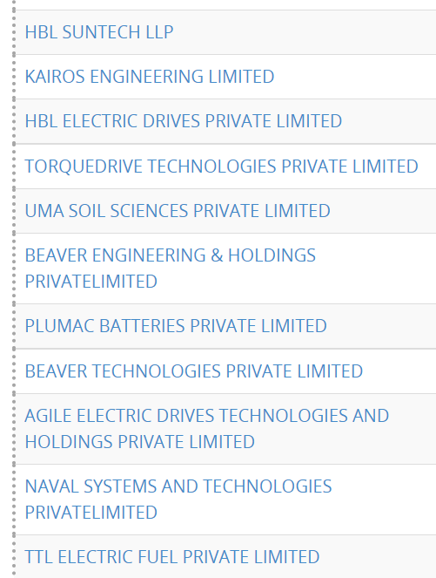
HBL Power – Risks
Directors run several Pvt Limited Cos. Some operate in same segment
KAVITA PRASAD ALURU

Slide 17
Timken – Background, Segments & Revenue
Timken India Ltd is engaged in the manufacturing, distribution and sale of anti-friction bearings, components, accessories and mechanical power transmission products for the customer base across different sectors. It also provided maintenance contracts and refurbishment services and industrial services.
Incorporated in 1987 as a JV with TISCO and part of the global Timken Group. This stake was acquired back by Timken in 1992 to end the JV
In 2018, acquired ABC Bearings Limited, having manufacturing facilities at Bharuch & Dehradun.
Products include Tapered Roller Bearings, Cylindrical Roller Bearings, Spherical Roller Bearings and Slewing Bearings with dedicated manufacturing in Jamshedpur and Bharuch.
Customers : Expertise in the domains of metallurgy, tribology and mechanical systems enables collaboration with Original Equipment Manufacturers (OEM) to design and develop solutions as per application. It has about 50+ Industrial and 100+ Automotive channel partners.
The company has four operating segments: Mobile Industries, Process Industries (includes Wind), Aerospace and Defense, and Steel. Major markets include aerospace, automotive, construction, consumer, defense, energy, industrial equipment, health, heavy industry, machine tool, positioning control, power generation and rail.
Revenue share for 2022 was Exports – 30-33%, Distribution – 20%, Mobile – 20%, Railways – 17%, Process – 13%
Market Share was 7% before acquisition of ABC and expected market share of low teens post acquisition. Global market share of Timken is also ~12%.

Slide 18
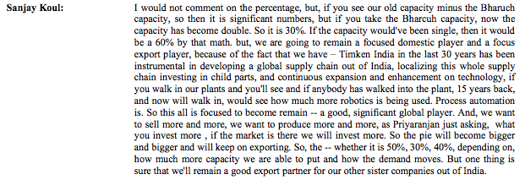
Timken – Investment Thesis
Exports are currently at 30%, increase in exports by 80% this Q - Make in India Make for the world and China +1 is playing out
Bearing companies are setting up low cost manufacturing hubs in India and is improving their margin mix
Significant demand from Railways
From Timken’s perspective, maximum buying from Railways is on the freight wagons front. The wagon building is outsourced to private players and they is turn have a tender out for bearings based on RSDO requirements.
Railways plan to tender out 90,000 wagons for the next 3 years. i.e. 30,000 wagons each year – some of this has already been tendered to Calcutta based builder. Each wagon requires 8 bearings and therefore the total demand from this alone is 7,20,000 bearings.
Railways have tendered out 90,000 wagons for the next 3 years. i.e. 30,000 wagons each year. Each wagon requires 8 bearings and therefore the total demand from this alone is 7,20,000 bearings.
Demand for Wheels currently imported might also augment the bearings demand in India
Finally, there might also be a lot of demand for maintenance of old wagons (increase in freight capacity)
Revenue doubled in Wind segment (India becoming hub for gear boxes manufacturing)

Slide 19
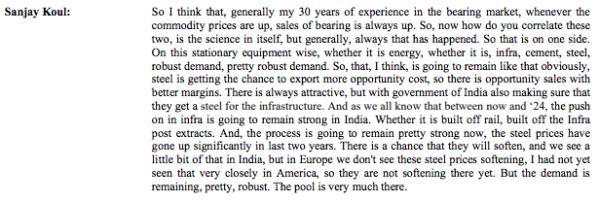
Timken – Investment Thesis Contd.
Parent company recognized as one of the world’s most ethical companies for the 11th consecutive year by Ethisphere Institute (global leader in defining standards of ethical business practices)
Commodity cycle (cement, steel, energy etc) & Infrastructure focus augurs well for bearings
Capacity utilization for Bharuch and Jamshedpur plats are at 80-82% but the railways capacity is still under-utilized and this could be a growth driver going forward
Mgt. mentioned many times that they are open for more Capex – brownfield takes 5-6 months, greenfield takes 12-24 months. Also they are putting some little bit of more capacity in our Bharuch plant, which is a very specific line, which we use for very small size bearings

Slide 20
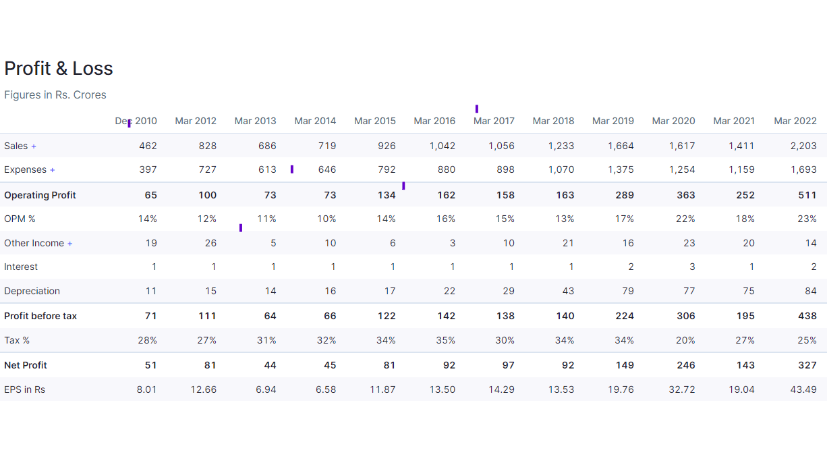
Timken – Investment Thesis (financial metrics)
Promoter holding 67.8%, FII/DII holding 15.91%
Low Debt 32 Crore, MCap 17.5K Crore
Stellar volume growth in March quarter, significant margin improvement leading to EPS doubling

Slide 21
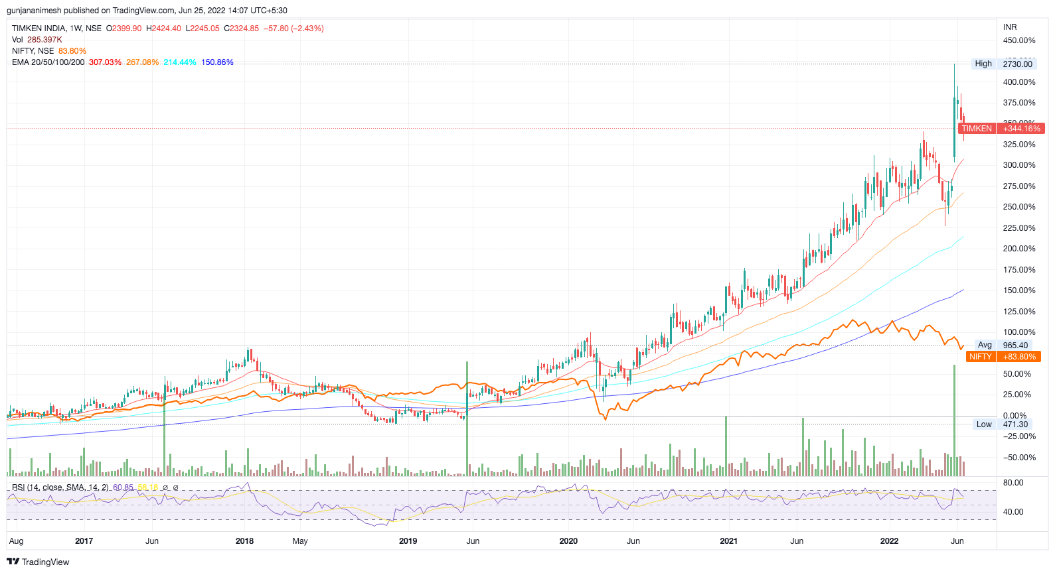
Timken – Basic Technical Analysis
EMA: trades above 20-50-100-200 EMA – in an extremely weak market
RSI is above 60 (small/mid cap indices fared even worse)
Px Vol action: Volumes on the up moves are very supportive

Slide 22
Timken – Risks
Alloy and Steel prices can affect margins as automotive customers are finicky about price increases
CEO mentioned in concall that the automotive market demand can vanish pretty quickly if the cycle turns
Competition from SKF (main competitor with 25% market share) and Schaeffler and valuation wise little expensive.

