Slide 1
Apollo Finvest
Unproven, risky emerging leader in lending + PaaS
Not just profitable, but >25% RoE
Proxy to fintech boom
Wants to be ‘AWS of lending’

Slide 2
Offerings
‘NBFC as a Service’: FLDG
SaaS platform: APIs for KYC, disbursements, collection, etc.
‘Capital as a Service’: Co-lending

Slide 3
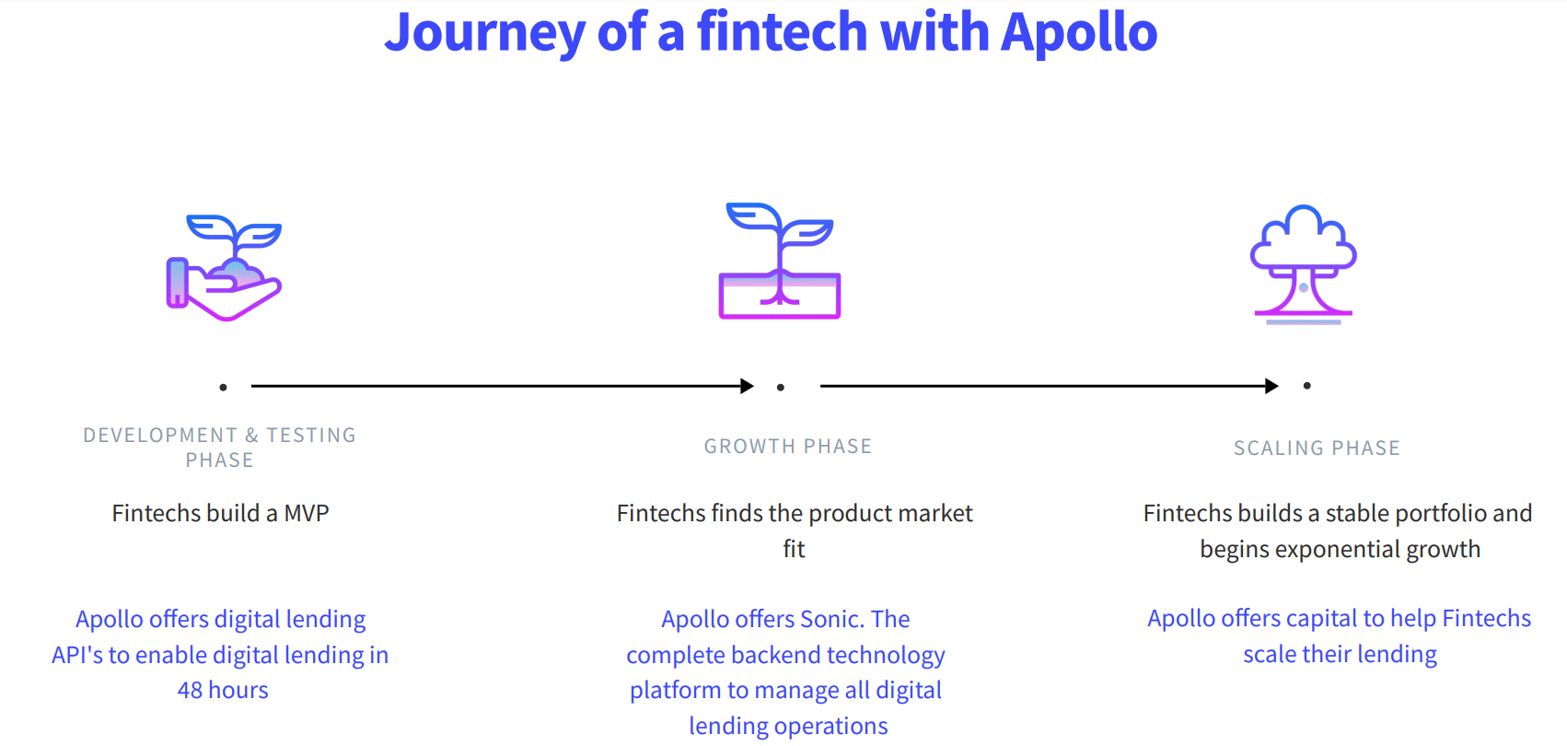

Slide 5
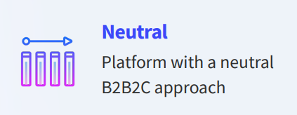
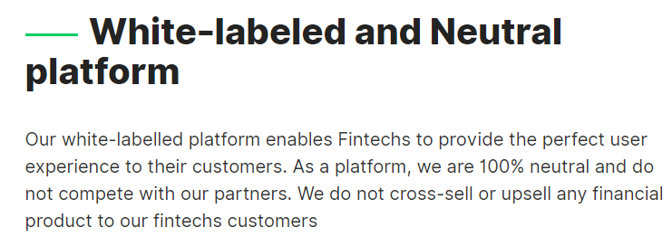

Slide 6
>70% promoter holding

