Slide 1
Understanding the Electronic Vehicle Battery Industry
Aritra Pal
-03/22/2021

Slide 2
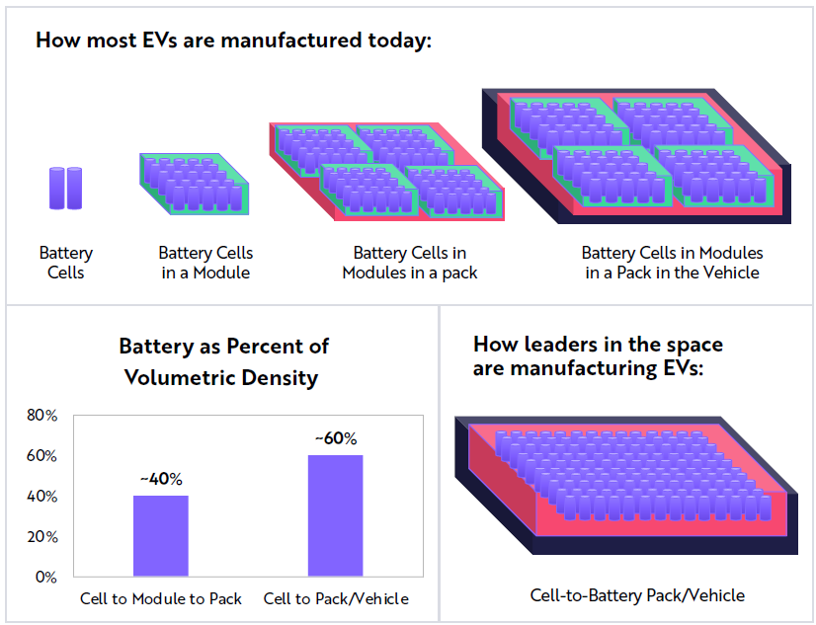
EV Assembly Process
Li-ion batteries make for the most expensive component of an electric vehicle, accounting for 40-50% of the cost

Slide 3
Li-ion Cell Manufacturing Process
TATA CHEMICALS
25-30%
35-40%
30-40%
Li-ion Cells
Mining
Cell Components
(Anode, Cathode etc.)
Battery Pack
Chemical Compounds
Lithium: Bolivia, Argentina, Chile
Cobalt: Australia, Congo
Nickel: Indonesia, Australia, Brazil
No mines in India
80% capacity in China
No capacity in India - Manikaran Power Ltd. from 2024
CATL, Panasonic, LG Chem, Tesla-Panasonic
India - Epsilon Advanced Materials
No present capacity in India
In Future - TDS, Li Energy, BHEL, Amara Raja, CUMI, Exicom, GOCL, Jyoti CNC, Thermax, Sukhbir Agro, NALCO
Presently - 1 GWh annual capacity
In Future - Exide, Amara Raja, Panasonic, Mahindra, Adani, Reliance, ATL, Hero

Slide 4
EV Battery Cost Breakdown

Slide 5
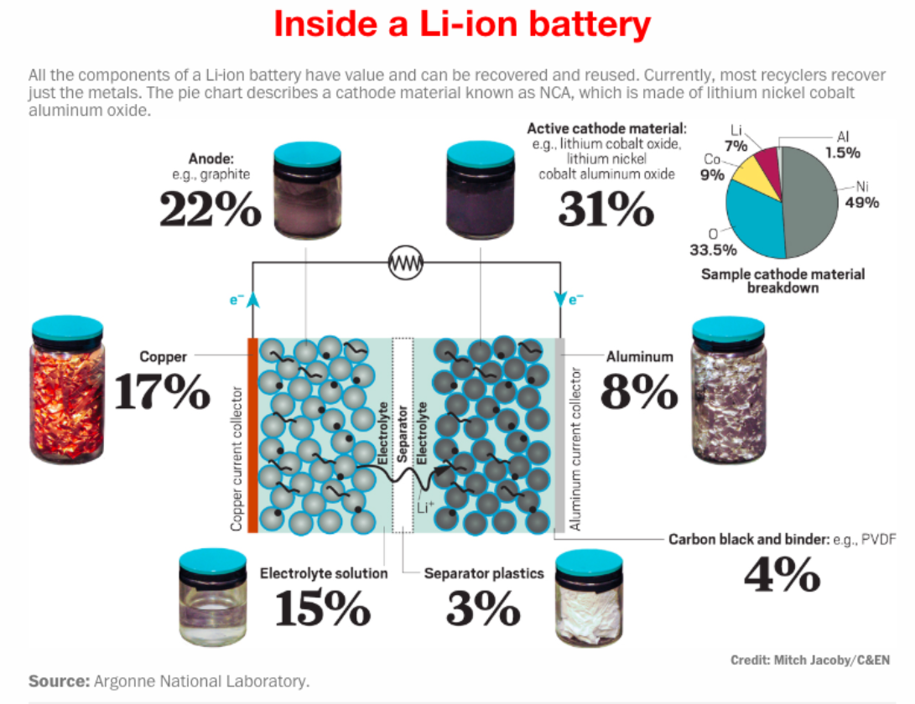
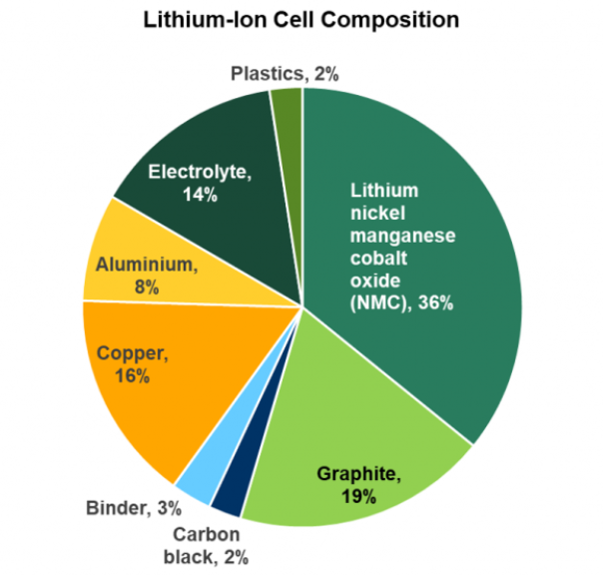
Li-ion Cell Diagram
Highest Cost due to Imports

Slide 6
Challenges in EV Battery Production
Zero in-house availability of key raw materials: Lithium, Cobalt, and Nickel
High Fixed Costs due to Large Capital Investment
Cost Disadvantage vs Global Peers –
High Import Costs – No Li-ion battery components made in India
Li-ion battery costs can be reduced by up to 80% on larger volumes. 50GWh capacity to achieve global parity in costs
Complex, Fast changing Cell Technology

Slide 7
Cost Improvement Areas
Cathode –
Cathode is the largest component of battery cost
3 oxide types in use - Nickel Cobalt Aluminum oxide, Nickel Manganese Cobalt oxide, Lithium Iron Phosphate
Cobalt is the most expensive material within the cathode, so formulations of these materials with less cobalt typically lead to cheaper batteries
Nickel cobalt aluminum oxide has the lowest cost-per-energy-content and highest energy-per-unit-mass
Inactive cell materials –
Contribute nearly 36% of cell
Improving cell design to reduce inactive materials

Slide 8
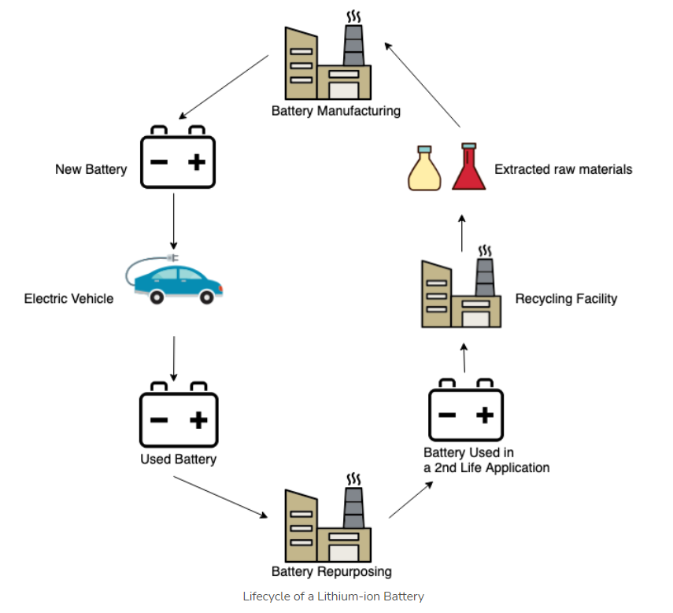
Cost Improvement Areas (Contd.)
Recycling – to extract Li, Co & Ni

Slide 9
Govt. of India Inititatives
Increased Import duty of Li-ion cells to 10% from April 2021(from 5%)
Increased Import duty of EV Battery Packs to 15% from April 2021(from 5%)
Approved PLI schemes worth a financial outlay of 18,100 Cr. over a 5 yr. period in Advanced Chemistry Cell(ACC) Battery
State Govt initiatives
Gujarat
Maharashtra
Andhra Pradesh
Tamil Nadu
Karnataka

Slide 10
References
https://cleantechnica.com/2019/07/28/lithium-ion-battery-manufacturing-heating-up-in-india/
https://evreporter.com/lithium-ion-battery-manufacturing-in-india/
https://www.pv-magazine-india.com/2019/03/12/li-ion-cells-face-doubled-import-duty-from-april-2021/
https://evreporter.com/lithium-ion-cell-manufacturing-in-india-guide-for-msmes/
https://www.ien.com/product-development/news/21141505/ev-battery-costs-explained
https://auto.hindustantimes.com/auto/news/why-are-electric-cars-expensive-the-cost-of-making-and-buying-an-ev-explained-41603419957680.html
https://qnovo.com/82-the-cost-components-of-a-battery/
https://www.energy.gov/eere/vehicles/articles/fotw-1128-april-6-2020-innovations-automotive-battery-cell-composition

