Slide 1
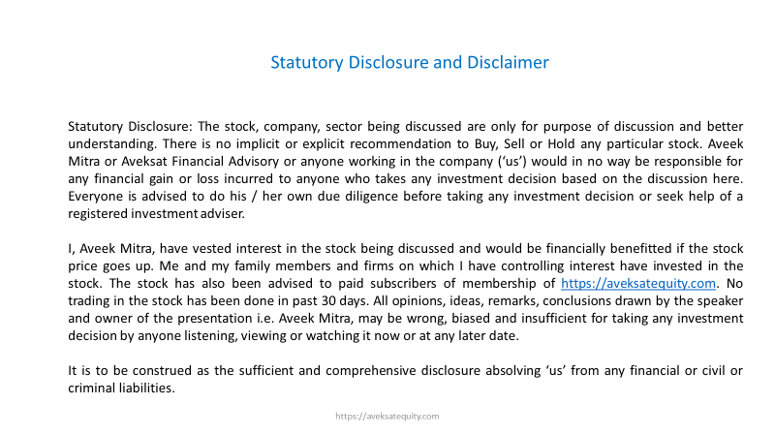

Slide 2
TCI EXPRESS
Mcap: Rs. 2400 Cr
ROCE: 44%
ROE:31%
EBITDA: 12%
EVEBITDA: 19
PE: 32
52W – H/L : Rs. 766 / Rs. 510
CMP: 627/- (16/09/2019)

Slide 3
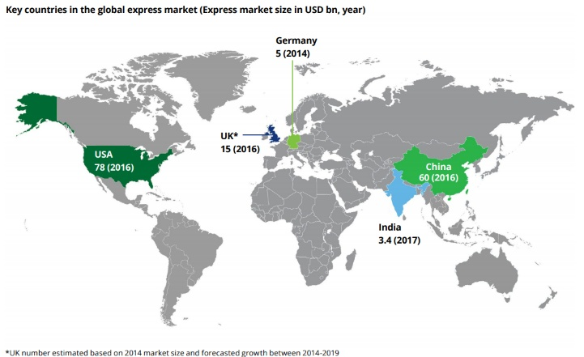

Slide 4
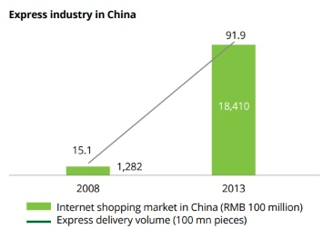
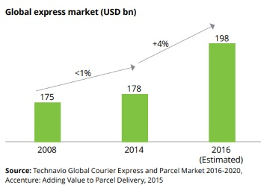
International:
Rs. 6000 Cr
CAGR 08 – 13 : 70%

Slide 5
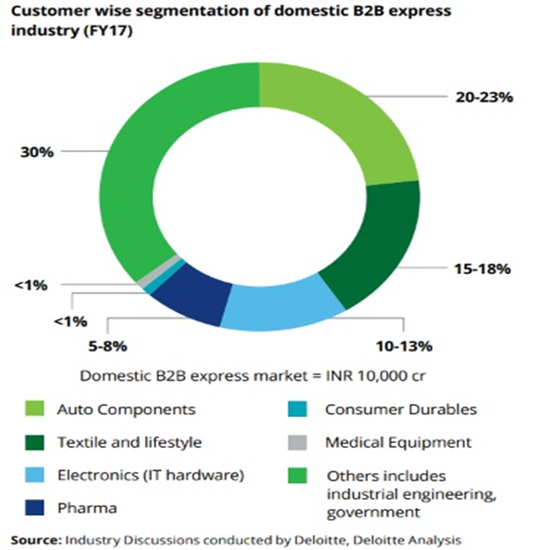
Overall Industry Segments

Slide 6
Business Proposition for Buyer (B2B)
Maximise Production Efficiency
Minimise Inventory Cost
Maximise Customer Experience
Enabler for SME / MSME to compete PAN India
Unique Character of Branding in Express Logistics
B2B has Brand value contrary to B2C in Express Logistics
B2C has zero brand salience
C2C has Brand value but very small & slowing market (Blue Dart)

Slide 7

Sector Characteristics
Logistics Industry is possibly 10% Organized and 90% Unorganized
Unit Economics of Branch Expansion is attractive for non-E-Commerce; non-B2C
(E-Commerce needs Return to Origin, Reverse Pick Up, Cash On Delivery related challenges)
Some reports say domestic Express Industry would be US$ 6.5 billion by 2025
Creating is easy, managing and profitably scaling is extremely challenging
TCI Group has multi year organization memory & long time client association
Back up of strong TCI Group transport infrastructure & decent promoter group

Slide 8
Best Performer in Industry over Years

Slide 9
Logistics Performance Index (LPI) of World Bank ---- India Rank 44 in 2018
China (26), Thailand (32), South Africa (33), Vietnam (39), Malaysia (41) are ahead of India. Indonesia just behind (46)
LPI doesn’t capture Intra country transport complications and challenges
In 2018, Govt constituted a sub national LPI, applying World Bank LPI concept
New position of Special Secretary created in Min of Commerce, in charge of coordination of policies and practises
across states and central govt bodies for smoother passage of merchandise across country.
Effects of GST and E-Way bill and DFC to streamline passage is well discussed and can be easily understood
FUTURE INVENTORY WOULD MOVE ON WHEELS THAN RESIDE ON WAREHOUSES
With better highways, more Domestic Air cargo would shift to Domestic Surface as cost differential is 4X

Slide 10
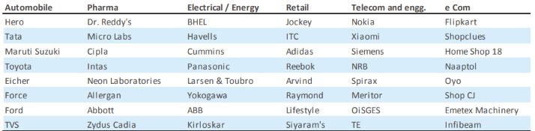
Representing list of Corporate Clients
++ Access to more than 200000 SME & MSME in India across all geographies and industries
Ability to address weight / packet / volume requirement of any size and type
in containerised mode

Slide 11
Rs. 400 cr Capex planned in 4 years --- Rs. 85 cr already committed till 2019 --- Capex 2020 is Rs. 60 cr
Sorting area capacity to increase from 1.5 mn sq ft to 3++ mn sq ft in next 2 - 3 years
Revenue expected to double in 3 – 4 years …. Optionality of International Cargo business pick up

Slide 12
Asset Light
Working Capital Light
Complex Ecosystem to replicate
Very Long Earning Visibility

Slide 13
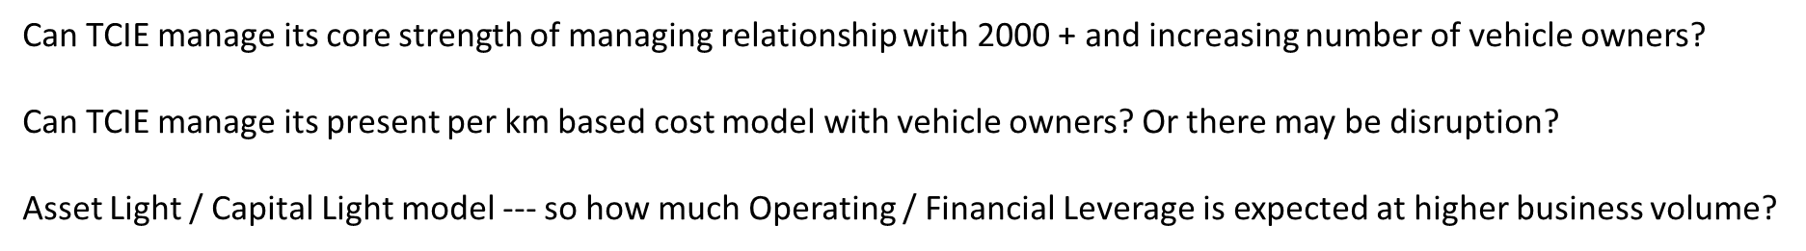
Is it worth buying at current valuation? Can I get it cheaper?
Are there better long term better bets available to the market to fill my portfolio?
How much to allocate? Can it be a core stock in Portfolio for next 5 years?
Can it be disrupted by newer entrants with large capacity to suffer?
Will India go into Long cycle structural recession which would harm economic and industrial activity?
Can Railways become a formidable challenger to Express Cargo industry?

Slide 14

For any question or clarification write to us
am@aveksatequity.com
Would be happy to know your feedback too
THANK YOU!!

