Slide 1
Statutory Disclosure and Disclaimer
Statutory Disclosure: The stock, company, sector being discussed are only for purpose of discussion and better understanding. There is no implicit or explicit recommendation to Buy, Sell or Hold any particular stock. Aveek Mitra or Aveksat Financial Advisory or anyone working in the company (‘us’) would in no way be responsible for any financial gain or loss incurred to anyone who takes any investment decision based on the discussion here. Everyone is advised to do his / her own due diligence before taking any investment decision or seek help of a registered investment adviser.
I, Aveek Mitra, have vested interest in the stock being discussed and would be financially benefitted if the stock price goes up. Me and my family members and firms on which I have controlling interest have invested in the stock. The stock has also been advised to paid subscribers of membership of https://aveksatequity.com. No trading in the stock has been done in past 30 days. All opinions, ideas, remarks, conclusions drawn by the speaker and owner of the presentation i.e. Aveek Mitra, may be wrong, biased and insufficient for taking any investment decision by anyone listening, viewing or watching it now or at any later date.
It is to be construed as the sufficient and comprehensive disclosure absolving ‘us’ from any financial or civil or criminal liabilities.

Slide 2
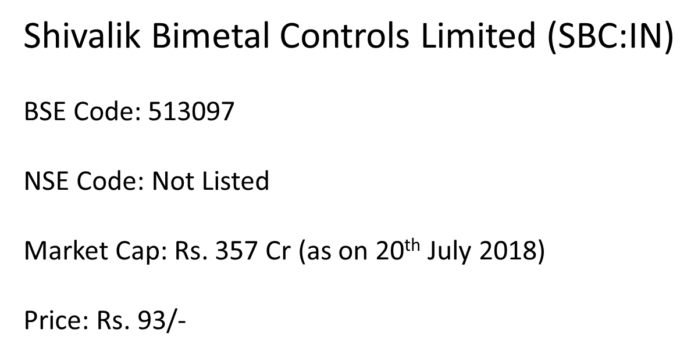
Before We Proceed ……
Look back at last year ……
Since I presented to you at same place last year so let’s go through
Price on 24/07/2019 ---- Rs. 94/- (went up Rs. 146/- in March 19 & down till Rs. 80/- in Dec 18)
(Disclosure: Holding & increased holding)

Slide 3
Not an Interesting Idea!!
A very boring business which regulators are hell bent to curtail
No Growth in top line for many years as core business is declining & unattractive for new entrant
The end product user segment would survive (and thrive) for many years for its criticality
Consistent high market share almost 75% in the niche it operates. Niche was big but in terminal decline
Consistent high ROE & ROCE & Dividend Pay out (yield average appx 3.25%)
Company is 100+ years old; Permanent Employee 1675 (as on March 19)
Hardly any investor interest --- Stock is range bound for last 4 years
Revenue: Rs. 2000 cr; EBITDA: Rs. 275 Cr; Market Cap: Rs. 3400 Cr;
Cash in Hand: Rs. 430 Cr; Total Debt: Nil; Core Business ROCE: 48% (w/o surplus fund)

Slide 4
But Something Interesting!!
Promoter Increased Stake from 51% to 51.90% in last one year (through market purchase)
Buyback announced at a Tender Price which is Lifetime High price for the share
Promoters are not participating in the Tender Offer (stake would be up to 54.81% post buyback)
Significant change in Management team in last 2 – 3 years with almost entire new team at the top
Industry where it operates are at significant, irreversible phase of transition
GST induced long term tailwind for the end product segment where it operates
Metro Rail across cities provide another fillip to long term opportunity
Purchased majority stake in a company which is in nascent but promising area of technology
Looks like in the process of creating a future ready Eco System (trying, just possibly trying!)
------- Let’s see ……………………

Slide 5
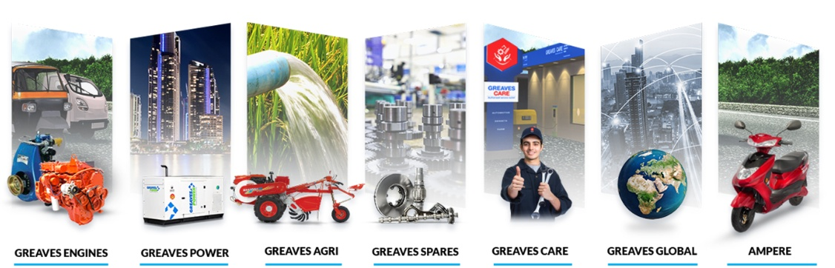
GREAVES COTTON LIMITED
GRV.IN Price NSE (24/04/2017): Rs. 137/- (dividend last year Rs. 5.50 per share)
PE: 20; EVEBITDA: 12; Buyback at Rs. 175/- (buy back ex-date over on 12th July ‘19);

Slide 6
No Growth But Revenue and Profit Protected
75% Market share in 3W and Small Commercial 4W Diesel Engine
Market for the same is almost stagnant slowly falling …. Only sell in Rural and Semi Urban Areas
Now 49% Revenue from Diesel Engine, 25% from Agri and Gensets and, 26% from After Market
Newer businesses in Agri, Engine for genset, pump set, CNG engine and aftermarket growing faster
Piaggio (20% of total GC 3W Engine), M&M, Atul Auto, TVS and most Regional 3W manufacturers are customers
5000 Retail footprint (almost as high as Maruti), 9000 Service touch points & 325 + Greaves Care Centre across India
Cumulative 5 million Engines sold …. Daily moves 5 L Ton cargo & 10 L Passengers
Cumulatively 3 million Pump set and 1 million Gensets sold
Huge base, customer connect and all India footprint can be leveraged in multiple ways
Can build appx. 4 L Engine per year (FY 19 sales 327601 engines)

Slide 7
Base Revenue Remain Constant & Profitable --- Over Years
**In FY 19 & FY 15, one time Exceptional Loss for investment in IL&FS & Discontinuation of Construction Business

Slide 8
New Leadership Team
Joined in last 1-2 years:
Nagesh Basavanhalli MD (ex Fiat Chrysler)
Ravi Damodaran (ex Varroc Engineering)
Subhankar Chatterjee (ex Cummins)
Debasish Mitra (ex Mercedes Benz)
Tarun Khanna (ex Fiat Chrysler)
Mohanan Manikumar (ex M&M)
Gagan Mathur (ex NRB Bearing)
Vijaya Kunnakavil (ex Bajaj Auto, TVS)
Neetu Kashiramka CFO (ex Jyothy Laboratories)
Joined Earlier:
Sanjeev Kumar (ex Varroc Engineering)
Anil Makhgola (ex Minda Industries)
New Leadership Challenge:
Take Company to next level of
Growth path in newer &
Growing areas of business
in 2W, 3W and Small Commercial
Vehicle space, opportunity of which
would upfold over next 10 years in
Transformative Ways and, focus into Agri
& Related Business Segments profitably.

Slide 9
Transition Time??

Slide 11
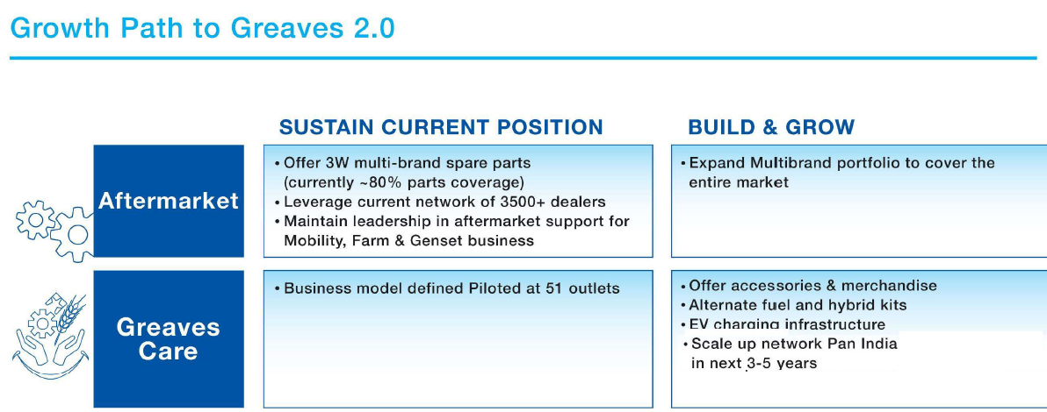
Since then it has grown to 325 outlets

Slide 12
Up by 2.7%
(Up 159%)

Slide 13
GC EV Story (Still a story for GC??)
Greaves bought 81.23% stake in Ampere Vehicles till for Rs. 120.50 Cr
Ampere has 85% Localised content for Sealed Lead Acid Battery model (not Li-Ion battery model)
Motor, Controller, Charger, Converter --- 4 key components designed, developed and made in India
High Speed High Range “Ampere Zeal” can be priced at Rs. 69K as it’s eligible for Rs. 18K subsidy under FAME II
Capex planned for next year appx. Rs. 10 Cr; present capacity enough for 3X – 4X sales
It would be sold, serviced from dedicated Greaves Care centres and possibly can use GC’s 5000 retail reach.
Greaves creating Charging Infra in GC Centres & 100 would come up in next 2 – 3 months in Southern India
Wall Mounted chargers for apartment complex & parking lots and, “Array Chargers” for fleet operators
But it’s a product for Urban / Semi Urban areas where GC is present in Rural (big question mark??!!)

Slide 14
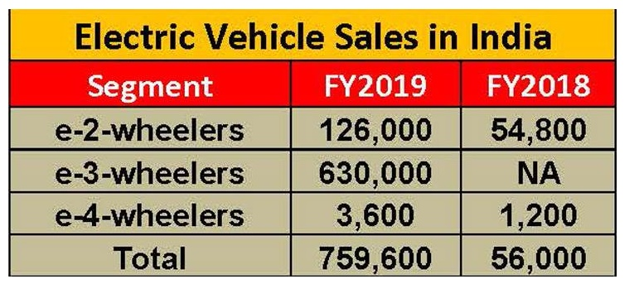
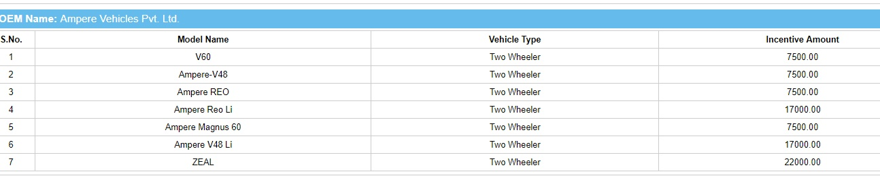
E2w major competitor are Ather / Avon / Hero Motors / Okinawa / Tunwal / Lohia Auto / Eletrotherm
With 14,304 e2W sales
Ampere has 10% + market share
Almost 95% priced below Rs. 45K with Sealed Lead Acid battery
variant but it also has Li-Ion battery variant
Source: www.fame-india.gov.in/ModelUnderFame.aspx accessed on 24/07/2019

Slide 15
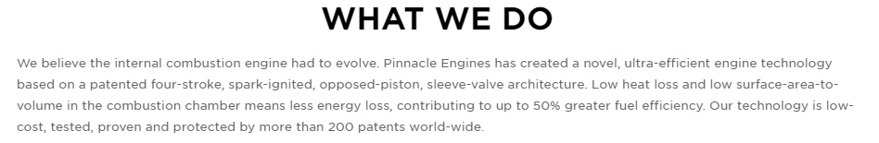
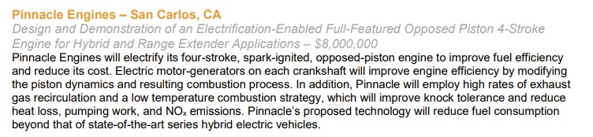
Pinnacle Engine
This Venture Capital funded company in US claims to have developed Opposed Piston Engine (remember
it is being tried for last more than 100 years)
Advanced Research Project Agency – Energy (ARPA-E) of US awarded the company in 2018
along with Achates Power for Fundamental Improvement in Energy Efficiency
From ARPA –E
Website.

Slide 16
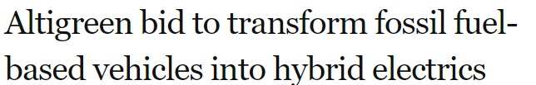
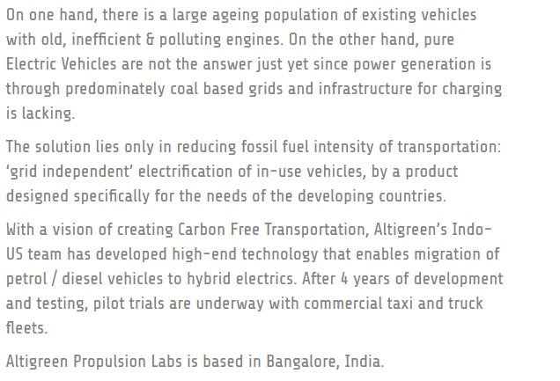
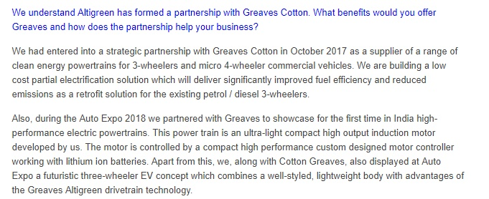

Slide 17
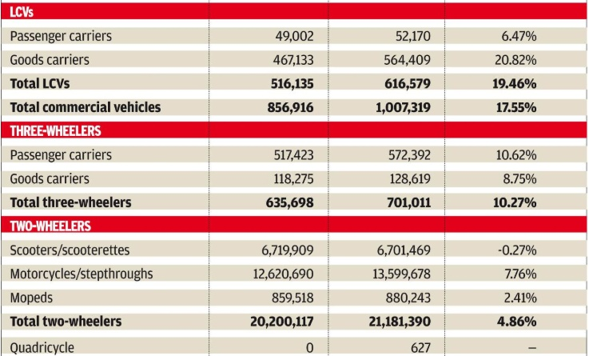

Increasing Addressable Market …. Much Larger Playground…. Affordable Mobility
2017 -18
2018 - 19
Change
Greaves?
Greaves?
Public Transport / Metro Rail for Urban & GST for Hub & Spoke Model of Logistics are possible growth enablers
As on date 8- 10% Indian population covered by CNG availability but CNG penetration can go up slowly & surely

Slide 18
Agri Equipment Business
Power Tiller market in India is only Rs. 6000 Cr…. Bangladesh market is Rs. 5000 Cr
Reduced Farm Holding and Labour Shortage may increase but it’s always low in India
Electric Pump set market has huge opportunity but margin is much lower
We have no expectations beyond GC maintaining a steady state performance
Greaves Care Centre
We have high expectation of margin accretion from this business (B2C in nature) as future engines of any
variety would need better support infrastructure from recognised and organized players.
The space is mostly unorganized as on date. Third party spare, one stop solution may be future
GC with its brand recall, large footprint, huge installed base, fast scaling up can really positive here

Slide 19

Fuel independent power train as claimed by Altigreen may take more time than envisaged
Pinnacle Engine has unique technology but many companies are working on similar lines like
Achates Engines, Aquarius Engines, Mazda Motor, Nissan, Toyota / Cummins
Ampere has an edge in market but EV roll out at scale would depend on things beyond their control

Slide 20
Things to remember
Promoters are a part of larger erstwhile Thapar Group : patchy history of wealth creation for minority!
This is the only listed entity of Karan Thapar’s part of business.
Karan Thapar is an avid Polo player. Search results in Google gives more info about him on Polo game than Business.
Karan Thapar name appeared in Panama Papers! Criticality of case and consequences unknown.
Most part of the stock story is “story” only built on different scenarios playing out favourably for GC
Commodity price can keep pressure on profitability
How much better “terms of trade” they can get from OEMs would determine their success of aftermarket forays.
Indian professional management team w/o oversight at times work for themselves than for company or minority.
Many a time group of professional managers join in herds and leave in herds. Uncertainty remains……

Slide 21
Conclusions
We invested almost an year back to protect downside of the portfolio.
We feel, the company has a strong brand & sustainable base business
We are confident EV would be future fastest growth area. And future is quite “near”.
We are reasonably sure that Fossil Fuel would still be significant at least in 2030 and possibly beyond.
We found dividend yield good. Buy Back came later.
Cummins sells a huge premium to GC though we feel Cummins is a poorer capital allocator than GC.
THANK YOU ALL !!

