Slide 1
Ferro Chrome/ IMFA

Slide 2
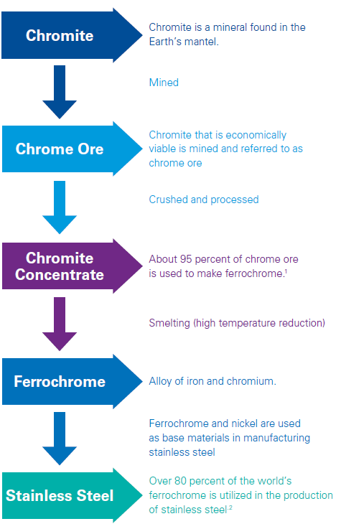
Extraction/Alloying Process
Chromite is the commercial name of iron chromium oxide (FeCr2O4), a mineral comprised of chromium and iron oxide that is naturally found in the earth’s mantle. When extracted, it is referred to as chrome ore.
Chromite is crucial for the production of ferrochrome, an alloying agent in manufacturing stainless steel. Chromite provides the corrosive resistance properties in stainless steel. Chrome ore is crushed, screened, jigged into chrome concentrate and then smelted into ferrochrome
One of the key costs incurred is power which is around 3000/3500 kWh/t of electrical energy.

Slide 3
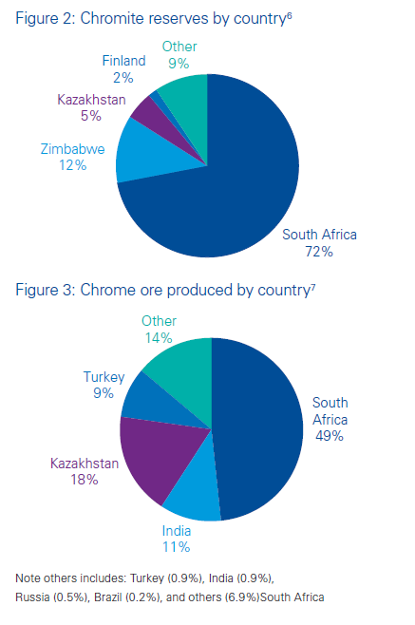
Chromite markets by geography
China is the highest producer/consumer/importer, but Chinese data is not available.
SA is the largest exporter of Chrome ore. Electricity costs and lack of smelting capacity determines the choice between Chrome ore vs FC.
Countries have offered subsidized power to develop FC industry. Taking away this subsidy has doomed the industry.

Slide 4
Key Players
The main market players are Glencore-Merafe, Eurasian Resources Group, Samancor Chrome, Hernic Ferrochrome, IFM, FACOR, Mintal Group, Tata Steel, IMFA, Shanxi Jiang County Minmetal, Jilin Ferro Alloys, Ehui Group and Outokumpuetc. The global production of Ferro Chrome increased to 12136 K MT in 2016 from 9512 K MT in 2011 with CAGR of 4.99%.

Slide 5
Pricing
SA mfrs and Steel producers sit and decide benchmark prices
Long term contractors work on a discount to benchmark prices
20% to 30% capacity is sold on spot.
https://www.meraferesources.co.za/news.php

Slide 6
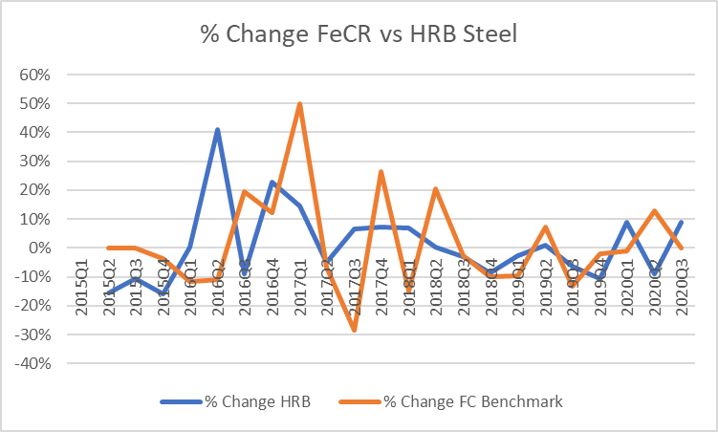
FC vs Steel

Slide 7
What moves the needle?
Steel Demand
SA production scenario
Exchange rate (RAND/USD/INR)
Power rates/subsidies
Export tax
Chinese ore stock

Slide 8
IMFA
Only Indian player with captive chrome ore mines and captive power with no coal linkages.
Other Indian players like Balasore and Facor doing very poorly due to power.
Exports 80% of its production material
IMFA has to compete with South African and Chinese ferrochrome producers in terms of cost effectiveness. With backward integration, IMFA’s production cost matches that of most of the efficient players in South Africa and it is lower from Chinese firms by vast margin.
Promoters decent, company has had multiple issues.
Political/Environment issues
Utkal coal block
Lost to Indonesia
Capacity constraints

Slide 10
Data
 | HRB Export Prices (Q Avg) | FerroChrome Q Benchmark | IMFA Operating Profit | MFA Production
2015Q1 | 456 | 108 | 240 | 205
2015Q2 | 385 | 108
2015Q3 | 344 | 108
2015Q4 | 289 | 104
2016Q1 | 290 | 92 | 121 | 189
2016Q2 | 409 | 82
2016Q3 | 372 | 98
2016Q4 | 457 | 110
2017Q1 | 524 | 165 | 513 | 235
2017Q2 | 497 | 154
2017Q3 | 530 | 110
2017Q4 | 568 | 139
2018Q1 | 607 | 118 | 432 | 234
2018Q2 | 608 | 142
2018Q3 | 590 | 138
2018Q4 | 539 | 124
2019Q1 | 524 | 112 | 250 | 216
2019Q2 | 529 | 120
2019Q3 | 496 | 104
2019Q4 | 443 | 102
2020Q1 | 482 | 101 | 89 | 237
2020Q2 | 438 | 114
2020Q3 | 477 | 114

Slide 11
Links
http://www.afarak.com/en/
https://www.argusmedia.com/en/news/2142599-european-4q-fecr-benchmark-unchanged-at-114lb
https://www.meraferesources.co.za/
https://www.meraferesources.co.za/news.php
https://www.miningmx.com/news/markets/44102-sa-to-apply-export-tax-on-chrome-exports-in-effort-to-support-domestic-ferrochrome/
https://www.glencore.com/investors
https://www.imfa.in/investor-information/stockdetails.htm

