Slide 1
NTPC Green – Analysis
July 27, 2025

Slide 2
Disclaimer:
This presentation is for informational purposes only and should not be construed as financial advice, an offer, or a solicitation to buy or sell any securities. The views and opinions expressed are based on publicly available information and internal analysis, which may be subject to change without notice.
Investing in equities involves risks, including market fluctuations, liquidity constraints, and potential loss of principal. Past performance is not indicative of future results, and projected growth rates or financial outlooks are based on assumptions that may not materialize.
We strongly recommend that investors conduct their own due diligence, consult with a qualified financial advisor, and assess their risk tolerance before making any investment decisions. Neither the presenter nor any affiliated parties assume liability for financial decisions made based on this presentation.

Slide 3

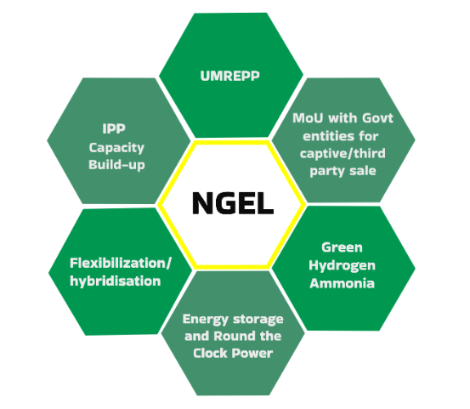
About NTPC Green (NGEL)
NGEL is an umbrella company for the green business initiatives of NTPC and undertakes projects through organic and inorganic routes and aims to be the flag-bearer of NTPC’s green energy journey
Incorporated in April 2022, manages a diverse renewable portfolio of solar and wind power assets strategically located across 6 states.
They do development, construction, and operation of renewable energy projects (solar and wind), supported by long-term Power Purchase Agreements (PPAs) in addition to BESS and Green Hydrogen.
Nuclear and Hydro projects are outside the scope of NGEL

Slide 4
Introduction and Tailwinds
Macro: India’s renewable energy growth – more than just promises
  In the race to achieve 500 GW of renewable energy by 2030
  By FY29 non-Hydro renewable energy share to reach 50% (34% now)
  Universe: FY25 – 29 Power capacity additions (Plan for India)
    Conventional Power: 32-35 GW
    Nuclear: 5-6 GW (from Kakrapara, Kalpakkam, and Rajasthan projects)
    Hydro: 15-16 GW (including 7-8 GW pumped storage)
    Renewable Energy: 180-190 GW (There is enough space for all)
Strong Parent Backing: (Skin in the game)
  Wholly owned subsidiary of NTPC Ltd (AAA-rated PSU)
  Access to low-cost debt and sovereign credibility
  75000 Crore Capital Infused thus far (Limited for PSU)
Locked-in Long-Term Revenue:
  25-year Power Purchase Agreements (PPAs)
  Low counterparty risk due to central/state utility offtakers

Slide 5
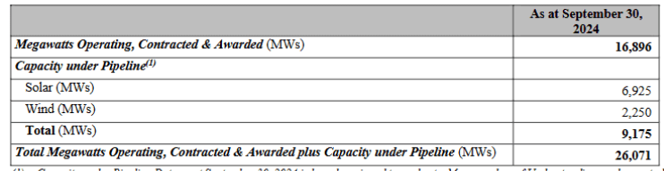
Right to Win / Thesis
Clear Ramp up Plan (Key Monitorable)
  Ramp up of 3GW, 5 GW and 8 GW over FY-25, FY-26 and FY-27 as per their plan. (Commissioned 3GW)
  Total visibility for a total capacity of 19GW by FY-27. (Current Operating Capacity
  Targeting 60GW by 2032
  Present Capacity – 6.8 GW (ngel.in data)
MoU’s with Indian Oil, ONGC, Multiple state governments for the development and procure Land and resources for the same.
BESS and Green Hydrogen (Optionality)

Slide 6
Key Metrics
Market Cap : 89,159 Cr
Current Price : 106 (25 July 25 Closing)
P / E : 188 (Company in Growth phase Should be valued like VC)
Price / Sales : 40.4
Debt to Equity : 1.05
Promoter Holding : 89% (Risk of dilution)
52W High / Low : 155 / 84.6

Slide 7
Risks
PSU Culture and Delays – Internal, Execution
  If capacity rollouts (3-5-8 GW) are delayed, revenue growth stalls
Heavy Dependence on Debt:
  Operates with 80:20 debt-to-equity model
  Highly sensitive to interest rate spikes
Incentive phase-out by Govt.
Grid Infrastructure constraints / scalability for offtake
China module dependency
Availability of clean water for Green Hydrogen
Battery storage and fire Safety risk for BESS and Hydrogen storage

Slide 8

Thank you

