Slide 1
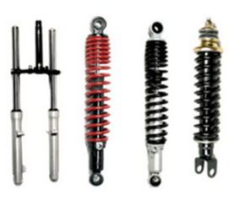
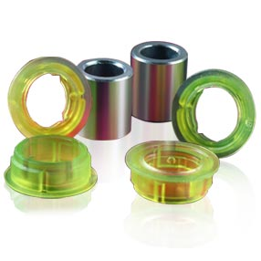
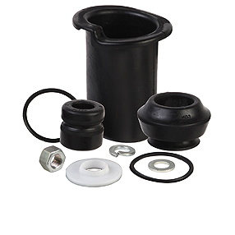
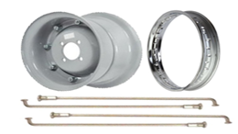
KEY PRODUCTS
Business Overview
Pioneer in Ride Control Products
Company History
Board of Directors
Management
Products
Segments
Customers
Financials
Valuation
Technicals
--Prateek Dugar VP Kolkata--

Slide 2
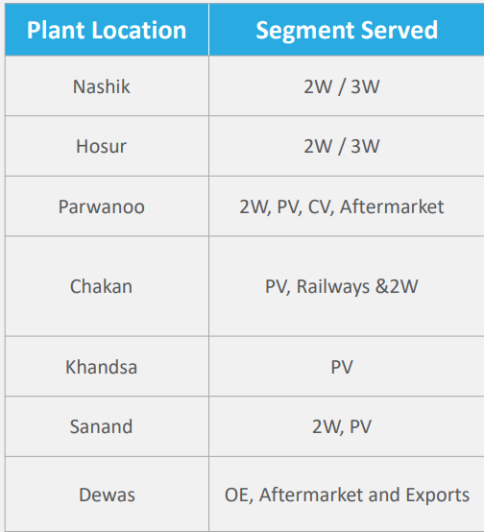
Company History
Gabriel India is a joint venture with Maremont Corporation (now Gabriel Ride Control Products of Arvin Meritor Inc., USA)
Established in 1961 – having over 6 Decades of Presence
Flagship company of ANAND Group – renowned name in Automotive industry with several key business partnerships
Single Unit Manufacturing to Multi Location segment wise manufacturing
Technological Collaborations & Business Partnerships –
KYB Corporation | Yamaha Motor Hydraulic System Co. Ltd. | KONI
4 Strategic Business Units
2&3 W | Passenger Cars | CVs & Railway | After-Market
Leader in Quality and Reliability and winner of Several awards and Accolades

Slide 3
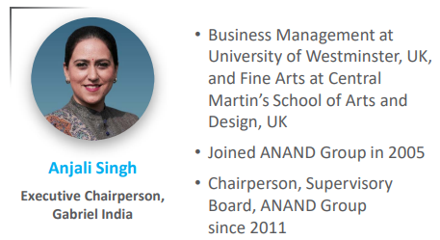
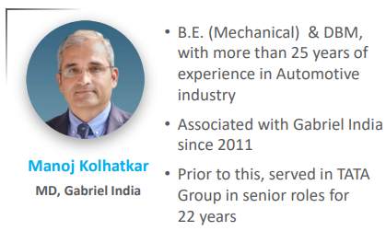
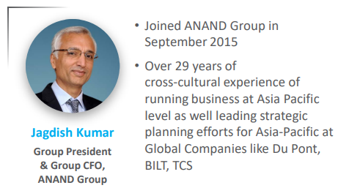
Board of Directors

Slide 4
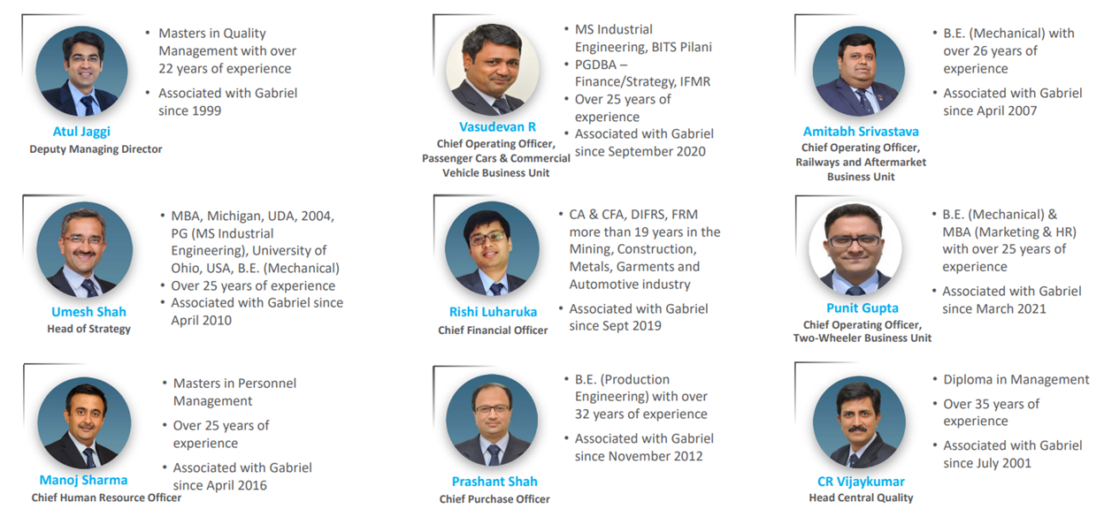
Management

Slide 5
Products

Slide 6
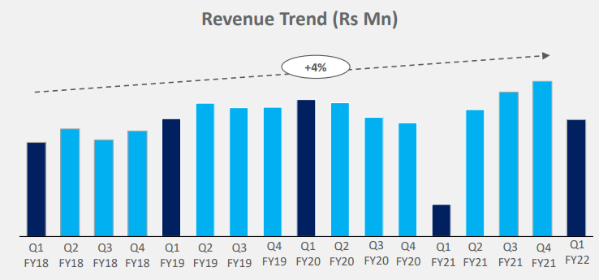
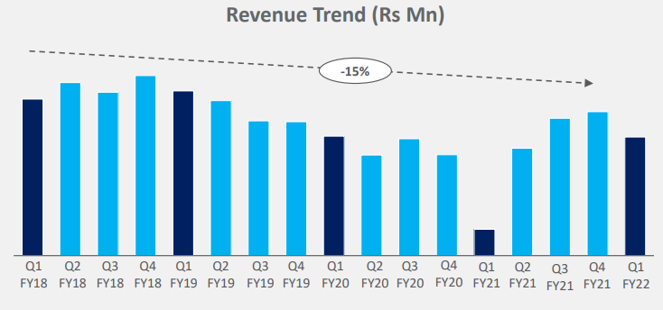
Strategic Business Units
2&3 Wheeler – 64% Revenue | 25 % Market share
In House test facility – shortening lead times for testing
Introduced products like gas-charged shock absorbers for scooters, dual spring shock absorbers and innovative products for exports
Technology provider serving Indian OEMs in Latin America (Gabriel De Colombia )
Preferred among Electric 2W customers
PV 4 Wheeler– 22% Revenue | 21 % Market share
Key suppliers to newly launched vehicles for several OEMs like Mahindra and Maruti Suzuki
New products in the pipeline –
M&M (2) | VW (1) | PSA (1) | TML (2)
Technology provider serving Indian OEMs in Latin America (Gabriel De Colombia )
Growth impacted by discontinuation of Maruti Omni due to safety norms and replacement of Wagon R with newer model where GIL is not the supplier

Slide 7
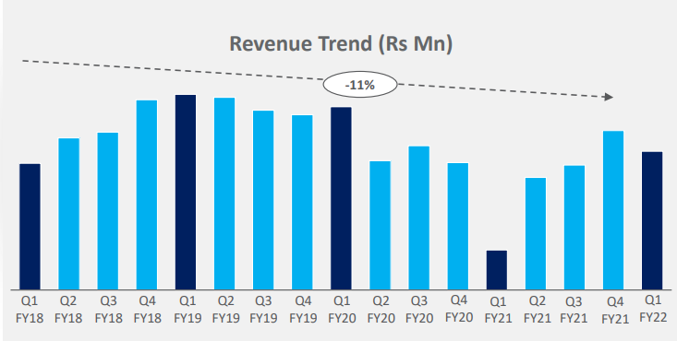
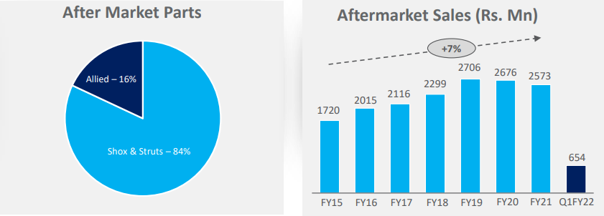
Strategic Business Units
CV & Railways– 12% Revenue | 75 % Market share
Technology license agreement with KONI B. V
Export tie-up with Isuzu Global (ASEAN region)
First Indian automotive components manufacturer to supply Linke Hofmann Busch (LHB) shock absorbers to the Indian Railways
Ashok Leyland – MBP, Partner | DAF – 2 programs
After Market– 2% Revenue | 40% Market share

Slide 8
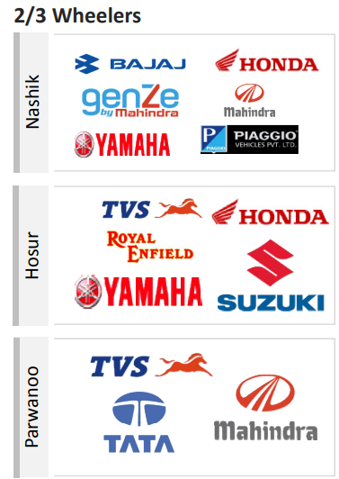
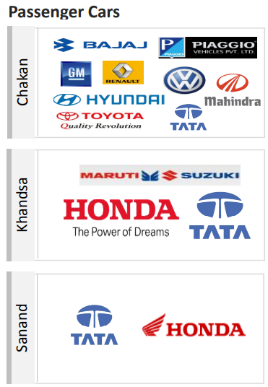
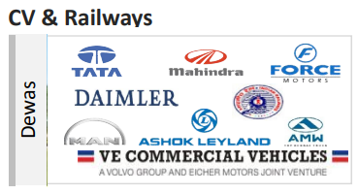
Customers

Slide 9
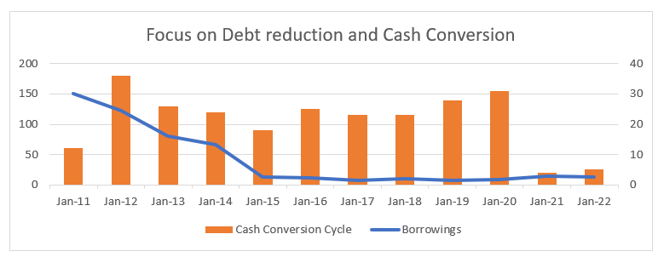
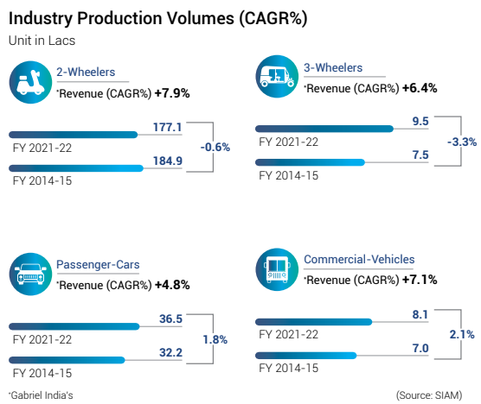
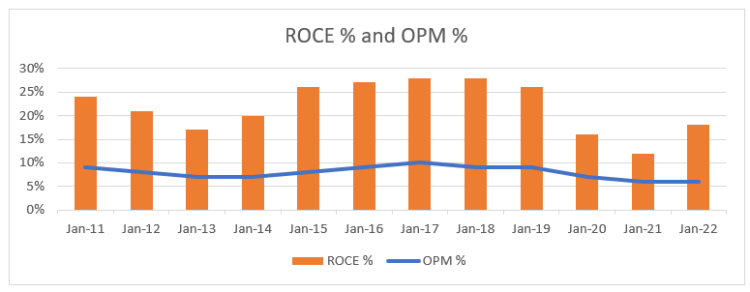
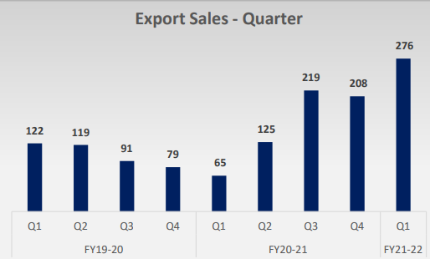
Financials
Revenue growth in a muted industry
Improved Exports

Slide 10
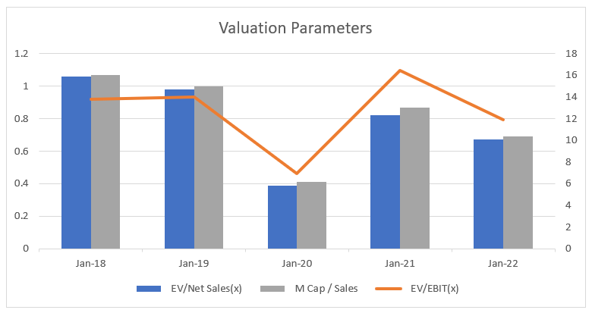
Valuations
Estimates for FY-25 | Bull case | Base Case | Bear Case
Mcap to Sales | 1.2 | 1 | 0.6
Sales / Growth CAGR | 3275 / 12% | 2700 / 5% | 1484 / 2%
Mcap | 3930 | 2700 | 1485
Price / CAGR | 274 / 30% | 288 / 13% | 103 / (-9%)
Assumptions:
Auto Cycle uptick
New products in pipeline
EV customer - OLA Electric, Okinawa, Ather, Ampere
Technologically Superior
Improving Financials

Slide 11
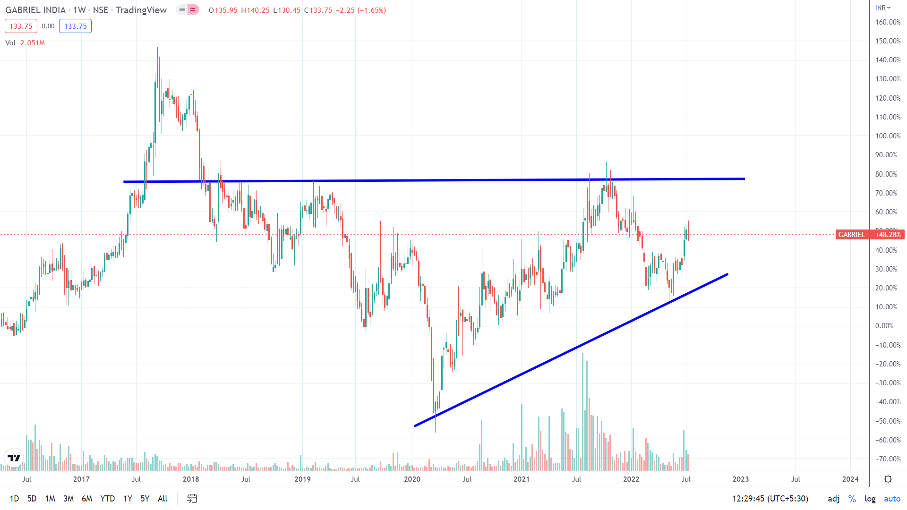
Technicals
Rising Wedge in weekly chart

Slide 12
END

