Slide 1
Star Health Insurance
Malhar Manek

Slide 3
Notes:
https://www.statista.com/statistics/1116425/india-health-insurance-market-share-by-type-of-insurer/

Slide 4
Retail is most profitable health insurance segment

Slide 5
Retail Group Government

Slide 6
Leadership in retail health insurance

Slide 9
Distribution strength- largest agents network

Slide 10
Low Attrition

Slide 11
Low SAHI agents attrition (1%)- Star is 50% of SAHI agents
Notes:
https://cafemutual.com/news/insurance/23727-india-has-one-individual-agent-for-every-550-people#:~:text=IRDAI%20data%20shows%20that%20the,lakh%20as%20on%20March%202021.

Slide 12
Largest hospitals network

Slide 13
Agreed hospitals…

Slide 14
Low-cost model

Slide 15
In-house claims management
Lower TAT, more cost efficient claims

Slide 16
Star HDFC Ergo
Notes:
https://www.hdfcergo.com/docs/default-source/default-document-library/he---annual-report---2022---a4.pdf?sfvrsn=da477c0e_0

Slide 20
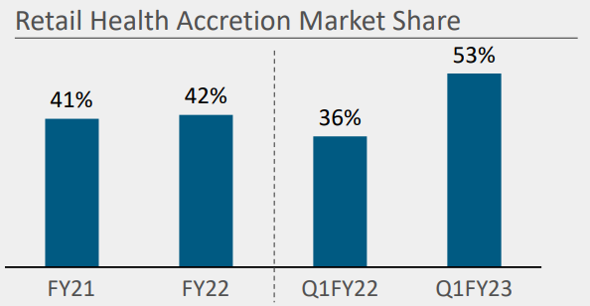
Incremental/Delta Share
Star Health Jul 22 Malhar Manek.xlsx
Good source to track: https://www.gicouncil.in/statistics/industry-statistics/segment-wise-report-on-homepage/
Notes:
https://www.gicouncil.in/statistics/industry-statistics/segment-wise-report-on-homepage/

Slide 22
Massive Rural/Semi Urban Opportunity

Slide 23
Key monitorable in the flywheel is “potential price leadership”: Scale economies shared

Slide 24
Intangibles and Culture
Notes:
https://timesofindia.indiatimes.com/city/chennai/venkatasamy-jagannathan-is-a-star-in-his-own-right/articleshow/88255299.cms

Slide 28
Pre Mortem Analysis: Anti-thesis, key risks

Slide 30
Corporate Agents Count- not the strongest
Star Health: 82
Care Health: 147
Niva Bupa Health: 40
Aditya Birla Health: 52
HDFC Ergo Health: 30
ManipalCigna Health: 55
https://www.irdai.gov.in/ADMINCMS/cms/NormalData_Layout.aspx?page=PageNo2818&mid=38.2.5 (Ctrl F for “Star Health”, “Care Health” etc.)
Banks/other corporate agents are allowed to partner with three SAHIs insurers
Notes:
https://www.irdai.gov.in/ADMINCMS/cms/NormalData_Layout.aspx?page=PageNo2818&mid=38.2.5

Slide 32
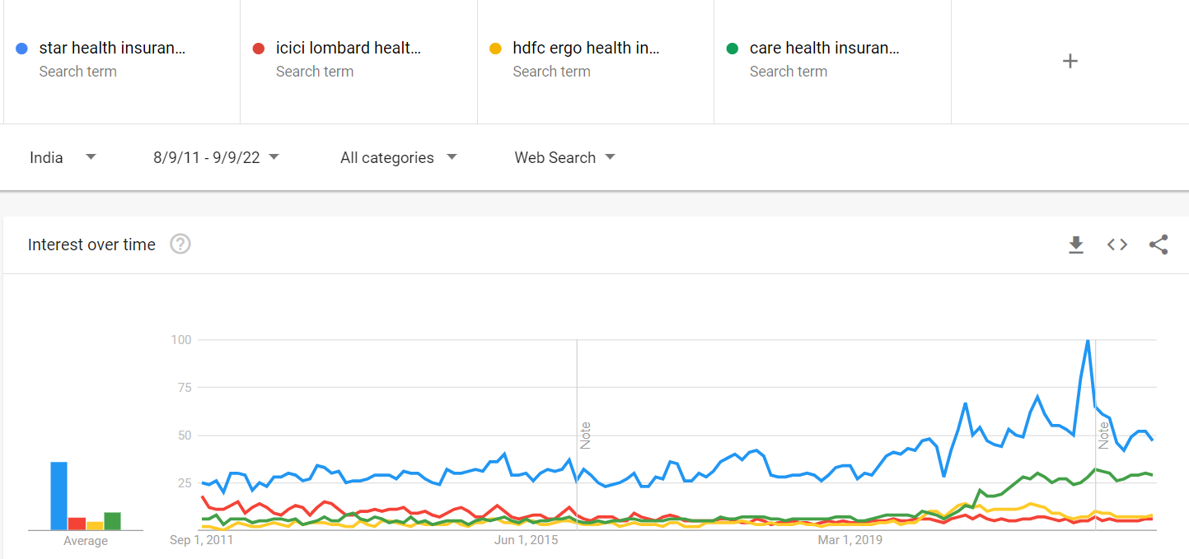
GTrends- Care has gained post Covid
Notes:
https://trends.google.com/trends/explore?date=2011-08-09%202022-09-09&geo=IN&q=star%20health%20insurance,icici%20lombard%20health%20insurance,hdfc%20ergo%20health%20insurance,care%20health%20insurance

Slide 34
"cost of float" = (underwriting profit or loss)/ (net loss reserves + loss adjustment reserves + funds held under reinsurance assumed - agents balances - prepaid acquisition costs - prepaid taxes - deferred charges applicable to assumed reinsurance)
Notes:
https://cms.careinsurance.com/cms/public/public_disclosure
https://www.irdai.gov.in/ADMINCMS/cms/NormalData_Layout.aspx?page=PageNo765&mid=31.2

