Slide 1
Nykaa: FSN ECommerce

Slide 2
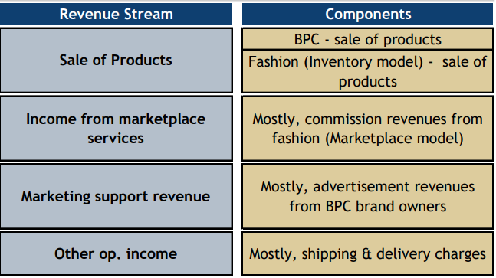
Revenue Model

Slide 5
BPC
Top 10 brands mkt share
Inventory model allows:
Authenticity verification
Availability
Timely delivery
BPC supply side is fragmented

Slide 6
Wide BPC Offering

Slide 8
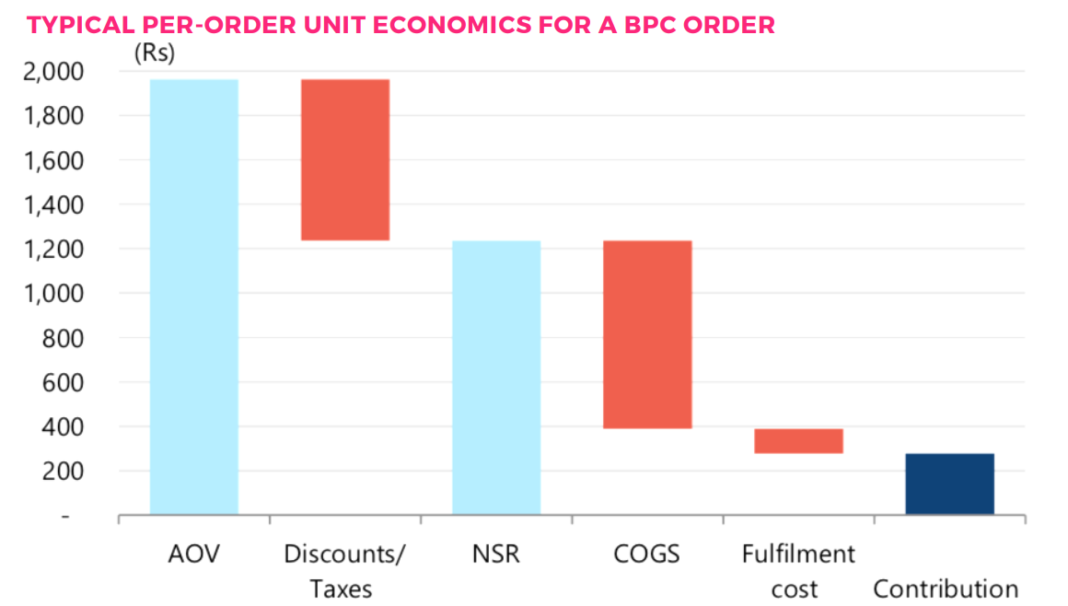
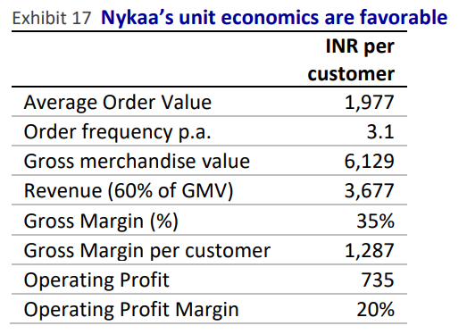
Unit Economics

Slide 9
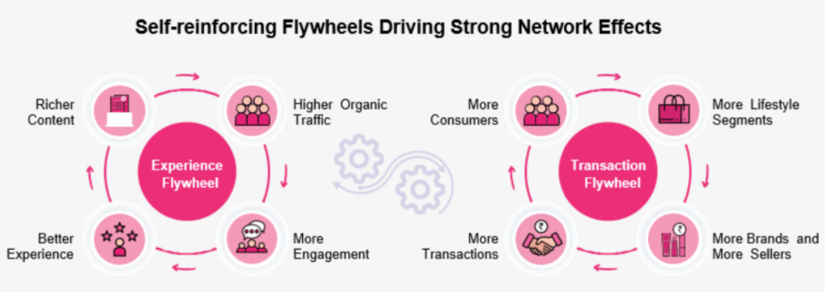
Network Effects + Winner Takes All
Content-based customer acquisition: organic marketing
FY20 Nykaa marketing+ad+promotion spend was 202.2 Cr (revenue 1767.5 Cr) vs 36.5 Cr for closest competitor Purplle (revenue 86.8 Cr)

Slide 10
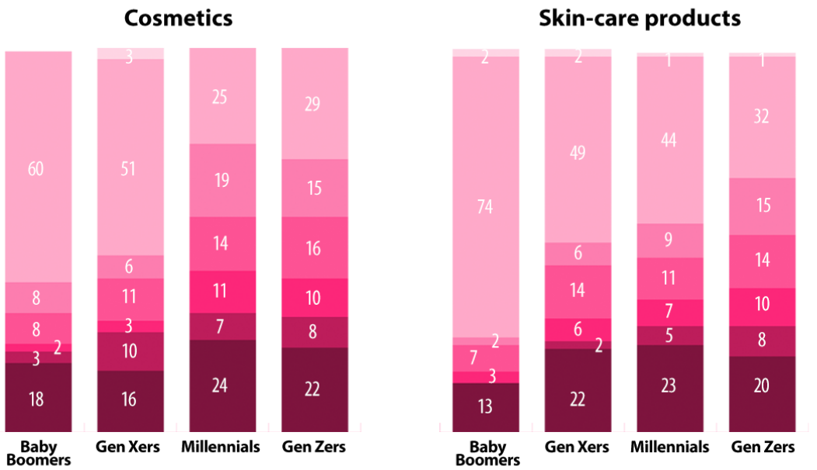
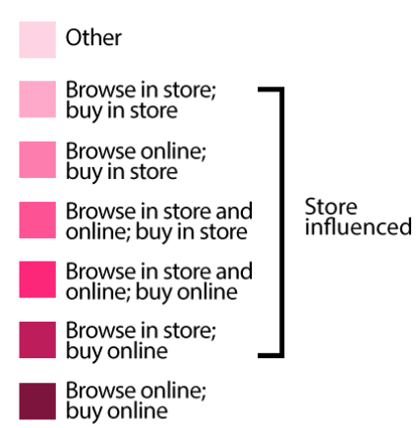
Omnichannel
‘High-touch’ element of shopping (high-tech, high-touch)

Slide 11
Offline BPC

Slide 12
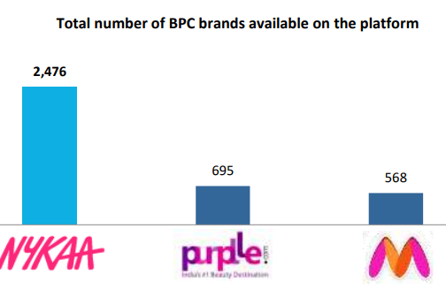
Brand Relationships
Strong brand relationships- entry barrier as difficult to replicate
Go-to platform for int’l brands to enter India (Jubilant Foodworks of BPC?)

Slide 13
BPC Competition
Nykaa started in 2012 vs Purplle in 2011
Myntra, Sephora

Slide 14
Nykaa vs Purplle

Slide 16
A&P and Employee- Purplle vs Nykaa
 |  | FY20 | FY21
A&P as % of Revenue | Nykaa | 21.9 | 15.94
 | Purplle | 39.9 | 43.94
Employee Cost as % of Revenue | Nykaa | 11.1 | 11.62
 | Purplle | 20.8 | 28.81

Slide 17
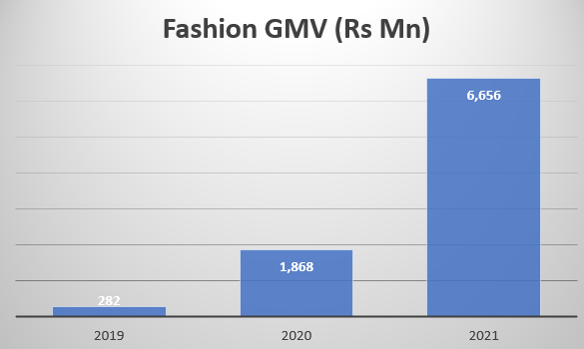
Fashion
Contribution +ve

Slide 18
Repeat + New

Slide 19
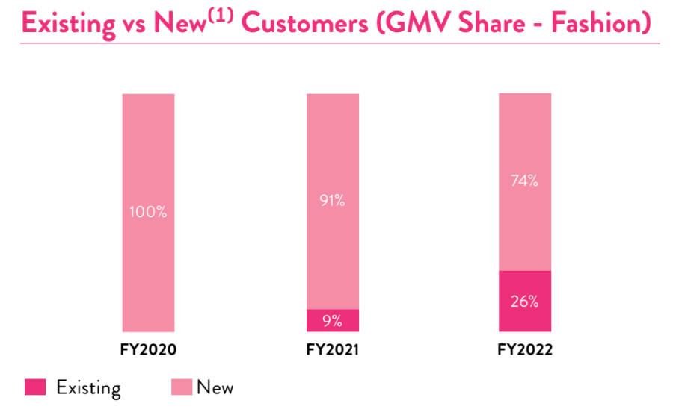

Slide 20
Customer Acquisition

Slide 21
Data Analytics

Slide 22
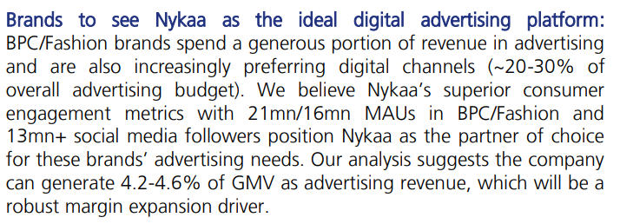
Marketing Support Income- All Flows To Bottomline

Slide 24
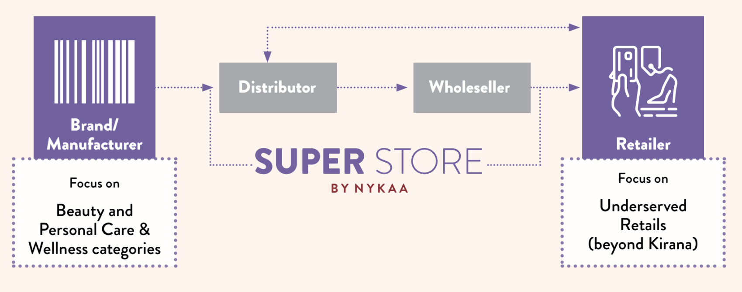
Seeding Optionality- eB2B BPC
Udaan of BPC

Slide 25
Future RoCE Will Be Much Higher…(1/2)
 | 201803 | 201903 | 202003 | 202103
EBIT | -30.29 | -5.03 | 33.81 | 107.63
Capital Employed | 204.64 | 541.03 | 734.72 | 822.63
RoCE | -14.80 | -0.93 | 4.60 | 13.08
Incremental RoCE |  | 7.51 | 20.05 | 83.97
2 Yr Delta Incremental RoCE |  |  | 12.09 | 40.01
3 Yr Delta Incremental RoCE |  |  |  | 22.32
Capitaline, Consolidated

Slide 26
Future RoCE Will Be Much Higher…(2/2)
RoCE = EBIT/CE = EBIT/Rev * Rev/CE = EBIT Margin * CE Turnover
 | 201803 | 201903 | 202003 | 202103
Capital Employed | 204.64 | 541.03 | 734.72 | 822.63
Revenue From Operations | 574.36 | 1111.39 | 1767.53 | 2440.9
CE Turns | 2.81 | 2.05 | 2.41 | 2.97
Incremental CE Turns |  | 1.60 | 3.39 | 7.66
Revenue From Operations | 574.36 | 1111.39 | 1767.53 | 2440.9
EBIT | -30.29 | -5.03 | 33.81 | 107.63
EBIT Margin | -5.27 | -0.45 | 1.91 | 4.41
Incremental EBIT Margin |  | 4.70 | 5.92 | 10.96
Capitaline, Consolidated

Slide 27
Drivers of Higher Incremental Margins
Lower ad spends- more organic over time; Scale economies in RM
1P vs 3P accounting- fashion growing faster than BPC hence accounting margins improve
Marketing support income
Common Size P&L | 201803 (12) | 201903 (12) | 202003 (12) | 202103 (12)
Raw Materials | 75.94 | 70.68 | 67.67 | 62.84
Power & Fuel Cost | 0.10 | 0.19 | 0.26 | 0.18
Employee Cost | 9.56 | 10.55 | 11.07 | 11.62
Other Manufacturing Expenses | 4.75 | 4.33 | 4.00 | 3.54
Selling and Administration Expenses | 24.24 | 22.78 | 21.93 | 15.94
Miscellaneous Expenses | 0.47 | 0.87 | 0.66 | 1.08

Slide 28
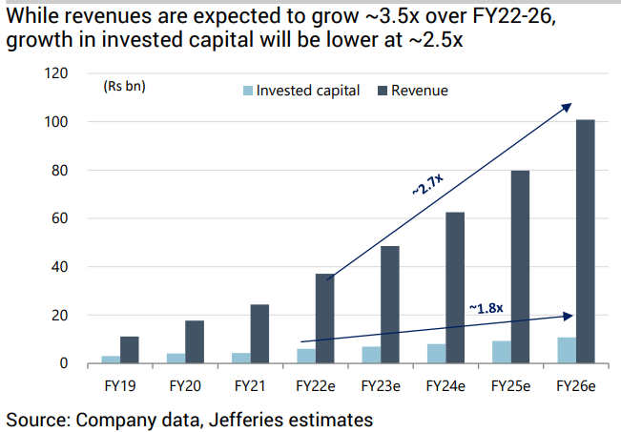
Drivers of Higher Incremental CE Turns
CE in fixed assets (offline stores) has spillover effect for online sales- ‘browse offline, buy online’
More data = Better inventory management
Shift to SOR (sale or return)

Slide 29
Leadership Attributes
Quantitative: 27.5% market share in online BPC in CY 2020; ≈ 41-42% incremental market share (on GMV) in online BPC from CY 2019 to CY 2020; capital efficiency- high valuation to raise
Qualitative: Expanding TAM through adjacencies (B2B BPC, Fashion)

Slide 30
Needle in a Haystack?
High promoter holding
Low amounts of capital raised
Strong unit economics

Slide 31
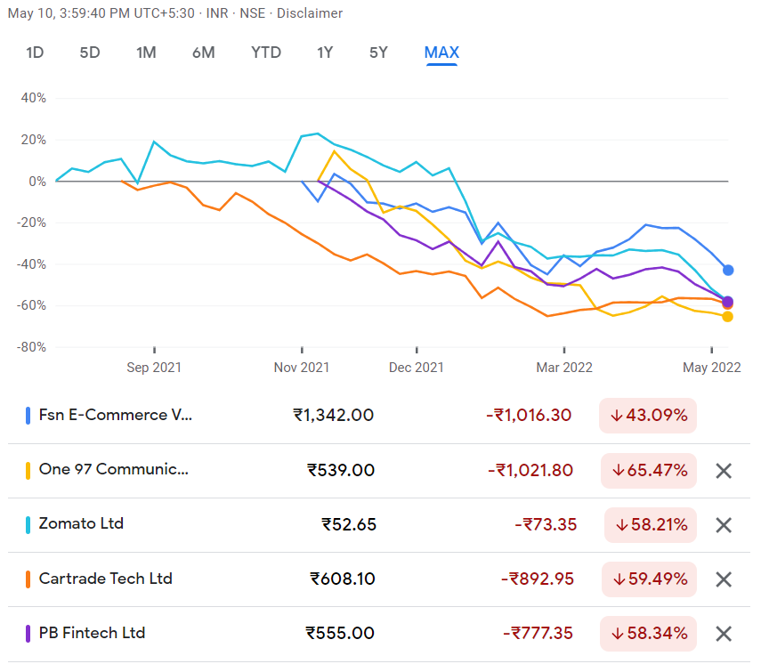
Wisdom of Crowds?
26th MOWCS

