Slide 1
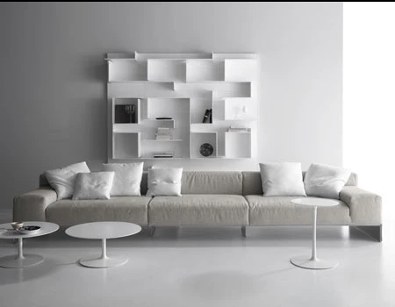
GREENPANEL INDUSTRIES

Slide 2
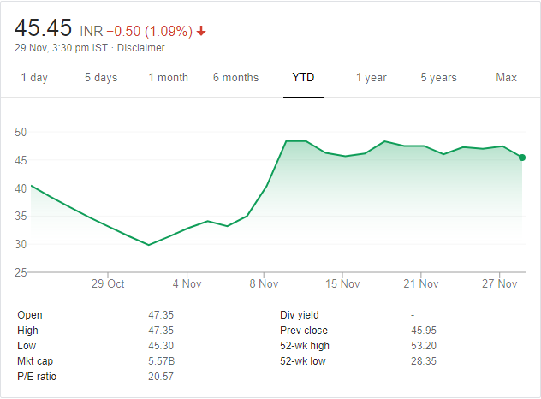
Stock Performance
Listed on 23 Oct 2019 at 40 Rs
CMP - 46
Mcap – 564 cr Net Debt- 567cr( As on 30 Sept)
EV – 1131 cr
52wk High – 53.50
52wk Low – 28.50

Slide 3
Background
Greenpanel Industries recently got demerged from Greenply Industries
Post restructuring, Greenply Ind will focus on the plywood business, while Greenpanel will focus exclusively on MDF.
Greenpanel Ind also got one plywood manufacturing unit in Rudrapur( no growth plans in plywood segment)
Ugly duckling – Low market cap, High Debt, Spinoff selling , Low institutional partnership, Low return ratios, Excess capacity in the industry, Real estate slowdown

Slide 4
MDF(Medium Density Fiberboard)Industry Overview
MDF acts as a substitute for cheap plywood and offers better quality at similar prices.
Not being positioned to replace the use of plywood (Mid and high end segment)
MDF is 55% cheaper than premium and 30% cheaper than the mid segment plywood
Plywood Industry size – 19000 cr growing at 6-7% p.a. out of which approx 5000 cr is low end plywood which is the potential MDF market.
Current MDF market size- 1800 cr growing 18-20% p.a.(despite having slow real estate market) and is expected to grow at 15%+ p.a. for years to come.
Mostly used in the organized furniture market which is estimated to grow at 25%+ p.a.(Engineered wood is one of the primary furniture choices across the world)
India is fourth largest furniture consuming and fifth largest producer globally
80% panel products made globally use MDF compared to 20% in India( rest 80% by plywood)
Superior input-output ratio of 90-95% compared with 60-65% of plywood

Slide 5
MDF(Medium Density Fiberboard)Industry Overview
Superior surface uniformity
Produced from 100% renewable and sustainable wood sourced from agro forestry plantation trees. Trees posses a life cycle of 3-4 years and do not deplete the forest cover(Around 70% plantation is eucalyptus)
MDF industry is entirely organized(High Capex requirement) as compared to plywood(75% unorganized market)
Stricter GST implementation would narrow the price gap between unorganized low quality plywood producers and organized players thus expanding the market size of MDF
Key players: Greenpanel(North and South), Centuryply(North), Rushil Décor(South), Action Tesa(Unlisted)(North)
Current capacity : 1.5mn CBM, current demand: 0.9CBM
Century: 198000 CBM, Action: 510000 CBM, Rushil: 90000 CBM, Green: 540000 CBM
MDF capacity trebled in just three years(0.5 in FY17) coupled with imports

Slide 6
Company Overview
India`s largest wood panel producer, 23% market share
Lowest cost producer in the market
Started MDF in North with 180000 CBM capacity, expanded to South by setting up the largest plant in Asia and 5th largest in the world having capacity of 360000 CBM thus taking total capacity of 540000 CBM
Freight sensitive nature made it unviable to supply from North to South, hence new capacity
Uttrakhand Plant(Pantnagar) : 10.5mn sq meter of plywood
More than 9 years of experience(MDF)
Manufactures plain, Pre-Lam MDF, of plywood, decorative veneers, wood floors doors
Manufacturing units close to raw material sourcing
AP plant is at 80 kms distance from Krishnapatnam port making it suitable for the exports

Slide 7
Company Overview
1250 dealers across India, 16 marketing offices , 6000 Retail points, Employee base 1619
Products: club Grade and HDF and Eco-Lite(MDF), Greenpanel Club Plywood
Unmatched Quality : Rejection rate of less than 1%
Promoter Stake : 51% ( Zero Promoter Pledge)
Export Market: South Korea, Sri Lanka, Nepal, Bangladesh, Malaysia, Qatar, Vietnam, and Middle East
Company was the first to deploy continuous press technology, helping rationalize cost production

Slide 8
Historical MDF Financials
*Revenue and EBITDA fig in crores *Sales Vol in CBM
Realization at FY12 levels due to excess capacity clearly unsustainable

Slide 9
FY20 Financial and Way Forward
In H1 FY20, plywood division did 107 cr Revenue with 14% EBITDA margin
MDF Revenue was 271 cr ,16% EBITDA margin(historical low) with 56% capacity utilization and lowest ever average realization of 19396 Rs/CBM primarily due to higher export mix(Export Realization is approx 12000 vs domestic realization of 22000/23000
Management guidance:
80% capacity utilization in North and 60% in South plant for MDF in FY20 Plywood to contribute around 190 cr Revenue with 13% EBITDA margin which translates to roughly 120 crores of EBITDA for FY 20.
Current debt stands at 567 cr including WC. Debt repayment schedule 80 cr in FY20 followed by 72 cr in FY21 and FY22
Assuming full capacity utilization by FY 22 and higher domestic sales in South in the coming years, company has a potential to clock in 250 cr of EBITDA(including 35cr from plywood segment) implying a valuation of 3.5x EV/EBITDA FY22

Slide 10
Potential Triggers
High earnings growth from operating leverage as capacity utilization ramps up
Debt reduction will add to equity value
Possible implementation of ADD to counter cheap import from South East Asian countries (Expecting by March 2020).Currently the pricing differential between thick MDF and imports is around 10% and thin MDF and imports is around 25%.
More sell side coverage
More Institutional participation once the market cap goes up

Slide 11
Key Risks
Capacity addition by Rushil Décor : 240000 CBM ( Expected by Q1FY21)
Capacity addition by Century Ply : 180000 CBM ( Expected by Q2FY22)
Lower average realization due to Imports in absence of ADD ( Currently, approx 25% demand is served by Imports)
Failure in ramping up the capacity

Slide 12
Disclaimer
This presentation must be used for information purpose only. Not a buy/sell recommendation. Consult your financial advisor before buying/selling the stock.
I am not a SEBI Registered Investment Advisor/Manager

Slide 13
Thank You
You can reach me at : kashishshambhwani@gmail.com
+91 9680828030

