Slide 1
“Personal Finance” Introduction
Version 0.4 - Jan 2021
Compiled by dumb.consultant.me@gmail.com

Slide 2
Disclaimer
I am NOT a certified financial planner and make no claim that content of the presentation is 100% correct
Contents in this presentation are part of the my learnings on my journey to financial freedom. Hence the information in the presentation could be incomplete in many aspects. Information shared in the presentation is for educational awareness only
Do not construe presentation’s contents as investment advice
Objective of presentation is to nudge people towards taking more active interest in their financial well being
Some of the material used in this presentation (images/lines of text, ideas etc.) are borrowed from other websites/sources (under fair use policy for educational purpose). To the best of my knowledge, I have mentioned source of the same on respective slides
Personal Finance is highly “personal” for each individual hence there is no single “right way” of doing it. You have you find what plan works best for your needs
If you find any mistakes or misrepresentation of facts in the presentation or have suggestions for improvement, please drop a email to dumb.consultant.me@gmail.com
If you do not understand personal finance management, it is strongly advised that you take help of good, professional SEBI registered and certified “fee only” financial planners

Slide 3
Layman’s Investment Approach
How much tax I will save?
Am I getting guaranteed returns?
How much returns I will get? Vs what is the risk?
Bitcoin is hot right now let me buy it!
Please give me some share market tips to bet my money
My cousin is an LIC agent, I have bought some good policies from him
My friend suggested me some mutual funds for SIPs, so I have bought them and continuing it
I actively trade in share market
I have some old mutual fund investments, should I book profits?

Slide 4
Some Investment Myths
Mutual funds can give 15%-18% returns per year
To make more money you need to take higher risks
Buy stocks and forget for 10-15 years for bumper returns
Share market has fallen so much it is risky to invest right now
Land and Gold are safest Investments!
Home loan is good as it is helping me save tax every year
Compulsory PF deduction is waste of money, government should allow to invest that money in equities instead

Slide 5
Our Investment Mistakes
Selling profit making stocks and holding on to loss making stocks
Redeeming Provident Fund after changing jobs or for buying depreciating assets like car
Investing all money in single asset class - am invested only in equities because they give superior returns or I don't like stock market risk and hence invest only in guaranteed returns
Every month I save something and invest - I am dong SIPs!!

Slide 6
Why do we want to invest money?
When people are asked what is the purpose of their investment many have no clue or clear picture
When prodded further some give vague answers like “to fulfil future expenses/ live a comfortable life in future/ fulfil my dreams etc.”
But do we now what exactly are future expenses/that comfortable life/your dreams and how much it will cost you financially?
Do we now where do we stand right now on financial well being and how far I need to travel the road to reach my destination?

Slide 7
Goal Based Financial Planning
Goal Based Financial Planning is a systematic way of bringing purpose, clarity and direction to our investments
It helps identify our life goals and tie our investment to the goals
This framework allows us to assess where do we stand right now, help quantify our goals and create a realistic plan to fulfil those goals
It also proposes systematic tracking, monitoring and provides for corrective actions to ensure we minimize downside to our investment and move towards meeting our goals

Slide 8
Step 1: Calculating our “Current” Net worth
It is a snapshot of your financial health as on “date of calculation”
Net worth is the difference between your existing assets and existing liabilities
If your assets are more than your liabilities, your net worth is positive (desirable). If your liabilities are more than your assets then your net worth is negative (situation you want to avoid)
Your Networth is subject to change depending on the increase/decrease in value of your assets and liabilities (which can happen frequently depending on how much of your assets are market linked or depreciating in nature and how much liabilities you take up at different stages n life)
Our long term goal should be to focus on increasing our assets that “appreciate in value”, help generate appropriate “cash flow” and reducing our liabilities

Slide 9
Step 1: Calculating our “Current” Net worth
Assets (What I own):
Cash in hand
Amount in savings account
Amount in Fixed deposits
Other Fixed investments (PPF, NSC, KVP, etc.)
Retirement corpus (PF, Super annuation etc.)#
Bonds and debt funds#
Direct equity#
“investment” component of ULIP insurance#
Real estate properties you own#
Value of gold, silver and jewellery#^
Mutual Funds#
Vehicles@
Other assets
Liabilities (What I owe):
Credit card outstanding
EMI purchase outstanding (phone, TV etc.)
Personal loan outstanding
Gold loan outstanding
Taxes for the year
Car loan outstanding
Education loan outstanding
Housing loan outstanding
Any other loan or liabilities
**Please include both principal and interest outstanding for loans
# current value as on date
^ consider value of jeweller only based on weight and at 18 or 22 carat for gold jewellery
@ Depreciated value as per age of vehicle
Networth = Total Assets – Total Liabilities

Slide 10
Important points to remember on “Net worth”
Please note that Net worth does not necessarily equal to “solvency value” as many asset types are either market linked (shares, mutual funds etc.) or have low liquidity (house properties)
Very important to understand that many of your assets are actually liability of someone else - for e.g. your balance in bank account is liability of the bank, your bond holdings are liability of the company, PF payment is liabilities of the PFRDA etc.
Hence there will always be a residual risk of some of these assets going bad during time of high risks or uncertainties (bank failure, company defaulting on its bond payments, etc.)
Prudent risk management of your assets and liabilities is important part of personal finance
At any point in time, goal should be to have enough short term and medium term fixed assets like cash, bank balance, FDs, liquid funds etc. to cover for your short and medium term liabilities, immediate life goals and emergencies
Avoid online calculators for calculating networth. Preferably use an excel template to document your assets and liabilities status each year (for e.g. at the end of each financial year), take a print out and document it in a file for record

Slide 11
Step 2: Goal Based Financial Planning
Don’t invest with the goal of saving tax / making more money in future / being richer then your relatives or neighbours or trying to beat the market
Do investments so that they can help you comfortably meet all your future life goals, your dreams and commitments
Relying only on risk profile based investment or thumb rules like “Age minus 30” rule of putting money in equity and fixed income instrument like (bonds FDs etc.) is useless
Unless you identify your life goals and align your investment plan to it, you are doing investments randomly and without concrete purpose
Every goal requires money for fulfilment and real risk in investment are:
      Loosing your capital
      Not able to meet your life goals
Buying real estate, mutual funds or doing SIPs etc. without linking it to your goals and without proper asset allocation is like “putting the cart before the horse” or relying too much on hope to help you meet future goals. Relying on “Hope” is not a good strategy
Entire financial industry is here to sell you products that help them meet their targets and earn their bonus – so do not overtly trust them to help you meet your life goals!!

Slide 12
Step 2a: Identify your life goals that need money
Sample Goals (For illustration only):
Basic protection (Goals dictated by life’s uncertainties)
Safety and protection for self & for family -
  Life Insurance
  Health insurance
  Emergency Corpus (to deal with sudden loss of job or income or any other eventuality etc.)
Life stage Goals:
Higher education
Marriage
Buying home
Buying Car
Children’s Education
Retirement Planning
Reducing Debt
Long term Health care costs
Aspirational Goals/Dreams
Buying 2nd home / Farm house
Start own business
Foreign vacations
Foreign education for kids
Financial independence and/or early retirement
Leaving a corpus for next generation
If you do not now where you want to go it doesn't matter which road you take! Please take time to think and write down your life goals!

Slide 13
Step 2b: Categorize & prioritize your life goals
Create a list of all your life goals. Please involve your spouse (if you are married) and / or parents in the discussion. Creating a shared vision of the future with your spouse and Experience of parents will be very valuable inputs
For each goal , determine whether it is “need” or “desire” and what is the priority of that goal for you in life. Not all your goals are of equal importance – decide what is really important for you and what is good to have.
There should not be any compromise on Basic Protection goals and Retirement Corpus. Fulfilment of these goals should be non-negotiable if you and your family want to get “peaceful sleep at night”
Define the target date by when the goal is due or when you want to achieve it
General thumb-rule for timeline categorization of goals - due in next 1- 3 years categorize as “short term”, 4-7 years as “medium term” and 7+ years as “long term”
We need to ensure our goals are SMART : Specific, Measurable, Attainable, Relevant and Time bound

Slide 14
Step 2b: Categorize & prioritize your life goals
Sample output: For illustration purpose only!!!
Goal | Category Need / Desire | Priority | Target date | Horizon (short term/ medium term / long term
Buy term insurance | Need | Non negotiable | On first salary/ immediate | NA
Buy house | Need | 3 | 2027 | Medium term
Buy Car | Desire | 1 | 2023 | Short term
Marriage | Need | 2 | 2024 | Medium term
Foreign vacation | Desire | 5 | 2029 | Long term
Retirement corpus | Need | 4 | 2040 | Long term

Slide 15
Step 2c: Quantify and assess your life goals
Find out how much money is required to meet each goal as of today referred to as “Current Cost of Each Goal”
Now calculate how much money is required to meet each goal by the target date. This is called “Target Corpus”
Use reasonable inflation estimates to calculate how much money will be needed to fulfil that goal by target date
Retirement Corpus goal needs more planning and thought as your life expectancy and other additional variables make calculation complicated
If your income sources do not seem to support all your goals then you need to do either or all of the below things
  Reduce the goals under “desire” category
  Reduce the quantum of your goal. For e.g.
    Is a smaller home enough for my needs (vs big one that might be my desire) ?
    Can do with hatchback car instead of Sedan?
  Push the target date of your goal to a later date
  Work on ways to improve your income in near future that can help u to save more and invest to support your goals
If you have too many goals, realistically check whether you can attain all of them with current and future visible income source. You can always revisit your goals (add/delete/modify) as per change in your income and ability to save more in future

Slide 16
Step 2c: Quantify and assess your life goals
Calculating “Target Corpus” value for each goal
Future cost of goal (Target Corpus)
= Present cost of meeting that goal today * (1 + Rate of Inflation)^ Time
Do not assume a standard rate of inflation for all your goals as inflation is different for different categories
Do not believe inflation numbers reported by Govt. They are at all India level and only factor specific categories which does not truly reflect inflation faced by individuals in real life
As of creating this presentation (subject to change in future) following were suggested thumb rules for inflation values:
  Retirement goal: minimum 6%
  Education goal: minimum 10%
  Life style goal: minimum 10-15% (depending on your life style)
  Other goals: You can also do a bit of research and use the rate at which you think prices will increase
  You can use “Future Value” Function in excel to calculate Target Corpus for each goal

Slide 17
Step 2c: Quantify and assess your life goals
Sample output: For illustration purpose only!!!
Goal | Category Need / Desire | Priority | Target date | Horizon (short term/ medium term / long term | Current cost to meet the goal | Future cost to meet the goal (inflation adjusted cost) - Target Corpus
Buy term insurance | Need | Non negotiable | On first salary/ immediate | NA | 10 k (for 1 cr insurance) | NA
Buy house | Need | 3 | 2027 | Medium term | 20 L for down payment | 28 L
Buy Car | Need | 1 | 2023 | Short term | 2 L for down payment | 2.38 L
Marriage | Need | 2 | 2024 | Medium term | 15 L | 22 L
Foreign vacation | Desire | 5 | 2029 | Long term | 5 L | 7.75 L
Retirement corpus | Need | 4 | 2040 | Long term | 4 Cr | 12.8 Cr

Slide 18
Step 2d: Create investment plan for each goal (1 of 2)
Calculate how much money is required to be saved and invested each month to help you accumulate “Target Corpus” for that goal by the target date
This requires identifying asset class(es) and asset allocation for each goal
Your choice of asset class for each goal will depend on
    Goal horizon (short term/medium term/long term)
    Likely future “rate of return” of each asset class
    Amount of risk you are willing to take with your investment
    Ease of Liquidity of the investment at time of your goal fulfilment
    Taxation
Please ensure you do not fool yourself and put your goals in jeopardy by assuming unrealistically high rate of returns. For e.g. Many Mutual Fund distributors routinely create an impression that you can get up to 15%-18% returns from equity mutual funds, which is not always true. Study shows that long term trend of returns from Indian equity markets are trending downwards.
Please take conservative estimate of “rate of return” especially for long term goals. Even fixed income interest rates have been trending downwards over long term.
Assuming lower rate of return in estimation would force you to invest more or cut down on the target corpus size for that goal. Both options are better than making wrong assumptions at start and regret later!
Higher returns are linked to higher risk, hence do not run after them unnecessarily!

Slide 19
Step 2d: Create investment plan for each goal (2 of 2)
If you are not comfortable with putting money in higher risk asset class like equity but want to stick with debt instruments like FD, PPF etc, then please be prepared to either increase your investment amount or delay the target date for fulfilment of the goal
General guideline for asset bucket depending on goal horizon:
    Short term: Fixed deposits or any other low risk option
    Medium term: Combination of fixed deposits, debt funds and equity (with rebalancing)
    Long term: Multiple choice of asset classes you are comfortable with but ensure equity is a big component of mix (at least to begin with and and has to be rebalanced later)
DO NOT FORGET – your investments will also have tax liability so net amount you will get after tax will be lower. It is always wise to calculate post-tax returns while investing in any financial instrument. Hence please use “post tax returns rate” as a guide for calculating monthly/lump sum investment amount
Use PMT Function in excel to calculate monthly investment amount for your goal:
https://www.livemint.com/money/personal-finance/calculate-the-amount-you-need-to-save-periodically-to-reach-a-goal-1566929654982.html
Other good to know formulae:
https://www.businesstoday.in/magazine/money-today/investment/top-10-financial-calculations/story/231893.html

Slide 20
Step 2d: Create investment plan for each goal
Sample output: For illustration purpose only!!!
Goal | Category Need / Desire | Priority | Target date | Horizon (short term/ medium term / long term | Current cost to meet the goal | Future cost to meet the goal (inflation adjusted cost) Target Corpus | Starting asset allocation plan | Starting monthly savings and investment amount
Buy term insurance | Need | Non negotiable | On first salary/ immediate | NA | 10 k (for 1 cr insurance) | NA | NA | NA
Buy house | Need | 3 | 2027 | Medium term | 20 L for down payment | 28 L | 50% debt 50% equity | Debt: 13453 Equity: 11996
Buy Car | Need | 1 | 2023 | Short term | 2 L for down payment | 2.38 L | 100% debt | 5906
Marriage | Need | 2 | 2024 | Medium term | 15 L | 22 L | 80% debt 20% equity | Debt: 32315 Equity: 7579
Foreign vacation | Desire | 5 | 2029 | Long term | 5 L | 7.75 L | 10% debt 90% equity | Debt: 541 Equity: 4187
Retirement corpus | Need | 4 | 2040 | Long term | 4 Cr | 12.8 Cr | 5% debt 90% equity 5% gold | Debt:14100 Equity:171582 Gold: 13500
 |  |  |  | Total

Slide 21
Step 2: Wrap up
Step 2a, 2b, 2c and 2d while being logical and simple are not going to be easy
“Target corpus” values for long term goals can be really unnerving when you calculate their value for the first time. This is perfectly normal so do not lose your sleep on this right now
It will require your time and attention and multiple attempts before you come up with a reasonable plan that suits you. It is perfectly normal to take 4-5 iterations to arrive at a realistic plan
If you are married please involve your souse in the exercise
Please make realistic assumptions on inflation when calculating future cost of the goal. Inflation rate is different for different things for e.g. for food 6% inflation is alright but for education inflation rate is 10%+ . For life style related goals inflation could be even higher at 15%+
Realisation of your current financial situation and the fact that some of the aspirational life goals may remain on paper is some times heart breaking/depressing or can be motivating to push you towards finding additional sources of income (depending on your thought process)
Depending on your life stage and existing investments you have already made you will have to map them and reconcile to the plan to get an idea of where do you stand right now and whether you need more investments in some of the goals
Excellent articles on goal based financial planning, how to identify, document, categorize, prioritize and plan financial goals:
https://stableinvestor.com/2017/05/financial-goals.html
https://stableinvestor.com/2017/01/financial-planning-goal-based-investing.html
https://proactiveadvisormagazine.com/goals-based-investing/

Slide 22
Asset Class Options (illustrative)
Sr. No | Asset Class | Snapshot of available options
1 | Debt | Bank Fixed Deposit, Company Fixed Deposits, NCDs, Senior Citizen Saving Schemes,EPF, VPF, PPF, Gilts, RBI bonds etc. Overnight Funds, Liquid Funds, Ultra Short Term Funds, Money Market Instruments, Dynamic Bond Fund, Credit Risk Funds, Fixed Maturity Plans (FMP) etc.
2 | Equity | Direct equity, Mutual Funds, ELSS, Arbitrage Funds, ETFs etc. Within MFs plethora of ever evolving and many times confusing options – Large cap, Mid cap, Small cap, Multi cap, Flexi cap, Balanced funds, Sectoral Funds, etc.
3 | Gold | Physical Gold, SGB, Gold ETF, Digital Gold etc.
4 | Real Estate | Land holdings, Row houses, Apartments, REITs etc.
5 | Alternate Investment Funds | REITs, Infra ITs, Private Equity (PE), Hedge Funds etc.
6 | Others | Art, Antiques etc.
** This is just a snapshot of the available options. Please do your own study on complete list of options.

Slide 23
Selecting Asset Class - Guidelines
  Your choice of asset class and the corresponding product has to be driven primarily by your Goals. Each investment has to be guided by and linked to your respective goals
  DO NOT INVEST IN ANY ASSET CLASS PRODUCT YOU DO NOT UNDERSTAND. AVOID COMPLEX PRODUCTS
  DO NOT BELIEVE SALES PITCH OF SALES MAN. PLEASE DO YOUR OWN DUE DILIGENCE BEFORE YOU COMMIT YOUR HARD EARNED MONEY!!
  No Investment is free of risk (including Govt bonds and Fixed deposits).
  In chasing higher returns, you set yourself up for higher risks!
  General purpose asset and product selection guidelines (in that order):
    Goal horizon (short term/medium term/long term)
    Likely future “rate of return” of each asset class
    Amount of risk you are willing to take with your investment
    Ease of Liquidity of the investment at time of your goal fulfilment
    Taxation on that product
  All things being equal, applicable taxation should be one of the last criteria in evaluating competing products , not the first one!!
  Please understand that Tax can be applied or exempted at 3 levels:
    When you invest the money
    The periodic returns you earn on your money (for e.g. interest, dividend, rent income etc.)
    When you encash the investment (in the form of capital gains)
  Please understand all these aspects before you make decision. Return rate in your calculation should be post tax returns

Slide 24
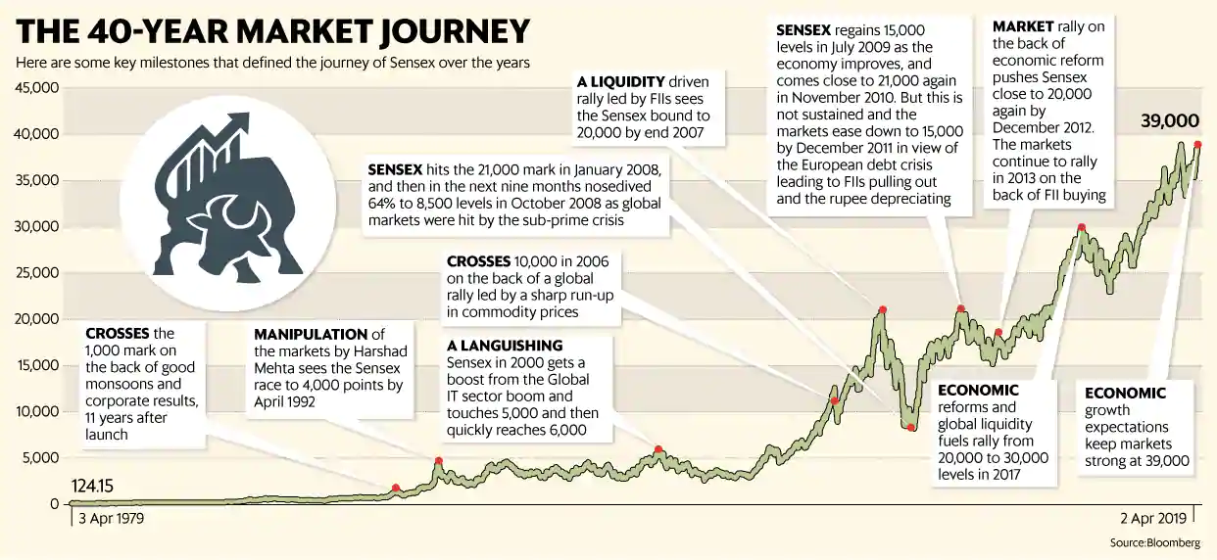
Investing in Equity – a tale of two graphs (1/2)
Source: https://www.livemint.com/market/stock-market-news/sensex-s-roller-coaster-history-from-100-to-39-000-1554225243494.html
Long term equity market always goes up and hence is the best investment. Let me to put all my money in equities !!!

Slide 25
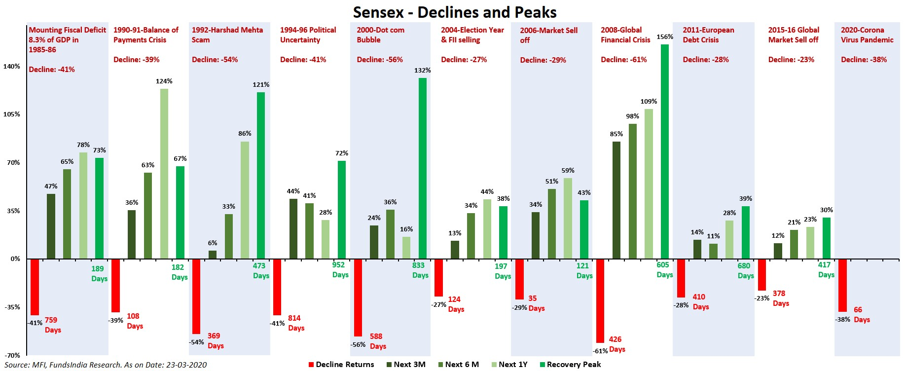
Investing in Equity – a tale of two graphs (2/2)
Source: https://www.fundsindia.com/blog/mf-research/what-will-happen-to-markets-your-maths-teacher-has-the-answer/18213/attachment/sensex-thru-history
Returns from equity market are unpredictable in short run. They can continue to give low or negative returns for extended period of time And f your goal target date falls during this phase you can loose up to 50% of your target corpus value during market crash and hence will have to compromise on your goal!!! This is known as “Sequence Risk”

Slide 26
Focusing on Risk vs Return
What will you do if you need to withdraw money when stock market is at the bottom?
Returns are not linear but lumped....poor in some years, average in some years and good or exceptionable in some years
As an average retail investor you cannot “time” the market every time
Even if you time your entry, returns are not in your control as they are decided by market participants and external factors out of your control
You can only focus on “target corpus” value and increase/decrease your investments accordingly

Slide 27
Step 3: Periodic Monitoring and Rebalancing (1 of 3)
Investments will rarely follow the target line due to variety of factors (change in interest rate, market performance of equity etc.).
Only solution available to overcome this problem is periodic monitoring and rebalancing as required

Slide 28
Step 3: Periodic Monitoring and Rebalancing (2 of 3)
Flight path towards target goal corpus (illustrative)
As we progress towards our goal, we should start reducing exposure of the investment in volatile asset classes like equity
Periodically moving small portion of investment to debt through “rebalancing” and changing our investment asset allocation mix is important as we progress to our goal
This is critical if we want to guarantee the target corpus money on the date of fulfilment of the goal

Slide 29
Step 3: Periodic Monitoring and Rebalancing (3 of 3)
Just because we have made investments as per plan does not mean we will get results as per our original plan
Hence it is a good practice to periodically monitor progress of our investments and check status of actual flight path to our target goal
Multiple factors like interest rate movement, volatility in equity market returns, inflation, currency devaluation, tax law change, your income tax slab change etc. all will impact how much our investments are earning and whether they are on track to meet your “target corpus” value
Our primary goal and focus should be to ensure we reach our “target corpus” value despite all these surprises!
Hence it is critical that we rebalance the investment between debt/equity and other asset class whenever any asset class outperforms for e.g. if due to boom in equity we get higher returns from equity part of the corpus, we should book some gains and move it to debt side. Our goal should be to ensure we reach the “Target Corpus” value for each goal as we move towards it.
Periodic rebalancing also helps us avoid “sequence risk” in equity markets i.e. not leaving your corpus value to complete mercy of equity markets. You may have done fantastically well in saving and investing money and are on track for reaching your target corpus value. However if 1 or 2 years before your goal target date a market crash happens, your corpus can come down by up to 40%-50% and then you will have no option but to exit at lower value or push your goal fulfilment date to future when positive market will increase value of your corpus or remove money from elsewhere to compensate for the reduction in target value!!
Hence as we progress towards our goal, it is important we periodically move small amounts of money to fixed income instruments. Ideally by the date of our goal fulfilment our entire corpus for that goal should ideally be into fixed income asset (retirement corpus could be an exception to some degree)!! This will guarantee goal fulfilment as per plan!
https://primeinvestor.in/how-to-rebalance-your-portfolio/
https://freefincal.com/how-suhas-tracks-his-mf-investments-and-reviews-financial-goals/

Slide 30
Focusing on Budget vs Investments
Meticulously planning your monthly budget and tracking it is a good habit to know how and where you are spending and where you can save
However it is often cumbersome, difficult to follow and has diminishing returns beyond a point
Alternative is to focus on how much you can save and invest each month – the more you invest more you will be forced to automatically cut down on unwanted expenses

Slide 31
Know what you (don’t) control
Future Value = Present Value * (1 + Rate of Return)^ Time
Below 3 variables determine your Future Value of your money
1) Present Value – how much you invest
2) Rate of Return – dictated by Market forces (equities, MFs, Land, Gold etc. Or by RBI (FD interest rates) or Govt (PF, small savings scheme etc.)
3) Time horizon for which you invest
Most of us “focus” on estimating “returns” when making our investment decisions, which ironically is out of our control!!!
What we should be focusing on instead is “how much we can invest” and for “how long we can stay invested”

Slide 32
Value of Time in Investments
If you want to grow your money 10x:
in 7 years you need 40% annual returns on your investment
In 9 years you need 30% annual returns on your investment
In 17 years you need 15% annual returns on your investment
For getting very higher returns, investors often chase risky products which may or may not give returns but also can result in loss of capital. Sensible option is to start early, take lower risk and give your investments enough time to grow

Slide 33
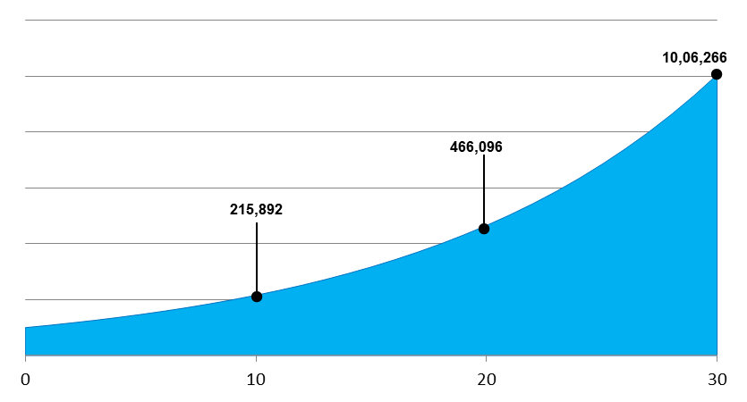
Value of Time in investments - Magic of CAGR
1 Lakh invested in year 1 for 8% compound interest rate gives
Only 2.16L in first 10 years
Reasonably good 4.66 L in 20 years
Excellent 10L in 30 years
Benefits of compounding grow exponentially over longer horizons
  Invest as early as possible
  Stay invested
  Keep doing incremental investment no matter how small, it all adds up in long run
Source: https://www.moneyworks4me.com/investmentshastra/how-the-magic-of-compounding-works/

Slide 34
Wealth is what you don’t see!
Consider two individuals A & B - A earns 1L/month and B earns 50K/month who is wealthy between the two?
If you answered A you may be wrong. To correctly answer the above question we need to now what are the expenses of A & B every month. For e.g.
    A earns 1L and his/her expenses are 80k. Hence A has 20K/month left to save and invest
    B earns 50K and his/her expenses are 20K. Hence B has 30K/month left to save and invest
Now we can confidently answer that B is more wealthy then A!
How much you earn is not as important as how much you can save each month. Your savings and investment rate will determine how much wealth you can create for yourself and your family
Someone living in a large house, driving expensive car, having the latest gadgets, flaunting an expensive lifestyle is not necessarily rich or wealthy. In fact that person is giving away his/her hard earned money to others. Splurging money on depreciating items is a sure shot way of remaining forever dependent on your next salary!
Worse, if that life style is financed through debt (like credit cards, EMIs etc.) is a sure shot of way of getting trapped into the debt bubble and remain in negative net worth!
Remember Warren Buffett says — ‘If you are buying things that you don't need today, soon you will have to sell things you need.’
300Cr expenses on children’s marriage for Ambani is not even 0.003% of his net worth. But that lavish wedding of 1Cr+ for yourself can become problematic if it is 30%-40% of net worth! Live within your means!!
Entire world out there is desperate to sell you their products and services. DO NOT get brainwashed into believing you need anything and everything latest and greatest. Understand what you “need”, not what you “want”
Money not spent today is money saved and can be invested towards your life goals that truly matter in the long run!
There is no harm in spending on things you like, but make sure you have earned and provisioned for all your main life goals before that

Slide 35
Emergency Corpus
Minimum 6 months of expenses (if both members are earning) or up to 12 months of expenses if only 1 member is earning. Your expenses calculation should also include ongoing EMI payment component
Spread your emergency corpus across Cash in hand (up to 1 month expense), FD in banks (ideally two different banks), money in liquid funds and some nominal gold coin/silver bars at home
Ensure FDs and liquid funds investment is in joint holding format only (either or survivor mode). This is to ensure that if something happens to one member another member can withdraw the amount and attend to emergency without hassles
Credit card is another useful option in some emergency situations (for e.g. if hospitalisation is required and hospital is not offering cashless option)
Emergency Fund is not just for “job loss” scenario but also range of other unforeseen circumstances like accident or sudden loss of loved one, health emergency, times of social unrest or government induced problems, bank going under etc.

Slide 36
Mutual Funds
Rampant mis-selling is a reality, avoid falling for the trap of Mutual Fund suggestions or any other financial products from banks or distributors. Buying from them will make them rich, not necessarily you. They get huge commissions on these funds
Returns from mutual funds are never guaranteed or linear in nature. Hence do not assume your Mutual fund investments will grow every year. There will be periods of good performance, bad performance, average performance and even no performance!!
In any given year 50% of mutual funds will give lower returns then index (Sensex/Nifty/ any other index they are benchmarked against). This is statistical fact! If your mutual funds are underperforming for a considerable period of time, please take a hard re-look if you want to switch to a better fund (please take professional advice if you do not understand this area)
Using CAGR formula to calculate total returns from mutual funds is misleading if you are investing in them through SIPs or you do multiple investments over a time horizon. Please use XIRR (average internal rate of return) to calculate the returns
Investment in SIPs help reduce market volatility risk only when investment corpus size is relatively small. As As your SIP corpus grows big, that logic does not hold true
Industry performance payment is not linked to returns of your portfolio....it is linked to how much Asset Under Management (AUM) i.e. people’s money they have been able to accumulate under that scheme
Whether your portfolio grows or not, fund house and distributors will continue to make money in the form of administrative charges and trail commissions every month, even if your investment is in negative. Hence it is better to invest in mutual funds in “direct” category
Relying only on investments in mutual funds or direct equities to meet your financial goals exposes you to “Sequence Risk”. Hence “Asset Allocation” and periodic “Rebalancing” is very important
Mutual fund mis-selling: https://www.moneylife.in/article/how-to-find-your-way-through-the-mutual-fund-maze/62514.html

Slide 37

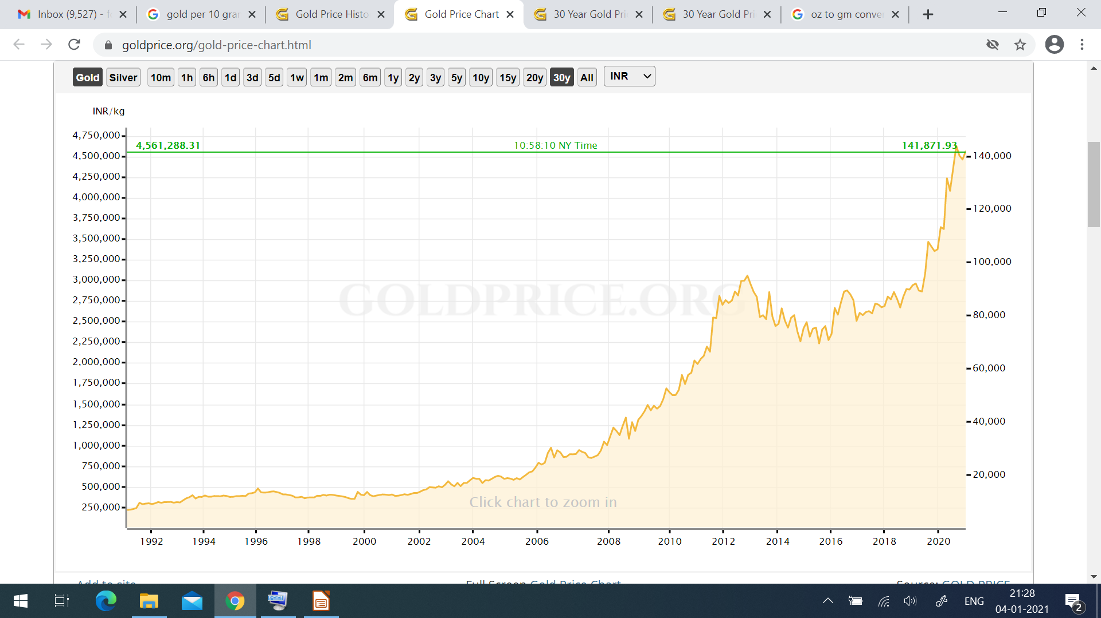
Gold – Tale of two charts
Source: https://goldprice.org/30-year-gold-price-history.html
Even though Gold s a global commodity and considered as hedge against inflation, returns from Gold in USA (left chart) have been far lower than returns from Gold in India. One of the big reasons for this is the devaluation of Indian currency against USD

Slide 38
Investment in Gold – viewpoints (1 of 2)
Gold is considered reserve currency of the world because it provides independence from financial world and also from Governments!!
To that extent, investment n gold should be done to the extent of hedging your portfolio volatility risks (anywhere from 5% to 15%)
Gold does not generate cash flow and brings its own risks, so suggest not to go overboard on gold
Jewellery is strict NO if you are buying it for investment - Big Yes if you want to make your wife happy.
Jewellery is made from 18-20 carat gold and has other alloys added hence purity is low. In addition, making charges of Jewellery is very high (8%-25% of gold weight)
Gold purity in Jewellery from local market is highly suspect. Please go for hallmarking even if your jeweller tries to talk you out of it.
when you sell jewellery you will only get money for weight and purity of gold in the jewellery...so you are already losing money you paid for making charges. Breaking old jewellery and get new one created against it is even bigger problem - your existing jewellery is measured only on weight (money you paid as design charges is sunk cost) and new jewellery you are charged for gold design again. In addition not to forget the gold gram-mage reduction claimed by jewellers as wastage. Buying jewellery is an emotional investment, not financial investment!!!
If you want Gold as investment, go for gold coins/gold bars from top refineries only.

Slide 39
Investment in Gold – viewpoints (2 of 2)
SGB sold by RBI is not gold but bond linked to price of gold. It is the only Gold product that also gives 2.5% interest per annum (taxable)
Buying Gold through ETFs is another option that offers easy liquidity, but has its own overhead costs
Digital gold options are now a days available from different vendors that allow purchase and storage of gold in central vaults managed by them. Please read about terms and conditions to thoroughly understand them before investing your money. As of the date of creation of this presentation, there was no legal framework available to deal with disputes/challenges in digital gold purchase
Putting gold in locker is not as safe as you think - most banks insure only up to 1L worth of your goods in the locker. So tomorrow if the bank branch gets robbed or your locker is found broken into, bank will only pay you 1L (irrespective of the value of your locker contents)
In summary, investment in Gold is more suitable for
  Safety and emergency use instead of active investment option
  Provides independence from Govt (Think Demonetization) and Financial system (Bank failures, crisis of 2008) or uncertainty (corona crisis etc.)
  Gold does not produce any cash flow or regular income (SGB is exception to this, but returns are very small and taxable). Gold price depends upon various factors out of our control
  Hence do not go overboard with gold investments, but keep it in portfolio as part of overall asset mix for diversification and hedging

Slide 40
Life Insurance (1 of 2)
Insurance is purely a hedge against loss of life of earning member of family. Please DO NOT mix it with investment!!!
DO NOT fall for the “lollipop of guaranteed money”. ULIP policies give really poor returns when you factor in impact of insurance and calculate XIRR. ULIP policies only make insurance agents rich, not you!
Do not fall for the marketing gimmick of Term Insurance with “return of money” or term insurance with upfront payment.
They are fooling people by asking higher premium (by taking more money from you so that they can give it back to you through the lollipop of “money back”) and the money you will get back at the end of policy would be worthless as it would have lost its purchasing power due to inflation over 20/30 years.
Stick to plain vanila Term Life Insurance that provides for “sufficient” cover for your family expenses if something were to happen to you. If you are not able to calculate sufficient cover, please take help of certified financial advisor (do not fall for the number thrown to you by insurance company agent!!)
Do NOT get fixed on numbers like “1 Crore insurance”. Your insurance cover should be dictated by your all liabilities and family’s future life requirements (living expense, children's education etc.)

Slide 41
Life Insurance (2 of 2)
Do not lie about your existing health ailment or family history when applying for insurance. It can come back to bite your family in the future if insurance company manages to find out these details at the time of claim. You will not be around to fight with them at the time of claim, so remember that!
Do not go for Term insurance beyond your retirement age! You will be simply wasting money on premiums
Buying insurance online or through agent is a personal choice. Some agents are better than many others. Go for agents only if you believe you trust them and they will be around to hand hold your family and help them in claim process if something happens with you
Do not depend “only” on Term insurance to save your family from the unfortunate even of your loss of life – claim may or may not be honoured So please work on building a financial corpus as well that they can fall back on!
Ensure family is well aware of your life insurance polices and the claim process - especially if you have brought the policy online
Excellent article on things to know before buying term policy: https://freefincal.com/what-you-need-to-know-before-buying-term-insurance/
Excellent free e-book from Melvin Joseph (one of India first SEBI registered investment advisors) to understand life insurance nuances and select a policy: https://finvin.in/wp-content/uploads/2020/05/Life-Insurance.pdf

Slide 42
Health Insurance
Average life expectancy in India has gone up over past decades. So is the fact that there is explosion of life style diseases. Correspondingly, Healthcare costs have also exploded in India
This creates a triple whammy for average citizen like us
Most of us would have a health cover as part of our employment. However many of us are not aware of the policy details, extent of policy coverage and its suitability to our needs, and what is the process to avail it in case of emergency
Policy cover provided by our employer may or may not cover all our health care needs (current or future). Also, employee health cover lapses when we resign and have not yet joined another employee. Worse if we lose our job suddenly, the health cover also stops
If any health related emergency comes up during this period (job transition time or during job loss), we will be exposed to very high costs that can wipe away our years of hard earned savings
Hence it is important that we opt for a personal health insurance cover. However just buying a standard cover with arbitrary coverage like 5L or 10L may not help us unless we understand our health care needs, policy coverage, exclusions etc. requires dedicate time and attention as there are lot of parameters to factor in
This excellent free ebook from, Melvin Joseph (one of India first SEBI registered investment advisors) serves as a perfect guide to understand health insurance nuances and select the right insurance policy that meets your requirement: https://finvin.in/wp-content/uploads/2020/05/Health-Insurance.pdf

Slide 43
Home Loans (1 of 3)
Interest rate on Home loans in India is dependent on one of the 4 benchmark rates :
  Prime Lending Rate (PLR),
  Base Rate,
  Marginal Cost of funds (MCLR)
  Repo Rate
Repo rate is the latest one and better compared to other benchmark rates
Older home loans may be still on PLR /Base Rate/MCLR which DO NOT give very good rate transmission - meaning when RBI reduces interest rates, banks may not reduce your rates immediately and/or proportionately (though they will increase them immediately if RBI increases rates). Hence check with your home loan vendor and shift to “Repo Rate” benchmark as soon as possible
If you intend to buy home insurance get it separately - Sales people try and bundle it with your home loan and payment for the same is also amortized over the home loan period!!! which means you keep paying much more then actual price of insurance
Don't fall for the sales hubris saying you have to buy home loan insurance compulsorily from the loan provider. Sales may say it is mandatory but it is not. You can always push back and say you will complain to RBI
If you have a sufficiently high Term insurance cover that can also take care of home loan aspect if something were to happen to you then you can avoid taking separate home loan
https://www.cnbctv18.com/personal-finance/plr-base-rate-mclr-and-now-rllr-repo-rate-linked-lending-rate-3722521.htm

Slide 44
Home Loans (2 of 3)
If you can afford higher EMI, please opt for a lower loan tenure right at the start. Bank will always push for longer loan tenures as it helps them earn significantly higher interest income from you
Many well educated people in India have no idea of what their interest rate is or how much actual tax savings they are getting from home loan. They routinely make statements that am saving tax on home loans....yes but how much??
Principal outstanding payment tax benefit is counted within 1.5 L bucket of 80C (which also has your PF, Insurance PPF/ELSS and many more)...so you are hardly saving tax on that! And tax relief on interest paid is limited to 2L / year... .With high value home loans of 50L- 1Cr the interest paid in initial years is so high that these 2 L exemption can look insignificant (unless you have joint loan) !!!
Don't fall for pre EMI start directly with EMI
Periodically keep checking & comparing your existing home loan rate with rates being offered n the market. F there s difference bigger than 0.5 %, please investigate if you want to negotiate better rate with your existing home loan provider or shift to a competitor This will require some calculation and due diligence on your part. Most existing home loan providers now allow for periodic Interest rate reset if you pay a small fee. Negotiate shamelessly on the money they ask you to pay for interest rate reset.

Slide 45
Home Loans (3 of 3)
Always remember these points:
  Banks love to earn interest from you and hence they always try to collect maximum interest amount from you in the first few years. Generally the EMI paid by you in first year goes towards 95% interest payment and only 5% principal payment. This ratio of interest vs principal component of your home loan payment gradually goes towards equilibrium by the middle of your home loan tenure (i.e. your EM payment will go towards 50% interest reduction and 50% principal reduction)
  Interest on your home loan is calculated on outstanding of principal amount. Higher the outstanding principal amount, higher is the interest you pay!
Any amount you pay as prepayments is directly adjusted (reduced) against your principal outstanding – which means with prepayment you are not only reducing principal outstanding but also the interest on principal outstanding for free!!!
If you have higher cash flow each month beyond your expenses and basic investment needs t s highly recommended that you check if you want to pre-pay your home loan. Home loan prepayment at the early part of your loan tenure (typically first 3-6 years) can help you save very large amount of money that you would have otherwise paid to bank as interest
Very important : When you do interest rate reset and/or prepayment always always always ensure you ask the bank to reduce your loan term (i.e. keep the EMI amount same and reduce the duration). By default bank will push for reduction in EMI and keeping the term same. This is because longer the term of the loan higher is the interest income they earn from you!
There is no real benefit in pre payment of home loan towards last 2-3 years. Bank has already earned all interest from you and hence you will not get any benefit by closing the loan in the last 2-3 years

Slide 46
Retirement Planing (1 of 2)
Retirement planning should start on the very day you start earning. If you have not done it, you are already too late and have a significant amount of work to do to catch up
Inflation, life style costs and healthcare costs are growing each day and living a good life during retirement is going to cost a lot of money
Unfortunately, at that time you will not have a regular source of money like salary to take care of you and your spouse
Traditional social insurance i.e. - parents investing in kids throughout their life and hoping kids will take care of parents in retirement and old age is breaking down in India. Hence Hoping your kids will take care of you is not a very reliable strategy
Also, with rapid change in technology landscape many of us will find our skills to be outdated and will either take early retirement or forced into early retirement. There are already discussions on multiple forums of real retirement age shifting to 50 yrs for various job roles
This is double whammy as we get less time to earn (10 yrs less) and will need larger retirement corpus to see us through a longer period of life (10 yrs more) when we may not have active sources of income to see us through the twilight of our life
Traditional sources of retirement savings like PF, PPF etc. cannot be relied upon as the only source of retirement corpus. Rising inflation is already reducing purchasing power of money. Hence we all have to also invest in higher risk assets like equity if we want to ensure our corpus is protected from inflation

Slide 47
Retirement Planing (2 of 2)
Start saving and investing from day 1 for retirement corpus. If you start early, you can reap the benefits of compounding over longer time horizon. Remember compounding returns grow exponentially as time duration increases!!
Do not set arbitary goals like 1 Cr retirement corpus. It may sound a big number today, but if your retirement is decades away then 1 Cr at the time of retirement will be very small amount to cover your retirement expense!!
Please give good thought and consideration in calculating your retirement corpus requirements. Please consider at least 6% inflation rate for retirement corpus calculations. If you are used to higher life style, please use a higher rate
As a thumb rule, please save and invest a minimum of your current living expenses in retirement corpus. So if in current year you are spending 2 L on basic living expenses, please ensure you contribute at a minimum the same amount to retirement corpus. If you can do higher contribution, even better!!
Do not over estimate returns like 15-18 %when calculating your retirement corpus. Take conservative estimate of 10% to keep it real
DO NOT touch the money in your retirement corpus throughout your life unless you are in real difficult situation and do not have recourse to any other source of money. Withdrawal of PF funds or redeeming retirement focused MFs to buy a car or a fancy gadget is criminal sin in the world of financial planning!!
There are multiple retirement products available like EPF, PPF, VPF, NPS, ELSS, Direct Equity, Superannuation funds, regular income plans etc. Please do your due diligence before investing your money on any product
Do not get fooled by products which claim to give you amounts like 50,000 per month during retirement. If your retirement is more than 15+ years away, then 50,000 will be a paltry amount to cover your life expenses in retirement!! Please do your calculations on time value of money and inflation impact!!
It is critical that we build passive sources of income that will generate cash as we reach retirement age. This can act as secondary source of income to supplement the retirement corpus

Slide 48
Risk Management
Risk is not knowing what you are doing
Risk is different for each asset class. No asset class (including your money in bank or Govt bonds) is without risk! Once you understand the degree of risk and its potential impact on your goals, you can take a judgemental call
Investing in equity markets is risky, but not doing so is even riskier because of the long term negative impact of inflation on your savings
Do not assume something is low risk or high risk just because some vague article on news portals say so. Do your own due diligence (read the fine print of the product)!
Reading those boring prospectus or offer documents are boring but worth it if you want to keep your money and investment safe. Alternatively you can always consult a certified financial advisor

Slide 49
Importance of joint accounts, nominations and will
If a family member passes away, current process to close their accounts and withdraw money or investments is really painful
This becomes critical if the spouse passes away or worse if both parents pass away
To the extent possible ensure you have joint accounts for key investments. There are different options available in joint accounts. From emergency perspective “Ether or survivor” is better suited option among available joint account options. Please learn more about them and find out which option works best for you.
Nomination for every bank account, Bank FDs, Bank locker (yes separate nomination is required) and ALL investments (including retirement funds) is next critical step
Creaton of Will is also extremely critical especially around retirement age unless you want to leave open the potential of future problem of dispute on your property
You may have made great investments and wealth but if that is not accessible to your loved ones when they need it, it is of no use!

Slide 50
Life book
Document your Financial investment in “Life book”, print it and update it in a file every six months to a year
Minimum details should be included refer templates or create your own
Should have all required details for your spouse or children (when they grow up) to know your investments and keep track of it
In digital world it is critical as there are no financial account statements available
Investments are spread across banks, locker, mutual funds, demat, physical holdings etc.
Track periodically and audit once in 6 months or a year
Do joint audit with your spouse. Mark one day in a year on your calendar, call it “financial date” and treat it sacrosanct
Important don't keep life book in digital format only...please take a printout and keep details in file in a place that your spouse/family members are aware of. Laptops and phones or online storage all have passwords. If something happens to you no one will be able to access the details.
You may have made great investments and wealth but if that is not accessible to your loved ones when they need it, its worthless. So please take this seriously!!
Sample Template link: https://www.bemoneyaware.com/blog/money-book-finances-record/

Slide 51
Tracking and protecting your finances
Investments are spread across banks, locker, mutual funds, demat, physical holdings etc.
In digital world it is critical to track your finances as there is no single financial statement of account available that gives you a complete picture
Track periodically and audit once in a year. Do joint audit with your spouse. Mark one day in a year on your calendar, call it “financial date” and treat it sacrosanct
Electronic Consolidated account statements (e CAS) is published by NSDL and CDSL (as per SEBI mandate) over email once every month (if you have active transactions) or once every months. You can also get details from their website.
It contains all your investments across demat account and ALL mutual funds. Also has recent transaction history, information on how much returns each MF has delivered, whether MF has nominations etc.
New age platforms also give some of these options including to track your life goals and progress against them (available in MFUonline, Kuvera, Groww and others )
Mutual funds that are struggling for considerable time 2 year plus should be reviewed for potential switch
If you are in direct equity investment, please make sure you get rid of your loss making shares and ride the profit making ones (retail investors do the exact opposite...don't make that mistake)
Use average internal rate of return (XIRR) method to measure performance of investments that are done over time...for example accumulation of shares at different time periods, Mutual Funds and SIPs
Tracking progress against the goal is most important ..dont lose sight of that

Slide 52
Protect Yourself from Fraud (1 of 2)
Don't blindly sign on papers given by agents. You have no idea for what purpose it might be used!
Data protection and data privacy are a joke in India. So don’t blindly share your sensitive details like Aadhar, PAN, Account details etc. over whatsapp/email to agents. You have no idea where it will get forwarded and used without your knowledge
Do not believe any phone calls or sms asking you for sensitive details on the pretext of helping you ‘unblock’ your account/card or offering to give you money or any other pressure tactics. In matter of finance, deal only and only with bank/company officials even if that means a physical visit to branch
Attest carbon copies of your sensitive documents only after mentioning the purpose and the date so that you reduce chances of misuse
If you care to check the default maximum transaction values on your cards/accounts transfer/online purchase etc., they are often in excess of your requirement (some times even Lakhs/per transaction/day!)
Put limits on maximum transaction on your debit and credit cards and online transfers and online purchase transactions. This will limit potential downside if your cards and accounts get compromised.
If you have multiple credit cards, try and reduce them to 2. You may not be able to monitor or use all the cards and any fraud on non-monitored card can adversely impact your credit score

Slide 53
Protect Yourself from Fraud (2 of 2)
Disable international card usage on your debit/credit cards if you are not a frequent traveller
Disable third party transfer of funds through net banking for accounts where it is not needed..for e.g. if parents are not tech savvy and don't use online transfer please disable it
If you are still using magnetic tape based cards, please ask the bank to replace it with chip and pin card
Monitor bank accounts, mutual fund accounts and Demat etc. Regularly. Even ensure you check contents of your bank safe deposit locker at least once a year. Please ensure you also have complete inventory of stuff you have stored in locker that you can verify once a year
Anything suspicious in your accounts, please raise it immediately with banks or fund houses
Fraudsters are getting smarter every day and continue to invest new techniques in social engineering. As a simple rule, DO NOT share any sensitive data on any incoming phone calls (no matter what the calling number is or who the caller claims to be). Always update required information in your net banking account or visit the branch in person.
Do NOT google bank customer care numbers. Google results can be gamed. Always go to the website of the bank and find customer care numbers from there to call them

Slide 54
Yogic Wealth – Wealth beyond finances
In his book “Yogic Wealth”, author Gaurav Mashruwala tries to share very valuable wisdom and as given to us by our scriptures.
As per the book, our scriptures talk about four types of wealth:
    Physical wealth ( our physical health)
    Social Wealth (relationship with spouse, family, friends, acquaintances and society in general)
    Emotional Wealth
    Financial Wealth
When all the above are in harmony, is when we will have a blissful life!
Financial wealth is of no use if any of the other 3 dimensions of wealth are out of sync, hence in focusing on financial wealth, let us not lose focus on the other 3 categories of wealth
Let us pledge to ensure we earn wealth ethically, through right means and give it the due respect and focus
Wanting to become wealthy is not a crime, but using non-ethical means to reach there is!
As per our scriptures, it is said that “Ma Lakshmi is Chanchal” meaning she can change her mind anytime and leave us if we do not respect her blessings
So let us not get overtly arrogant of our wealth or get consumed by it. Let us not link our wealth to our status or our ego or let it rule our thoughts and actions
Hunger for wealth will make us beggars, respect for wealth will make us worshippers!
Always learn to give back to society in your capacity! Let us use the wealth bestowed upon us for larger good as well!
Book Name: “Yogic Wealth” Author: Gaurav Mashruwala

Slide 55
Key Takeaways (1 of 2)
Many times other people will appear to make more money than you through their investments Do not get jealous about it or lose your sleep on that
Remember your financial plan is linked to your goals (and not theirs). As long as your investments are on track to help you meet your goals in life do not get worried or change your investment unnecessarily to what others are doing
Seek financial help whenever required but do not “outsource” your financial well being to others
We all need help in different walks of life. If you are struggling with personal finance or need guidance, do not hesitate to take help of good, professional SEBI registered and certified “fee only” financial planners
Do not fall for the trap of investment suggestions given by your personal relationship bank manager or some insurance agent or MF agent no matter how appealing the product is. Always do your due diligence check the relevance of product to your goals. Most of these agents/relationship managers are here to improve their financial life (by meeting their targets) and not yours.

Slide 56
Key Takeaways (2 of 2)
Personal finance as the name suggests is personal...it will be different or each person depending on their life stage, life choices and goals
Please train your mind to differentiate between “Need” and “Wants/Desires”
Inflation is a reality and you will need exposure to equity to beat the inflation effects and ensure your purchasing power in future does not erode rapidly
Your life goals purpose and its duration should decide which asset you need to buy and for how long
Returns from assets are out of your control so focus on “Target Corpus” instead of “Target returns”
Periodic rebalancing of the portfolio is highly recommended to ensure you reduce the risk of not reaching your target corpus
Please develop secondary skill and alternative source of income
Learn to give back to society

Slide 57
Appendix

Slide 58
Importance of Secondary income source
To Be Updated

Slide 59
Financially Independent, Retired Early (FIRE)
To Be Updated

