Slide 1
MK Exim

Slide 2
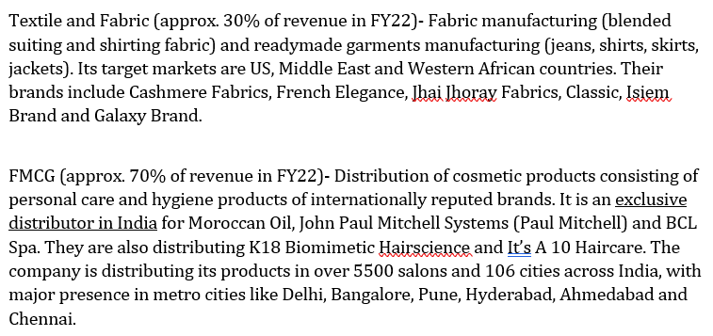
Textile and Fabric (approx. 30% of revenue in FY22)
Cosmetics Distribution- haircare focused (approx. 70% of revenue in FY22)

Slide 3
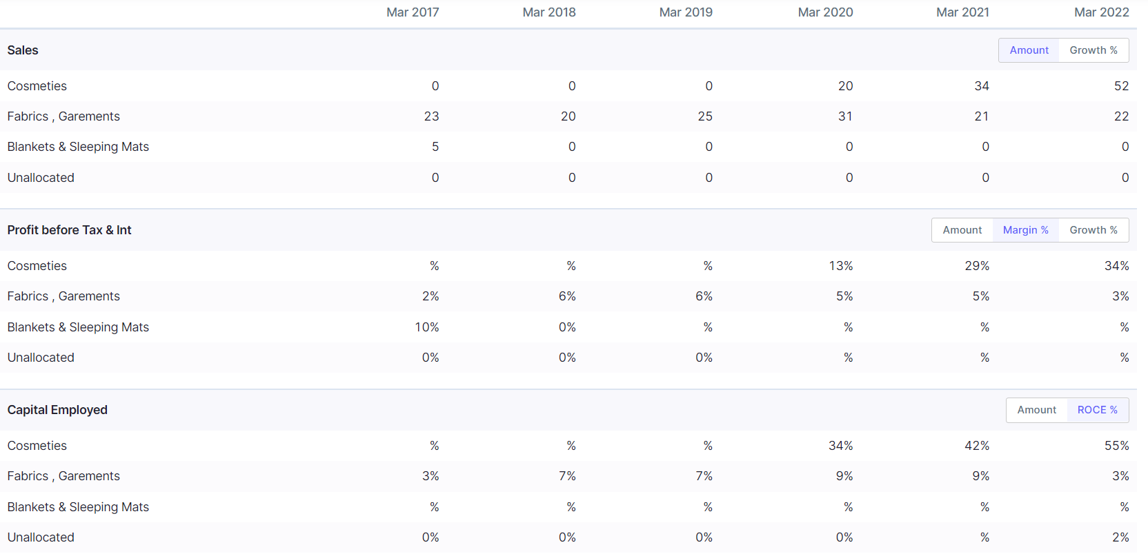

Slide 4
Incremental Business Direction
 |  | 19 | 20 | 21 | 22
 | Sales | 24 | 49 | 55 | 73
Of which | Cosmetics Distrib. | 0 | 20 | 34 | 52
 | Textiles | 24 | 29 | 21 | 21
 | Delta Sales |  | 25 | 6 | 18
 | Delta Cosmetics |  | 20 | 14 | 18
 | % of delta sales from cosmetics |  | 80 | 233.3333 | 100

Slide 8
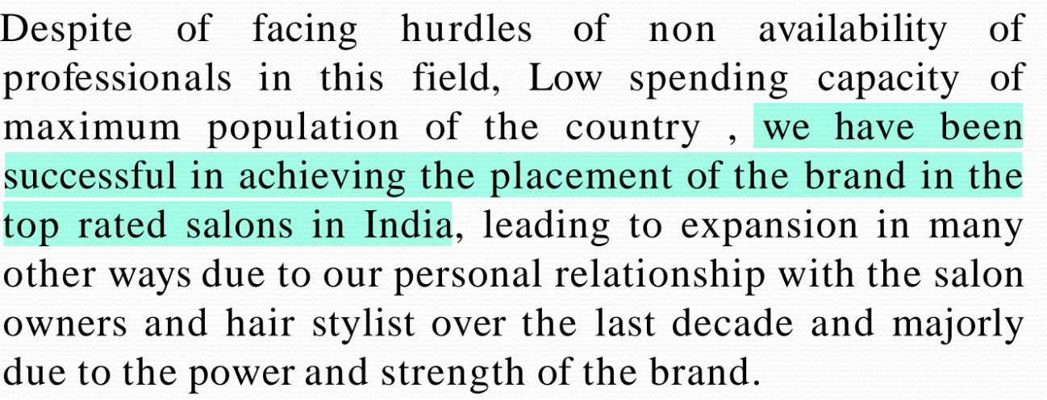

Slide 9
MK Exim does marketing

Slide 10
Sells to Nykaa

