Slide 1
Crowdstrike

Slide 2
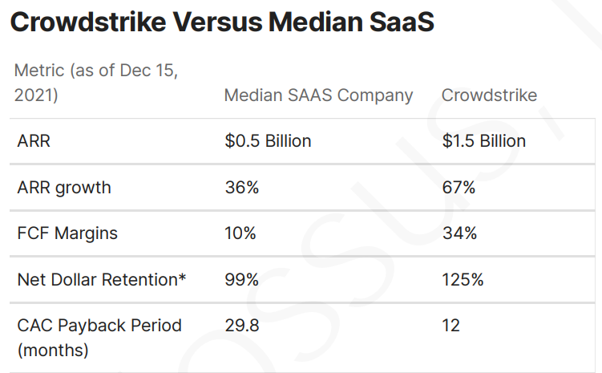

Slide 3
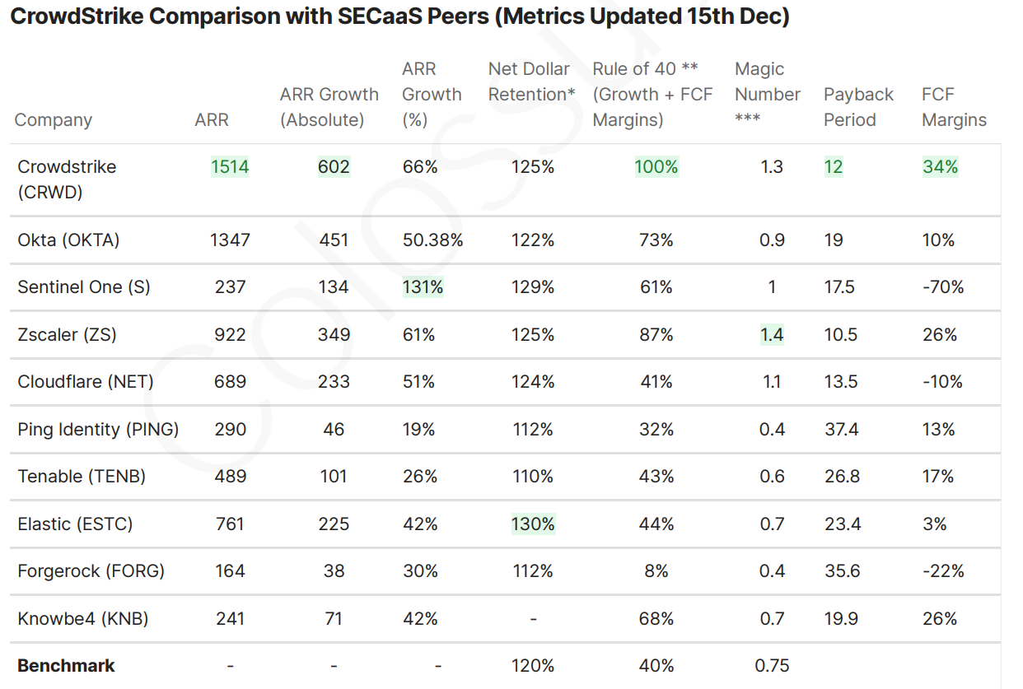

Slide 4
they're spending about 90 cents to acquire a dollar of ARR at 30% incremental margins, which at 2% churn spits out a 40% incremental ROIC

Slide 5
https://www.joincolossus.com/episodes/79440285/desai-crowdstrike-the-security-cloud?tab=transcript
https://joincolossus.com/research/crowdstrike..pdf?utm_source=Reading+List&utm_campaign=7a65781e8c-EMAIL_CAMPAIGN_9_13_2020_12_27_COPY_01&utm_medium=email&utm_term=0_325454c9ab-7a65781e8c-513924599

