Slide 1
Mumbai Investors Meet 30th Nov-19 Why I sold Sterlite Tech at a loss Amey Kulkarni Candor Investing amey.kulkarni@candorinvesting.com

Slide 2
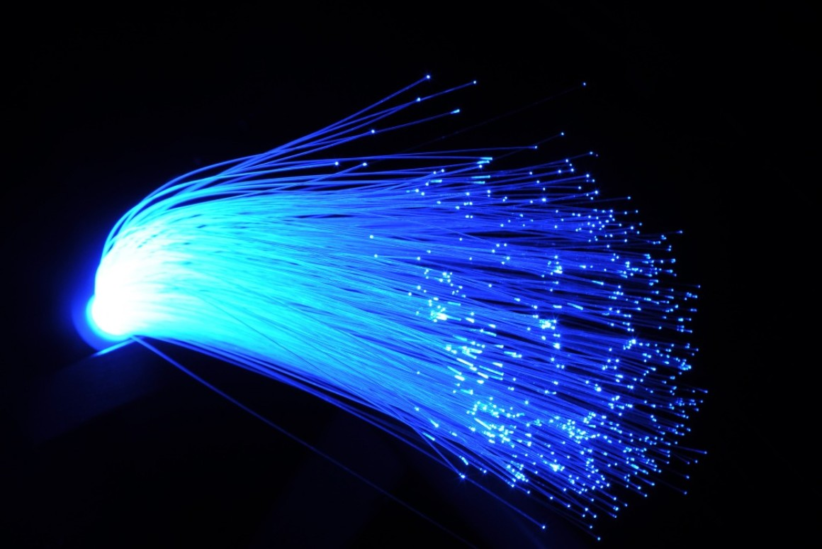
Why did I invest in Sterlite Tech?

Slide 3
Why did I invest in Sterlite Tech?
Sterlite Tech is one of the largest manufacturers of optical fiber preform in the world. There are only about 10 manufacturers of the preform core.
Sales Growth (3 yr) = 34%
Profit Growth (3 yr) = 54%
Sterlite Tech has increased optical fiber capacity from 10 Mn fkm in 2010 to 50 Mn fkm in 2019.
Fiber optic demand is a secular growth story.
A good balanced analysis of Sterlite Tech may be found here https://finception.in/stocks/sterlite-technologies-ltd/

Slide 4
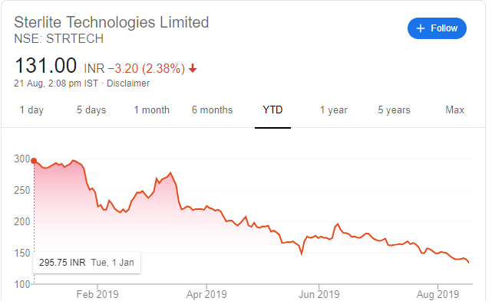
But then this happened

Slide 5
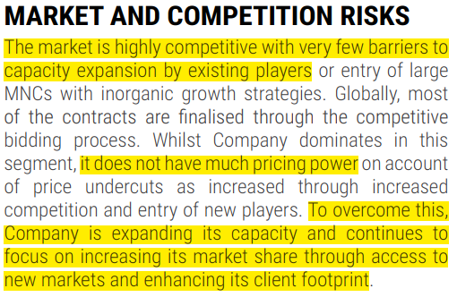
Let us start our investigations
Extract from - Annual Report 2017

Slide 6
Business Model Risks
The optical fiber market is highly competitive
Low barriers for capacity expansion by existing players.
Sterlite Tech is a price taker
The way it was trying to overcome this problem was by aggressive capacity expansion
But, so was everyone else

Slide 7
Global capacity expansion

Slide 8
But then this happened
“In a commodity business, demand increase happens gradually, supply increase happens in jumps (steps).”

Slide 9
But then this happened
When demand outstrips supply making the business very profitable for the existing players, they start by expanding capacities. This is what happened in 2017 and 2018.
All players make healthy profits and typically this phase is characterized by faster increase in profits than revenues. (as seen in the financials of Sterlite Tech from 2016).
New capacity comes online in large chunks and a day comes when supply again becomes larger than demand.
Prices collapse and many of the weak players start losing money and the leveraged ones start going bankrupt.
It takes years for the demand to again outstrip the supply and for the prices to rise and become profitable for most/all players in the industry.

Slide 10
Price stabilization was inevitable

Slide 11
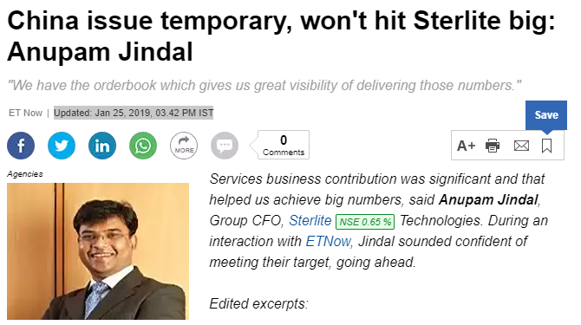
Management says

Slide 12
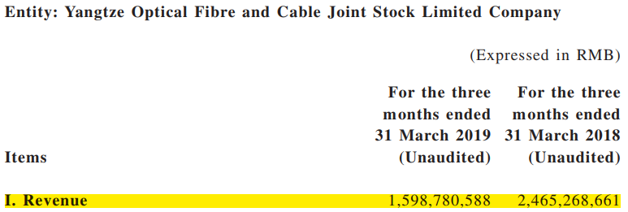
But what was happening in China?

Slide 13
And what does the largest player CORNING say?

Slide 14
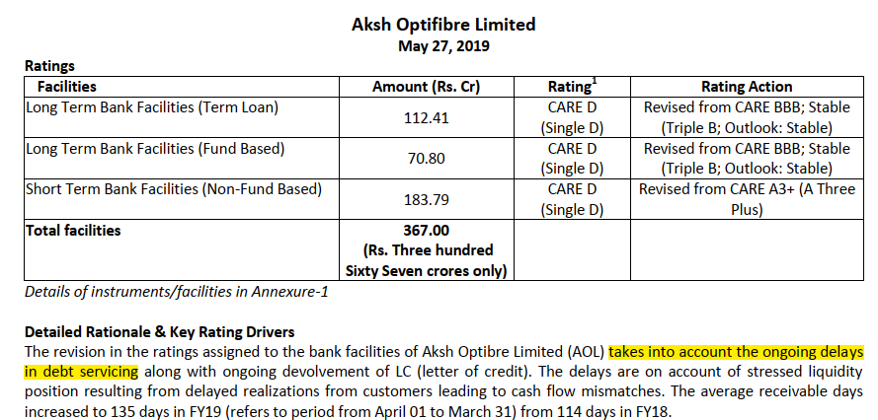
And it spreads to India

Slide 15
Is the negativity built in the price?
As on 20.08.2019 Market Cap = Rs 5,410 Crs Total Debt = Rs 2,067 Crs Enterprise Value (EV) = Rs 7,477 Crs Sales (12M trailing) = Rs 5,642 Crs Operating Margins (12M trailing) = 21%
In my opinion, the operating margins could reduce to anywhere between 12% to 15%
Assuming 15% operating margins,
Operating Profits (Est) = Rs 846 Crs
EBIT (Est) = Rs 627 Crs
Thus, Sterlite Tech is trading at a valuation of
EV/EBIT (Est) = 7477/627 = 12

Slide 16
Is the negativity built in the price?
If the operating margins reduce to 12%,
Operating Profits (Est) = Rs 677 Crs
EBIT (Est) = Rs 458 Crs
EV/EBIT (Est) = 7477/458 = 16
In a commodity industry, with supply outstripping demand, expectation of demand de-growth and falling prices a valuation of EV/EBIT of 12 seems expensive.

Slide 17
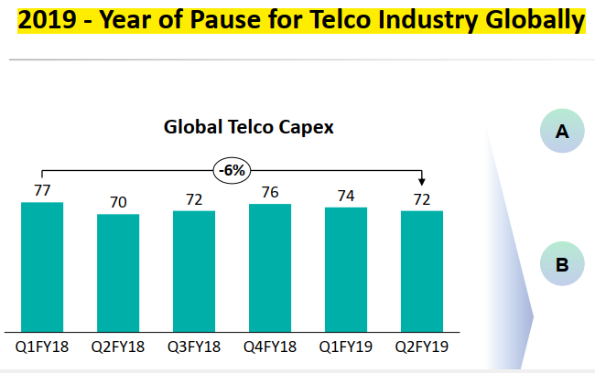
Sterlite Tech admits – decline in CAPEX

Slide 18
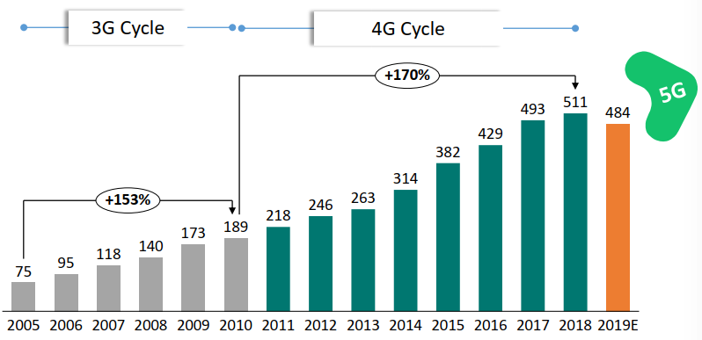
Fiber demand – reduced after 15 years

Slide 19
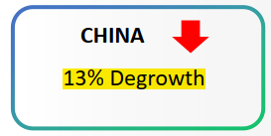
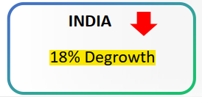
Demand degrowth – pressure on pricing

Slide 20
THANK YOU amey.Kulkarni@candorinvesting.com

