Slide 1
Structural Changes in FinTech
Goa
July 2018
@deepakvenkatesh & @a_basumallick
Disclaimer: Content provided in this presentation is only the personal views of the presenters. No affiliation to any organization be considered.

Slide 2
Agenda
Transaction Banking Opportunity
Consumer Financial Needs
Global Payments Landscape
Indian Payments Landscape
Payments Value Capture
Indian Retail Banking Changes
The Bets to Make
Guessing the Future

Slide 3
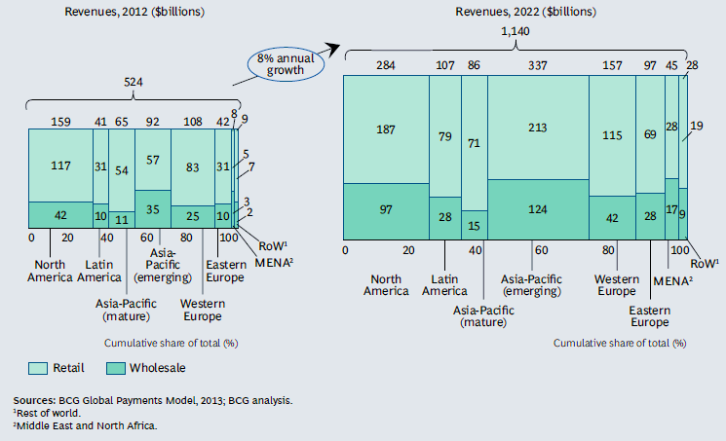
Maximum growth in Payments & Transaction Banking Revenues will happen in Emerging Asia Pacific Region
14%
13%
Notes:
Source:
BCG Global Payments Report 2013

Slide 4
Retail Transaction Banking Products are being commoditized
Credit
Deposits
Investments
Investments
Investments
Investments
Insurance
Insurance
Insurance
Higher up on the pyramid
More revenue generation capability
More complex products
More variance in offerings of incumbents
Credit
Credit
Payments
Savings (Demand & Time Deposits)
Savings
Payments
Notes:
Source:
None as such. Via experience working in Banks & Payments companies
HDFC Investor Presentation

Slide 5
Retail Payments has seen tremendous growth in China and India
$15 Bn
$3 Bn
$9 Bn
$50 Tn
$500 Bn
$300 Bn
In 2023
Indian payments market projected at $1 Tn
Non cash transactions will overtake cash transactions
China
India
USA
China
India
USA
2011
2020
Notes:
Source:
BCG Google Payments Report India 2016
PWC on Global Payments

Slide 6
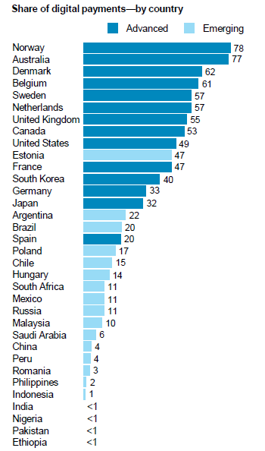
But India has less than ~1% share of digital payments as of today
Notes:
Source:
McKinsey

Slide 7
UPI is democratizing payments in India
Notes:
Source:
RBI Monthly Payments Indicators

Slide 8
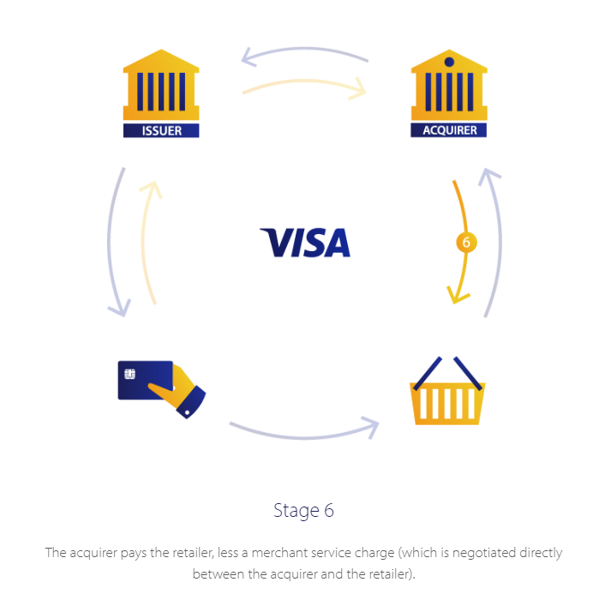
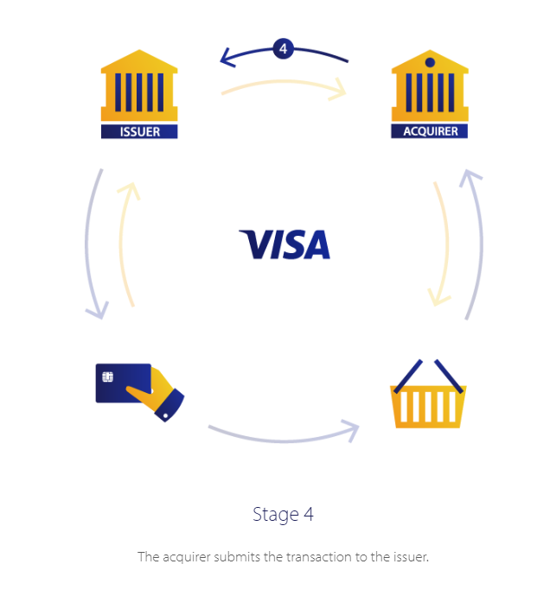
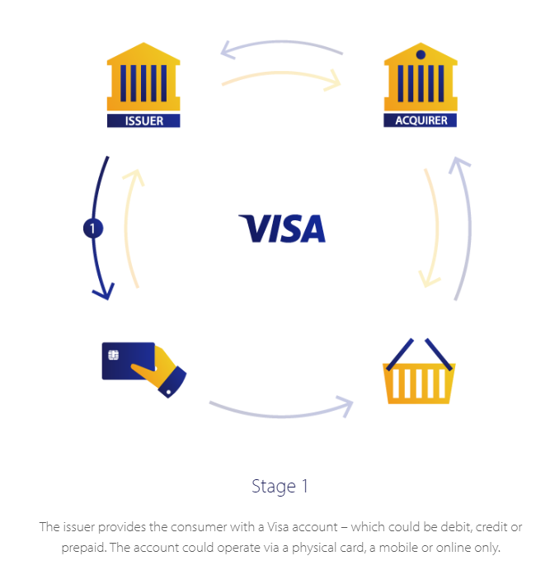
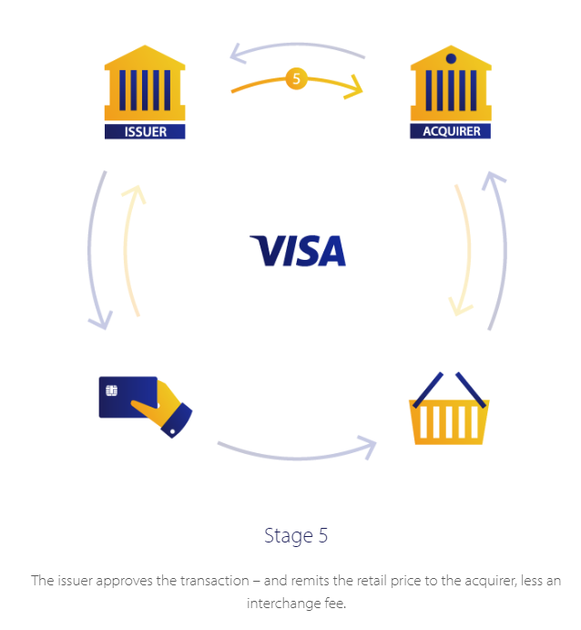
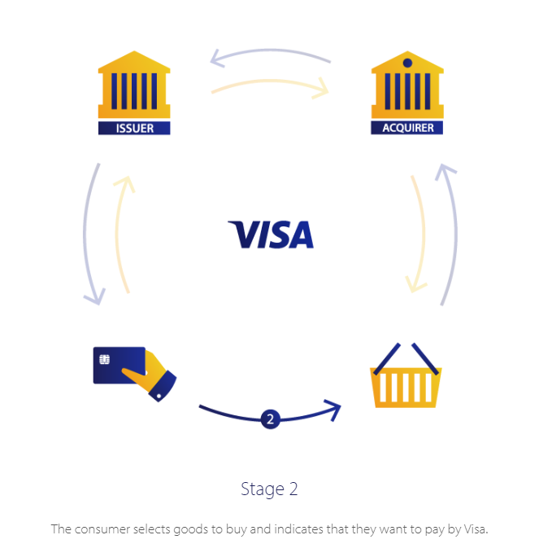
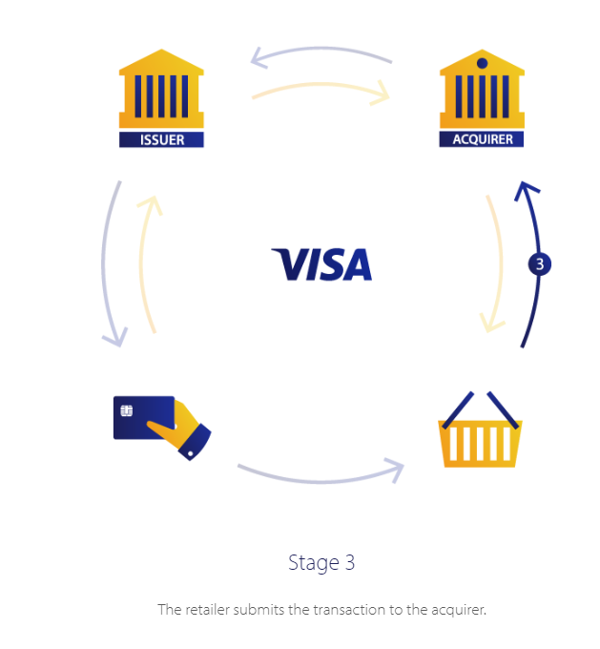
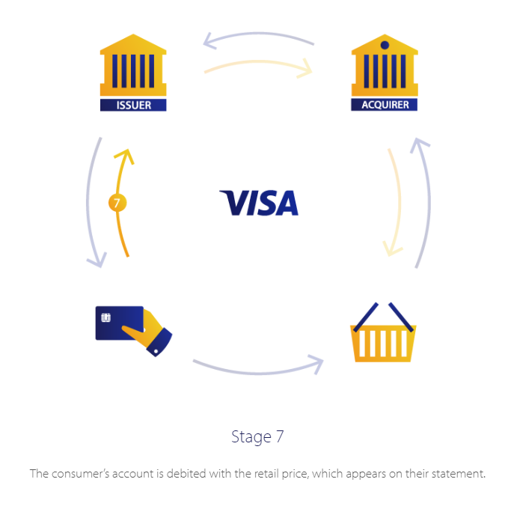
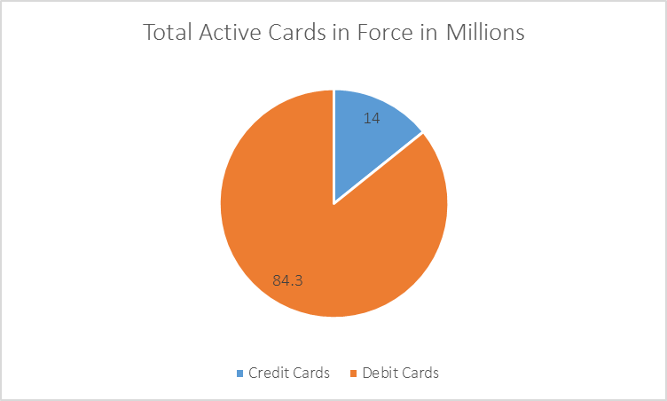
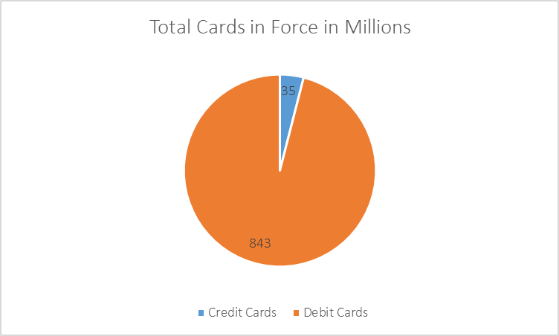
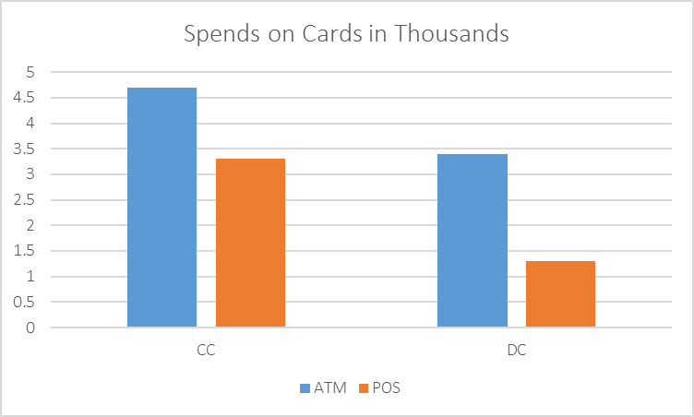
Issuing entities make the chunk of the revenue while networks make a steady consistent income with no additional capex
Processors Fee
Interchange
Merchant Service Fee
Acquirer Fee
Card Network Fee
Payment Network
Issuer
Acquirer
Customer
Merchant
 | # in Million
POS Terminals | 3
ATM | 0.22
QR | 0.2
DC Activation | 10%
CC Activation | 40%
10 cents
Flat Fee/Tiered Fee
0.5%
1.5%
2%
Authentication -> Authorization -> Clearing -> Settlement
Notes:
Source:
Visa

Slide 9
Banking is moving to the phone
Mobile
Internet
IVR
ATM
Branch
Consumer adoption rising
Costs falling
Drop by
Metro 21%
Urban 32%
Semi Urban 55%
Rural 70%
Notes:
Source:
DBIE RBI

Slide 10
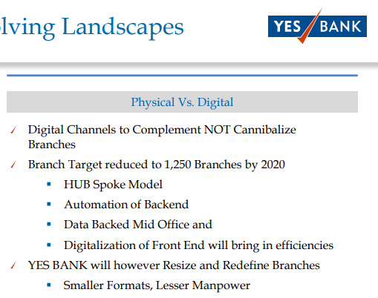
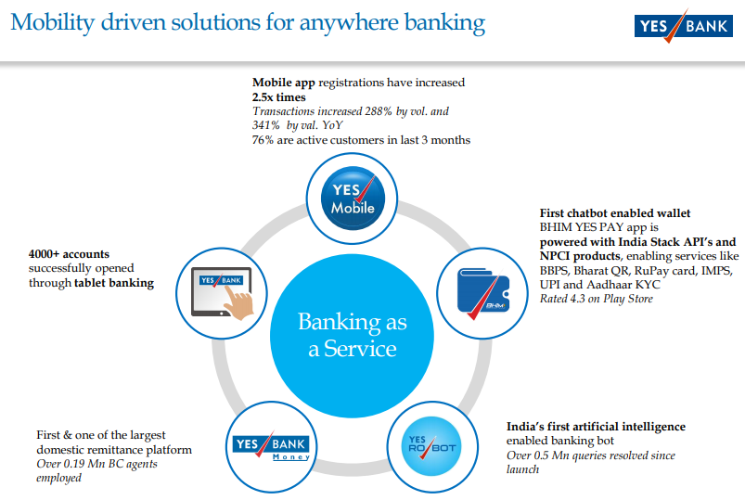
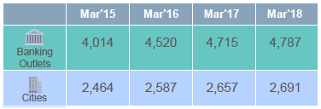
Indian consumers are using phones to do financial transactions
506
195
72
Notes:
Source:
Investor Presentations

Slide 11
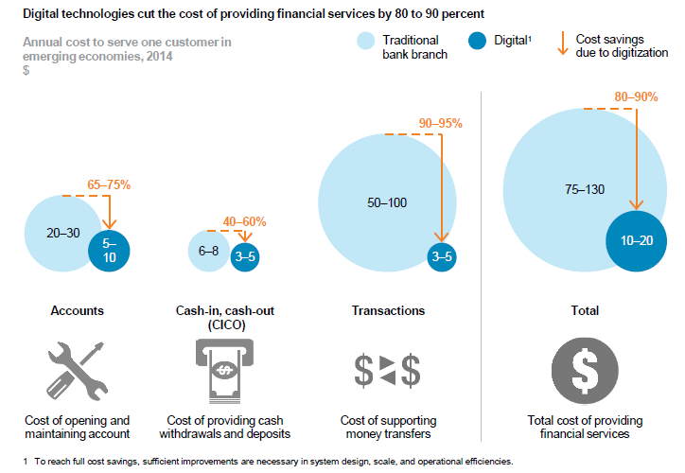
Digitization will improve profitability of financial service providers
Notes:
Source:
McKinsey

Slide 12
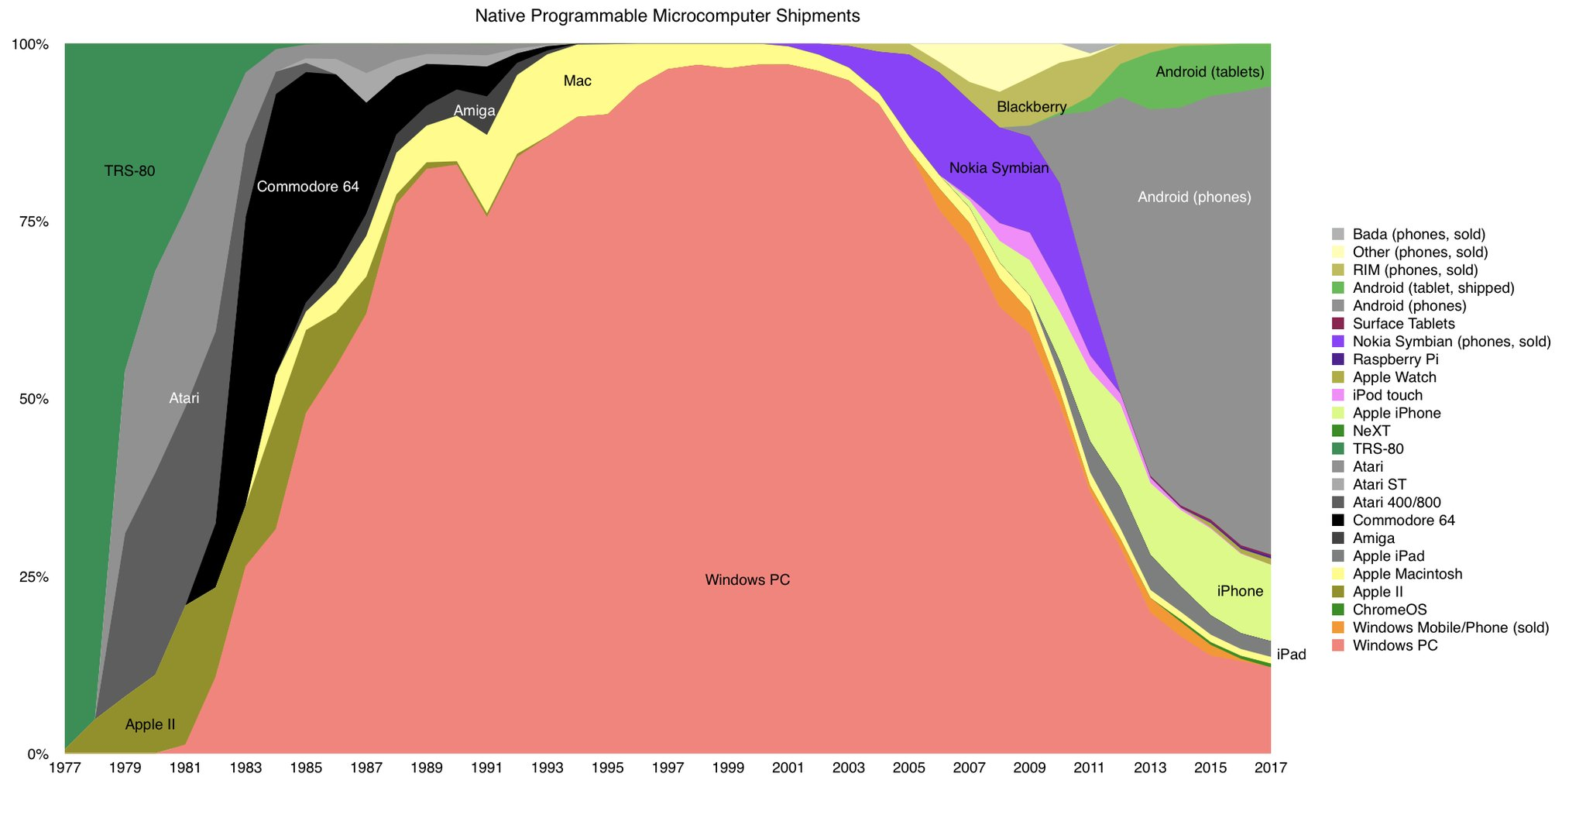
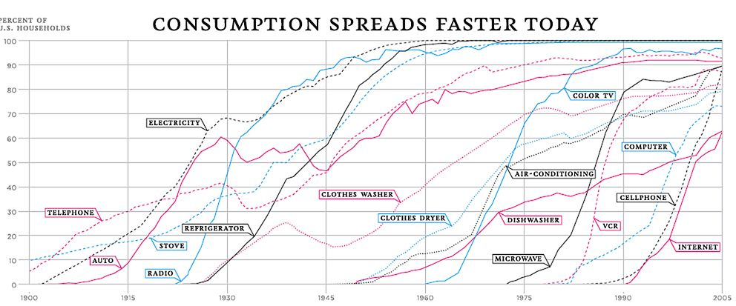
Mobile Phones have had one of the fastest adoption amongst technologies & Android phones rules the computer world
6%
65%
Notes:
Source:
Economist & Google

Slide 13
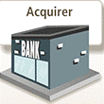
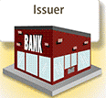
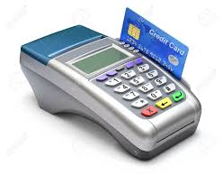
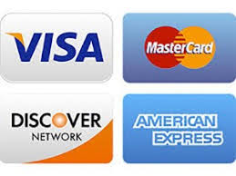
The Actors
Regulators
Banks/Payments Bank
Networks
Processors/ Intermediaries

Slide 14
The Roles
Banks
Payments Core Processor
Sponsorship Income
Networks
Income/txn
Tech Sophistication
PSP
Thin Margins/Scale Game
Cash Burn/Consumer Facing
Processors
Lenders (New Age)
Insurers (New Age)
Fund Managers (New Age)
Underwriters
Deposit Holders (Escrow/Nodal)
Regulatory Favorable
Agility
Volume Game
Wafer Thin Margins
B2B
High default
Not proven model but big opportunity
Specialized Segments
Thin margins
Entry Barrier
Oligopolistic
Low Switching Cost for Consumer
Network Effects
No Pricing Power
Not proven model but big opportunity
North Star

Slide 15
The Safer Bets
BIN Sponsor (Issuer/Acquirer) Income: 90-10/80-20
Fee Income (Txn)
Income Sources
Float in Escrow/Nodal
API Services
Underwriting
 | Banks | Scaling in FinTech
 | PSU – SBI | ✓
 | PSU – Others | ✗✗✗
 | Private Biggies - ICICI | ✓✓
 | Private Biggies - HDFC | ✓✓✓
 | Private Biggies - Axis | ✗
 | Private New Kids - YBL | ✓✓✓
 | Private New Kids – RBL | ✓✓✓
 | Private New Kids – KMBL | ✓✓
 | Private New Kids - IndusI | ✓
One Word
Banks
Account Opening/Mgmt
ABC…
Costs

Slide 16
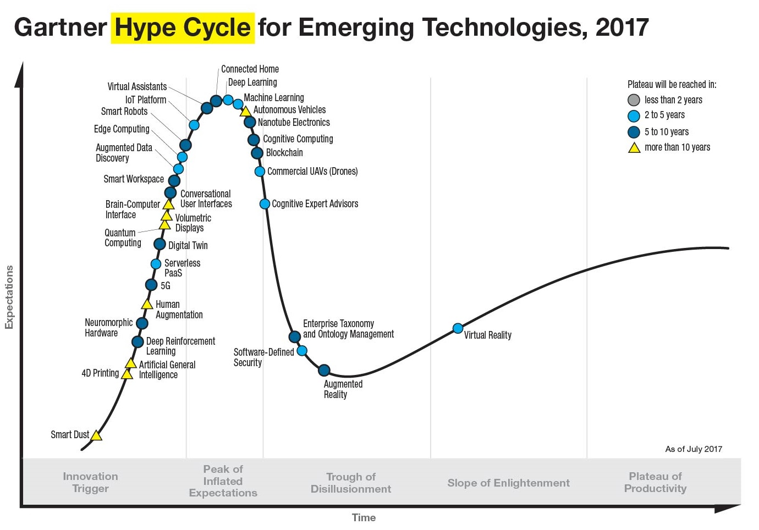
Consumer Facing Technologies such as Visual & Voice Search, Assistance by AI & so on will take forefront
Consumers Favor Visual and Voice Search
By 2021, early adopter brands that redesign their websites to support visual and voice search will increase digital commerce revenue by 30%.
Digital Giants Self-Disrupt
By 2020, 5 of top 7 digital giants will willfully self-disrupt to create their next leadership opportunity.
Legitimized Cryptocurrencies
By the year 2020, the banking industry will derive $1B of business value from the use of cryptocurrencies.
Bots Take Over
By 2021, more than 50% of enterprises will spend more per annum on bots and chatbot creation than traditional mobile app development.
AI Creates More Jobs Than It Takes
In 2020, AI will become a positive net job motivator, creating 2.3M jobs while only eliminating 1.8M jobs.
?
?
?
?
?????
?
?
Notes:
Source:
Gartner

Slide 17
Thank You & Questions Please ☺

