Slide 1
PRAJ INDUSTRY
NARENDRA
Discl:Invested 3% of PF

Slide 2
Business verticals
PRAJ INDUSTRY
BIOENERGY (50-60%)
1G PLANT
2G PLANT
ENGINEERING DIVISION(30%)
CBG PLANTS
Hi PURITY (10%)
CRITICAL PROCESS EQUIPMENT
WASTE WATER MANAGEMENT
BREWERY PLANTS

Slide 3
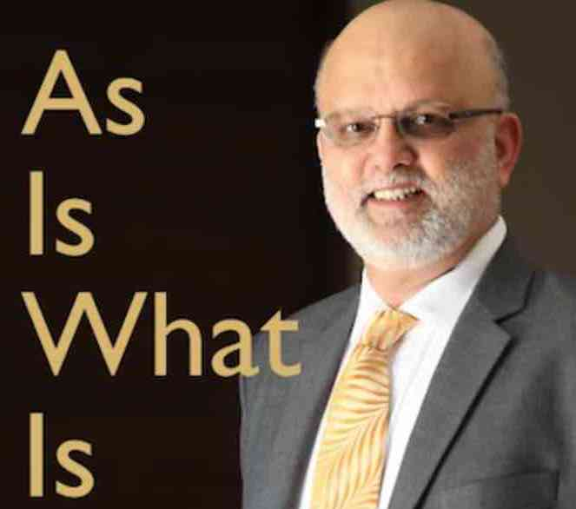
Management
Chairman: Mr Pramod Chaudari
Global top 100 people in
Bioenergy space
Building of Praj
Excerpts from interviews:
Business cycles
Importance of cash flow
Global diversification
2018:CEO & MD- Shishir Joshipura
Thermax ltd-Global head of C& H business
MD OF SKF INDIA LTD(2009-2018)

Slide 4
Praj Matrix:R &D
Data for 6000 samples of sugar molasses
700 samples data at Praj matrix for 2G Ethanol
16 patents, 63 applied
115 technologists working in R&D-30 PhDs & 80 masters
2-3% of sales on R&D
New technologies in processing/water-preservation/ethanol plants
Bio-products: Nutrition and livestock health

Slide 5
Business for next 2-3 years
1G and 2G PLANTS

Slide 6
Govt initiatives for Ethanol blending
National biofuel policy-2018
Categorisation of Biofuels and differential pricing for blending
Expands the scope of raw material
B heavy molasses, sugarcane juice
Sugar beet, corn, cavavsa..etc
Surplus food grain
Interest subvention scheme for distilleries(6%)
Soft loan of 4400Cr increased to 21000Cr
GST-removal of interstate excise duty
Reduced GST from18 to 5%

Slide 7
1G plants
Process design, engineering, fabrication and comissioning
Complete one stop solution for ethanol plants
6000 references across 70 countries
Many plants in Europe-1st UK ethanol plant
SEA and SA: dominant market share
Greenfield plants
Modernisation of existing/Retrofit services
Designing ZLD systems for ethanol plants
2/3 rd market share India

Slide 8
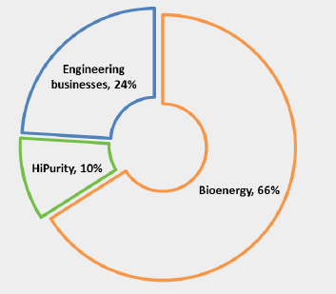
Opportunity size:1G plant
Interest subvention scheme:
No. of applications from 114 to 268
10-12 have been finalised
Total opportunity size:
Avg capacity/plant: 60-100KLPD
Avg 60 KLPD – Investment of 60cr
50% i.e., 30 Cr is revenue opportunity for Praj
Take 100 plants will be executed over 2-3 years
100*30=3000 Cr
Reflecting in current order book

Slide 9
Opportunity size:1G plant
Expanding services-process plant-30% of revenue
Tie up with Thermax ltd for incineration system equipments-adding to revenue pie-another 30%
Developed new technology to reduce power requirement by 2/3rd
PROFIIT technology: Zero liquid discharge system for ethanol plants:
Premium pricing of +20% & repeat customers

Slide 10
Operating leverage
Does not have permanent blue collar employee
Engineer from Praj will execute projects with outsourced employee/contracted
One Engineer can execute many projects
Margins to improve over 2-3% for FY

Slide 11
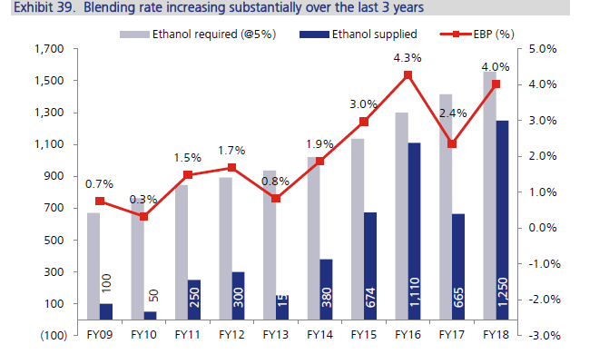
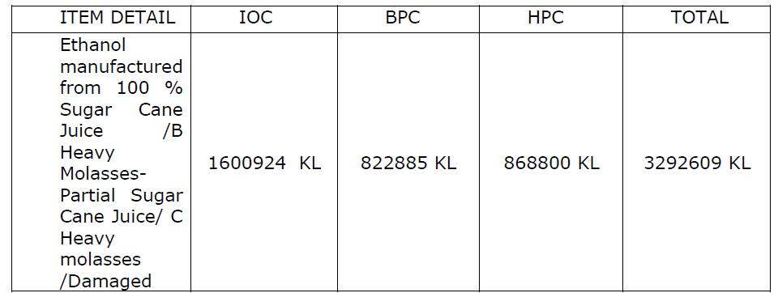
Ethanol blending
FY19- 7.5%
Target 20% blending

Slide 12
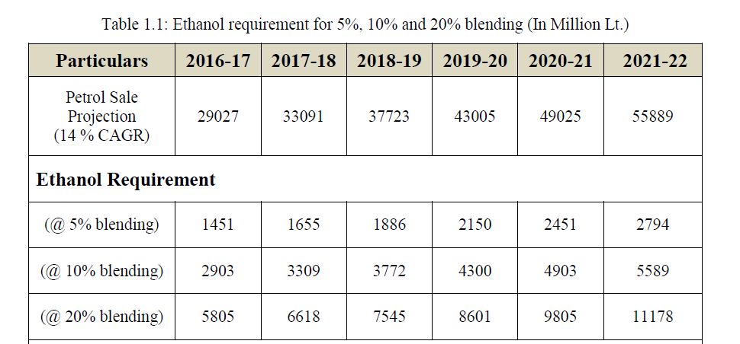
Ethanol requirement projection

Slide 13
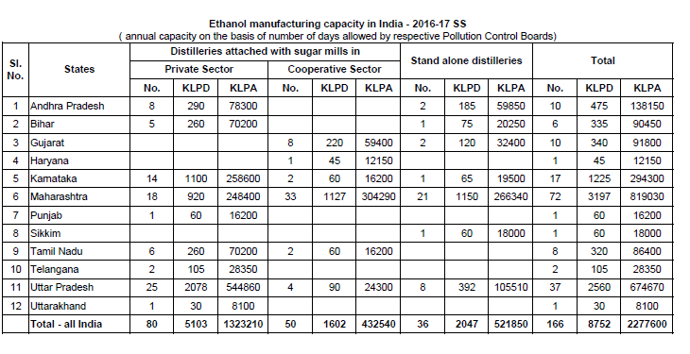
Current Ethanol capacity

Slide 14
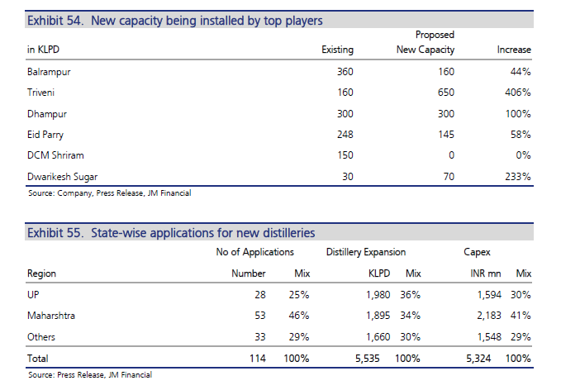
Expansion by major companies

Slide 15
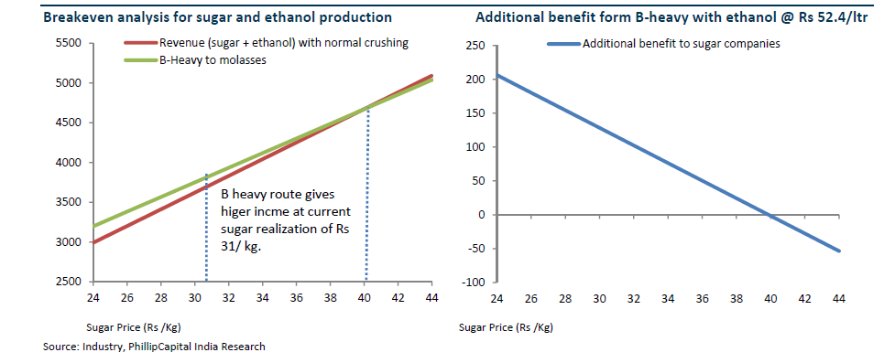
Sugar industry margins from Ethanol
COMPANY | BCM |  | DHAMPUR |  | DWARKESH
 | FY19 | FY18 | FY19 | FY18 | FY19 | FY18
REVENUE(Cr) | 467 | 331 | 498 | 185 | 363 | 249
PBIT(Cr) | 316 | 108 | 185 | 63 | 268 | 136
% OF PBIT | 68 | 33 | 37 | 34 | 74 | 55
Even at 5K/ton of molasses price margins will be>50%.
Dwarkesh sugar Q4 concall

Slide 16
New technology
Zero liquid discharges
Incineration technology and boilers
Allowing to run plant for 330 days
More efficient production

Slide 17
Advanced biofuels: 2G PLANTS
Need for 2G Ethanol: limitation of sugar molasses
Food v/s fuel debate
Benefits of 2G plants:
reduce oil import
environmental
rural job creation
income to farmers
waste management
Govt support-funding for plants and demo plants
1800 Cr for 12 plants
150 Cr for demo plants
Viability gap funding for 2G plants
Rs.5000 Cr in 6 years
Tax incentives
Higher price for Ethanol

Slide 18
2G Demo plant by Praj
Capacity – 1 million litre per annum
Capability to process multiple feedstock –
corn cobs & stover
rice & wheat straw, cane trash
cane bagasse, cotton stalk
Empty fruit bunches (EFB)
Complete end to end offering from feedstock processing till end product
Wastewater management to meet ZLD
Multi-product - The plant is designed to produce Bio-ethanol, Bio-gas with provision for set-up of Bio-CNG unit

Slide 19
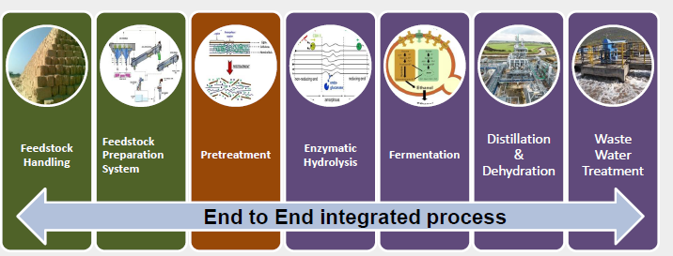
Praj 2G technology
Pre-treatment –
most important
Advantageous to Praj due to data/R&D on feedstock
Enzymatic or acid hydrolysis
Fermentation
Distillation

Slide 20
2G plants
Govt plan of 12 plants
6 plants finalised
Praj selected for 4: different stages of execution
IOCL/BPCL/HPCL and MRPL
competitors:
Beta Renewables S.p.A
Renmatix .Inc
DBT-ICT

Slide 21
Revenue opportunity for Praj
150 Cr per projects
Includes licencing, technology transfer and critical proprietary equipment
Major revenue from critical process equipment- confirmed from IOCL
2-3 years plan

Slide 22
2G plants challenges
Feedstock- from 50km radius
Mandi based system
4 to 500 tons/day
Technology has to mature
Cost of ethanol: Rs 120.00??
Cost of feedstock:

Slide 23
RED II initiative and EU opportunity
Mandatory to blend with advanced bio fuels
Discussion with many EU clients in advanced stage
Large size plants... higher revenue
7.4% to 15% by 2025 from advanced bio fuels
Penalty: 3 Euros/lit

Slide 24
CBG PLANTS to drive business after 1-2 years
5000 CBG Plants by 2025 under SATAT policy
15mn tons of Bio CNG...40% of current consumption
Use of sugar cane pressmud, agri waste, cattle dung, and municipal solid waste
100 to 200 tons/day of feedstock
Public transport /PVT vehicles
10% cheaper compared to CNG
CBG can be integrated with CGD.

Slide 25
CBG plants
Praj is the only known player (Biogas plants)
Competitor: German & small local players
Investment of 50Cr /plant

Slide 26
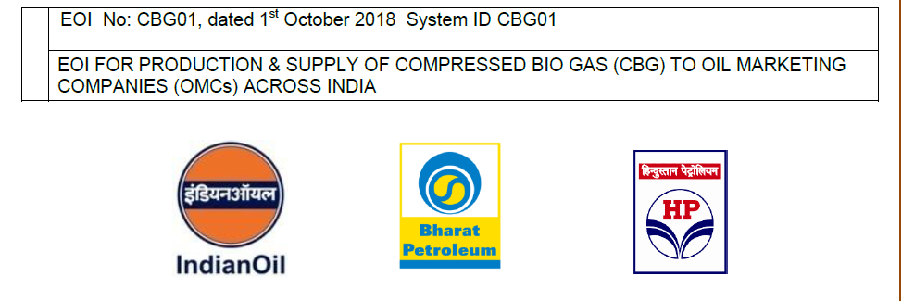
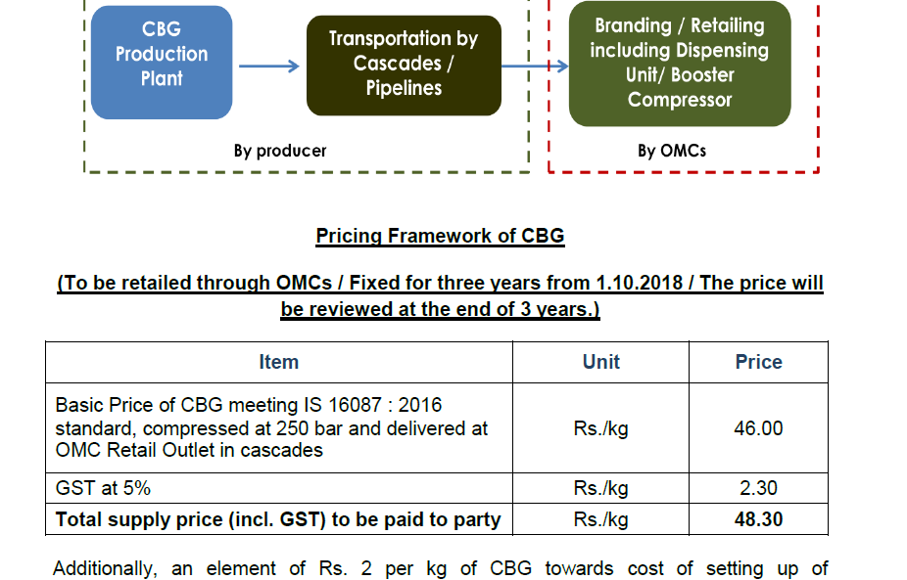
CBG plants
EOI:
250 applications by March- 19
Off-take agreement
:next 90 days
Attractive payback period
:3 yrs

Slide 27
Hi-purity division
Hi-Purity by acquiring stake in NEELA system
Supplying turnkey solutions for highly purified water for pharma, healthcare..etc
Depend on Pharma cycle
Looking for export opportunity
10% of revenue
Plant at Wada: US FDA, UK MHRA & WHO approved

Slide 28
Other business: Waste water management
Change in business strategy
Was difficult to make margins
Let the orders go and stick to good customers
Focussed on industries
Not depends on municipal/govt orders

Slide 29
Other business Critical process equipment and systems
Pressure vessels, heat exchangers, reactors..etc
Oil and gas industry, Global EPC players, pharma companies
End user to OEMS
Plant approvals done- target 15 customers
Confirmed orders
Next 12-18 months for execution

Slide 30
Other business : Brewery plants
Brewery: 75% market share in India
MNC players in India- Plants executed by Praj
Technology tie up
10% growth
Seasonal business
Africa opportunity with same MNCs with different seasonal business

Slide 31
Risks
Govt policy changes-Biggest risk
Delay in 1G/2G plant orders
Raise in molasses price
Low sugarcane production
Technology risk
Risk of Ethanol imports for blending
New competitors
Electrical vehicles and reduced oil consumption

