Slide 1
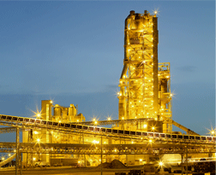
Shri Keshav Cement Ltd Multi fold Capex
Pure Capex Play

Slide 2
Rationale of choosing
Much awaited Capex (announced in 2013, started in 2017 partially) is going live
Details
Current operating capacity – 450TPD (Plant 1 250 + Plant 2 200)
Capex completed in Feb – Plant 2 upgraded from 200TPD to 750TPD
Market Cap of 46.63 crore as of 31st Aug 2018

Slide 3
Shree Keshav Cement
Shree Keshav Cement Infra Ltd. Is a reputed group manufacturing Keshav Cement
The Company is engaged in manufacturing and trading of cement within the states of Karnataka Goa and Maharashtra
Besides they also do petrol pump activities and trading of coke in small proportion
Related Parties
Katwa Infotech Ltd. (KIL) is a medical transcription unit engaged in providing services to American Hospitals and Clinics.
Katwa Finlease Limited incorporated in 1995, commenced its business of hire purchase finance for automobiles in 1996
Katwa Construction Co. Ltd. is engaged in construction of luxurious flats targeting NRI’s. This company is proposed to be merged with the flagship KCIL soon

Slide 4
Income Statement
Amount in Rs Crores for Income Statement

Slide 5
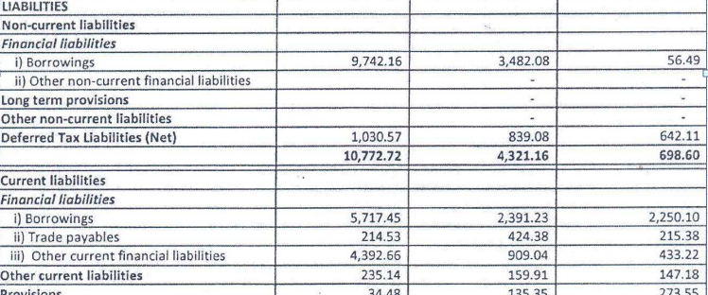
Balance Sheet

Slide 6
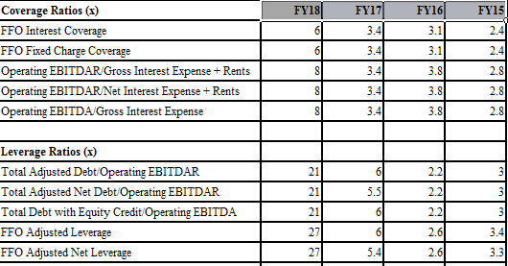
Coverage and Leverage calculations
Shri Keshav Cements and Infra Limited (INR million) | FY18 | FY17 | FY16 | FY15 | FY14
Summary Income Statement
Gross revenue (+) | 521 | 504 | 554 | 510 | 482
Revenue growth (%) | 3.4 | -9.2 | 8.8 | 5.7 | -4
Operating EBITDA (before income from associates) | 73.7 | 107 | 126 | 112 | 108
Operating EBITDA margin (%) | 14.2 | 21.2 | 22.7 | 21.9 | 22.4
Operating EBITDAR | 73.7 | 107 | 126 | 112 | 108
Operating EBITDAR margin (%) | 14.2 | 21.2 | 22.7 | 21.9 | 22.4
Operating EBIT | 11.8 | 38 | 96 | 83 | 80
Operating EBIT margin (%) | 2.3 | 7.5 | 17.4 | 16.2 | 16.6
Gross interest expense | 8.9 | 31 | 33 | 41 | 46
Pre-tax income | 2.9 | 7 | 63 | 42 | 34
Net income | -17.2 | 7 | 42 | 29 | 16
Source: Company Financials, Ind-Ra

Slide 7
Balance Sheet Summary India Ratings
Summary Balance Sheet | FY18 | FY17 | FY16 | FY15
Cash & Equivalents | 18 | 59 | 2 | 4
Working Capital | 196 | 70 | 52 | 128
Accounts Receivable | 60 | 32 | 10 | 22
Inventory | 157 | 117 | 64 | 110
Accounts Payable | 21 | 79 | 22 | 4
Total Debt with Equity Credit | 1546 | 644 | 274 | 335
Short-Term Debt | 572 | 246 | 231 | 263
Long-Term Senior Secured Debt | 974 | 398 | 42 | 72
Long-Term Senior Secured Debt | 0 | 0 | 0 | 0
Long-Term Subordinated Debt | 0 | 0 | 0 | 0
Other Debt | 0 | 0 | 0 | 0
Equity Credit | 0 | 0 | 0 | 0
Total Adjusted Debt with Equity Credit | 1546 | 644 | 274 | 335

Slide 8
Salient Features
Shri Keshav Cements took over the ailing – Sangam Cements from KSFC and Shri Quality
Cements Ltd from IDBI and turned around those sick units into profitable entities
- Company has paid dividends, whenever distributing wealth to shareholders has made more sense than capex
The promoter holding has also increased to more than 67.8% in the during 2012-15 (nothing has been pledged till date)
Capex completed 200TPD to 750TPD for plant 2 in Feb. More in progress with target 3000 TPD in total (Currently financials reflect 450TPD capacity)
20MW Solar Power Plant for captive use (already showing effects on operating parameters in June quarter)
Cement Demand Likely to Improve in FY18: Ind-Ra expects the cement industry to grow 4%-6% during FY18. Absence of any significant incremental capacity additions in the market is expected to increase capacity utilisation rates in the coming years.
A favourable monsoon, which can increase rural demand, and government’s initiatives (such as Housing for All and thrust on infrastructure activities) are expected to improve cement demand post FY18.

Slide 9
Operating Efficieny of Keshav Cements
Parameters as of Nov 2017
Realisation Revenue Per tonne – 5191
EBITDA per tonne of INR1,103-1,398 – operates in nearby areas
(during FY15-FY17 due to low freight cost of INR27-152, resulting from lower average lead distance of 250kms between the company’s plants and market. Ind-Ra expects EBITDA per tonne to remain at around INR1,133 in FY18 owing to stable realisation)
Interest coverage (operating EBITDA/gross interest expense) remained between 2.4x and 3.8x during FY14-FY17 (FY17: 3.4x, FY16: 3.8x).
Negative
Net leverage (total adjusted net debt/operating EBITDAR) deteriorated to 5.5x in FY17 (FY14: 3.7x) due to debt-led capex. Ind-Ra expects leverage to improve and remain below 3x from FY18 onwards with incremental EBITDA from capacity additions and absence of major debt-led capex plan.

Slide 10
Negative Aspects
Pros
Consistent Related Party Transactions since years, having loans worth 17 crores approx currently with decent interest rates (10% or more)
the company has taken 3 months more than market expectations for capex completion of phase 1 which resulted outlook turn negative from stable in Ind-RA ratings BBB-
However
‘Improved capacity utilisation through the additional facilities leading to an improvement in the revenues and EBITDA margin thereby providing visibility of financial leverage reducing below 3x by FY19 would lead to the Outlook being revised back to Stable. ’
Yearly maintenance capex averaged about 1.5-2 crores since last 7 years

Slide 11
Annual Report highlights

Slide 12
References
http://equitybulls.com/admin/news2006/news_det.asp?id=213395
https://aceinvestortrader.wordpress.com/2015/07/13/shri-keshav-cements-infra-cementing-your-portfolio/
https://www.indiaratings.co.in/PressRelease?pressReleaseID=29783&title=India-Ratings-Assigns-Shri-Keshav-Cements-and-Infra-%E2%80%98IND-BBB-%E2%80%99%3B-Outlook-Stable
https://www.indiaratings.co.in/PressRelease?pressReleaseID=32584&title=India-Ratings-Revises-Shri-Keshav-Cements-and-Infra%E2%80%99s-Outlook-to-Negative%3B-Affirms-%E2%80%98IND-BBB-%E2%80%99

