Slide 1
My experiment with investing in FY18
Presented by :
Dhiraj Dave
July 25-29, 2018

Slide 2
Key Learning
Arrow Greentech
Avoid hope and growth story
Control grid
Ignore action of other market participant
Faze 3
Trade shall not become investment
Turn around are difficult to achieve
If projection are not met, ACT
Premco Global
Illiquidity is kind of leverage, friend in bull market and enemy in bear market
Provide development time for investment. Despite 6 quarter non-performance continue to hold stock in hope of recovery

Slide 3
Case: Arrow Greentech
Concern about conduct of business and management were already highlighted
http://forum.valuepickr.com/t/arrow-greentech-old-name-arrow-coated-products-anybody-tracking/323/6?u=dd1474
Was tracking company for almost year (Bought tracking position) in March 2016
Read a research report on the company in September 2017
Attended AGM of the company in Mumbai in September 2017

Slide 4
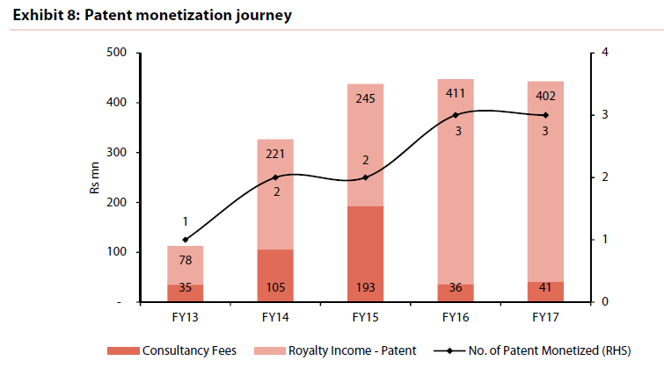
Arrow Greentech: IP commercialised
Positive points:
The company manufactured water soluble films which has have many end usage. The product was mostly exported to UK for which the company has entered into royalty agreement

Slide 5
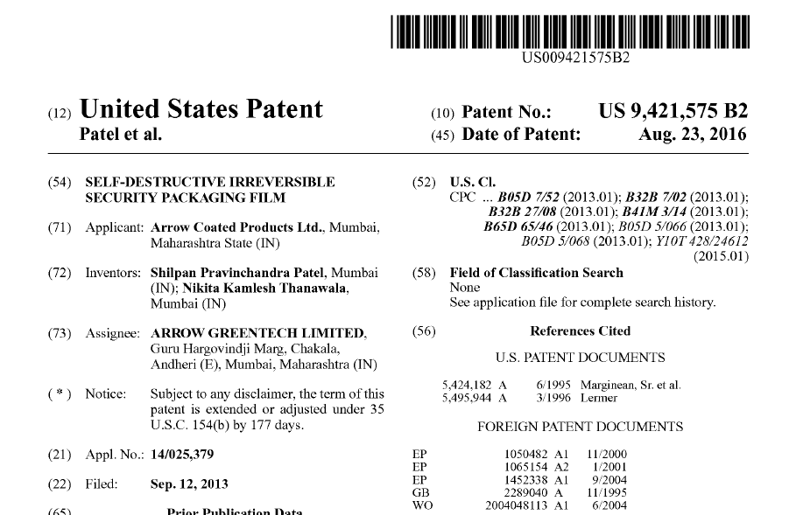
Arrow Greentech: Patent file in US/EU

Slide 6
Link for Patents
EU Patent office:
https://worldwide.espacenet.com/searchResults?search=06766258.5&DB=EPODOC&submitted=true&locale=en_EP&ST=singleline&compact=false&DB=EPODOC&query=06766258.5
US Patent office:
Search from Google patent on enclosed link with Patent No 9421575
https://patents.google.com/patent/US9421575B2/en?oq=9421575
https://patents.google.com/?assignee=%22Arrow+Greentech%22&oq=%22Arrow+Greentech%22

Slide 7
Other points
Checked authenticity about operations of the company, checked on PF office data about employee
Also got a link detailed dispute between Income tax and company providing comfort about genuineness of business
https://indiankanoon.org/doc/150721164/
Filed suit against NU Therapeutics, acquired by Shilpa Medicare claiming infringement of Arrow’s patent in Delhi High Court in December 2015
Got a positive feedback on the company from a friend
“Familiarity biase” Visited AGM and used cleaning products of company which improved confidence.

Slide 8
Risk factors ignored
There was no view about brain behind various patent filed by the company. No clue about real brain behind the research efforts. Neither board member, nor employee appear to have that capability
Commercial value of patent registered. Also the counterparty with whom the company has signed royalty agreement were also unknown and small
One of the large HNI Param Capital exited from the company with almost on gain from investment. On Jan 12, 2015, invested at around ` 505 and exited in September 2017 (price around ` 580-600). However, in June 2017 quarter, DSP Blackrock Microcap MF took around 5% stake in the company. Param Capital group was holding around 2% stake while DSP Blackrock acquired around 4-5% stake in the company.

Slide 9
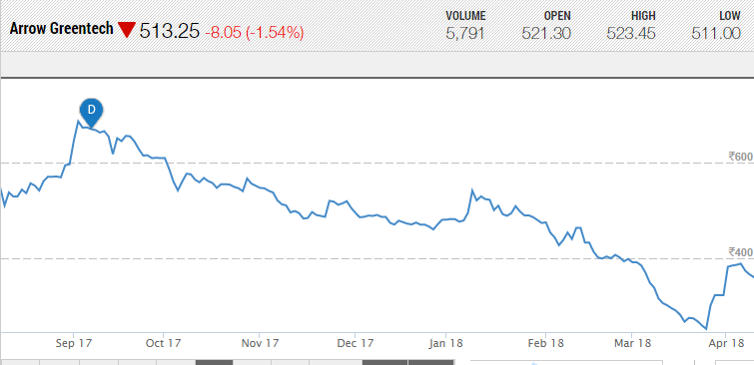
Trigger to Sales
Constant decline in share price
Update from presentation in February 2018.

Slide 10
Development Post Sell
Price continue decline from ` 341 in March 28 2018 to ` 81 on July 5 2018.
March 2018 Results was disaster

Slide 11
Learning
While like the story, due to non availability of critical information i.e. real innovator in the company, did not made core holding and taken only small position with maximum allocation of 1%. That saved from incurring major loss
Scuttlebutt is an art. Need to learn same
Risk is fear and contingent rewards are greed. While first part of statement is truth, second part has more hope and leap of faith
Closely watch the company. At appropriate price, may be good optionality in future. The company is paying tax, dividend and has genuine patents. No debt funded expansion and limited existence risk.

Slide 12
Disclaimer
The name of companies in this presentation are more for learning purpose. The presenter experience is also contributed to his limited understanding, wrong entry/exit price and lack of detail working.
Reader shall take his/her own due diligence before making any investment
The presenter may again invest in company in case he find risk return profile are favourable to his understanding.
The presenter reserve his “Right to be wrong”.

