Slide 1
ValuePickr 2019 Stock Idea Presentation Anup Engineering Ltd
- Ankit Gupta

Slide 2
Disclaimer
The stock discussion is not a recommendation.
I am not a registered SEBI analyst or an adviser.
I am biased as I and my family hold the stock

Slide 3
What does the company do?
The company was demerged from Arvind Ltd and listed on stock exchanges in March, 2019
Engaged in design and fabrication of process equipment including heat exchangers (80 – 90%), pressure vessels, centrifuges, columns/towers and small reactors
Heat exchangers are used to transfer heat or cooling from one liquid to another.
Key industries served – oil & gas refineries, fertilizers, chemicals, pharmaceuticals, food and other allied industries
Technical collaboration with Lummus Technology for special High Efficiency Heat Exchangers (Helixchanger)

Slide 4
Product Profile
Source: Anup’s Presentation

Slide 5
About the industry
Heat exchanger is a USD 21 billion industry globally – used to increase efficiencies
Largest players in the industry include: - Alfa Laval (>30% market share), Kelvion (Germany), Hisaka (Japan), SPX Flow/APV (US), SWEP (US)
High profitability margins with many companies reporting gross margins of more than 45%. Alfa Laval has EBITDA margins of 14 – 15% while its Indian subsidiary also has EBITDA margins of 19%.
Threat of competition from emerging markets:

Slide 6
Transformation journey of the company
Despite being in the industry since 1972, the transformation journey of the company started after company’s current CEO, Mr. Rishi Roop Kapoor joined the company in 2010. He is an IIT Roorkee pass out and had experience in Godrej & Boyce for over a decade.
Lalbhai family is not involved in day to day operations of the company and the company is professionally managed
The company has become a net cash company during the past few years and generates healthy cash flows

Slide 7
What led to the transformation?
Increasing market reach with increasing exports
Empanelment with large EPC players
Even approved for global projects
Improving designing and manufacturing
capabilities – one of the rare companies
with entire range of metal processing
capabilities under one roof
Increasing complexity and weight of the
product manufactured
Sticking to deadlines and avoided paying liquidated damages
- Gained confidence of customers leading to repeat buys

Slide 8
Peers
Pure play companies like Patel Airtemp and Tema India & large capital good companies like L&T, ISGEC and Thermax
Anup has highest margins amongst its peers and even better than much larger and diversified player – One interesting thing to note is the healthy GM of pure play heat exchanger cos

Slide 9
Way forward
All time high order book of the company – 300 crore by end of FY19 – largely from domestic market
Expanding capacities – Target to spend 150 crore in capex for brownfield capacity in Odhav, Ahmedabad and greenfield capacity at Kheda – 40 kms from Ahmedabad – to be funded through internal accruals
Looking for further technological tie ups to enhance capabilities
Targeting 30% growth in revenue in FY20 and 1000 crore over then next 4 – 5 years

Slide 10
What is attractive about the company?
Large industry size globally – new orders expected from all round the globe to improve efficiencies and cleaner fuels from refineries – Euro VI and BS VI implementation.
Valuation – 42 crore PAT reported in FY19 and market capitalisation of around 500 crore currently. Healthy growth expected in revenues and PAT in FY20
Attractive industry dynamics with many players reporting attractive gross margins
Net cash balance sheet

Slide 11
Key Risks
Lumpy business – less visibility of revenue beyond one year
Largely dependent on oil & gas segment
Peak margins – Track record of having margins in the range of 24 – 28% over the past 5 years
Working capital intensive operations
Risk of CEO leaving the company
Rs.40 crore of loans & advances extended to Arvind Ltd (interest bearing though)

Slide 12
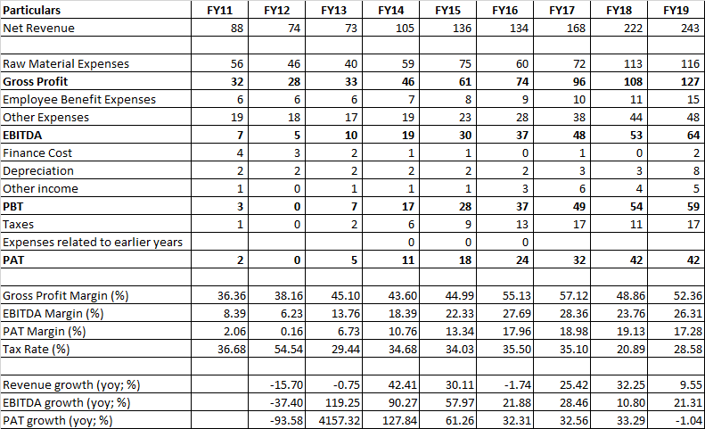
Brief Financials – Profit and loss & ratios

Slide 13
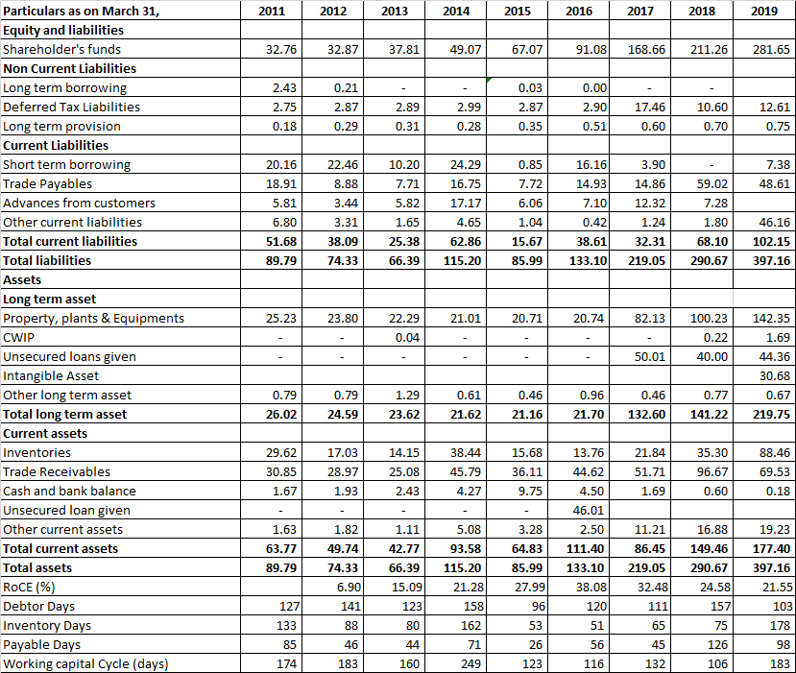
Brief Financials – Balance Sheet & Ratios

Slide 14
Thank You

