Slide 1
Specialty Chemicals – Opportunities ahead in India

Slide 2
Industry Overview
Global Specialty Chemicals market accounted for $1.11 trillion in 2017 and is expected to reach $1.97 trillion by the year 2026
Specialty chemicals market is expected to register a CAGR of 6.5% during the forecast period of 2017 - 2026
Asia-Pacific is estimated to lead the market owing to its rapid economic and industrial growth, especially in the paints and coating industry segment
The Indian chemicals sector is a market worth about USD 160 billion, with specialty chemicals representing about 20 per cent of the value
The domestic specialty chemical sector is expected to grow by about 10 per cent annually to almost double the market size by FY25

Slide 3
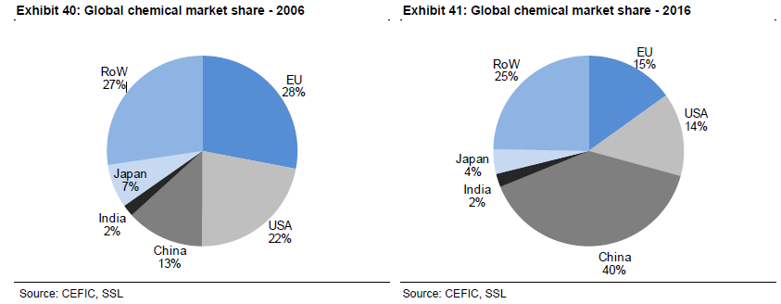
Industry Overview….Contnd
From a distant 3rd player, China has become a leader over the last decade
China has come up with a ‘Blue Sky’ policy focused on introducing stringent pollution control norms to improve air quality . Last year China shut down around 25 chemical plants along the river Yangtze within a month
Though China is still a dominant player but increasing focus on environmental concerns is impacting the growth and this is where India has a golden opportunity to grab a larger pie of the Industry
Major global companies in this space are BASF,Dow Chemical,Dupont,Clariant

Slide 4
Chemical Sector Value Chain
Raw Materials
Basic Chemicals
Polymers
Specialty Chemicals
Raw materials are mainly metallic or non- metallic minerals ,oils and natural gas extracted from mining
Involves raw material procurement,R&D,development and patenting of innovative chemicals and chemical processes
Refining of oil and gas into Petrochemicals
Products manufactured during this step includes Olefins (ethylene & Propylene),Polyolefins and industrial gases
Basic chemicals production from raw materials is second step in the value chain
These basic chemicals are used as raw materials to manufacture commercial products such as dyes,detergents,chemical
Includes synthesis,distillation,thermal cracking and polymerization
Products manufactured during this step includes Intermediates
This step involves the manufacturing of polymers from basic chemicals
Polymer manufacturing is hybrid of batch and continuous processing
Raw materials for polymers referred to as feedstocks are by-products of petroleum or natural gas production generally produced in step 2
Polymers, principally used to make plastic goods constitute about 80% of the chemical industry’s production output
Most complex chemicals produced during fourth step known as specialties chemicals
Fine chemicals are complex, pure chemical substances produced by traditional organic synthesis in multipurpose plants
These fine chemicals are used as starting materials for specialty chemicals
SC are used for a variety of purposes and include additives,coatings,pharmaceuticals and vitamins

Slide 5
Sector Understanding
The chemical industry is classified on the basis of value add and the major categories are as follows
SC is a capital intensive industry with complex technological products and processes
It’s categorized as a cyclical sector since the major raw material consumed to produce specialty chemicals are natural gas and petroleum products and hence the volatility in oil and gas prices impacts it’s profitability

Slide 6
Sector Understanding – Contnd..
Specialized nature of products leads to significant differentiation
Factors such as substantial research and development (R&D) requirements, technical skills, capital intensiveness, long approval process and stringent regulations create important barriers to entry
SC is a consumer driven sector and the companies in this sector compete based upon pricing, technology and services. Vendors operating in the Specialty Chemicals Market strive to deliver the best quality products based on innovative technologies and best practices
Raw materials account for ~> 60% sales for most chemical companies. Any increase in raw material prices significantly impacts the profitability but one big advantage is that the established players have pricing power and can pass on the added cost to the customer

Slide 7
Growth Drivers for Indian SC
Domestic availability of raw materials at competitive prices
With increased GDP and consumption led double digit growth in key markets, there is a big domestic market already in place
Strong demand growth in consumer industries and a domestic industry supports ‘premiumisation’ of products
Growing trend of easternization and reduction of capacities in China on environmental concerns.
Low cost manufacturing
Policy support from Government - set up a National Chemical Policy to accelerate the manufacturing in the chemical sector
Strong Engineering and R&D Capabilities
Strong base of technically skilled manpower with the expertise needed to store and handle chemicals
Supporting FDI policy with 100% FDI investment allowed in this sector
Most of the chemicals currently are under 18% GST slab in India and going forward the Govt is aiming to bring almost all the items under 12% slab that can be another positive for the sector

Slide 8
Key Risks To The Sector
Regulatory overhang since pollution is a key concern so there is always a threat of ban of products by the Government
Change in environment regulations and delay in environmental clearances
Fluctuation in raw material prices
Delay in product approval from Customer and as well as regulators
China may decide to loosen it’s pollution norms again since their economy is going through a rough phase
Currency volatility risk as the companies in this sector have a large part of their revenue coming from exports in multiple countries
Demand Supply imbalance : e.g. Phenol and Acetone price dropped by 27% in last 3 months in China thereby denting the margins of Deepak Nitrite significantly
Dependency on major suppliers

Slide 9
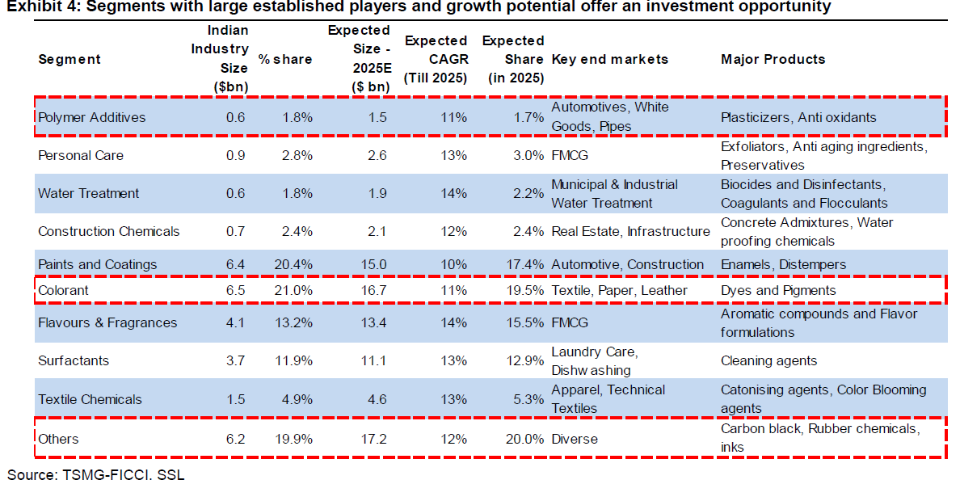
Key Sub-Segments & Market Share

Slide 10
Key Players
COLORANTS
AARTI INDUSTRIES
Top tier specialty chemical player in Benzene derivatives segment
Diversified product offerings with 200+ products and 1000+ customers in more than 41 countries
Recently won two major long term contracts of value with revenue visibility of Rs 9bn per year
Follows a Cost plus pricing model and hence is immune to raw material volatility to some extent
Foraying into new derivatives such as Toluene
BODAL CHEMICALS
One of the largest integrated dye-stuff manufacturer with 25% and 13% domestic market share in dye intermediates & dye stuff respectively
Almost debt free company with a major capex completed recently more than doubling the capacity of dye stuff in March ‘2018
Presence across entire dye stuff value chain reducing dependency on supplier and cost advantage
Export revenue 45% with sales to 150+ Customers in 45+ Countries
Debt free company with consistent track record of expansion in growth areas

Slide 11
Key Players
COLORANTS/FRAGRANCES
Atul Ltd
One of the largest integrated chemicals company with a diversified product portfolio of 1350+ across multiple business segments
Operates primarily through 6 business divisions namely Colorants, Pharmaceuticals,Agrochemical,Intermediates and Polymers
Undergone major capex of 360cr over last 3 years with focus on significantly expanding it’s base in specialty bulk chemical and specialty polymers
Debt free company with strong management (Lalbhai group)
Management targeting 15%+ revenue CAGR in coming years with improving profitability due to sustained effort to launch higher margin products
SH KELKAR
One of India’s largest fragrance and flavor company with market share of 14%+
Strong relationships with fast-growing FMCG companies, high exposure to
emerging geographies & product innovation are the key for the company’s growth
Emerging player in India’s INR 18.8bn flavor market which is dominated by small unorganized players providing huge opportunity for players like SHKL to grow
Strategy shift in ingredients and exports business to drive margins – intends to
shift production to low cost Vapi facility and outsource production of low
value items.

Slide 12
Key Players
OTHERS (RUBBER /CARBON BLACK)
NOCIL
India’s largest manufacturer and supplier of rubber chemicals
Acknowledged as a dependable supplier of rubber chemicals due to it’s decades of experience and one stop shop offering to customers
Debt free company with last 3 year average ROE and ROCE of 18%
Undergoing a significant capex of 425 cr mainly to be funded by internal accruals and will double the asset turnover
It’s a part of Arvind Mafatlal group and has a sound management
PHILIP CARBON BLACK
7th largest Carbon black company globally with leadership position in Carbon
black in India
Low financial leverage with penetration in new geographies and increasing
Customer base
Currently in the midst of a brownfield expansion of 320cr to increase its specialty black capacity by 32000 MT and Rubber carbon black by 48,000 MT
Developing new specialty applications to cater to automotive, consumer electronics and home appliances market

Slide 13
Evaluation Parameters
 | Management | Financial | Scalability | Valuation | Risk
AARTI Industries
Atul Industries
Bodal Chemicals
NOCIL
SH KELKAR
Philip Carbon Black
strong
weak

Slide 14
API Opportunity
Total production market of API in India was valued at approximately US$ 11 Billion in FY 2016. This market is forecasted to grow at a CAGR of around 9% during the period of FY 2016–FY 2022
Of the total domestic consumption, ~ 32% is imported. Of the total imports, China alone accounts for 57-60% of the APIs imported by India
Ongoing supply disruptions in China on account of an estimated 40 percent of all China factories being shut down in the last one year itself presents huge growth opportunity for API producers in India
China has started increased API prices as labour costs had gone up in that country. This is the right opportunity for India to develop APIs and intermediates. China has started purchasing APIs from India and concentrating on manufacture of formulation drugs

Slide 15
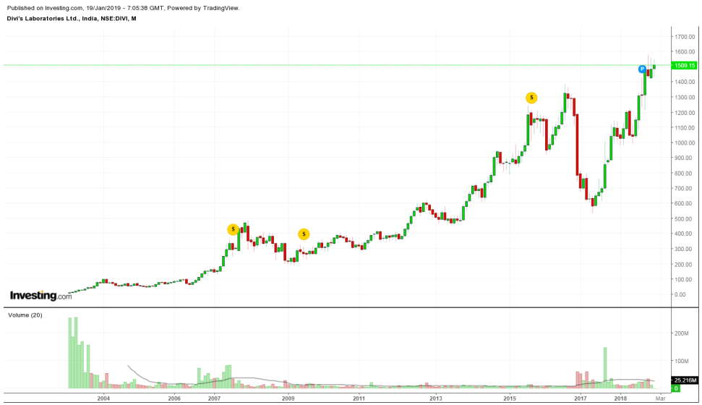
Divi’s Labs attractive API bet
Robust financials with ROCE 21% + and ROE 15%+
Promoter holding above 50% and debt free company
Healthy Operating margin of 40%
Management is quite bullish on APIs and sees a multi-year opportunity in the sector
Embarked on a Rs 1200 crore fresh brownfield capital expansion at its two units in Visakhapatnam and Hyderabad.
Some of the other major players in this space are
Laurus labs
Aurobindo pharma
Hikal
Lupin
Stock generated > 50% return since Jan’ 18

