Slide 1
Sirca Paints – Kyonki Hum Diwaron Par Nahi Rehte

Slide 2
Disclaimer -
The following is not a buy or sell recommendation.
My clients and I may have an exposure in the below mentioned company.
Please do your own due diligence and consult with your financial advisor before buying/selling the below mentioned company.

Slide 3
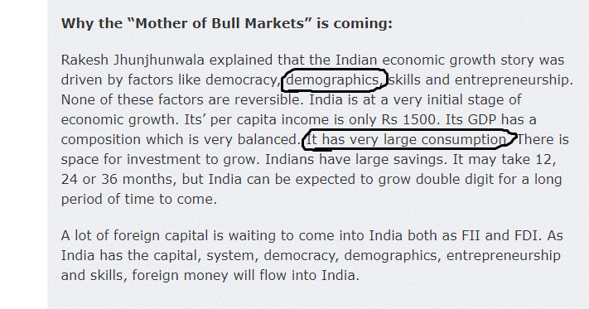
Rakesh jhunjhunwala on bull mkt

Slide 4
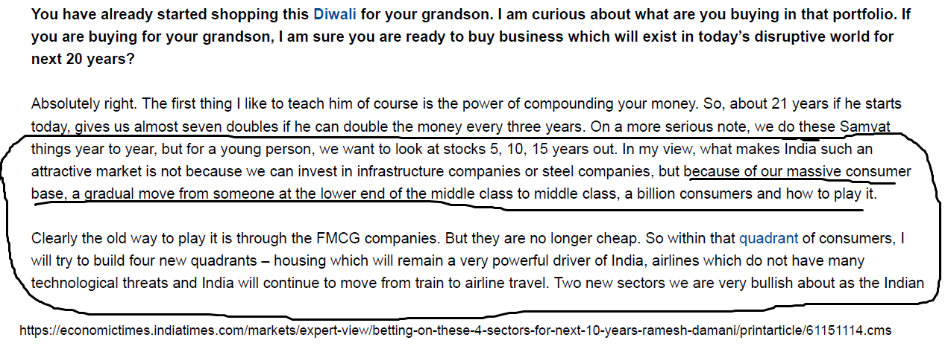
Ramesh Damani’s advice for young investors

Slide 5
UNSTOPPABLE CONSUMPTION:
As the per capita income will go up, people will keep on buying new things or upgrade the old things.
Cooler ------ Air Conditioner
Video Game ------ Play station
Bikes ------ Cars
Constant buying/upgrading the things……..

Slide 6
Investment philosophy
Value + Growth + Quality is where all the fun is.
Ideal business is one that takes no capital but yet grows!
We all want to buy companies which are available cheap, have clarity on good earnings growth and have good quality products.
Early Bird discount – Getting in early in a good company can be fruitful before the market figures out its potential.
Early Bird discounts exist for a variety of reasons-
1- SME exchange companies don’t get valuation.
2- Funds generally are not allowed to buy these companies.
3- A lot of brokers don’t list these stocks on their platform.

Slide 7
The Paint industry – we all know about it.
Kansai Nerolac management in the last concall said the paint industry will grow in double digits for the next 30 years.
There is not any technological disruption envisaged against this sector.
Generally Paint companies trade at premium valuations due to stability and consistency of earnings growth – Its structural growth!
A constantly upgrading Indian consumer bodes well for the sector.

Slide 8
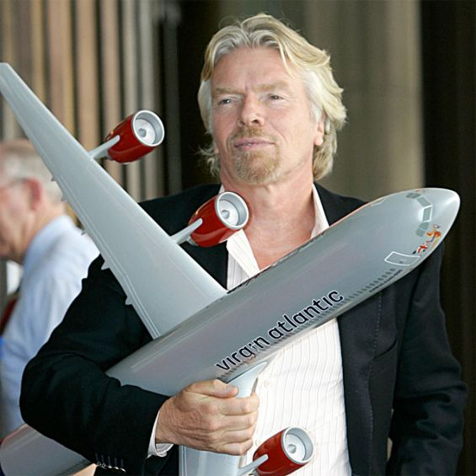
Richard branson

Slide 9
Sirca – Products
Sirca offers a large range of products which are applicable to most users.
Products include Stains, PU finishes, Water borne coatings, Glass coatings, Metal coatings etc.
These products provide better finish & durability as compared to traditional polish.

Slide 10
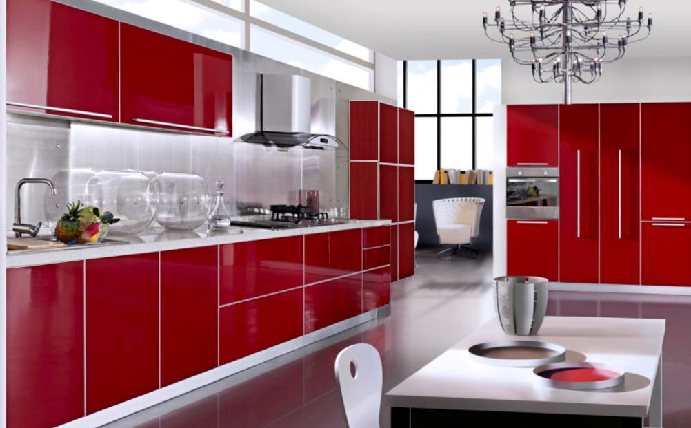

Slide 11
Sirca Paints - A large ever growing runway ahead of it.
Sirca Paints caters primarily to the premium wood coatings market. They have just entered the metal coating segment (They do not operate in the wall segment).
Sirca Paints India has an exclusive long-term distributorship & Manufacturing agreement with Sirca SPA which is an Italian company.
Since the last few years, they were importing from Italy and selling it in India. They have grown revenue at a near 25% CAGR since 2013.
From 2019, they will also manufacture in India which is set to start a whole new chapter of growth for Sirca Paints India (Currently, if European Paint products have to be exported to Bangladesh or Sri Lanka, they have to pay custom duties in excess of 100% which makes it unviable but once the paint is manufactured in India, the custom duties fall to 5% hence opening up large export markets for the company).

Slide 12
Sirca Paints…continued
The wood coatings segment is growing at 20% p.a. which is a big tailwind for the company.
Sirca does not compete with Asian Paints, Nerolac, Akzo Nobel etc as it is only operating in its niche super premium wood coating segment.
Company has recently forayed into metal coatings as well.
Company has about 85% business from OEM and balance Retail.
Company is a market leader in the North with great brand recall and now is in the process of a Pan-India roll out.

Slide 13
Sirca - A few highlights.
ROCE is 43% as on FY18.
Virtually a debt free company.
Always generated positive OCF.
Revenue CAGR has been 25% approx over last many years (This number could accelerate with entry into pan india and also export markets such as Bangladesh, Sri Lanka & Nepal).
Company has always been able to pass on RM volatility due to its products being in the super premium segment.
Product quality of Sirca Paints is extremely high and often regarded the best in class in its segment.

Slide 14
Sirca - A few highlights.
FY 18 Revenue was approx 90 crores
PAT was approx 20 crores.
Mcap is around 400 crores which implies the valuation of 20x on trailing numbers.
Company will grow at 25% plus considering the expansion due to manufacturing in India and sales in newer geographies.
Significant re-rating will happen once the street sees the performance of the company followed by migration to the main board.

Slide 15
Q1 snapshot
Company recorded a revenue of INR 26cr in Q1FY19 registering a growth of +31% YoY.
Q1 is the weakest quarter for the industry. Still the Q1 runrate takes us significantly above last year’s revenue of 92cr.
Company has started sharing volume data from Q1. Volume for Q1 stood at 650,000 litres.
Receivables had an one-off spike in FY18 due to GST but it has already stabilized.

Slide 16
Corporate governance
Company has given a Q1 circular on NSE even though SME exchange companies need to report only every 6 months.
Some marquee investors in the company include Reliance Mutual Fund.
Management has indicated their future growth will be faster than the market but without compromising on ROCE & Margins.

Slide 17
Company vision
Grow above industry growth rates of 20% p.a
Focus on maintaining margins.
Growth with internal accruals only.
Generate a Pan-India presence in the coming years.
Capture more Retail business.
Capture a part of the export market which is larger than the domestic market at present.

Slide 18
Management Team
Mr. Sanjay Agarwal (Chairman cum Managing Director)
▪ Chairman cum Managing Director of Sirca Paints India Ltd. ▪ Chartered accountant ▪ With 20 years of Experience in wood coating industry, he worked as a pioneer and leader in this segment and marked presence of brand Sirca in every part of India
Mr. Gurjit Singh Bains (Non Executive Director)
▪ As a co-founder of Italian Furniture brands to different parts of world Including India ▪ As Director In BGB ITALIA an Italian registered firm, exports Top renowned ▪ First to introduce branded Italian furniture in India ▪ Completed degree in masters in economics from University of Venice Industry ▪ Experience of more than 20 years in wood coatings and Italian Furniture Sirca paints India Pvt Ltd, built Brand Sirca In Indian market
Mr. Apoorv Agarwal (Joint Managing Director)
▪ Experience of more than 8 years in Italian Furniture and Italian wood coatings ▪ Completed masters in Finance and marketing from IIPM and Degree of Commerce from University of Delhi ▪ Started a career with Sirca wood coatings Italy, Managing sales and marketing and later took training with many renowned Furniture brands from Italy ▪ Formed La Tendenza , a unique destination to experience high-quality European furniture with Brands like BEB Italia , Reflex , Laura meroni , Simone Cenedese etc

Slide 19
Risks
Current margin of 30%+ could reduce to 25%-28% range.
High receivables due to instability of GST (although Management has indicated this has already started to normalize).
New entrants in premium segment (although Asian Paints, Pidilite have been trying to penetrate this market since a few years, Sirca has always remained a dominant player in the North due to its superior product quality and strong relations with Dealers, Contractors, Architects & OEMs).

Slide 20
KASHISH SHAMBHWANI
NEGEN CAPITAL SERVICES PVT LTD.
You can reach me at: kashishshambhwani@gmail.com kashish@negencapital.com

