Slide 1
NSE: ARMANFIN
VP BLR meet
21-October-2018

Slide 2
Disclaimers and About Me
Disclaimers:
I am not a SEBI Registered Analyst or Investment Advisor
This presentation states facts and opinions and is not investment advice
I am invested in Arman Financial so views are biased
About me:
Market experience (“seat time”) – 4 years only
Day job – Risk and Financial Advisory with Big 4
Web presence – Blog: www.timedimpulse.com, Twitter: @fearful_greed,
Why I chose highly risky Microfinance / NBFCs ?
Chasing Margins (40%+ OPM)
Chasing Growth (Topline)
“Since equity is a sliver of the overall value of a financial service firm, small changes in the value of the firm’s assets can translate into big swings in equity value” – Aswath Damodaran
AKA
Leverage is like dry powder, can propel you or blow up

Slide 3
Arman Financial Services: Background
Arman Financial Services (NSE: ARMANFIN) is a diversified Gujarat based NBFC (Asset Finance & Microcredit)
Arman Financial Services
(NBFC – AFC)
Offerings:
2 & 3 Wheeler finance – 21% total outstanding loans
MSME Lending (since 2018) – 11%
Presence: Gujarat, Madhya Pradesh
ARMANFIN is a CARE rated MFI 2+ (MFI Two Plus) on a 1-5 scale, 1 being the best rated
ARMANFIN had an AUM of 423 crore as of last reporting date versus Market Cap of 180 crore (as of 15-October)
Recently had a rating upgrade from BBB to BBB+ due to increased geographical diversity
Namra Financial Services
(NBFC – MFI)
Offerings:
Microfinance lending – 68%
Presence: Gujarat, MP, Uttar Pradesh, Uttarakhand, Maharashtra
Investment history and Capital Structure
Arman started operations in 1992 as Arman Lease & Finance Ltd, went IPO in 1995
Promoters own 27.26% of the public shares – they also have class A shares (i.e. shares without significant voting rights)
April 2018 - SAIF Partners invested (50 crore minus interest) via Debentures convertible to Equity in 18 months (25% stake). Tier 1 injection that can support 300 crore AUM (MFIs need to maintain 15% CAR)
SAIF deal is Venture Debt -> Venture Equity + Interest
Debt to Equity ratio is 6, equity size is small, counter is very illiquid
Recently raised 33 crore debentures at 14% interest per annum in 2016 when they were BBB rated.
No other private debt raised so far (significant point for an NBFC)

Slide 4
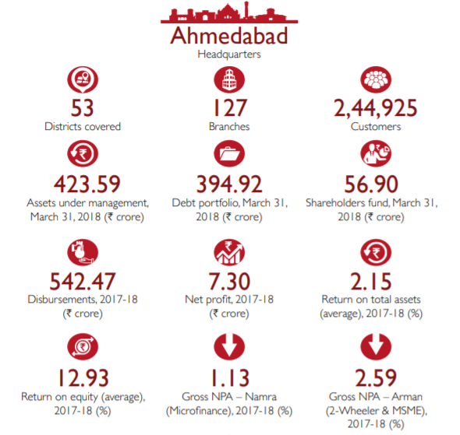
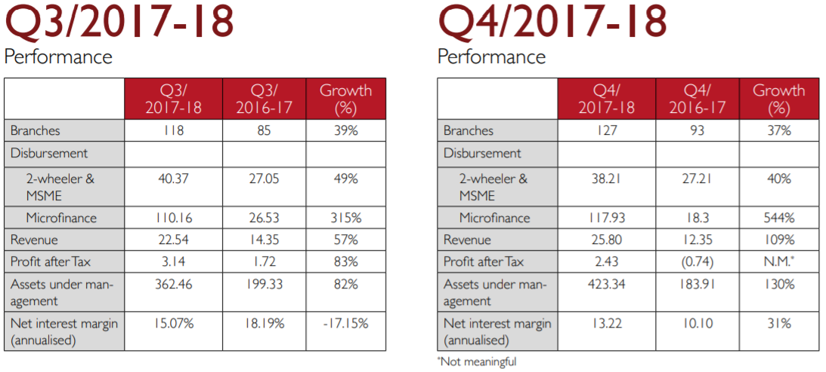
Arman Financial Services: Background
Management Team:
Executive Director since 2010, Alok Patel worked with KPMG for 4 years as independent auditor and has a Credit Risk background. Father and Managing Director - Jayendra Bhai Patel is an industry veteran of 25 years.

Slide 5
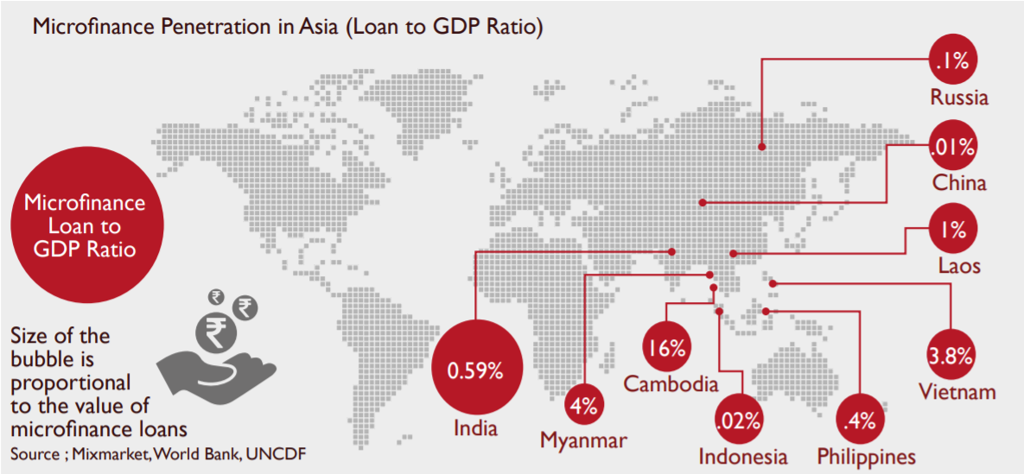
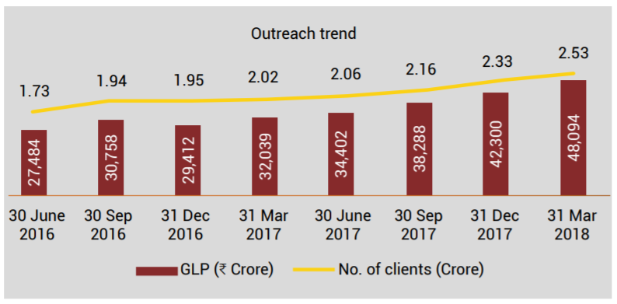
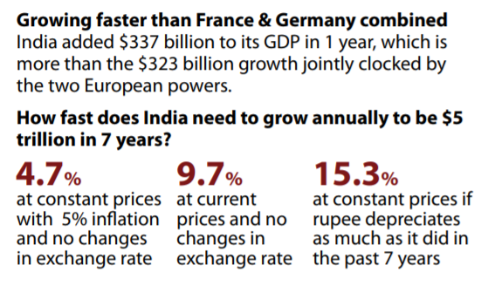
Microfinance: Investment Thesis
Loan to GDP Ratio is currently 0.59%
Loans will grow
GDP will grow
A
B
A
B

Slide 6
Microfinance: Investment Thesis
Lesser risk than it used to be .. Lesser risk than it seems .. (Contrarian?)
Risks – In Principle…
LIABILITIES / FUNDING
Lack of stable funding sources
Raising debt periodically
ASSETS / LENDING
Loss Given Default (LGD) = 100%
The unbanked are riskier customers than gentrified
Unsecured loans are always riskier
Risks – In Reality… ?
LIABILITIES / FUNDING
Good relationships with banks (M&A, partnerships)
Internal accruals with high ROEs substitute debt
Lower tenor of loans
ASSETS / LENDING
Post demonetization recoveries almost complete
Recoveries even in written off accounts (LGD<100%)
Lower ticket size loans (<30k INR)
Joint Liability acts as effective guarantee
Better asset quality than affordable housing finance

Slide 7
MFIs as Banking Channel Partners
Before Demonetization
After Demonetization
Consolidation / M&A
Disbursements
Disbursements
Kotak Bank -> BSS Microfinance
DCB Bank -> Annapurna Microfinance
IndusInd -> Bharat Financial Inclusion
Yes Bank -> Yes Microfinance
CASH
CASH
DIGITAL
CASH
Collections
Collections
DIGITAL DISBURSEMENTS
DATA & DIGITAL:
Better Risk Data
Lowered Lending Costs
Lowered Operational Risk
LENDER
Banking Channel
BORROWER
Jan Dhan A/C
Micro ATMs / ATMs
CASH

Slide 8
Changing Risk Map of Microfinance in India
The Industry continues to survive shocks, self-regulate and strengthen its inherently fragile business model
Risk Type | Direction | Explanation
Political / Policy | Down | Risk is idiosyncratic (demonetization). RBI regulatory framework gives stability and provides protection. Lending spreads are less usurious than before – RBI policy
Economic | Sideways | Risk is idiosyncratic, e.g. famine, financial distress amongst milk farmers
Default | Down | Default risks depends on geography and credit practices of the MFI Maturing practices, access to better risk bureau data and greater integration with banking channel improves credit quality
Funding | Sideways to Up | Funding risks depend on the relationships, size and rating of the MFI Easier to fund short term lending than long tenors (e.g. Housing Finance)
Interest Rate | Up | Interest rates are expected to tighten globally
Operational | Down | Operational risks go down with electronic disbursements

Slide 9
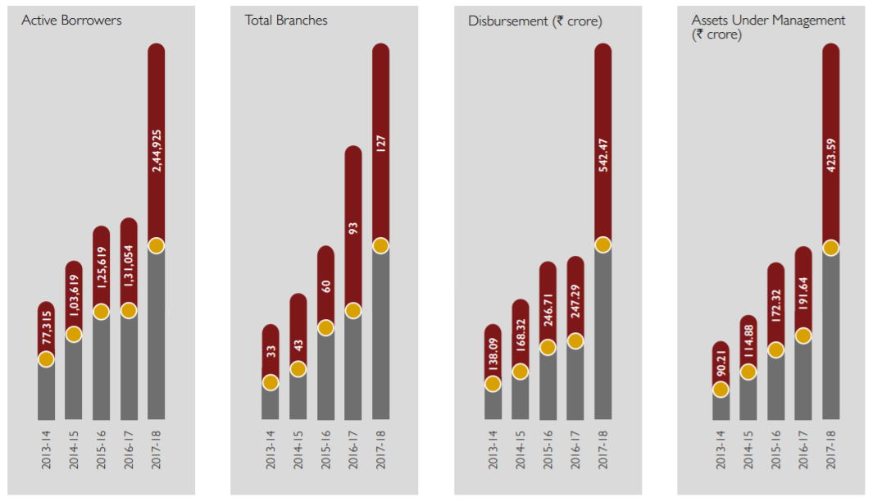
An NBFC without CASA should play Chess not Poker…
Strategically Conservative and Aggressive (Defensive-Attack):
Arman froze all disbursements post-demonetization, aggressively provisioned for losses and focused on collections
After stabilizing the assets, Arman entered new states of UP & Maharashtra to capture space vacated by other players (such as Satin)
As AUM has increased Arman has focused on diversifying its MFin heavy loan book, expanding into MSME and LAP (higher ticket size)
Product | Product Strategy
Microcredit | Not be the first MFI in a district Low ticket size, biweekly collection Avoid cluttered districts Strict focus on rural lending
MSME Loans | Target rural areas Target MFI+ clients (more affluent) Unaddressed ticket size 40k to 1.5 lakh
2&3 Wheeler Financing | Cash cow business

Slide 10
Risk Management as Moat
An NBFC is essentially a leveraged business:
Risk-adjusted returns: In long run, effective Risk Management should serve as a sustainable competitive advantage, not yield chasing
Risk Culture v/s growth culture: Culture is the DNA of a “bank” (e.g. a Kotak v/s a Yes Bank) and even more-so for an NBFC.
ROE accretive: Effective Risk Management will improve credit quality but should eventually also lead to lower cost of funding.
ARMANFIN has demonstrably good risk practices:
Credit Appraisal: Lending is evaluated independently for risk at the branch and head-office levels.
Risk segmentation in new product offerings: MSME clients are not overlapping with MFI clients.
Conservative accounting: Aggressive provisioning during Demonetization. Historical preference for write-offs than provisions.
Recovery: Separate recovery teams for MFI loans
Conservative outlook: Consciously chose not to get into Housing Finance as risk was perceived
Gross NPA at 1.13% for MFI business in 2017-2018, compared to Satin’s 4.4% and Bharat Financials' 4.6%
Growth Drivers:
Management team gets better –
Alok Prasad appointed Independent Director. Mr. Prasad is a veteran banker with over 35 years of regulatory, banking, and financial services experience, former CEO of MFIN (Regulatory body).
Mridul Arora, managing director at SAIF Partners, has been appointed as a non-executive additional director. He focuses on financial sector investments for SAIF Partners.
Geographical Advantages – West and North India are most underpenetrated regions for MFI loans. Gujarat is an MSME belt.

Slide 11
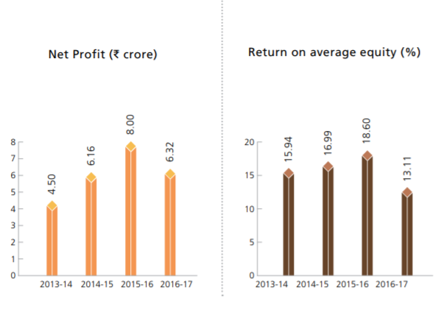
Risks are Real Too…
Pre-demonetization levels of Net Profit, ROE & ROA are still to be achieved
Very illiquid counter – the exit doors may be shut!
Competition from Small Finance Banks, FINTECH disruption and Jan Dhan overdraft loan facilities
Risks from political changes and geographical expansion (expanding rapidly into Uttar Pradesh, Maharashtra)

Slide 12
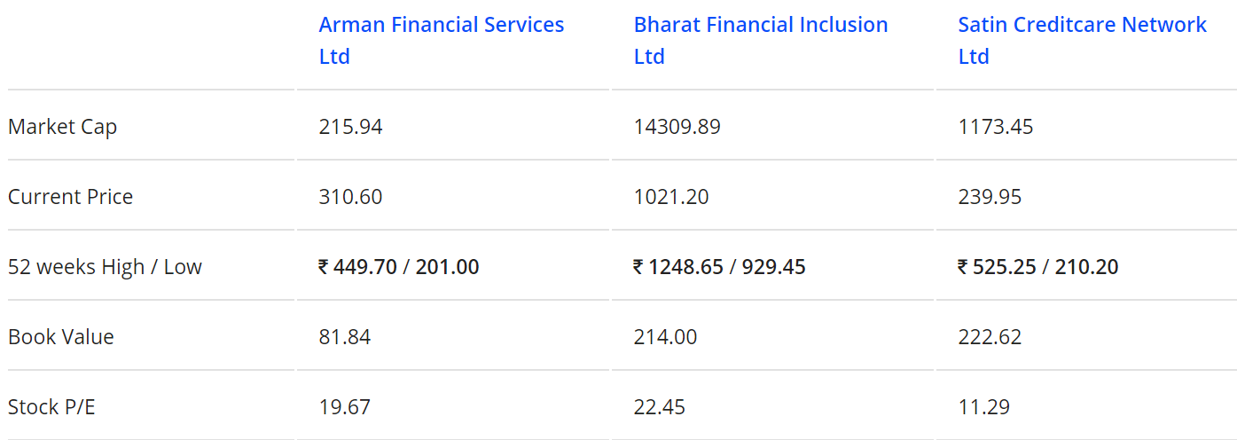
Peer Comparison

Slide 13
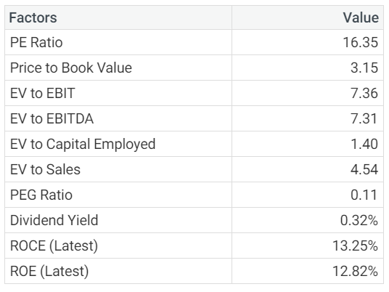
Valuations
ARMANFIN

Slide 14
THANK YOU

