Slide 1
My Investment Journey and Learning
1
A failed market enthusiast → Financial analyst → Data Scientist & Individual Investor
Trying to find common ground through a set of experiments

Slide 2
My Journey so far..
$$ Evaporate
$$ Mutual Funds
$$ Portfolio Management Models
Gradual shift from mutual funds, to equity, build process, framework, tools, leverage power of analytics
Pursue MBA, Financial Due Diligence, The Equity Desk, The Intelligent Investor
ACCEPTANCE
EXPERIMENTS
2009-12
2015-18
2007-08
2013-15
2019-25
IGNORANCE
RELUCTANCE
WAY FORWARD
No clue of markets, opened trading account, watched TV to buy
Personal life shifts, Career shifts, Kept reading, Money parked in mutual funds, averse to equities
To leverage the art and science of value investment leveraging layer of machine learning (ML) to generate above index returns
$$ Touch and Go
$$ Personal Equity Management
2

Slide 3
2015-2018
Do not try to imitate others and work as per your SWOT analysis
Need to balance time for cash inflow generation as well as wealth creation
Leverage technology and analytics for better return per unit time
INVESTOR and DATA SCIENTIST working in collaboration
Play bigger games in your own arena and not on foreign pitches
Don’t forget to practice few matches on foreign pitches
Keep Learning, Keep Experimenting, Keep calibrating
Basic principles beneath the journey
DOMAIN (Company -> Industry -> Sector -> Market)
BEHAVIOR (Heart + Mind in Sync)
TECHNOLOGY (Descriptive -> Predictive )

Slide 4
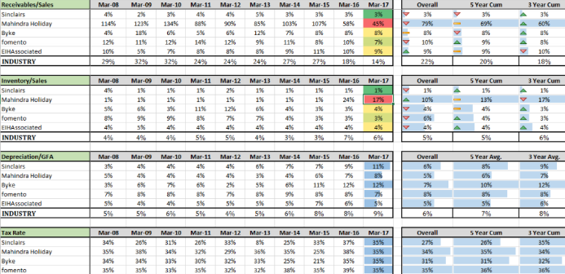
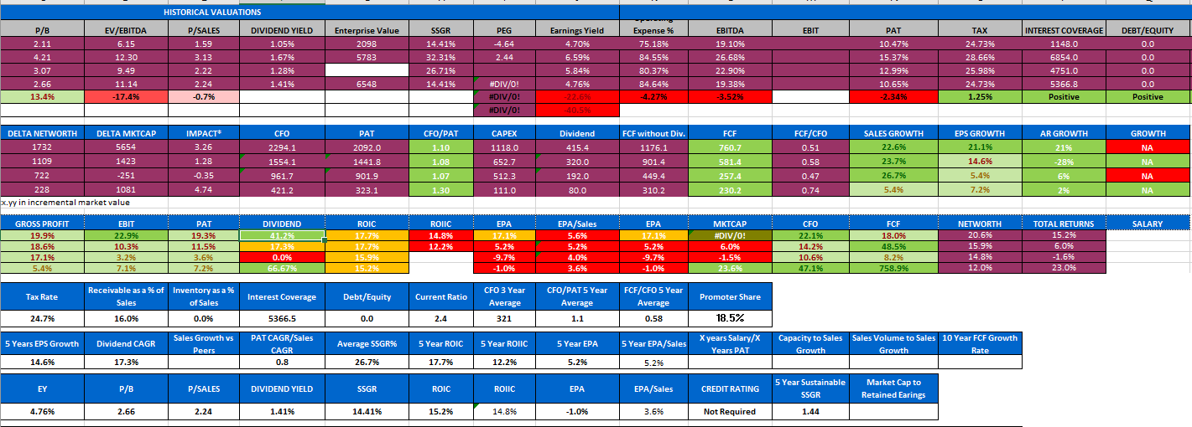
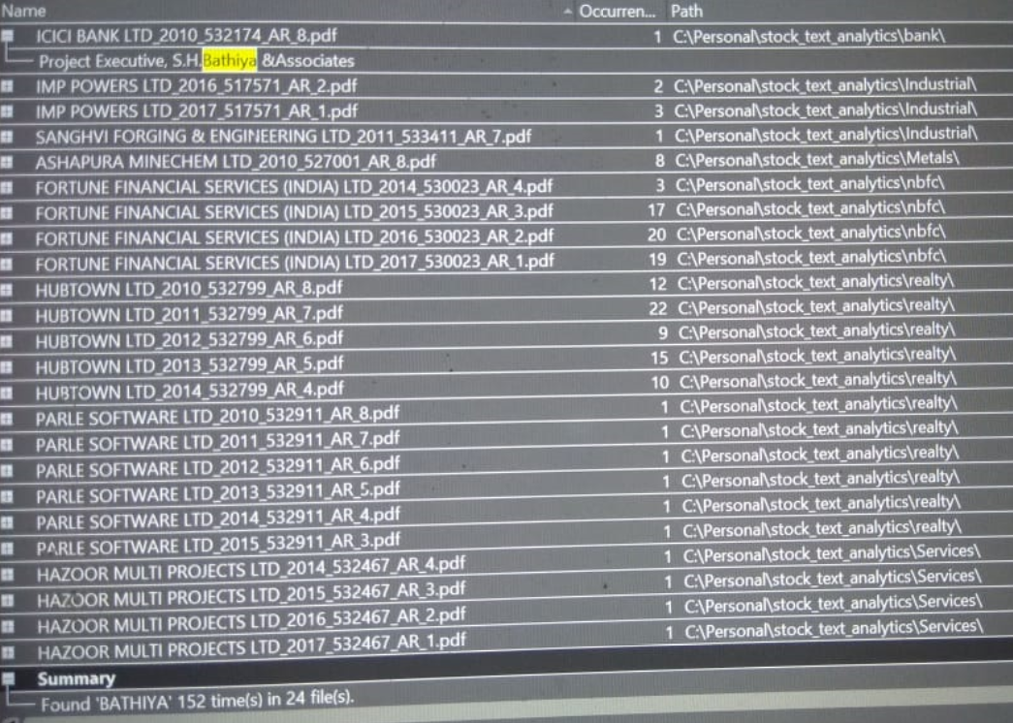
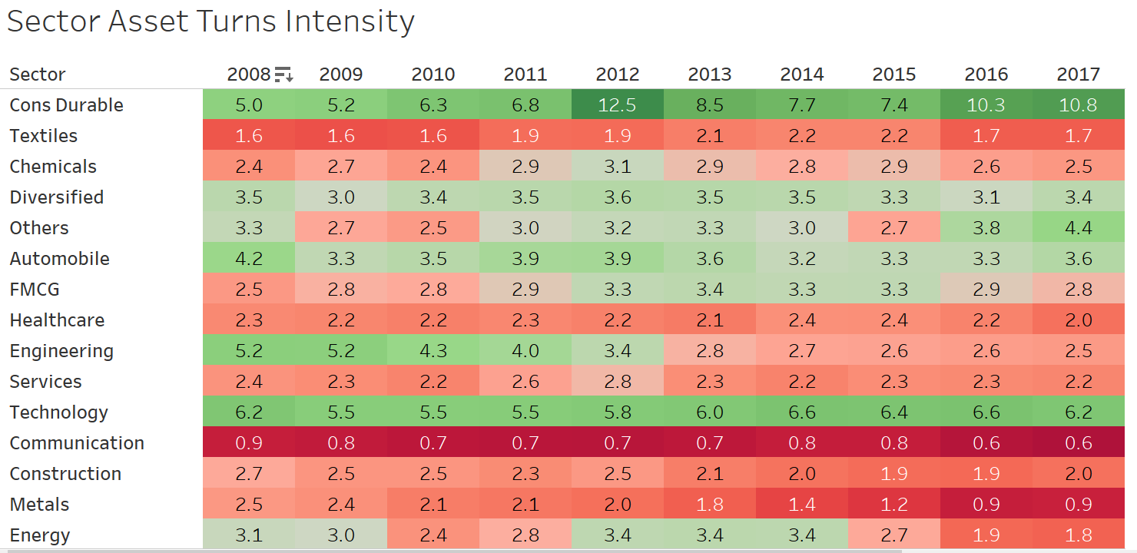
Learning Process and Outcome..
Company
Industry/Sector
Market & Portfolio
Checklist
Competitive Analysis Framework
Leverage screener to build our screens of checklist rules for various situations as per level of expertise for initial filter
Exchange Information Filing Analysis Tool
Competitive Analysis Tool
Automatically download consolidated exchange filings tagged by information categories and filing links available
Company Analysis
Framework
Compare a company with 4 competitors over 70+ key financial metrics
Company/Industry/Sector/Market Analysis Framework
Company Analysis Tool
Leverage screener to analyze companies based on historical financial performance
Competitive Analysis Tool
Annual Report Database & Analysis
Open source project to analyze sectors/ industries / business cycles & related opportunity
Audit a concerned auditor, entity, person across companies

Slide 5
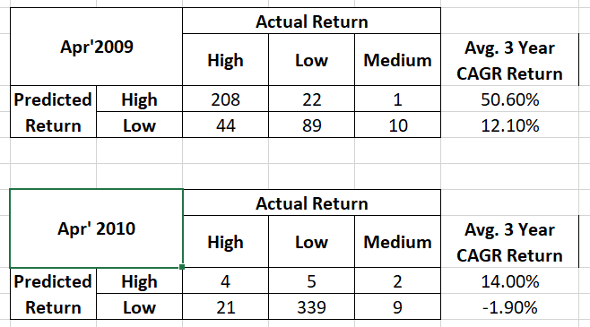
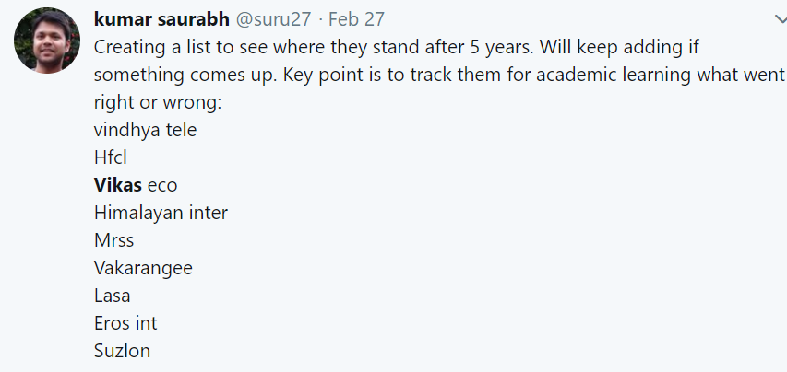
Learning Process Pipeline..
Machine Learning and Domain Knowledge Driven :
Market Attractiveness Index
Portfolio Selection Model
Web Driven Corporate Governance Scorecard for Companies/Promoters/Board Members
Probability of Fraud/Financial Shenanigans models

Slide 6
Key Learnings (3 Years) – Worked/ did not work?
The power of data in isolation vs data consolidated is MULTIFOLD
Taking sectoral bets when going was tough:
IT (2017),
Real Estate & NBFC (Nov’16)
Hotel (Early 17)
Improved on experimenting and failing quickly rather than being emotionally attached
Individual stock portfolio
1st shot on identifying turnaround stories
Tried to follow a basket approach in pharma which failed
Staggered accumulation and distribution with varied time frame stock wise distributed works better
Try to understand the industry but if it is too hard, then avoid
Perfect timing is not required but reasonable timing is important
Many times, even numbers scream, mental perception does not allow us to read through it
Mistakes of omission : Safari (came across an article 60’s is new 30’s for these CEOs, compared with VIP, did not feel margins can be go than market leader and discarded)
Mistakes of commission : Pharma Basket
Mistakes of risk interpretation : Wonderla
Asset heavy industries can have debt free/free cash flow companies
In short term, quality is a sentiment

Slide 7
Thank You All..
7
We all live for dreams and aspirations. I dreamt this and I am living it in this moment

