Slide 1
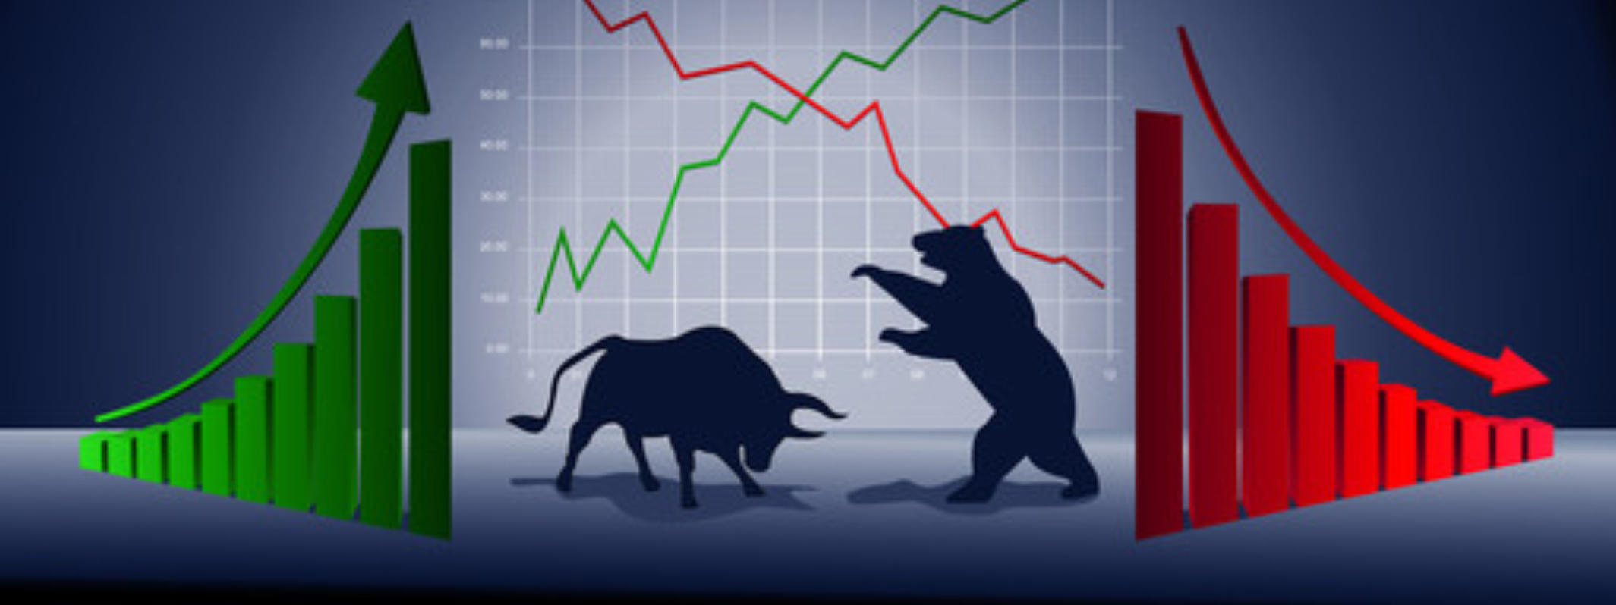
F&O Markets
How is it relevant to you
- Rajesh S

Slide 2
Introduction to Future and Option(F&O)
What is F&O Market ?
Options and futures are both financial products that investors use to make money or to hedge current investments.
Derivatives are securities which derive their value from one or other underlying securities.
Simple explanation: A derivative is like buying financial product whose value is derived from the Stock Price. The value of the derivative would replicate the value of the Stock.
The only place where we can sell something without even owing that – Buy Low and Sell High or Sell High and Buy Low .

Slide 3
Type Of Derivatives
Future
Options

Slide 4
Options
CALL Option
Put Option

Slide 5
Can we Make money in a falling market with “Investment” only approach ?

Slide 6
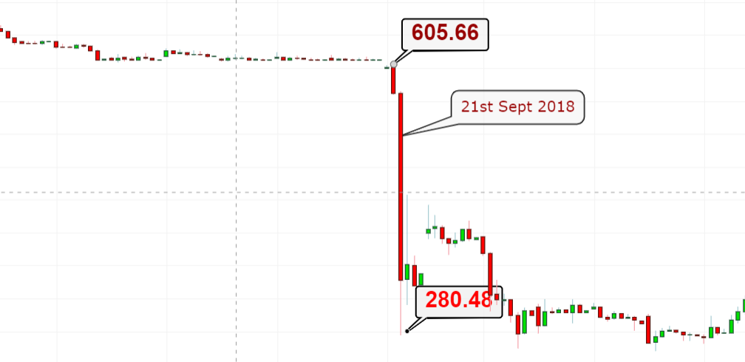
Value Destruction !!

Slide 7
What was cooking ??

Slide 8
Huge Position formation !!
Position as percentage (%) of MWPL
Sr No. | Underlying Stock | Client 1 | Client 2 | Client 3 | Client 4 | Client 5 | Client 6 | Client 7 | Client 8 | Client 9 | Client 10 | Total
1 | ADANIENT | 4.89 | 4.35 | 4.20 | 3.63 | 3.34 | 3.05 |  |  |  |  | 23.46
2 | ADANIPOWER | 4.98 | 4.64 | 4.13 | 3.96 | 3.18 | 3.16 |  |  |  |  | 24.05
3 | ALBK | 3.12 |  |  |  |  |  |  |  |  |  | 3.12
4 | ANDHRABANK | 4.02 | 3.57 |  |  |  |  |  |  |  |  | 7.59
5 | APOLLOTYRE | 4.99 | 4.10 |  |  |  |  |  |  |  |  | 9.09
6 | ARVIND | 4.78 |  |  |  |  |  |  |  |  |  | 4.78
7 | AUROPHARMA | 4.98 | 4.69 | 4.68 | 4.62 | 3.16 |  |  |  |  |  | 22.13
8 | BALKRISIND | 4.02 |  |  |  |  |  |  |  |  |  | 4.02
9 | BALRAMCHIN | 5.66 | 4.88 | 4.65 | 4.15 | 3.71 | 3.71 | 3.69 | 3.61 | 3.53 | 3.48 | 41.07
10 | BANKBARODA | 4.96 | 4.43 |  |  |  |  |  |  |  |  | 9.39
11 | BEL | 3.52 |  |  |  |  |  |  |  |  |  | 3.52
12 | BEML | 4.98 | 3.72 | 3.62 | 3.46 |  |  |  |  |  |  | 15.78
13 | BHEL | 3.53 |  |  |  |  |  |  |  |  |  | 3.53
14 | BIOCON | 3.57 |  |  |  |  |  |  |  |  |  | 3.57
15 | BRITANNIA | 3.12 |  |  |  |  |  |  |  |  |  | 3.12
16 | CADILAHC | 4.92 | 3.48 |  |  |  |  |  |  |  |  | 8.40
17 | CANBK | 3.81 | 3.06 |  |  |  |  |  |  |  |  | 6.87
18 | CANFINHOME | 3.39 |  |  |  |  |  |  |  |  |  | 3.39
19 | CAPF | 4.02 | 3.99 | 3.82 | 3.51 | 3.46 | 3.10 | 3.03 |  |  |  | 24.93
20 | CENTURYTEX | 4.67 | 4.60 | 4.57 | 4.17 | 3.79 | 3.73 | 3.16 |  |  |  | 28.69
21 | CESC | 4.99 | 4.71 | 4.33 | 4.04 | 3.08 |  |  |  |  |  | 21.15
22 | CGPOWER | 4.95 | 4.90 | 4.69 | 4.56 | 4.41 | 4.37 | 4.06 |  |  |  | 31.94
23 | DHFL | 4.63 | 4.38 | 3.87 | 3.38 | 3.37 | 3.31 | 3.29 | 3.17 |  |  | 29.40
24 | DIVISLAB | 3.03 |  |  |  |  |  |  |  |  |  | 3.03
25 | DLF | 4.44 | 3.72 |  |  |  |  |  |  |  |  | 8.16
26 | DRREDDY | 3.18 |  |  |  |  |  |  |  |  |  | 3.18
27 | ENGINERSIN | 5.00 | 3.24 |  |  |  |  |  |  |  |  | 8.24

Slide 9
How Much is F&O Deliverd ?
ATM PE 600 19th Sept
₹ 10.85
ATM PE 600 21th Sept
₹ 260

Slide 10
F&O Advantage Over Investment
F&O Provide Early Indication Of Trend
Make Money In Bearish Market
Low Gestation Time
Power Of Leverage
Can Trade Market Trend Through Index Trading
Future Markets are Very Liquid

Slide 11
Headwinds
Perishable
Quick reaction
Skills Driven – Quant Skills Needed

Slide 12
Skills
The word "quant" is derived from quantitative, which essentially means working with numbers.
Numbers, numbers and numbers: F&O Traders must be exceptionally good with numbers .
Innovative mindset.
Risk-taking abilities.
Comfortable with failure.

Slide 13
Confused ?

