Slide 1
Investment idea
Maithan Alloys Limited
Presenter: Atul Agarwal
Email id: Cherrypicks001@gmail.com
: : atulastra
TradingView id: https://in.tradingview.com/u/atulastra/

Slide 2
Disclaimer:
I am not a SEBI registered stock analyst.
I have vested interested in the discussed stock.
The vested interest is less than 1% of the outstanding shares of the company.
The discussed idea should not be considered as recommendation of buy/sell and this is just purely for educational purpose.

Slide 3
Background and management:
Maithan Alloys Limited (MAL) was incorporated in 1985. It manufactures various grades of ferro manganese, silico manganese and ferro silicon products. The company setup two plants in a span of five years (2007-2012, Meghalaya and Vishakhapatnam).
Mr. S.C. Agarwalla, is one of the principal promoters of Maithan Alloys. He has over 25 years of experience in this Industry.
Mr. Subodh Agarwalla (SON) is the CEO of Maithan Alloys and at a young age of 39 years, he manages and oversees the entire operational activities of the organization. He is B.Tech from IIT Varanasi and an M.B.A from IIM Bangalore.
Mr. Sudhanshu Agarwalla (SON) is the President & CFO at Maithan Alloys and has been with Maithan Alloys since 2004. He currently manages the diverse fields of finance, marketing and procurement for Maithan Alloys in his capacity as the CFO of the organization. Sudhanshu holds a degree in M.B.A from XLRI Jamshedpur.

Slide 4
Strengths
Debt free company:
Cash and cash equivalents of ~384cr as on 31 March 2018 ie ~30% of the total assets.
Rapid growth:
Biggest manufacturer of Manganese alloys in India
Long term relations with the customers > 10 years for domestic customers like Tata Steel and SAIL (both of them are expanding steel production capacity)
The Company is one of the lowest-cost ferro-alloys manufactures in the world.

Slide 5
Opportunities:
Capacity expansion:
Capacity expansion planned worth INR 275cr which will increase the capacity by 50% by 2021
Company plans to expand the production to 2X of current capacity by 2022.
Diversification of product mix:
New capacity is planned is for Ferro Chrome of 120,000 MTPA.
Inorganic growth:
The company is waiting patiently for opportunities to come up in stress sale of assets in the alloys business.

Slide 6
Threats:
Working at optimal capacity:
Capacity utilization of ~96% for FY2018. So the company cannot have substantial addition in volumes.
Commodity business:
Any fall in commodity price can have significant impact on its profitability.
Competition risk:
The company operates in an industry which is having overcapacity issues but off recently the prices of the alloys have firmed up and remains at elevated levels.

Slide 7
Manufacturing units at a glance:

Slide 8
Capacity expansion in Ferro Chrome of 120,000 MTPA planned worth 275cr which will increase the capacity by 50% by 2021
Company plans to expand the production to 2X of current capacity by 2022.
Recent developments:

Slide 9
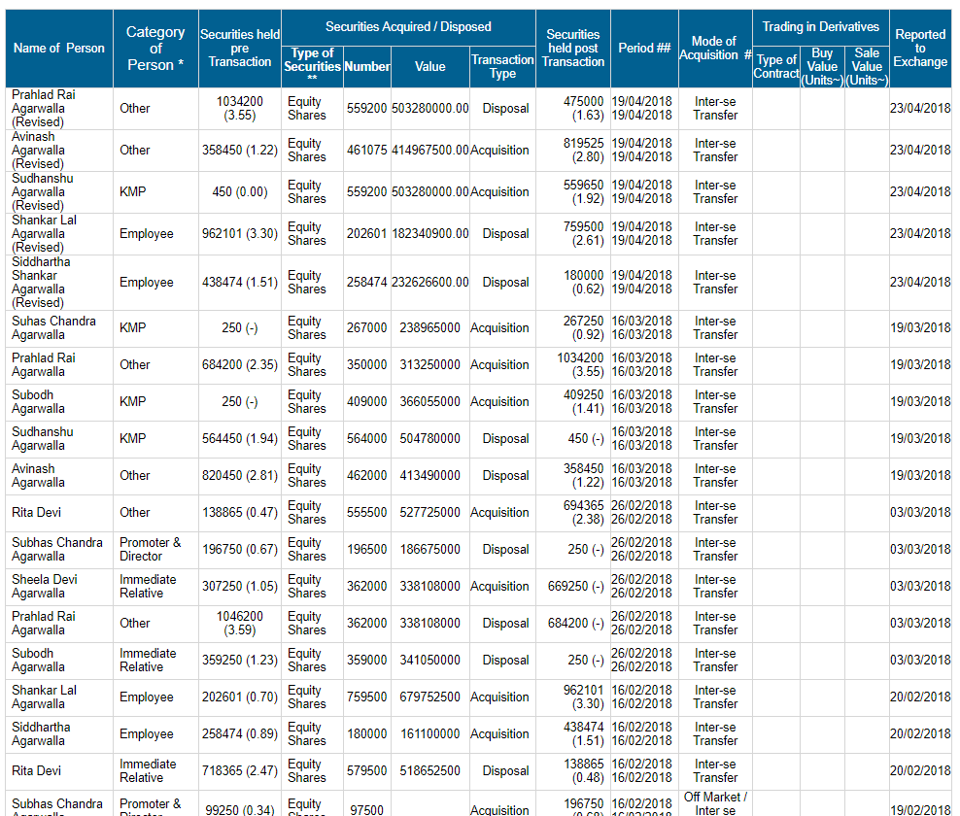
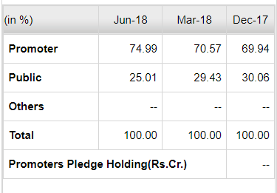
Shareholding pattern and intra promoters share exchange:

Slide 10
Valuations:
Market price: Rs 578.3
Market capitalization: ~Rs 1690 cr
Price to earning ratio: ~5.7 vs Industry PE: 6.25
Earning per share: ~102
Dividend per share: Rs3 FY2017-18
Price to book value: ~2X
* as of 31 Aug 18

Slide 11
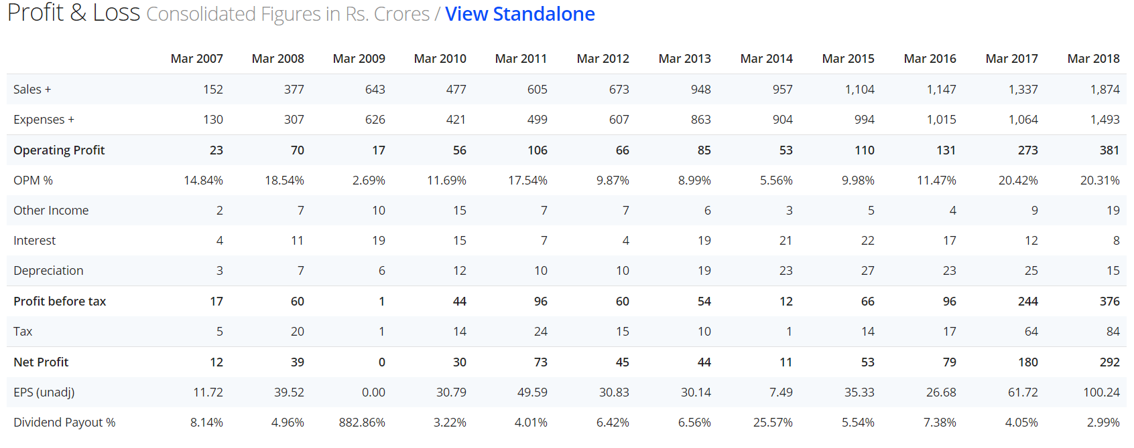
Financial Performance:

Slide 12
Net cash flows

Slide 14
Thank You
Happy Investing

