Slide 1
Investment idea
HIL (Previously Hyderabad Industries Limited)
Presenter: Atul Agarwal
Email id: Cherrypicks001@gmail.com
: : atulastra

Slide 2
Disclaimer:
I am not a SEBI registered stock analyst.
I have vested interested and thus have biased view on the discussed stock.
The vested interest is less than 1% of the outstanding shares of the company.
The discussed idea should not be considered as recommendation of buy/sell and this is just purely for educational purpose.

Slide 3
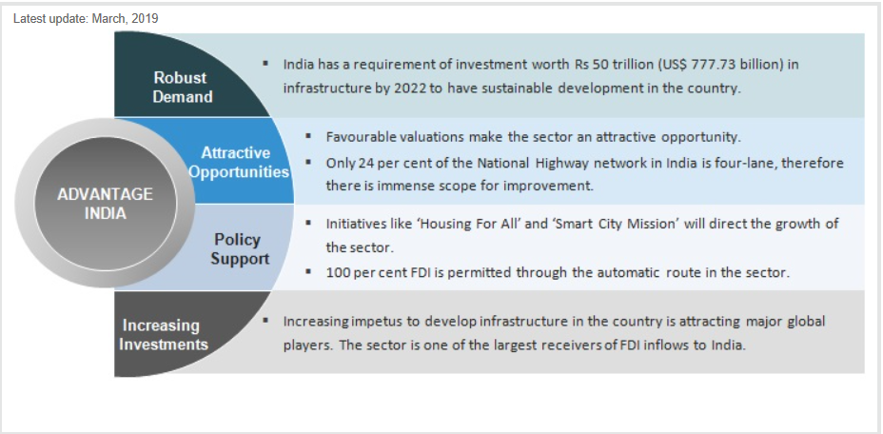
Infrastructure: Booming opportunity
Source: IBEF.org

Slide 4
Government Initiative:
Real Estate Regulation and Development Act (RERA) which seeks to protect consumer interest will ensure efficiency in all property related transactions, improve accountability of developers, boost transparency and attract more investments to the real estate sector.
Housing for all- The Union Cabinet launched the “Housing for All by 2022” project on 25th June, 2015, also known as the “Pradhan Mantri Awas Yojana”, aimed at urban areas. The key components of Yojana, include i) benefits for slum development projects, ii) assistance of Rs1.5 lacs per house for the economically weaker sections, in projects wherein the project has at least 250 houses and 35% houses are reserved for economically weaker sections category; iii) subsidized loans at 6.5% per annum for economically weaker sections and lower income group for loans up to Rs6 lacs (calculated at net present value); and iv) assistance of Rs1.5 lacs for individuals of economically weaker section category for construction of own house.
Indira Awas Yojana- Indira Mantri Yojana is a flagship scheme of the Ministry of Rural Development, Government of India to provide houses to below poverty line rural households belonging primarily to the scheduled caste, scheduled tribe and bonded labor categories.

Slide 5
Background:
HIL was established in 1946, part of C K Birla Group other prominent names of the group are Orient Cement, Orient Paper, AVTEC, BirlaSoft among others.
Market leader in building material Segment in India.
Number of manufacturing units 24, operations in 5 continents.
The company has 5 business segments and 4 major brands.

Slide 6
Parador Acquisition
Parador Holdings GmbH, founded in 1977, is a Germany based, vertically integrated, full-range supplier which designs, manufactures and distributes a wide range of flooring solutions including resilient flooring, laminate and engineered wood floors, wall & ceiling panels, skirtings and related accessories
Sales FY17 EURO 142.2 Million vs EURO 134.8 Million in FY16
The Company has long-standing relationships with all major customers and exports more than 50% of its sales to over 80 countries
Parador is expected to take 4-5 years to reach 100% capacity utilization from current 68% in Germany and 65% in Austria.
Expansion of units possible as lot of additional land available.
Financial details:
Acquisition cost: EURO 82.8 Million
Funding:
Indian debt 276 Crore with interest rate of ~8.6%
EURO debt 32 Million with interest rate of ~1.6%

Slide 7
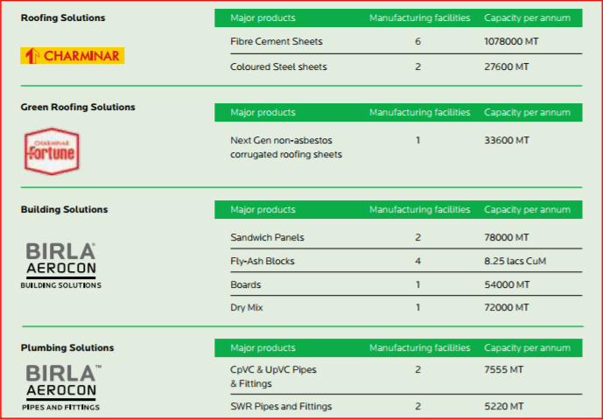
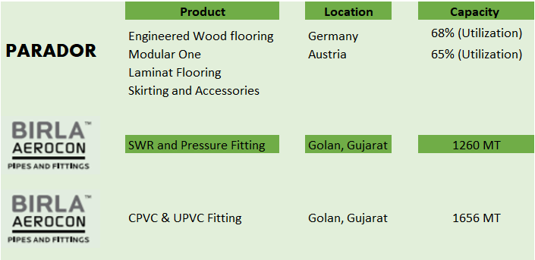
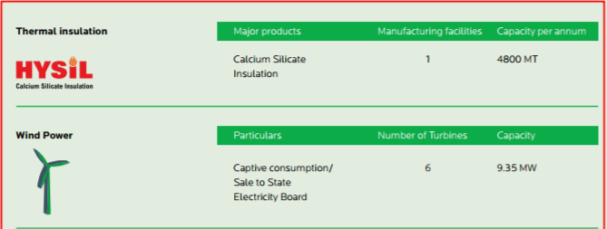
Production capacity:
2017-18
2018-19
Notes:
-- Capacity Utilization 2017-18 Roofing solution 65% Building solution 90%
-- Capacity Utilization 9M2018 Annualized 74% and 85%

Slide 8
Why HIL?
Market leader in its segment:
Fiber Cement Sheet -- Brand name Charminar
Fly-Ash blocks – Brand name BirlaAerocon
Sandwich Panels -- Brand name BirlaAerocon
Thermal insulation sheets -- Brand name BirlaAerocon
Increase in margins due to working capital optimization
Investing in R&D:
Filled for 9 patents in last 3 years (Till FY17-18)
Strong brand: SuperBrand list
Birla Aerocon Rank 20
Charminar Rank 28
Strengths:

Slide 9
Why HIL ?
Expansion to new markets:
Parador has opened a mega store in Shanghai China
Parador can be used to supply to Indian market a new segment for HIL
Capacity Expansion:
BirlaAerocon is working at 90% capacity new expansion will come up in next 4-5 months
NDA or UPA:
The stress will be on rural economy NDA promise of doubling the farm income by 2022
Congress NYAY free distribution of Rs 72,000 pa to below poverty households
One stop shop for all the construction requirements
Opportunities:

Slide 10
Why HIL ?
Slowing economy:
Indian economy has slowed down considerably as visible from the inflation numbers, the first casualty of this is normally poorest of the poor which is the primary segment for the roofing business.
Competition risk:
The company operates in a market with lot of competition from unorganized players.
Threats:

Slide 11
Management:
Mr. Dhirup Roy Choudhary has been the Managing Director of HIL Limited since January, 2017 and has been Chief Executive Officer since April, 2017.
He has been instrumental and bringing in the new aggressive posture to HIL through:
Rewarding long time loyal dealership network
Expanding in new products and large quantities to existing network
Reducing working capital requirements
IPL tie-up and brand building
Continuous efforts towards margin expansion by bringing in efficiency in production

Slide 12
New capacity for Pipes has commenced production in May, 2019.
Parador starts operations in Shanghai China, March, 2019.
Great place to work Award March, 2019.
Commercial production of Dry Mix plant February, 2019
Recent developments:

Slide 13
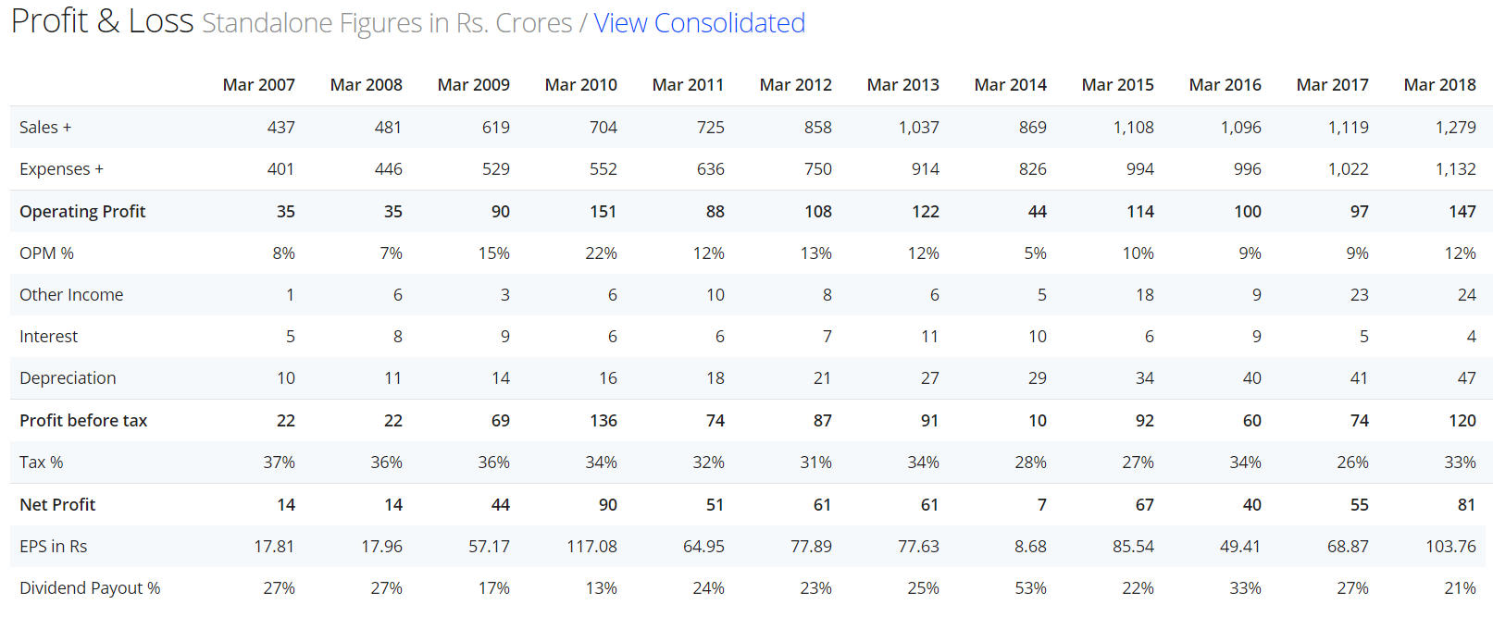
Financial Performance: Annual

Slide 14
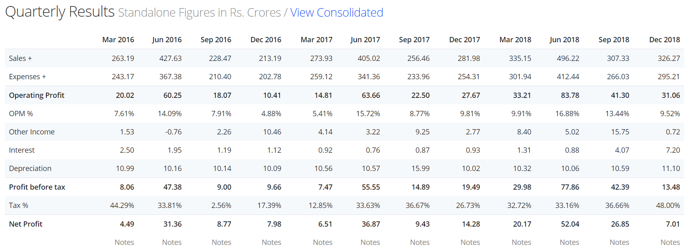
Financial Performance: Quarterly

Slide 15
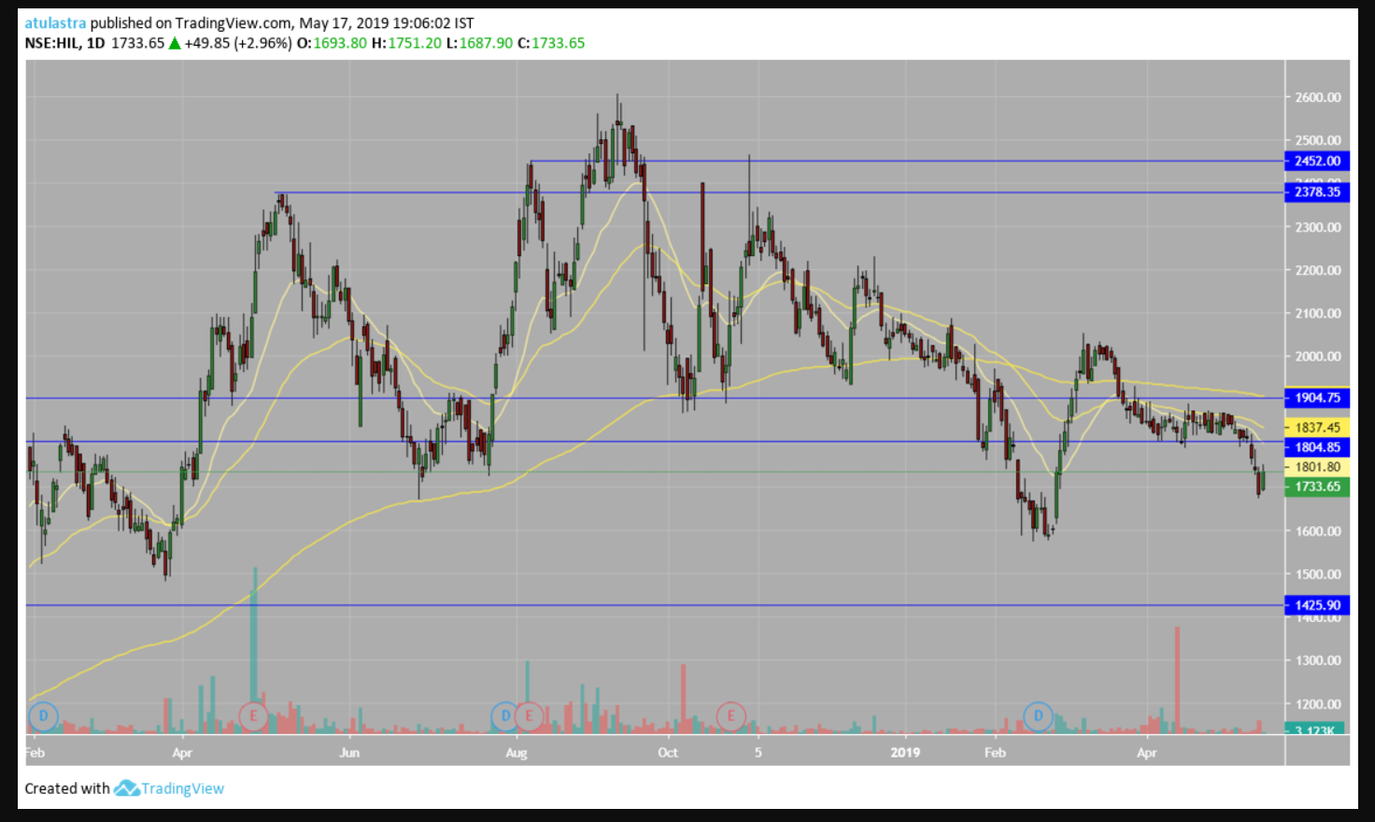
Technical Analysis:

Slide 16
Valuations:
Market price: Rs 1,740
Market capitalization: ~Rs 1296 cr
Price to earning ratio: ~12
Earning per share: ~141
Dividend per share: Rs22.5 FY2017-18
Price to book value: ~2.3X
* as of 17 May 2019

Slide 17
Questions:

Slide 18
Thank You
Happy Investing

