Slide 1
Orient Refractories Limited
Arun T
18th Nov, 2018

Slide 2
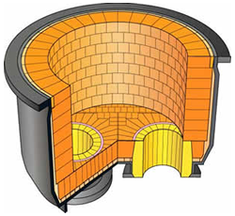
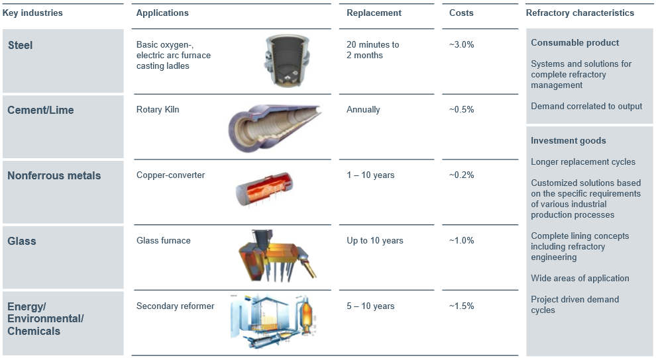
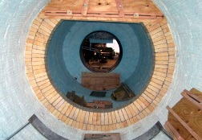
What is Refractory?
Materials that can withstand high temp without softening and deformation in their shape.
Used for the construction of furnaces, converters, kilns, crucibles, ladles etc.

Slide 3
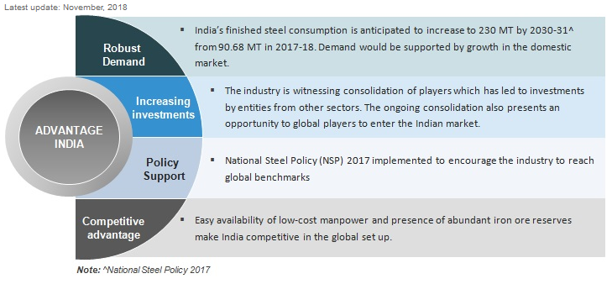
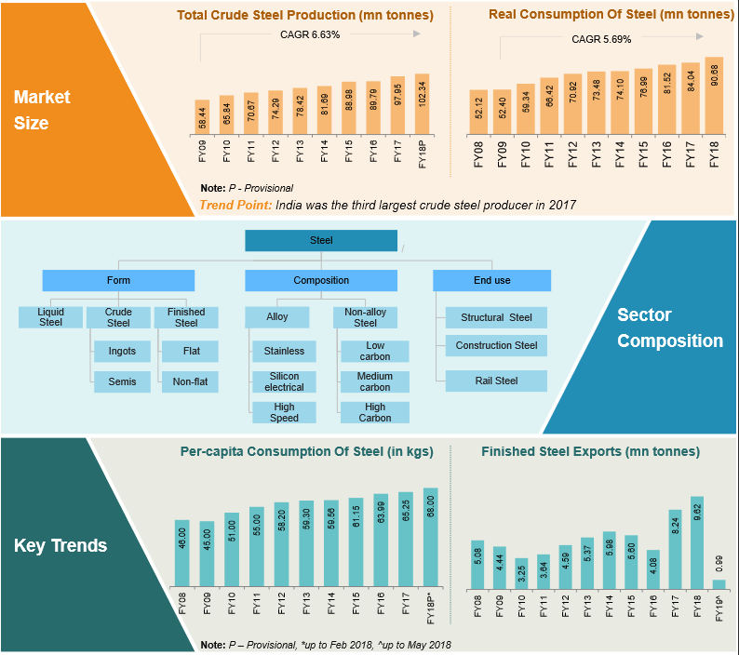
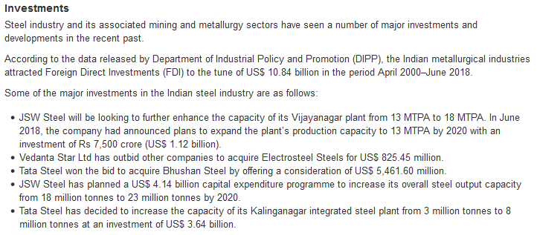
Indian Steel Outlook

Slide 4
Per capita Steel Consumption Gap
India became 3rd largest steel producer and is aiming to become 2nd largest replacing japan by 2030.
An ambitious government program aims 300 MT steel production by 2030. Nearly triple.
Per capita income steel consumption should increase from 63 kg to 160 kg in 2030
India is a key growth market for RHI Magnesita

Slide 5
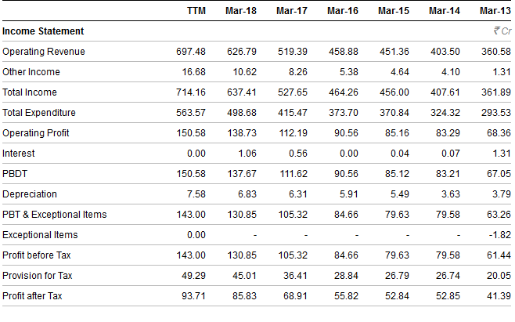
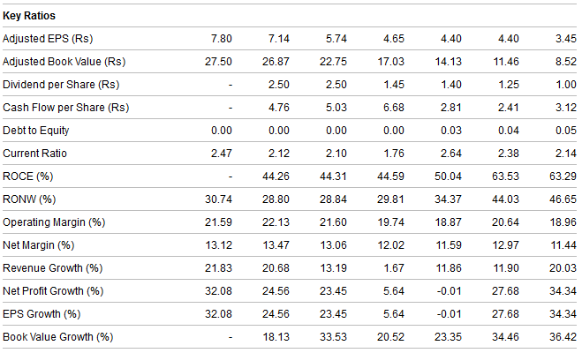
Not a Cyclical or Commodity Company

Slide 6
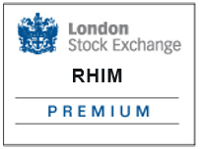
Promoters : RHI Magnesita
A Premium Listing is only available to equity shares issued by trading companies and closed and open-ended investment entities. Issuers with a Premium Listing are required to meet the UK’s super-equivalent rules which are higher than the EU minimum requirements. A Premium Listing means the company is expected to meet the UK’s highest standards of regulation and corporate governance – and as a consequence may enjoy a lower cost of capital through greater transparency and through building investor confidence.

Slide 7
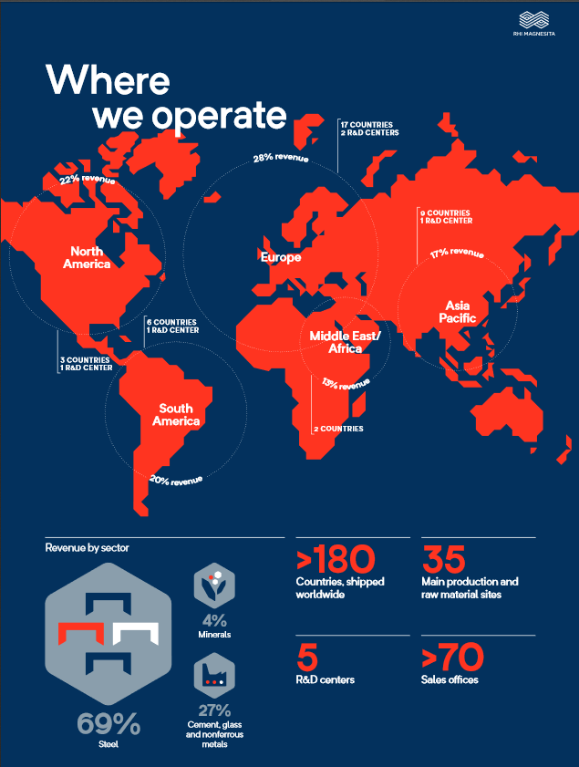
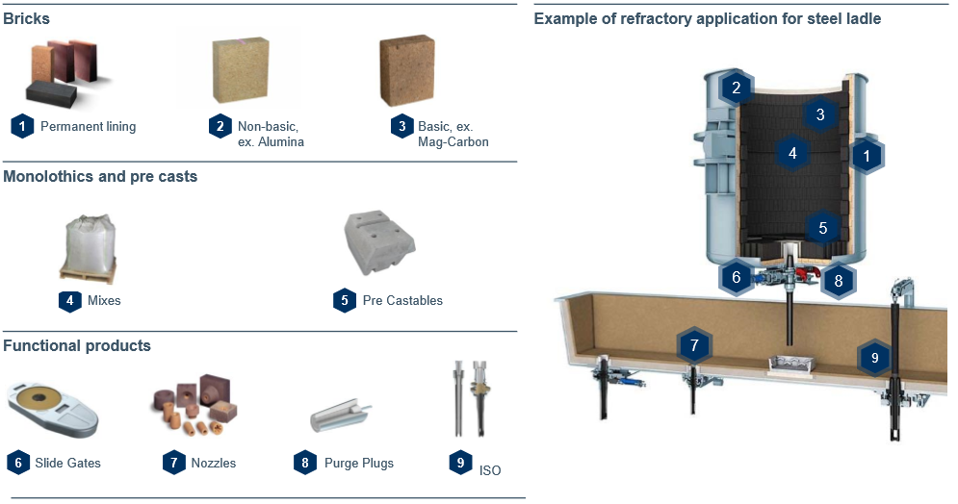
RHI Magnesita Snapshot
Products

Slide 8
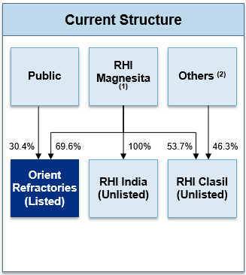
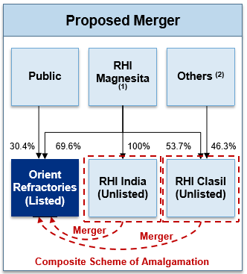
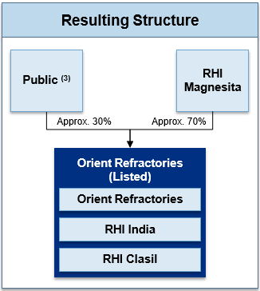
RHI Magnesita Amalgamation Scheme

Slide 9
Pros & Cons
Strengths:
1) Strong multi-national promoter having raw material network and technological moat. They have a high standard of corporate governance.
2) Increase in Isostatic Pressed products. It is claimed to be the most profitable product category for the company.
3) The increase of market share of Electric Arc Furnace (EAF) route of steel production is beneficial for ORL as their revenue share and production capacity is more suited towards that. For records, in India 57% of steel is produced by EAF route compared to world average of 27%.
4) In China only 5% of steel is produced by EAF route and since environmental concerns and high fixed cost are limiting growth of steel production through BOF (Basic Oxygen Furnace), we feel price of Refractory materials would remain firm in growing production environment.
5) The worldwide steel production is up by 5.6% in Q1 17 (Jan - Mar) and in India it increased by almost 11%. As ORL revenue is function of total steel produced, it is a good proxy to steel upcycle.
6) Oligopolistic structure with 4 key players in the Indian market ensures discipline in pricing environment.
Concerns:
1) Availability and price stability of main raw materials Magnesite and Dolomite. These are mostly imported from China to India. We don’t foresee any major hindrance in this as RHI globally is a large purchaser.
2) It’s dependency on steel cycle. Even though the ORL track record says if did reasonably well in downcycle too and protected most of its profitability and return metrics.

Slide 10
Thank You
cashflowbuddy@gmail.com
@cashflowbuddy

