Slide 1
RAIN INDUSTRIES - Sunil Kumar

Slide 2
Rain Industries PART - I

Slide 3
Disclaimer
This presentation is solely for discussion and knowledge sharing purpose
Examples shown are for understanding concepts and should not be considered as stock recommendations
Please do your own research and due diligence for any investment actions and/or consult an investment advisor for the same
Authors are not liable for any claims arising from use of the data provided neither there is any guarantee for accuracy of data
The views are our own and does not represent views of our employer in any manner

Slide 6
GreenPetCoke .. What is green about
Making of Petcoke
https://www.youtube.com/watch?v=qZZigKd43NU
Pet coke is a byproduct of oil refining. The term “green” used in connection to pet coke refers to the raw, unprocessed pet coke which comes out of the Coker. It does not refer to environmental friendliness.
GPC has several different structural forms commonly referred to as needle coke(s<0.6% and VM <5%), sponge coke(anode) S< 4%,V< 400PPm, VM < 13%), and shot coke. Crude oil quality plays a major role in determining which of these is produced, although the Coker operation can also play a role.
GPC must be calcined or heat-treated at temperatures above 1200C before it can be used to make anodes. It is necessary to drive out the VM during calcining so that the coke shrinks and densiﬁes
Calciners always prefer GPC with a lower VM content because it results in a calcined product with lower porosity and higher bulk density.
Most of the world’s newly constructed reﬁneries are conﬁgured to process heavy, sour crude oils that sell at a signiﬁcant discount compared with light, sweet crudes.
Many existing reﬁneries, particularly in the United States, have made capital investments to allow the processing of more heavy, sour crudes like those from Canada. These changes have directly impacted the quality and volume of GPC produced.

Slide 7
Types of Petcoke
Petroleum coke
Needle
Honeycomb
Fuel Grade Coke
Shot
Made from either Fluid catalytic cracking (FCC)decant oil or coal tar pitch.
Sponge
From Crude Refinery
From Crude Refinery

Slide 8
Fuel Grade Pet Coke
GPC(Fuel Grade Coke)
High Sulphur
Low Sulphur
Anode Coke(Used to make CPC)
Fuel for Power generation
Desulfurization of petcoke A high sulfur content in pet coke reduces its market value and may prevent its use as fuel due to restrictions on sulfur oxides emissions for environmental reasons. Methods have thus been proposed to reduce or eliminate the sulfur content of petcoke. Most of them involve the desorption of the inorganic sulfur present in the pores or surface of the coke, and the partition and removal of the organic sulfur attached to the aromatic carbon skeleton.

Slide 9
CPC
Every ton of aluminum , smelting process consumes 0.4 tons of CPC
Crude Oil
GPC
CPC
Aluminum
Byproduct
Calcination
Smelting
Every ton of aluminum consumes 0.1 ton of CTP
Every ton of aluminum consumes 0.4 ton of CPC
Each ton of metalarurgical coke gives 0.04 ton of CTP
Coal tar distillation yields approx 50% CTP, 40% aromatic oils and 10% napthalene oil.
Therefore, production of primary aluminum is one of the most important determinants of demand for CTP/CPC

Slide 11
CPC Strategy

Slide 12
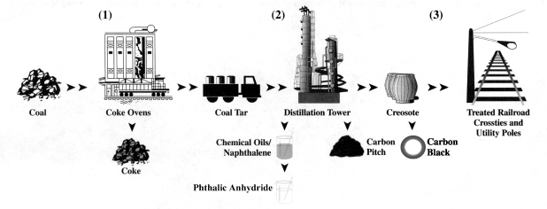
CTP Process
Coal tar is a by-product generated through the processing of coal into coke for use in steel and iron manufacturing. Variety of intermediate chemical products derived from the coal tar distillation process, including the co-products of the distillation process. During the distillation process, heat and vacuum are utilized to separate coal tar into three primary components: carbon pitch ,creosote oils and chemical oils .

Slide 15
Crude-Coal-Bauxite-Aluminium(relation)

