Slide 1
Rain Industries PART - II
- Sunil Kumar

Slide 2
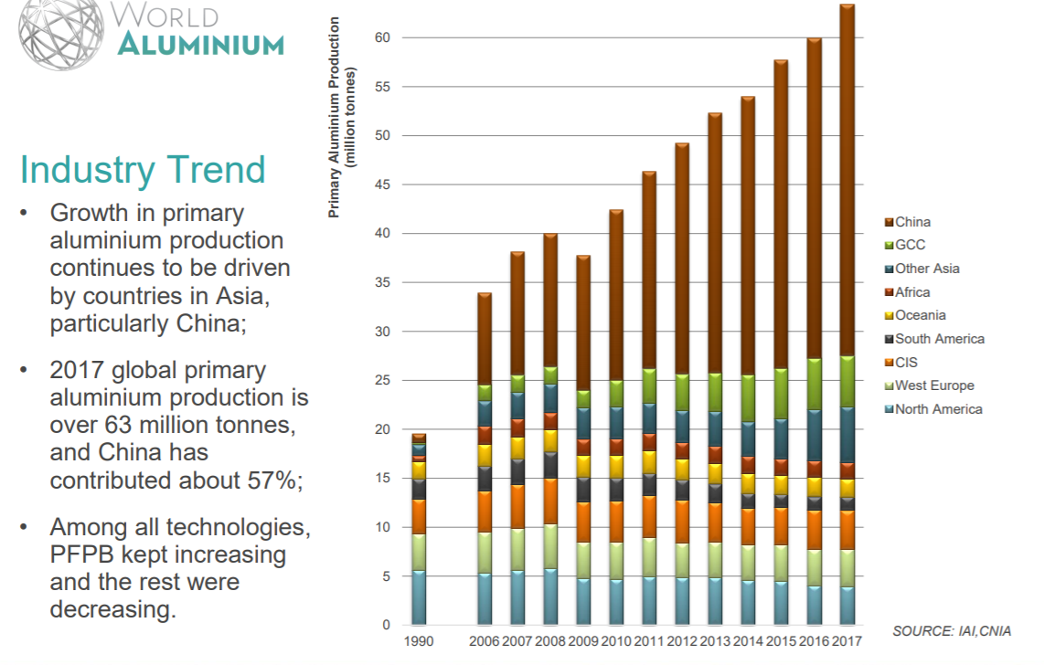
Aluminium Production Worldwide

Slide 3
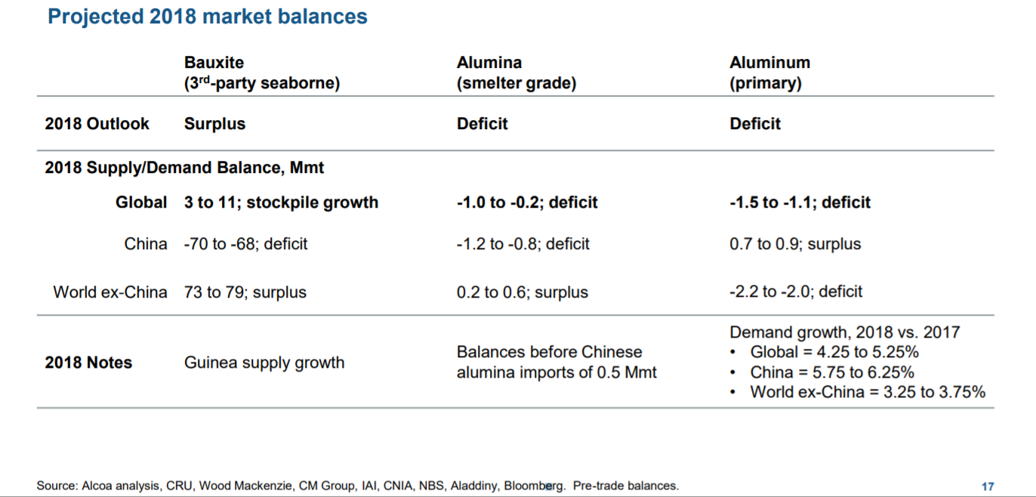
2018 Aluminum Demand Supply

Slide 5
CPC/CTP financials
The increase is mainly due to higher sales volumes of calcined petroleum coke (CPC) by ~11.5% and other carbon products by ~8.9% which also offset the higher input cost of GPC. Management also highlighted that the surging GPC prices have moderated in Q3 2018.
The outlook for the CPC business is better than 1Q and 2QCY18
CTP price is stable, but realization is lesser because of appreciation of USD against Euro. So in USD terms, there is minor decline, but in Euro terms, it’s not. It’s stable.
During Q2 CY18, the average blended realization increased by ~48.3% after considering the favorable impact from the appreciation of the US Dollar and the Euro against Indian Rupee by ~4.0% and ~12.5% respectively.
Finance cost during Q2 CY18 decreased by ~24.6% compared to Q2 CY17 due to the savings in interest expenses resulting from refinancing of fixed coupon bearing high-yield bonds averaging ~8.25% rate of interest with a EURIBOR-linked, Euro-denominated Term Loan B in January 2018 with an effective rate of Interest of 3%.
During Q2 CY18, the Company has a foreign exchange gain of ₹72 million, as compared to ₹392 million in Q2 CY17. The foreign exchange gain in the current quarter is primarily due to the restatement of inter-company loans on account of depreciation of the Euro against the Canadian dollar and also from the restatement of the US Dollar denominated receivables on account of depreciation of Indian Rupee against the US Dollar.
Overall carbon segment is operating at 80 to 85% utilization

Slide 6
Carbon Products Details…

Slide 7
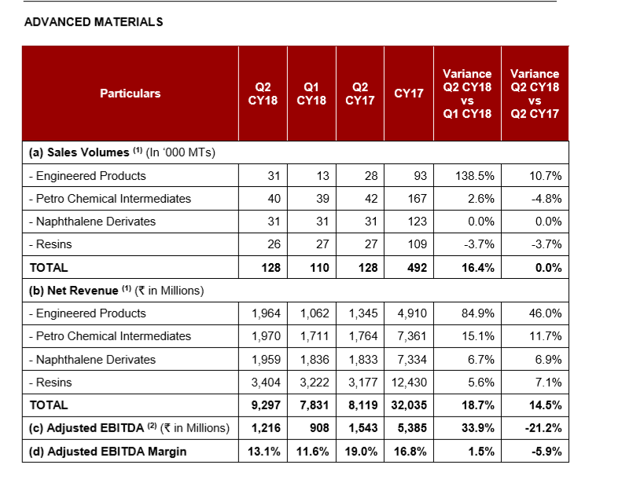
Advance Materials
This segment reported good results and is the prime focus going forward . Comprises of 200 products and The demand for products is seasonal and realizations may vary. Some raw materials are indexed to crude prices. Higher crude prices in the quarter translated into higher raw material costs and also other reason for costs being high is Euro has been depreciating against USD, most of costs are incurred in Euro and realization is partly in USD.Q2 and Q3 are stronger quarters for this segment.
Ralf Meixner has joined the company and will fill the newly created position of Head of Advanced Materials.
Meixner comes to Rain Carbon from BASF, and brings more than 30 years of global experience across the sales, marketing and business development spectrum . He was on a project to develop a 21st century customer service organization for the company's Europe, Middle East and Africa region. Earlier, he spent nearly five years in the United States and China as senior vice president of BASF's battery materials business.

Slide 8
Cement Segment
This segment is operating at 55% capacity utilization. The EBITDA Margin declined due to higher operating cost.
Realizations decreased by 18% YoY, partially offset by increase in volume by 2.9%
Revenue decreased by 16.4%, EBITDA decreased by 44.5% - due to increase in operating costs, and lower cement clinker ratio.
Frieght cost went up bcos of diesel price as they use truck as the plant is not located somewhere nearer railway siding

Slide 9
Financials across all segments

Slide 10
Last 10 Qtr Financials

Slide 11
10 Year Financials

Slide 12
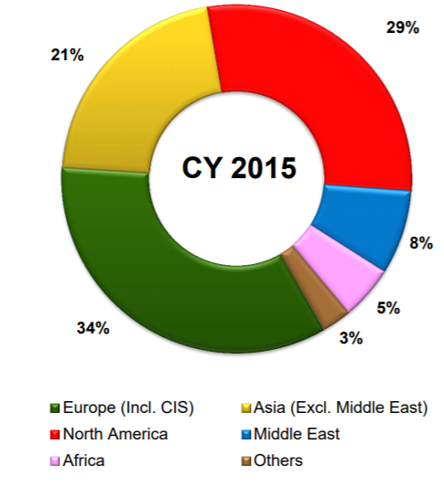
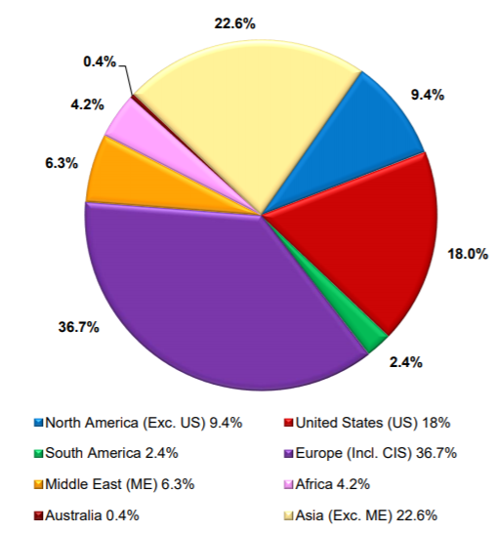
Revenue By Geography
CY2014 CY2015 CY2016

Slide 13
CAPEX
Q3CY19
3.7MT CPC plant in Vishakhapatnam. Estimated Capex is US$ 65 Million.
Hydrocarbon Resin plant in Germany. Estimated Capex is US$ 66 Million.
Q4CY18
Debottlenecking of petro tar distillation facility in Germany, Belgium and Russia
Q2CY19
Cement plant upgradation . Estimated cost US$7million
All capex thru internal funding

Slide 14
MOAT
Cut in Corporate Tax rate in U.S from 35 to 21%
Cut in Belgian Tax rate from 21 to 29%
Refinancing of Debt brought in savings of about 140 cr (avg Int rate around 5.2%)
High Entry Barrier
Long standing relationships with raw material suppliers and end customers
Leading R&D function drives continuous innovation
Diversified geographical footprint with advantaged freight and logistic network
Facilities with overall 125 MW co-generated energy
International management team
Strategy shift from low margin products to favourable product mix

Slide 15
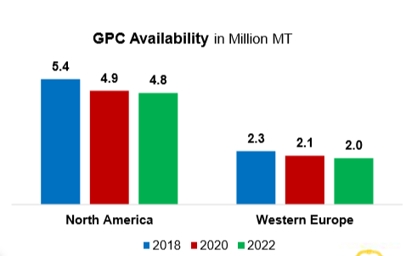
MARPOL
New MARPOL (International Convention for the Prevention of Pollution from Ships) limits on sulfur content in marine fuels starting in 2020. This additional crude demand would contribute to crude market tightening in 2020-21.
In 2020, global sulfur limits for marine bunker fuel will be lowered from the current 3.5% to 0.5%, affecting fuel demand from the shipping industry.
There is a high degree of uncertainty over the level of compliance from shipping companies, and if they do switch, which alternative fuels they will use. They could continue using high-sulfur grades and install scrubbers, which remove the sulfur from exhaust gases
Impact of MARPOL on GPC availability
The enactment of MARPOL will put existing quantities and qualities of calcinable green petroleum coke (“GPC”) production at risk of decreasing.
As per the recent industry estimates, upon the enactment of MARPOL, over 900KMT of calcinable GPC supply is expected to be at the risk of disappearing from global marketplace. This includes approximately 600KMT in NorthAmerica and 300KMT in Western Europe.

Slide 16
Debt Analysis
No major debt repayment plan till 2025 but has the flexibility to do the prepayment
All capex planned so far is thru internal accruals , so no plan to increase debt further

Slide 17
Supreme Court Ruling
It is quite clear that a consensus decision has been taken that the use of imported pet coke all over the country may be permitted only in the following industries: Cement, Lime Kiln, Calcium Carbide and Gasification as these industries may be permitted to import pet coke for use as a feedstock or in the manufacturing process and not as a fuel.
The decision on the use of imported pet coke in the steel industry and aluminum industry is still under consideration and is expected in 8 weeks till October 1st
As Ban would not only affect Rain but steel and aluminum industry as a whole
The company maintains 3 months inventory and the production wouldn’t be impacted.
Notes
According to estimates, India's domestic CPC production of about 2 million mt/year requires around 2.6 million mt of anode-grade green coke as feedstock.
Indian domestic production of anode-grade GPC is estimated by some sources at around 500,000 mt, leaving the market structurally short of just over 2 million mt, if a ban becomes permanent.

Slide 18
China Factor
Rain does not export to china , so not bothered about what goes into china but concerned on what comes out from china
Unconfirmed US calciner source said much tighter regulations were coming into effect on sulfur oxide emissions in China, which could have a much bigger impact on the winter closure programs compared with last year. The allowable emissions by calciners are due to fall by 60% compared with last year, meaning there could be a significant impact on the operations of calciners during the winter closure program during the heating season between mid-November and mid-March.

Slide 19
Concerns
High Debt
Operations in multiple country with multiple currencies , any depreciation of currency has a impact on bottom line
Commodity company .. Entry and exit needs to be timed well else can take years for an exit.
Government policies (ban on pet coke/Rusal sanctions etc..)
What’s Working
Expect increase demand for aluminum from US operations
Better positioned amongst its peer worldwide
Looking for futuristic products on the AM. Hired top honco from BASF for expanding operations . Watch out for this space
EV Boom will lead to demand for more aluminum
China Winter cuts

Slide 20
Rain industries – End Product Usage

Slide 21
FAQ
What is the Impact of falling Crude Oil / Commodity prices on the businesses carried-out by Rain?
Prices of CPC and GPC are not indexed to Crude Oil or other Commodity prices and they are influenced by their own supply-demand dynamics. Although, prices of both GPC and CPC fluctuate widely, the spread between prices of GPC and CPC move in a narrow-range. Prices of certain Carbon products and Chemical Products manufactured by the Company are indexed to Crude Oil or other Commodity prices. As both Raw-materials and Finished Products in Coal Tar Distillation are indexed to Crude Oil or Other Commodity prices with a lag of few months, there is no impact of falling Crude Oil or other Commodity prices on the business of Coal Tar Distillation in the medium term.
What is the Impact of falling Aluminum prices on the businesses carried-out by Rain?
Prices of CPC and CTP are not indexed to Aluminum prices and they are influenced by their own supply-demand dynamics. As CPC and CTP are critical consumables used in manufacturing of Aluminum metal, their demand is directly proportionate to production of Aluminum metal and not linked to Aluminum prices.
What is the Impact of weakening Russian Ruble on the viability of Russian Tar Distillation Plant?
The weakening Russian Ruble will not impact the viability of Russian Expansion, as the finished product from Russian Plant will be sold either in Russia (as an import-substitute) or exported from Russia. With conversion costs being incurred in Russian Ruble, the plant will be more competitive in the international market.

Slide 22
FAQ
What is the Impact of weakening Euro against US Dollars on the businesses carried-out by Rain?
The Company generates 45% - 50% of revenues from Plants located in Europe. About 10% of revenues from such Plants are generated in US Dollars, for which costs are incurred in Euros. A 10% decline in Euro-Dollar Exchange rate would result in less than 2% decline in operating profitability in US Dollar terms.
What is the impact of RUSAL Sanctions ?
Rusal will eventually meet the requirements and the sanctions will be lifted in due time. Oleg Deripaska has agreed to cut his shareholding to below 50% from around 70%. Rusal is an important customer to Rain, but it’s just < 2% of global sales revenue and Moreover there is a growing demand of CPC from the US markets and CTP in the middle east and throughout Asia , so sanctions will not have any signifanct impact

Slide 23
Peer Comparison
Company | Mcap | debt | EV | EBITA | Sales | P/E | mcap/sales | EV/EBITA
Rain | 7000 | 7300 | 14300 | 2800 | 14000 | 6.7 | 0.5 | 5.10
Goa | 700 | 195 | 895 | 60 | 600 | 12.5 | 1.16 | 14.91
Himadri | 5700 | 660 | 6360 | 520 | 2300 | 21.2 | 2.47 | 12.23

Slide 24
Sources
Medium.com
https://www.rd-carbon.com/
Koppers inc
Rain Carbon
Screener.in
CenturyAluminum
Springer.com
Spglobal.com

Slide 25
Good to know …
The Company has commissioned a Flue Gas Desulfurization (FGD) Plant at its calcining plant in Chalmette, Louisiana, U.S.
Facilitates the flexibility to process High-Sulphur GPC while Maintaining Strict Environmental Compliance.
Restores CPC Capacity of 230,000 Tons per annum
Generates incremental energy from increased CPC volumes.
Eligible for Higher Tariff from the Power Utility.
Alunorte Brazil reduced bauxite prod by 50% resulted in lesser aluminum in Q1
In Q1 AM has weekend bcos of cost incurred in Euro and sale in $ and bcos of Euro appreciation against $ , margins were impacted and there are plant outages as well
The only link to crude oil is the freight cost incurred
Effective tax rate between 32-34% 200 to 300 basis points less than historic rates
the US federal government has reduced the corporate tax rate from 35% to 21%. In Belgium also, there is a rate reduction from 34% to 29%. So because of these two events, whatever the deferred tax liability that we have as of December 2017, the future tax liability has been reinstated at the new enacted rate. So because of that we got the tax benefit and the tax provision for the quarter is only about Rs.37 million. We do expect the average consolidated effective tax rate for the group is around 36%. We expect at least a 2-3% reduction going forward from the calendar year 2018 onwards.
Current working capital days approx. 55 days

Slide 26
THANK YOU

