Slide 1
Sowing Many Seeds
Our approach to diversified investing

Slide 2
How does our portfolio look like?
No formal procedure or rule
Lot of flexibility. Everyone free to do what they want.
It is a sowing ground where more the merrier.
10-15 Stocks are 70-75% of the portfolio. Then there is long tail of 20-30-50 ideas.
Notes:
We never thought about allocation in initial years.
Graduated from absolute amounts to certain percentage of company to more of portfolio percentage.
It usually takes atleast a cpl of quarters to get a feel about the company. Incremental additions are done on incremental confidence, insight.

Slide 3
Why we diversify?
Notes:
Our 80-85% net worth has always been in equities. We don’t know anything else.

Slide 4
We have very limited knowledge
Many often the stocks where we worked very hard, where we thought we knew enough, gave the worst returns.
While many others - not our favorites - gave extra-ordinary returns.
We are very number driven.
We don’t know much about various industries, future and qualitative aspects.
Notes:
I think its important to be a realistic and know what your strengths and weaknesses are.
Its a fact that we have limited knowledge - Its only offlate and in recent years that we have been able to have benefit of deep diving. If left to our own - we haven’t been like that.
Plus very less knowledge of industries
Small network of people from industries. I believe for very concentrated investing - one should have some sort of extra edge and ears to the ground. I know successfull concentrated investors - who travel a lot, have contacts in the industry etc. Our knowledge is usually the one from AR, website etc etc.
Often stocks where we did lot of work haven’t worked out well - AYM, GRP, Kitex (long list). Other examples - Ajanta, Shilpa. While we didn’t loose money. Plus they performed best when undiscovered. Its like a backbencher performing well - he gets rewarded more.

Slide 5
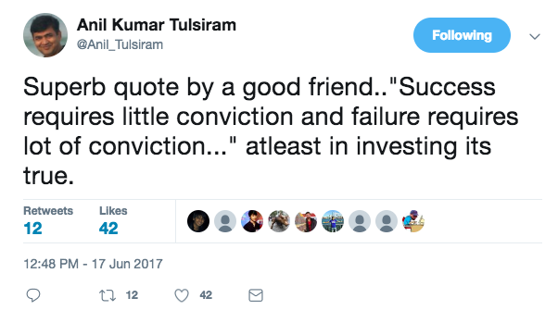
Notes:
Share story of 3 friends who were very bright but couldn’t stay long enough in markets

Slide 6
We are loss averse
We have seen some super smart people quit markets.
Negative black swans can wipe one's capital.
“Sar salamat, toh pagdi hazaar”
Notes:
Cos like Satyam, Fin Tech, Opto, Core Project, Tanla. Loads of mid caps multi-baggers in 2005-08 periods. Still fear about 90% wipe outs. Seen the smartest people loose money in such cases.
Often we feel we are in control. Or we feel that this company is extra-ordinary. But things change. This world is very fast changing.
Enterpreneurs change - eventually they are human beings.

Slide 7
5 big winners is better than 1 big winner
“If you’re looking for a gold needle in a haystack of gold, it’s not better to find the gold needle.” - Warren Buffett
Astral vs Mayur
Why not both?
Notes:
Its tempting to wish we had money in just Avanti, Astral, Ajanta, PI, Canfin….etc etc. In VP itself we have long list of multi-baggers. But its all easy in hindsight. These names came, because of experimentation.
I think importantly - our usual criteria is - can the stock double in may be 2-3 years? We are happy to have 30% CAGR

Slide 8
Markets are an ocean
“So I think it was just looking at different companies and I always thought if you looked at ten companies, you’d find one that’s interesting, if you’d look at 20, you’d find two, or if you look at hundred you’ll find ten. The person that turns over the most rocks wins the game.” - Peter Lynch
We feel that Indian markets are full of opportunities. It is an error to be limited / exposed to very few stories especially in early part of career.
Notes:
How do you know value of something. Dad gives example of vegetable market - can you bargain?
There would have been 100s of multi-baggers in the last 5 years. And there was some pattern or interesting insight to learn from so many of them. Actually we have been able to participate in many of them in some small portion or the other - some quick names DFM Foods, Acrysil, Stylam, Laopala. Most of the cases, there was nothing much to loose. But something interesting was there.

Slide 9
We have too much idle time
But consciously, we are learning about lots of industries and companies.
We never knew about what shrimp is, what USFDA is or what DI pipe is.
We want to read everything!
We are 3 people.
We need to do something to fill the time.

Slide 10
Why we have a long investments tail?
Notes:
Most imp reason - there are actually so many interesting cos - its hard to ignore!
How to ignore Caplin, Lactose, Jyoti Resins,
And they are at valuations which are rewarding
Some scripts are added just in 10-15 minutes of works.

Slide 11
Darwin’s Theory
Darwin believed that we would quickly find reasons to reject a new idea until we consciously work on it and participate.
That it is difficult to accept new ideas.
Notes:
I have tried keeping To study list electronically
Commitment bias

Slide 12
“You know a girl only after you marry her”
Notes:
This slide has been put by Pratyush
Why buy? Why not study with discipline? Because we view stocks differently when we have actually put in money.
You might start liking her more - you might start hating her.

Slide 13
By buying, we put our foot in the door
If there is a sudden change, we start wondering about what could have been the cause.
Sometimes we invest in a new company only based on last quarter results - giving it less than an hour of study.

Slide 14
Think of it like an R&D cost to a pharma company
Notes:
To be lucky you have to expose yourself to new things

Slide 15
Limited Downside
In most cases, the company is too small, with insufficient information and a 30 page annual report.
This very uncertainty makes them cheap and extraordinarily rewarding.
If the story doesn’t work as expected (which happens often), we can sell out at a little loss.
Notes:
CM - It is a year wasted if you don’kill one of your best idea
You are in shade today because someone planted a sapling few years ago.
How do you escape from getting married to your idea?
Also, given that you have so many ideas - you are able to switch from poor ones to better ideas when they come. Its in a way like cash.
We buy ideas when someone we respect buys - Respect quota
Often allocation is not much as these are small cos and it takes long time to buy or they move up in between.
You get rewarded for mistakes in bull market

Slide 16
Strategies and examples?
Notes:
Loads of our screening work used to be manual earlier. And It may still be more effective.
Read all BSE announcement
Go through almost all results
Go through CM magazine

Slide 17
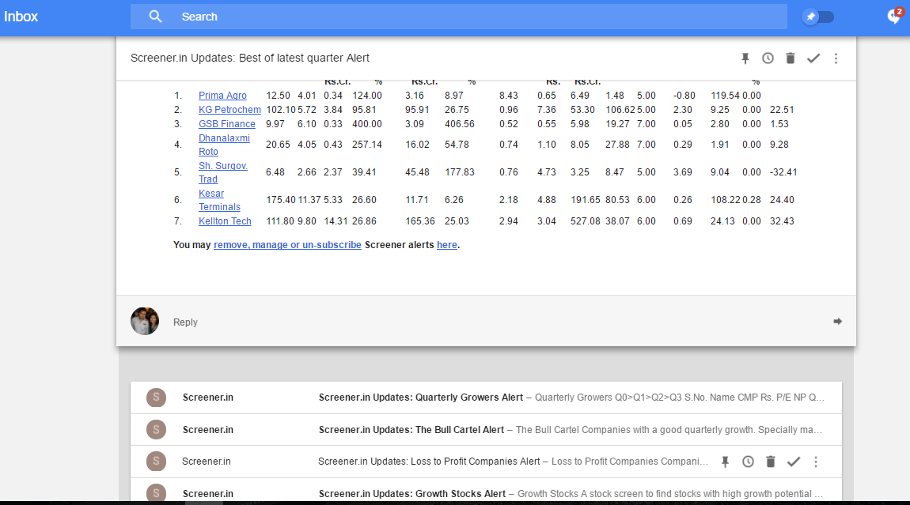
Alerts in Screener.in

Slide 18
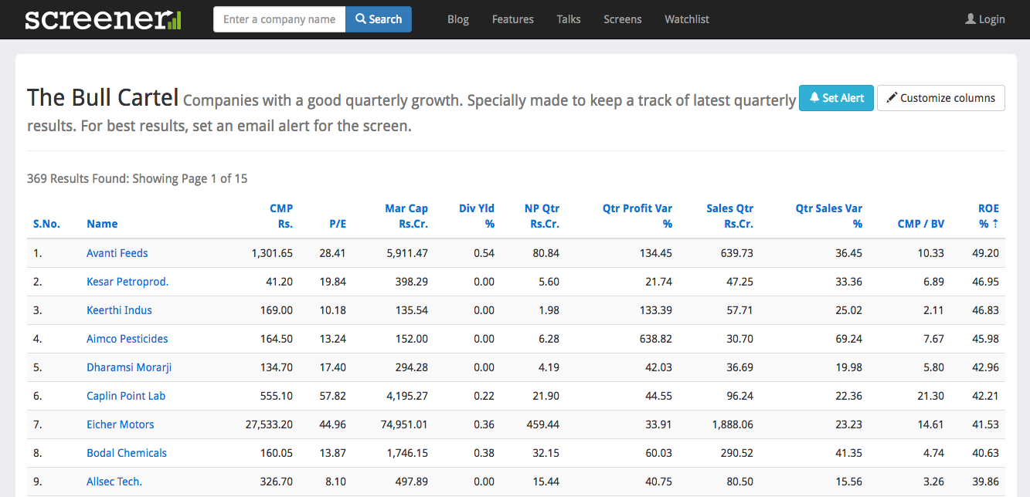
Alerts in Screener.in
Notes:
Plus add lots of stocks to watchlist - peers of co you track etc. Email

Slide 19
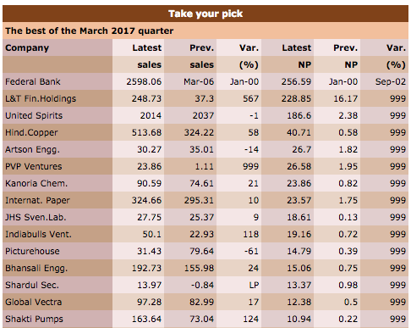
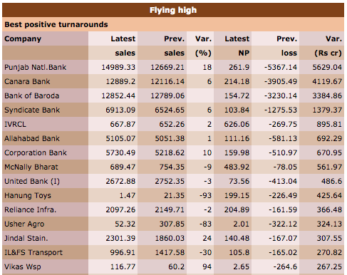
Capital Market Magazine

Slide 20
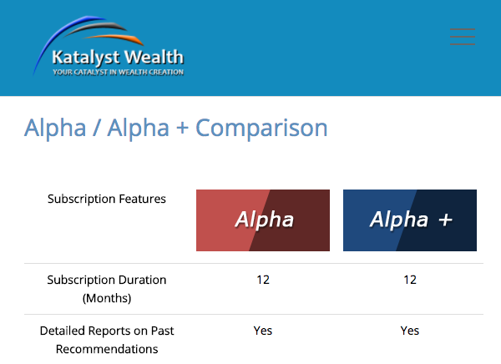
Paid Subscription Services

Slide 21
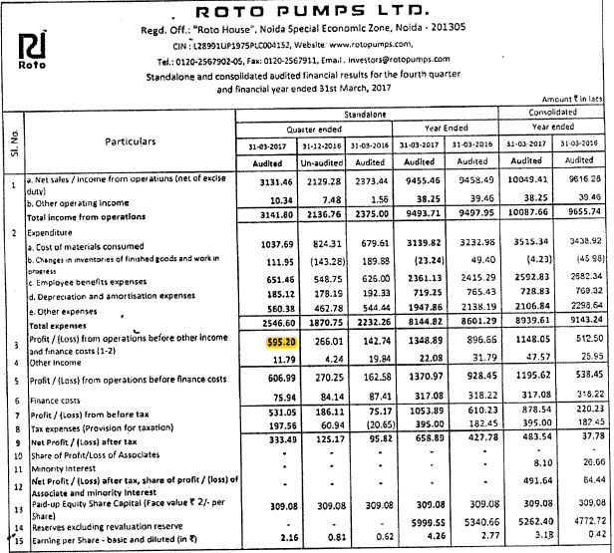
Notes:
Sales increased from 23 Cr to 31.5 Cr. While Operating profit from 1.4 Cr to almost 6 Cr.
Imp thing - past experience and insights
Stock price has been down

Slide 22
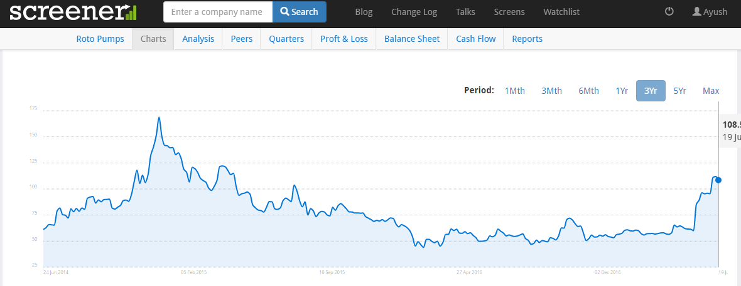
Notes:
Add some examples of picking ideas in recent qtr - Roto, Swelect, Aimco, Kamat
Not so good ones - Nahar, GHCL, AYM

Slide 23
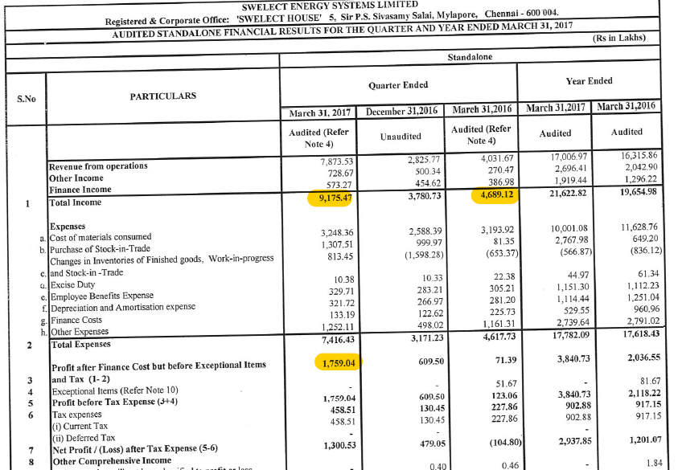

Slide 24
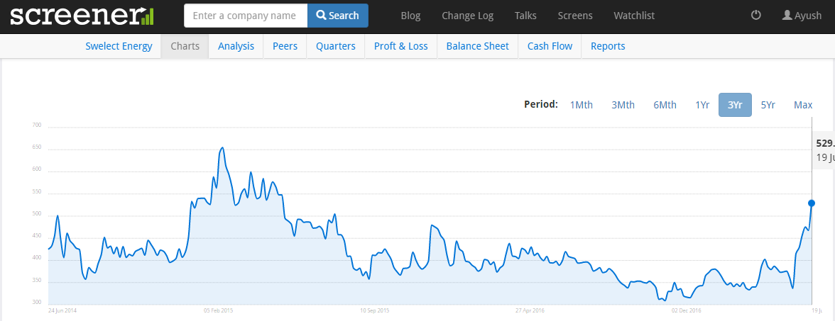

Slide 25
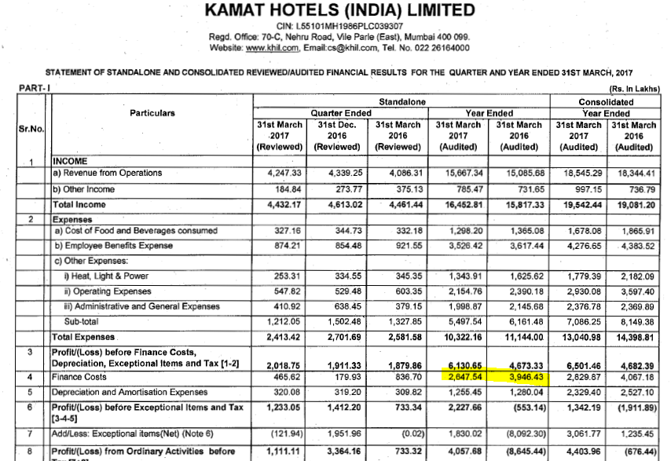
Notes:
EPS for the year is 17 vs negative 18. Ofcourse lots of issues.
However, interesting to see the hotels, margins.
Needs lot of work

Slide 26
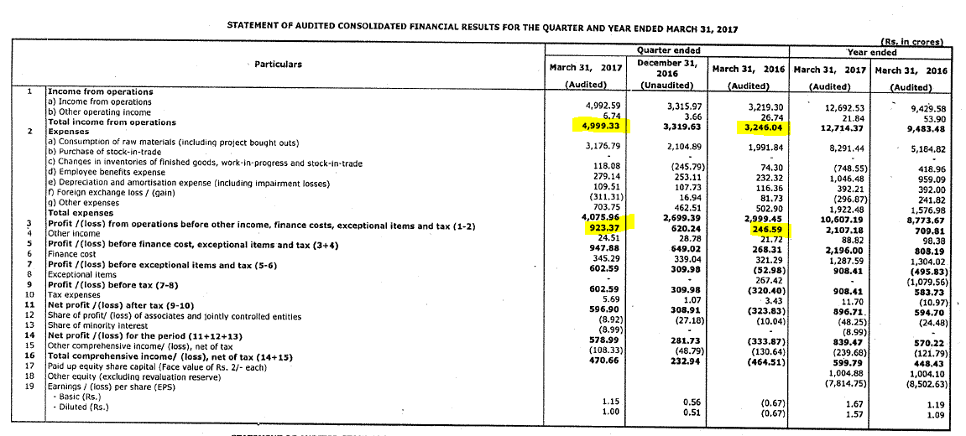
But same pattern hasn’t worked out for Suzlon, Hind Zinc, IMFA!
Notes:
Few on similar patterns but didn’t work - Suzlon! Nahar Industrial

Slide 27
Thoughts on catching a business in transition
Past will be poor - focus on few small things which may be changing.
Be aware of the negatives in a company. See if the same is changing. The negatives might not be a deal-breaker.
Concept of dis-conforming evidence eg. Ajanta, Chamanlal, Premco.
Notes:
Why is it important - cause it will be very expensive later. Once history is long enough to extrapolate, undervaluation is gone!
Be very open - Focus on change - Management, Restructuring, Small segment bringing the change (Tata Metalik). Don’t ignore.
Catching business in transition -
Stylam, Innovative, Kitex
Premco - actually invested despite self-disbelief. But when the margins continued that way for more than an year - it was logical to think - there is something more. Chamanlal - everyone complains it's a trading company
Ajanta - was very skeptical and used to think its a chor co - however, reducing debt and then reducing working capital
Transpek - Volatile nos but not getting a very long term contract from MNC Break down the top 3 costs to the company - and see what has been the change?
It excites me to see an ambitous article or aim and think what if it is acheived - Atul Auto, Hester, Kitex, Innovative. Especially when not paying for it.
While doing all of this Risk is to be controlled from BS side - debt, dilutions etc

Slide 28
Embrace Failures
“If you are not failing then you’re not learning” - Munger
Make and break things like an artist.

