Slide 1
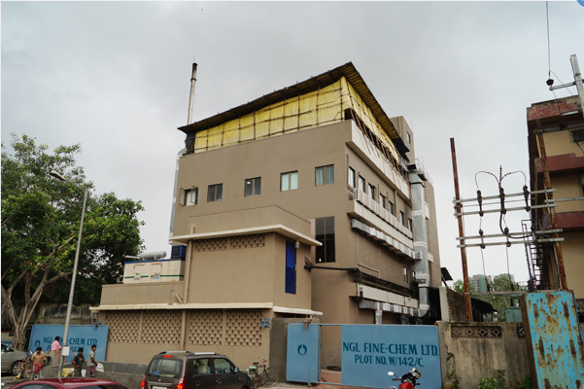
NGL Finechem Conservative and Steady Growth Story
Pure Capex Play

Slide 2
Rationale of choosing this sector
The global animal health active pharmaceutical ingredient (API) marketis projected to register an impressive expansion at 7.3% CAGR during the forecast period 2017 to 2025, according to a recent study by Persistence Market Research (PMR). PMR’s study estimates the market to increase from revenues worth US$ 5,216.1 Mn in 2017 to reach US$ 9,162.2 Mn by 2025-end.
Antiparasitic API growth in the global animal health API market is owing to a large number of pharmaceutical industries in the Asia Pacific region especially focusing on antiparasitic APIs. Persistence Market Research forecasts the antiparasitics API type segment to grow from more than US$ 2,500 Mn in 2017 to over US$ 4,600 Mn by 2025 end
Anti-infectives is expected to be the second largest market for animal health active pharmaceutical ingredients
12 out of 19 listed products on NGL ‘s website are anti parasitic in nature

Slide 3
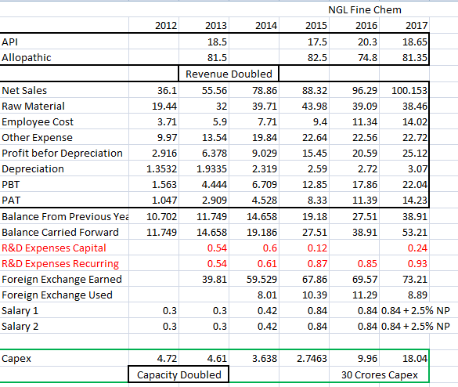
Financial Snapshot
Negative Points – Solely targeting API and not formulations, less R&D over years

Slide 4
Inferences from Annual Report and Financials
Capacity Utilization levels are healthy historically
Revenue more than doubled and PAT more than tripled during last Capex in 2012-13 within two years of capacity addition
PBT Margins increasing constantly
Company doesn’t expand unless it has additional demand in place
Capex of 30 crores, financed by internal accruals and only 9 crore LT debt additionally

Slide 5
Inferences from past concalls
Pros
The segment will be more than Rs 5000 crore market worldwide and is growing around 15% every year.
the company has around 21 products, the market size for these 21 products will be around Rs 700 crore as on date and is increasing every year. (Sep -2016)
Antiprotozoals and Anthlmintic are major products for the company catering to de-worming and anti infection segment.
Most of the company's products are sold to non regulated markets. Even though EU accounts for 40% of total sales, the end products are further exported and land in some other geographies
Top product of the company constitute around 18% of total sales and top 4 products constitute around 40% of total sales. The company would be selling its products to more than 400 customers worldwide.
None of the MNC's are interested in these space, as they are busy in higher volumes and regulated markets mostly. This space thus is left with low competition.
Cons
None of the products are sold in US markets. Company's product may enter US but indirectly and only after lot of hands are changed from intermediates to dosages to injectibles format.
Key competitors within India in veterinary space are Lasa laboratories (Omkar), Rakshit Drugs, D H Organics and some other local players.

Slide 6
Capex Trigger
The company is operating at around 95% of its installed capacity of around 150 cubic meters. The company was trying for capex since 2014, but received the environmental clearances only post 16 months from that. Thus there was a delay in capex, which is why the company is struggling badly on volumes, as there is a demand, a ready market but no capacity.
Further, the company has received approvals for 4 new products and clients are ready for the delivery, but the company does not have the capacity as of now.
Finally after all the delays, the brown field capacity expansion of 100 cubic meters, at Tarapur will be completed and commercialized by May-June 2017 only ie Q1 next year. Till then whatever growth will come will be only from debottlenecking.
Another green field capex for which land has already been purchased near Tarapur is aimed by the company once, the ongoing capacity expansion is on stream. Capex will be around Rs 50 crore in 2 phases. The company has applied for environmental clearances for the same as well and expects the same to receive in 12 months kind of timeframe.

Slide 7
In News
NGL Fine-Chem Ltd's expansion project commences trial production runs in first week of Oct.
This can add significant revenues in next two years
Entry Barriers in EU
However, the pharmaceutical industry in Europe has been concerned with potential short-term impacts of REACH regulations. This is likely to result in decreased supply of materials, or reagents, which are not preregistered by EU suppliers

Slide 8
References
https://www.persistencemarketresearch.com/toc/16972
https://www.medgadget.com/2017/11/animal-health-active-pharmaceutical-ingredients-market-to-reflect-a-significant-cagr-of-7-3-during-2017-2025-2.html

