Slide 1
TATA ELXSI
www.tataelxsi.com
Tata Elxsi (TELX) is a niche software design company that derives its business from two verticals – Software Development & Services (SDS ~95% of revenue) and Systems Integration (SI). TELX has seen a transformational change in its business model (closing down loss making segments and scaling down SI business) over the last few years, which led to higher revenue growth along with improvement in margins. Within the SDS segment, TELX has focus on Embedded Product Design (EPD) in high growth areas like automotive and broadcasting & communication.
According to Nasscom, while the global Engineering & RD (E&RD) spends are expected to increase at 10% CAGR over FY13-FY20E, India is likely to grow at 15% p.a. The complex innovation requirements by the OEMs need to be cost effective which makes a good case for offshoring to India due to its capabilities along with cost advantage.

Slide 2
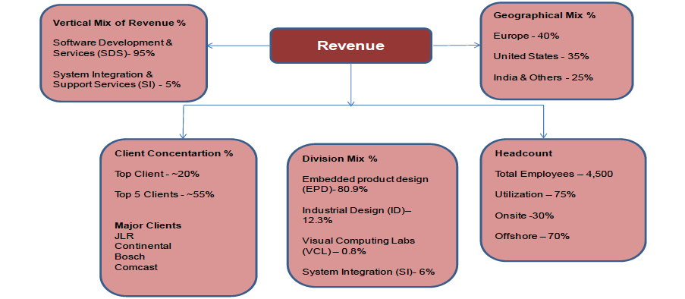
Business Mix – Q1FY16

Slide 3
Restructuring

Slide 4
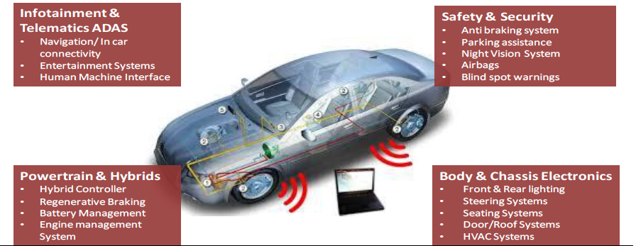
Future Growth Areas Identified
Auto (~45% of the EPD revenue)
• _Increasing software component in car: Software which comprised 2% in total value of the car in 2002 has reached to 15% (CAGR of 1%) and is expected to reach 20% (CAGR of 5%) by 2020. The disruption in the automotive segment is leading to smart phone capabilities, information/entertainment services (Infotainment), ADAS etc. which will eventually make driving safe, comfortable and autonomous. The cars are now a connected device with high end infotainment systems allowing 3G-4G services and real time information with high end Human Machine Interface (HMI) facilities, integration of consumer devices into the vehicles which when used with rear-seat systems enable videos/movies, live maps in the cars. Given the fact that car owners on an average spend around 50 minutes a day in the vehicle, there is a real big opportunity to monetize the digital media revenues and generate additional high profitable revenue streams.
Internet connected cars to increase to 20% in 2020: According to Industry reports (McKinsey), by 2020 every one out of five cars i.e. 20% will be connected to internet (internet connected cars) as compared to just 3% of the cars with network solutions in 2011. Further, electronic and software cost now accounts for 25-30% of the total production cost of the car and more than 90% of the innovation in a car is from the electronics and software in the form of safety and infotainment features.

Slide 5
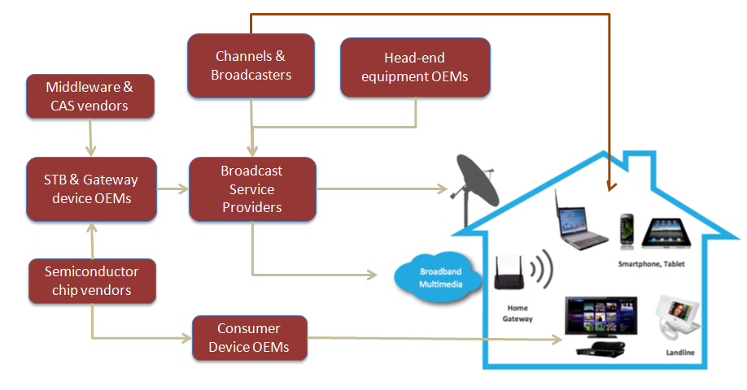
Broadcasting & Communication
The emergence of OTT has disrupted the traditional broadcasting business affecting the entire value chain. It has created a new route into the home which bypasses the broadcast service providers to deliver content directly via the internet (like Hotstar). It will no longer involve any service provider (Tata sky, reliance digital, Videocon etc.) because the new route via internet has created a large market not only through pay TV’s concept but also through over the air and over the top content.
Thus, the market is evolving and TELX works with each member in the ecosystem. It works with the semiconductor vendors, with set top box companies to build those boxes & supply it to the suppliers and even with the Channels & Broadcasters providing OTT content. With the experience of more than 15 years, strong client base i.e. working with 2 Set top box companies of top 3 and working with top 3 MSO’s and an addressable market of $400 – 500 million ( presently TELX addresses 10% of the same), TELX has huge opportunity in the broadcasting segment.

Slide 6
The Management Direction Since –Q3FY17
Tata Elxsi’s Patent pending V2X Emulator software
Tata Elxsi- Irdeto and Tata Elxsi Partner to Provide Secure In-Car Display Systems
for Automobiles
Spirent and Tata Elxsi announce new customer win in China for their joint
Advanced V2X test system:
Medical electronics and Internet of Things (IoT) – could see significant
contribution on going forward:
NOS Accelerates RDK Deployment with Tata Elxsi’s Continuous Integration Environment
Tata Elxsi helps Welspun to engage kids in immersive storytelling using Augmented Reality
Tata Elxsi and MStar partner for providing Next Generation Set Top Box Software Solutions
Testing of Automated Car on Bangalore Roads.
TELX’s employee base stands at 5,600, of which 300 were added in 3QFY17

Slide 7
TATA ELXSI
Pros
Strong balance sheet and return profile: TELX has a strong balance sheet with zero debt, comfortable working capital (current ratio 2.5x) with cash conversion cycle of 38 -40 days
The change in the business mix has helped in improving margins (~24%) and return ratios. Generally, IT product companies in the growth phase have lower return ratios and companies with matured product profile have higher return ratios but moderate revenue growth. TELX is in the sweet spot having both revenue growth and healthy return ratios
Top 10 customers are in Transportation and Media (6 in transport and 4 in broadcast)
Started focusing on IP based business. Licensed product to Chinese Cable and Portugal one
Mgmt mentioned in Q3 Concall , they will NOT be impacted by ‘Border Tax’ or H1B restrictions.
Most of their hires are at onsite and onsite presence small
Also need to understand business model where they execute projects that will be deployed in multiple Objects (eg Connected Car)
In Q3 concall, Madhukar Dave mentioned, they will give 20%+ topline growth in 2017-18/Hiring will be muted unlike 2016-17 ( Total HC 5600 & Utilization rate 75% ) & project specific only /Margin 22-24%
20% of Revenue comes from JLR , down from 25%
Implemented UX on Mumbai International Airport, working on Cochin & Nagpur Metro
Opening of Panasonic ODC is the game changer in IOT space. This division of Panasonic, contributes to revenue 75 BUSD and it is the appliance business. They will start working with Refrigerator product line 1st
Moving from small components IP to Solution Based IP
No negotiation in contracts, space we are in ,customer focus more on quality rather than on price,we keep a part of the Automation with us

Slide 8
Pros
Increase in Global Engineering & RD spends – Opens offshoring opportunity: With the continuous increase in automation and software led innovations, the global E&RD spend has increased from $980 billion in 2008 to $1400 billion 2013 and is expected reach $1600-1700 billion by 2020. The complex innovations requirement of OEM’s and Tier-1 suppliers needs to be cost effective which opens up offshoring opportunity to India given strong engineering capability along with cost advantage. According to NASCOM, India’s share in Global E&RD offshore market is expected to increase from 20% to 30% by 2020 to reach $35-40 billion. TELX is well placed to encash the opportunity in both automotive and broadcasting with an estimated addressable market of $600-700 million and $400-500 million respectively.
Off-shoring in Auto R&D set to increase: According to Industry reports (NASCOM & PWC) the overall R&D spending by the automotive industry has gone up by 4.6% CAGR in last decade. It was $105 billion in 2014 as against $71 billion in 2010, growing at a CAGR of 10% in last 4 years. Global Engineering R&D spend has increased from $980 billion in 2008 to $1400 billion 2013 and is expected reach $1600-1700 billion by 2020.
Since, the complex innovations requirement of OEM’s and Tier-1 suppliers needs to be cost effective which opens up offshoring opportunity to India given strong engineering capability along with cost advantage. According to NASCOM, India’s share in Global Engineering, R&D offshore market is expected to increase from 20% to 30% by 2020 to reach $35- 40 billion.
The key growth areas for global auto R&D spends are:
Powertrains and Hybrids;
Infotainment (entertainment& in car connectivity);
Safety & Security.
TELX is well placed to take the opportunity as it derives auto revenue from Powertrain & hybrids (~40%), Infotainment (~40%) and safety and security (~20%). The company works with 8 – 10 top OEM’s & 25 plus TIER I suppliers (viz. Bosch, Continental etc.). Total addressable market stands ~$600-700 million and TELX’s present share is 10-11%.
Strong balance sheet and return profile: TELX has a strong balance sheet with zero debt, comfortable working capital (current ratio 2.5x) with cash conversion cycle of 38 -40 days. The change in the business mix has helped in improving margins (~24%) and return ratios. Generally, IT product companies in the growth phase have lower return ratios and companies with matured product profile have higher return ratios but moderate revenue growth. TELX is in the sweet spot having both revenue growth and healthy return ratios.

Slide 9
TATA ELXSI
Risk factors:
Project driven business; 2) any strong currency fluctuation; 3) Slower than expected growth in innovation within auto and broadcast sectors; 4) any significant slowdown in sales of top 5 products
Hedging lost of 3-10 crs every qtr
Management change
Significant product failure and its repercussions on Brand Equity
Execution will be key
I don’t see any significant good profile ( technology Wizard) in top management. Like TCS, Veterans are managing the show. Is it risk ??

Slide 10
TATA ELXSI
Scuttlebutt from Vaibhav
People Apprehensive to divulge details
Employees of TATA Technologies also had a chat with them , did not divulge much info
Overall happy Employees with the Work & Job Security
Low Salary disgruntled employees
Panasonic ODC , Dedicated IoT Lab , Simulation Centres
Patents in work
Management ?

Slide 11
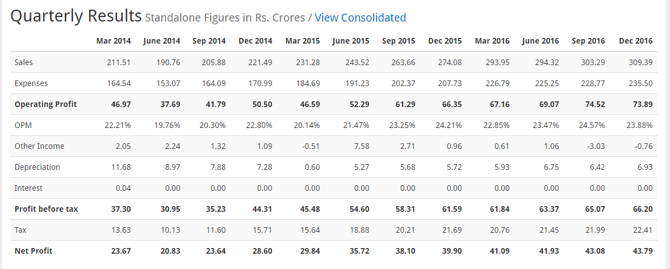
TATA ELXSI –My Calculation ( Please do your own research)

