Slide 1
Investment Opportunity
04 Feb 2018
For Mumbai ValuePickr
By - Balaji Kasal
balaji.kasal@gmail.com
+91 92235 89829
Kasal Investments

Slide 2
What is Value Investing?
Wonderful Businesses?
Buy Cheap?
Sell higher price?
Opportunity – Changes in Business strategy; Industry dynamics; Asset play; Management goof-up; Regulatory changes; Overall Stock Market condition; Corporate Action; M&A; ??
Horizon: Weeks to Years

Slide 3
Noida Toll Bridge
Business: To develop construct, operate and maintain the DND Flyway on a Build Own Operate Transfer (BOOT) basis
8Lane; 6KM
Revenue: Toll collection, Advertisement Space sell
Promoter: IL&FS Transport
Disclaimer: I have holding in Noida Toll Bridge as ‘Special Situation investment’ with single digit ‘Capital allocation’.

Slide 4
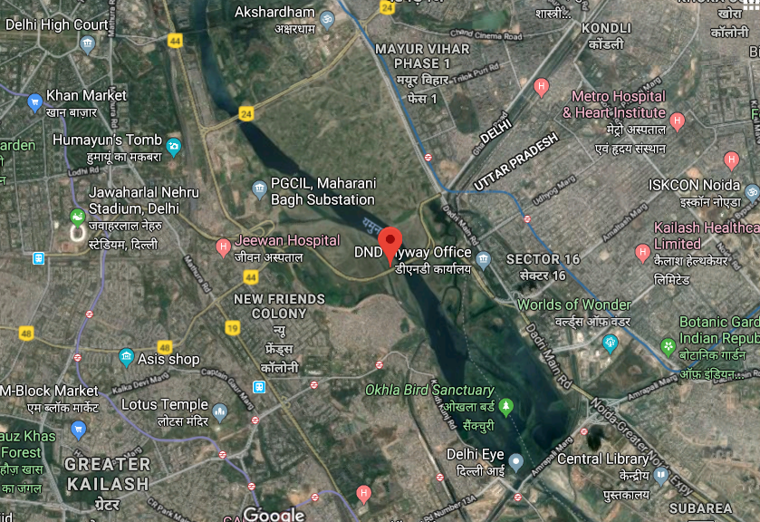

Slide 5
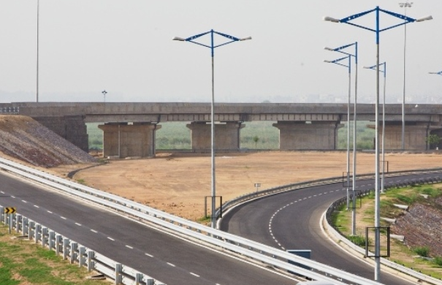
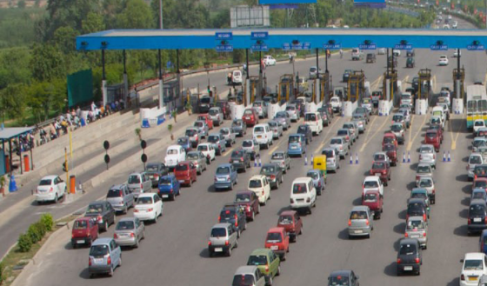

Slide 6
Financials:
Market Cap: ~243Cr
Source: Screener

Slide 7
Sequence of Events
First PPP Model: Concession Agreement (CA) among Govt. Delhi, UP, Noida, World Bank, ADB and IL&FS in effect post Cabinet approval in 1997
RoI: Post tax IRR of 20% PA
Concession period: 30 years or earlier if returned achieved or extendable to 3 years
International competitive bid & Financial closure (70:30 ~ 400Cr) in 1998
Operation begins in 2001 with low traffic volume till 2005
Public litigation filed in 2012
Hon’ble Allahabad HC asked to stop toll collection in Oct 2016
CAG submitted report in Mar 2017 to Hon’ble SC
“Initial cost of project under CA remains unrecovered and is not going to be recovered in the original concession period”
Arbitration proceedings against NOIDA Feb’2017

Slide 8
Recent Developments
BSE filling –
Sep 2017:
Jan 2018:
In Dec 2017: SDMC granted to display out door advertisements for 31k sq feet for 5 years which could extendable by 2years

Slide 9
Closing Comments:
Probable in favor of Company, as legal deed, but in which form not clear
Margin of Safety
As litigation in WIP, not sure on timeframe resolution of issue
Annuity or One time compensation?
Advise: Investors need to considering Risk – Return & Timeframe before taking own call

Slide 10
Thank You.

