Slide 1
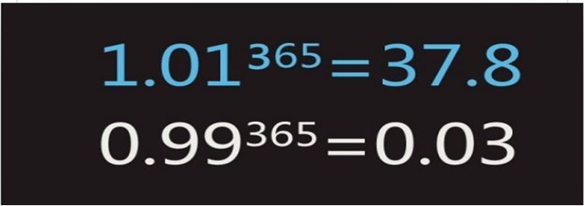
“EARN is a part of the word LEARN. To earn more, you have to learn.”

Slide 2
The Investing dilemma
-Betting on a company or its management.
Pankaj Gupta
September 11, 2016

Slide 3
Multibagger Matrix
Years/ CAGR | 5 | 10 | 15 | 20 | 25 | 30
10% | 1.6 | 2.6 | 4.2 | 6.7 | 10.8 | 17.4
15% | 2.0 | 4.0 | 8.1 | 16.4 | 32.9 | 66.2
20% | 2.5 | 6.2 | 15.4 | 38.3 | 95.4 | 237.4
25% | 3.1 | 9.3 | 28.4 | 86.7 | 264.7 | 807.8
30% | 3.7 | 13.8 | 51.2 | 190.0 | 705.6 | 2,620.0
40% | 5.4 | 28.9 | 155.6 | 836.7 | 4,499.9 | 24,201.4
50% | 7.6 | 57.7 | 437.9 | 3,325.3 | 25,251.2 | 191,751.1

Slide 4
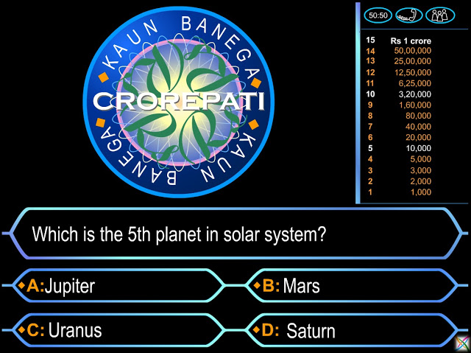
What does you look to find a ‘Multibagger’
Valuation
Business
Management
Luck

Slide 5
Investment Process
Management
Business
Valuation
Investment Process

Slide 6
Drivers of Value Creation
PE Multiple
Business Quality
Business Opportunity & Business Model
Sustainability & Risk Profile
Management Quality
Passion
Competitive Edge
Honesty
Competence
Transparency
"You need two things—a moat around the castle, and you need a knight in the castle
who is trying to widen the moat around the castle.“ – WB/CM

Slide 7
Why is Management Important?
Responsible for providing the strategic direction
Significant influence on the future growth of the company
Hire people and shape the culture
Capital Allocation
One can judge the management only over a fairly extended period of time

Slide 8
Investment Matrix
Good Management
Cyclical
Compounding
Bad Business
Good Business
Avoid
Value Arbitrage
Bad Management
The quality of an organization can never exceed the quality of the minds that make it up.
– Harold R McAlindon, American author, writer, management speaker

Slide 9
Investment Objective
Investing can primarily be done in three ways:
Compounding Growth:
We would invest in growth companies which would provide above-average growth in their earnings in the medium to long term. The growth in earnings would provide us with a multiplier effect on our investment thereby creating value
Valuation Arbitrage (undervalued companies)
This form of investment involves companies that are trading below their intrinsic value. These companies have good long term prospects which is not appreciated by the market community
Timing Business Cycle
These strategy works best with cyclical stocks. This would involve entering a stock in a down cycle with an expectation of turnaround and subsequently exiting it. The companies should be available at reasonable valuation at the time of entry.

Slide 10
Difference between Promoters and Management
Company | Market Cap (Rs Crores) | Company | Market Cap (Rs Crores)
TATA CONSULTANCY SERVICES | 512,942 | SUN PHARMACEUTICAL | 183,510
RELIANCE INDUSTRIES LTD. | 327,506 | MARUTI SUZUKI INDIA LTD. | 146,003
HDFC Bank Ltd | 317,763 | ICICI BANK LTD. | 145,528
ITC LTD. | 303,833 | TATA MOTORS LTD. | 144,748
INFOSYS LTD. | 238,710 | KOTAK MAHINDRA BANK LTD. | 142,721
HOUSING DEVELOPMENT FINANCE CORP.LTD. | 217,755 | BHARTI AIRTEL LTD. | 141,328
COAL INDIA LTD. | 212,609 | AXIS BANK LTD. | 139,065
OIL AND NATURAL GAS CORPORATION LTD. | 203,877 | LARSEN & TOUBRO LTD. | 137,575
HINDUSTAN UNILEVER LTD. | 199,533 | INDIAN OIL CORPORATION LTD. | 131,850
STATE BANK OF INDIA | 197,640 | NTPC LTD. | 130,938
Notes:
Professional, Govt Monopoly, MNC,

Slide 11
Bringing in External Managers
Management Competency
Importance of Board
Corporate Governance
Adaptability/Flexibility
Decentralisation
Capital Allocators Vs Business Management
Succession Planning

Slide 12
Promoters Vs Management
Owner Management
Reliance, Hero Honda, Bajaj
??
Owner Owned
InstitutionOwned
Marico, Tata’s
HDFC’s, ICICI
Professional Management

Slide 13
Public Sector Units
Objective of PSU
Are Interest of shareholders and management aligned?
Orientation of Management – Short Term/Long Term?
Competency level of the management?
Obligation while making key decision?

Slide 14
Multinational Companies
Royalty and Transfer Pricing?
Related Party Entities?
Does top management works for Indian or Foreign Entity?
Are all of them really honest?

Slide 15
Crony Capitalization
“When you see that in order to produce, you need to obtain permission from men who produce nothing - When you see that money is flowing to those who deal, not in goods, but in favors - When you see that men get richer by graft and by pull than by work, and your laws don’t protect you against them, but protect them against you - When you see corruption being rewarded and honesty becoming a self-sacrifice - You may know that your society is doomed." –
Ayn Rand, Atlas Shrugged, 1957
Notes:
Coal Allocation/Spectrum Allocation - Adhunik, India bulls, DLF, JSPL

Slide 16
Adding Assets, Adding Value !
2003
2016
Commodity Player
Poor Margins
LOW ROACE
Controlled Asset Creation
Low Cost of Production
Sustained Improvement in ROACE
 | Mar’03
Revenues | 486
BV Per Share | 64
PBT | 22
Bus. ROACE % | 8
M.Cap | 159
June’15
6,453
1774
400
8
60,000

Slide 17
Case Study I
OLIGOPOLISTIC BUSINESS
GOOD GROWTH
MANAGEMENT?

Slide 18
Case Study 2
SUNRISE INDUSTRY
FIRST MOVER ADVANTAGE
MANAGEMENT?

Slide 19
Key Management Evaluation
Composition of the Board
Alignment of Interest
Frequent Accounting Policies Change
Frequent Dilution – Warrant/QIP/Preferential Warrant
Management Guidance/Frequent Management Interaction with Investors/Media
Corporate Reorganisation – Merger/Demerger/Spinoff
Fraud
Employee Retention, Employee Promotions & Stock Option/Bonus policy

Slide 20
Key Management Evaluation contd…..
Money Diversion - Inflated Capex
Unrelated Diversification
Related Party/Group Company in similar businesses
Promoter Salary/Royalty/ESOP
Crony Capitalism
Revenue & Profit Management
Holding Company
Track record of inorganic growth

Slide 21
Key Management Evaluation contd…..
Innovation/creativity
Delivering on stated commitments/initiatives
Capital Allocation
Discipline attitude towards financial and operating leverage
Operational Excellence
Insider buying/selling - identify managers/promoters buying shares with cash
Longevity and cohesiveness of top management team

Slide 22
MANAGEMENT IMPAIRMENT TEST
Competency/Skill (Incapable successor)
Capital Allocation Skill (Larger than life ambition)
Integrity Impairment (Events)

Slide 23
Winners never Cheat
"The fundamental principle of economic activity is that no man you transact with will lose, then you shall not.“ -Quote from Arthashastra
“A business that makes nothing but money is a poor business.” — Henry Ford
EMPATHY with CUSTOMER, COMPETITOR, SUPPLIER. EMPLOYEES, SHAREHOLDERS

Slide 24
“Long--‐term profits come from having a deeper purpose, great products, satisfied customers, happy employees, great suppliers, and from taking a degree of responsibility for the community and environment we live in. The paradox of profits is that, like happiness, they are best achieved by not aiming directly for them.”

Slide 25
VANITY
SANITY
REALITY
REVENUES
PROFIT AFTER TAX
CASH FLOW
ABS REALITY
DIVIDEND
Source: Sanjoy Bhattacharya

Slide 26
INVESTMENT IS SUBJECT TO MANAGEMENT RISK. PLEASE RESEARCH CAREFULLY BEFORE INVESTING

Slide 27
Disclaimer: This presentation is meant for general reading and educational purpose only. The author does not accept any responsibility for any trading or investment undertaken in any form.
Any questions?
You can mail me at earninlearn@gmail.com
9331131562

