Slide 1
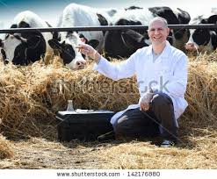
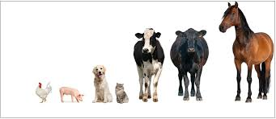
Omkar Specialty Chemicals
A Micro Cap Spin-Off Situation
Presentation By Girish Deshpande

Slide 2
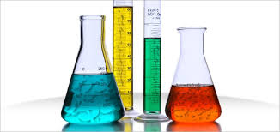
Disclaimer
The presentation is based on the data available at this point in time
This is not a Buy Recommendation or Report.
Objective is to present this case study to explain my investment process and share my learning
I am NOT authorized or qualified to recommend stock investments
I own this stock. That means I may be biased towards this stock.
Always do your own due diligence before you invest in any stock.
Micro cap stocks can be high risk - high reward kind and may not be for all

Slide 3
Investment Thesis in Nutshell
Specialty Chemical and Veterinary API (Lasa Supergenerics) divisions
Both businesses have strong tail winds for long term growth
Spin off of Lasa will unlock considerable value due to higher valuation
Momentum in Fundamentals visible – WC days, Margins, Growth, rating upgrade etc
Reduction in debt and de-pledging may lead to rerating of stock

Slide 4
Omkar - Company At A Glance
Develops and manufactures complex chemical molecules
R&D driven (15 DMFs and 18 process patents filed and 3 granted)
80+ products. Export to 40+ countries
40% sales from repeat customers. Top 30% customers contribute < 30% sales
Capacity of 5400 MT operational & 5300 MT capacity coming up this year
8 production facilities. 25 member DSIR approved R&D Lab
Recent rating upgrade – From BB+ to BBB

Slide 5
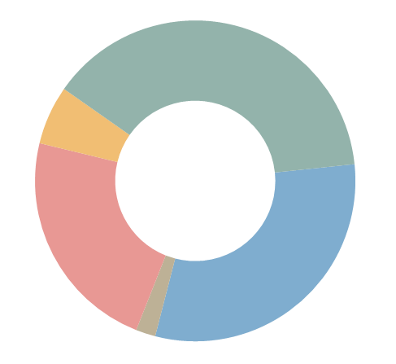
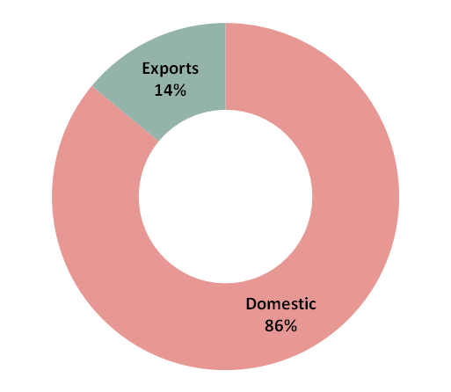
Segment & Geographical Revenue Split
–
Q1FY17
Q1 FY17
Segment break
FY16
-
up
Intermediates
Intermediates
27
%
38
%
Selenium Derivatives
Selenium Derivatives
3
%
6
%
Iodine Derivatives
Iodine Derivatives
33
%
23
%
API
API
35
%
Resolving Agents
31
%
Resolving
Agents & Others
2
%
1
%
Geographical break
-
up
Exports
10
%
Domestic
90
%
11

Slide 6
Company (Consolidated) Financials
P&L
Balance Sheet
 | FY16 (Cr) | Q1 FY17 (Cr) | Q1 FY16 (Cr)
Sales | 415 | 112.7 | 90.5
Sales Growth | 56% | 24.5%
Ebidta | 81 | 23.2 | 17.3
Ebidta Margin | 19.6% | 20.6% | 19.1
NP | 31 | 11 | 8.2
EPS | 14.9 | 5.3 | 4
Cash from Ops | 67
 | FY16 (Cr)
Shareholder funds | 195
LT Debt | 115
ST Debt | 113
Current Assets | 272
Current Liabilities | 279
Total Assets | 583
WC days | 117
Debt Ratios | FY 16
EBIDTA/Interest | 4.05
Total Debt/EBIDTA | 2.81
Net Debt/Equity | 1.1
Profitability
ROIC | 27%
ROCE | 24.7%
ROE | 15.7
Notes:
YoY growth for NP for FY16 is 26% Receivable days – 84 days Pietroski F score – 7 FY17 NP ~ 44 to 45 FY 17 EPS ~ 22 to 24

Slide 7
Return On Invested Capital
EBIT
ROIC = -------------------------------------------------------------------
(Beg. Invested Cap + Ending Invested Cap) / 2
Where,
Invested Capital = (Current Assets - Current Liabilities) + Fixed assets

Slide 8
Past Performance (Consolidated)

Slide 9
Lasa Supergenerics

Slide 10
Lasa Business Model
Customer
Products
Pharma API, Feed Additives, Reagents etc
Financials
Gross Margin- 40 to 50%
Sector
Sold to MNC Vet Pharma Cos
Now Introducing Formulations
EBIDTA% - 25% (Normalized)
ROIC – 35% ROCE- 25%
And New high margin products
WC Days- 45
Sales Growth- 25%+
35% capacity utilized
Top Vet Pharma Co customers
Niche & Growing Sector
Growth driver - Increased Protein intake
Increased Sourcing from India
Regulated – India FDA, TGA, EDQM, GMP
Higher Quality expectation
Merk
Novartis
Medibios
ChemiFine
35+ products
Holden Inc
New molecules- Higher GM
Stickiness– Repeat Biz

Slide 11
Lasa – Key Financials
P&L
Balance Sheet
 | FY16 (Cr) | Q1 FY17 (Cr)
Sales | 136 | 32
Sales Growth | 91%
Ebidta | 25 | 14
Ebidta Margin | 19% | 19.72%
Interest cost | 3.5 | 1.74
NP | 11.21 | 7.69
EPS | 5.44 | 3.73
ROIC | 38%
ROCE | 24%
 | FY16 (Cr)
Shareholder funds | 30
LT Debt | 45 (72)
ST Debt | 12
Current Liabilities | 50
Current Assets | 61
Fixed Assets | 66
Total Assets | 127
Asset Turnover | 1.25
Notes:
LT debt is going to be around 72 Cr in FY17. EPS FY 17 ~ 9.5

Slide 12
Competitive Situation of Lasa
Sequent Scientific and LGL Fine key competitors
Market domination in n few products
Backward integration ensures good Gross Margin
Enough Capacity available. No capex for next 2 years
35% capacity utilized. Operating leverage benefit
Current capacity can support sales of Rs 350 Cr for next 2 years.
Lasa has opportunity to exploit global market
Formulations will need different sales & Marketing strategy

Slide 13
Vet API - Peer Comparison
FY16 (Cr) | Lasa | Sequent Scientific | NGL Fine | Hester Biosciences
Sales | 136 | 634 | 96.29 | 101
Sales Growth | 91% | 36% | 9% | 12%
Gross Margin | 35 % | 51% | 57.6% | 64%
EBIDTA Margin | 19% | 11.60% | 22.4% | 34%
NP | 11.21 | -22.1 | 11.39 | 19.2
ROIC | 38% | 4.8% | 50.5% | 25%
Debt/EBIDTA | 1.81* | 3.66 | 0.6 | 1.13
Price/Sales | - | 5.37 | 2.35 | 6.34
EV/EBIDTA | - | 48.83 | 10.84 | 20.02
*This is based on FY16 data made available by Omkar.

Slide 14
Strategic Plans For Lasa
Backward and forward integration to ensure margins
Grow formulations business. 15 dosage forms in next one year
Formulations will need different sales strategy
Opportunity in Export markets
Innovation- At least 2 high margin molecules every year.
Make Compliance with regulatory & customer standards into competitive strength
LT debt payment in next 4 years

Slide 15
Specialty Chemicals Business
Note- This entity will retain the name Omkar Specialty Chemicals Ltd post spin-off

Slide 16
Specialty Chemicals Business Model
Customers
Top Pharma Cos Customers
Products
68 Specialty Chemicals
Financials
Gross Margin - 35%
Sector
Sold for function. Not for chemical composition
Iodine derivatives, Intermediates, Selenium derivatives, resolving agents
Vertically Integrated
EBIDTA% - 16 to 19% (Normalized)
New molecules - Higher GM
ROIC – 30% ROCE- 20%
Intermediates GM – 50%
WC Days – 130 or so
Sales Growth - 15 to 20%
Intermediates for Innovators
Increasing Sourcing from India by MNCs
Environmental regulations
R&D and knowledge intensive
Higher Quality
WC intensive
Mylan, API Solutions,
SIEGFRIED GmbH,
Netchem, Dr. Reddy’s
Top 5 customers:
40% sales repeat business
Export to 43 countries

Slide 17
Source-Allied market research

Slide 18
Sp. Chemical – Key Financials
P&L
Balance Sheet
 | FY16 (Cr) | Q1 FY17 (Cr)
Sales | 300 | 71
Sales growth | 55% | 9.2%
Ebidta | 45.3 | 12.3
Ebidta Margin | 15.1 % | 16.9 %
Interest cost | 16.5 | 4.6
NP | 22.2 | 5.6
EPS | 10.8 | 2.7
ROIC | 26%
ROCE | 12%
 | FY16 (Cr)
Shareholder Funds | 181.4
LT Debt | 79
ST Debt | 95.5
Current Assets | 215.7
Current Liabilities | 175.6
Total Assets | 320
Asset Turnover | 0.72
Notes:
EPS FY 17 ~ 12

Slide 19
Competitive Situation of Sp. Chemicals
China is not a Threat to Omkar
No competition for Advanced Intermediates, Selenium and resolving agents products in India
Large customer base. No dependence on few
Some barrier to entry –
Knowledge intensive and research driven. Experience matters.
Takes long time to gain trust & Approvals from Customers
Some customer captivity – Omkar in DFMs
Vertical Integration right after petrochemicals stage ensures efficiency, quality and profitability

Slide 20
Strategic Plans for Specialty Chemicals
Backward integration yielding results
Rising share of intermediates- High GM products
New high margin molecules- 15 DMFs filed.
Innovation to improve process efficiency - process patents filed
Outsourcing to avoid capex and improve ROIC
Improve WC days- Brought down from 200+ days in FY15 to 130-140 in FY16
Grow exports - Low interest loans, Import hedge, Better terms
LT Debt repayment in next 4 years
Notes:
Current export is 16% total sales as of Q1 FY17

Slide 21
Sp. Chemicals - Peer Comparison
FY16 Data (Cr) | Omkar (Sp Chem Only) | Navin Fluorine | Aarti Drugs
Sales | 283 | 661 | 1166
Sales Growth | 38% | 15% | -0.32%
Gross Margin | 35% | 54% | 33%
EBIDTA Margin | 16-19% | 21.3% | 14.72 %
NP | 22.21 | 86.5 | 66.28
ROIC | 22-25% | 26.7% | 18 %
Debt/EBIDTA | 3 | 0.21 | 2.52
Price/Sales | - | 3.55 | 1.03
EV/EBIDTA | - | 19.16 | 9.32

Slide 22
Key Risks to investment thesis
Operational
Raw material price rise
Regulatory
Vet API – FDA Regulatory risk
Financial
Competitive
Sp. Chemicals - environmental regulations
Debt reduction as planned
De-pledging as promised
WC cycle in chemicals biz
Increased competition for Lasa
Management depth & process maturity to scale up the business
Interest cost
Competing in global market
Formulations sales & marketing different than API
Stringent Customer audits
Key raw material iodine imported

Slide 23
Key Management Personnel
CMD - Mr. Pravin Herlekar
CFO - Mr. Pravin Agrawal
Director- Mr. Omkar Herlekar

Slide 24
So In Nutshell
LASA
Specialty Chemicals
Spin off of Lasa will unlock value due to higher valuation
Lasa is high profit, high growth, high FCF business
Formulations will improve margins & Growth further
Enough capacity to grow
Marquee customers & repeat business. Good Export potential
Sp. Chemicals business will grow @15-20% in next 2-3 years
New molecules will improve GM
WC issues coming under control.
Marquee customers. No competition in many intermediates & selenium derivatives
Specific time bound plan to repay debt in 4 years
100% De-pledging by Nov 2016

Slide 25
Thank You

