Slide 1
BATTERY INDUSTRY IN INDIA

Slide 2
Automotive – a)OEM b) Replacement
Industrial - a) UPS b) Inverter c) Telecom d) Solar e) Submarine f) Railways, g) IT/ITEs, etc

Slide 3
A Quick Look at EXIDE

Slide 4
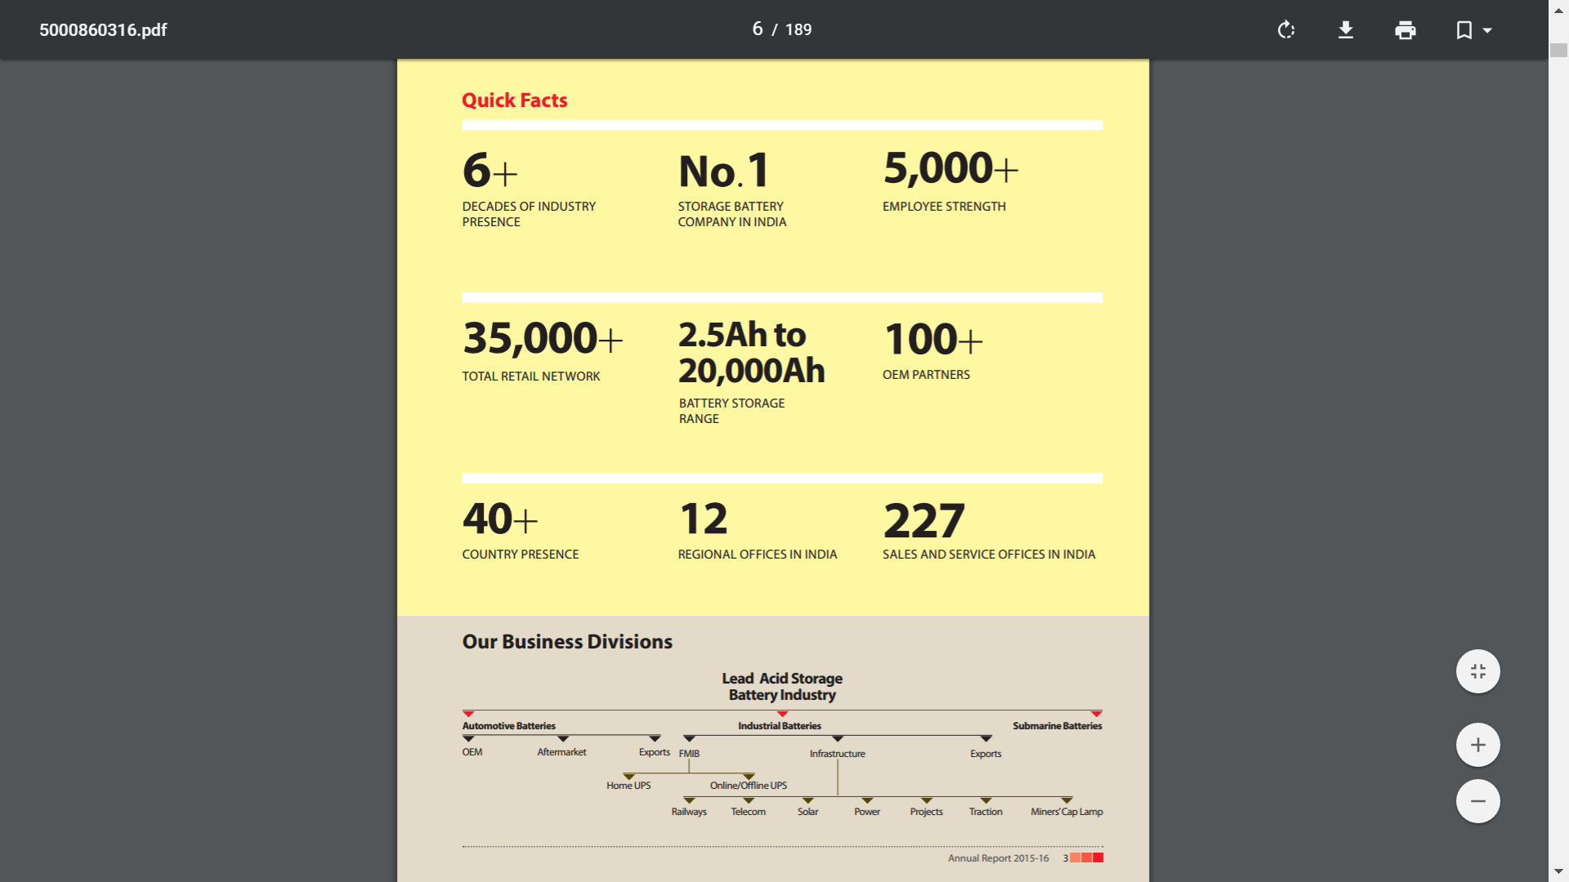

Slide 5
LEAD batteries are primarily used currently. In these batteries, Lead and Lead Alloys for nearly 80% of the Raw Material Costs (from Annual Reports of Exide and Amara Raja).
There are some other types of batteries such as Nickel-Cadmium and Lithium; however, lead batteries are the most frequently used ones.
Lithium batteries are a superior technology, but currently they are too expensive for automotive and industrial usage.

Slide 6
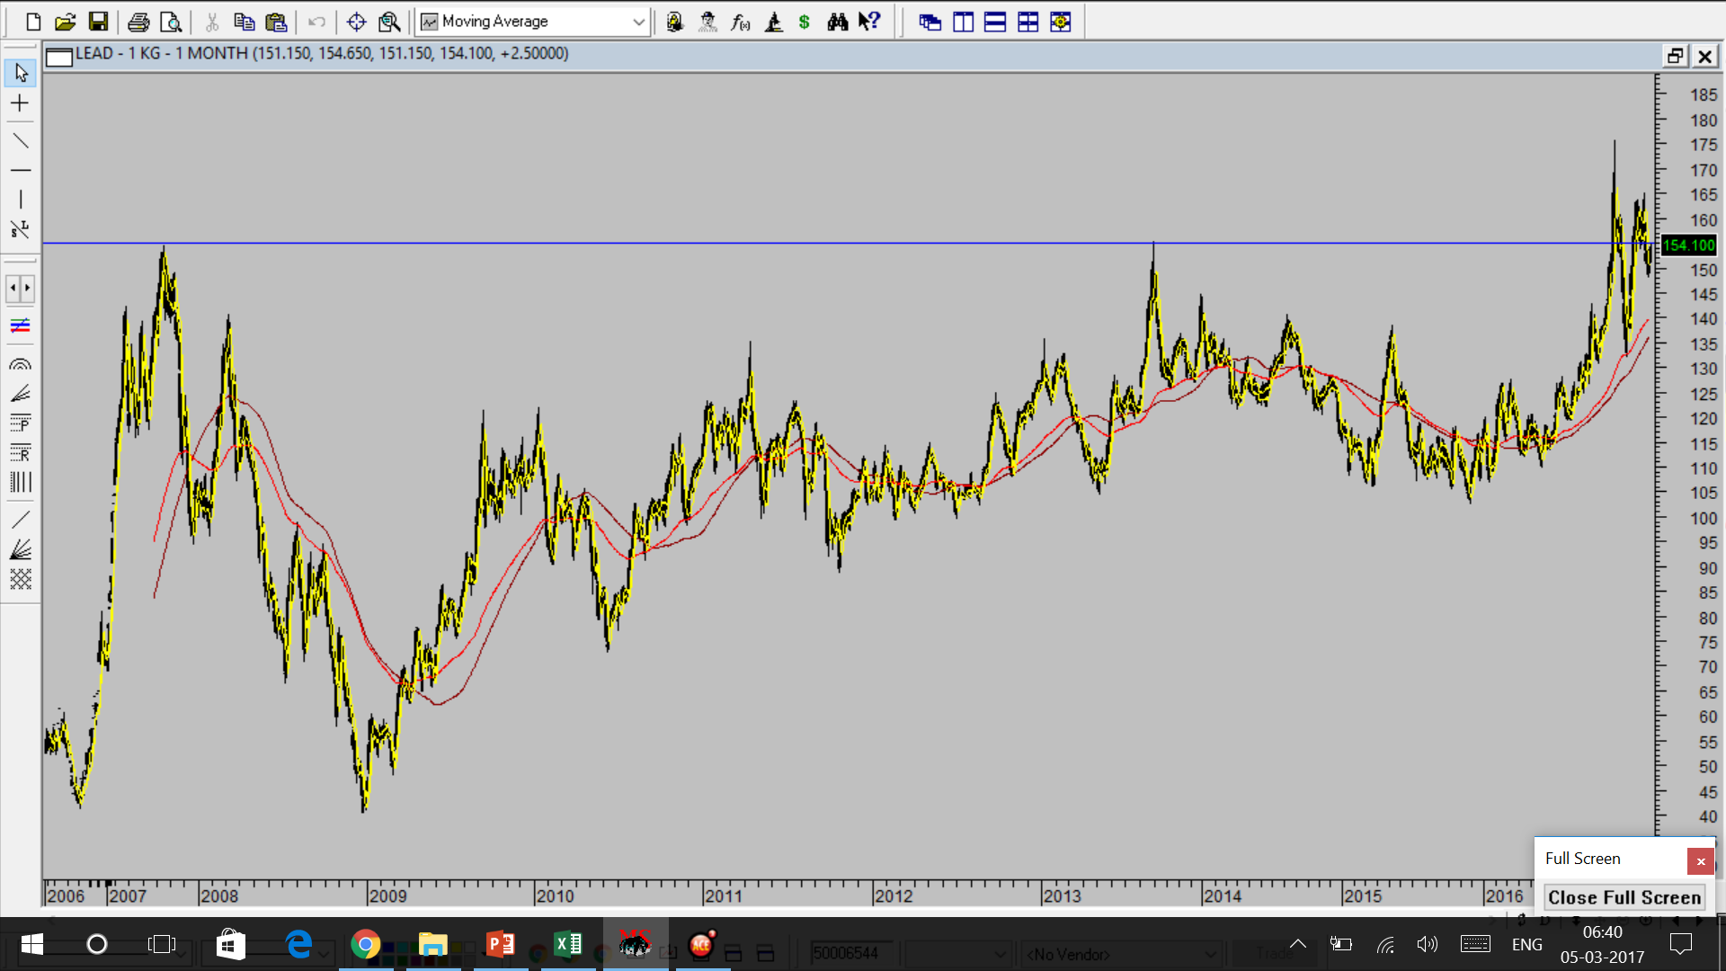

Slide 7
AUTOMOBILE BATTERIES IS PREDOMINANTLY A 2 – PLAYER MARKET
EXIDE
AMARA RAJA
Together they command 90% of the organized Automobile Battery Market. The only other noteworthy producer is Tata Green.
Exide still leads in Market Share in the OEM segment of 2/4 – wheelers as well as the Replacement Market, but Amara Raja now has a substantial share in both.

Slide 8
Exide’s growth lagged behind that of Amara Raja for several years from 2009 onwards, because Exide chose not to expand capacities anticipating a slow-down in the economy, whereas Amara Raja continued to successively expand its capacity over the years.
From 2010 – 2016, Amara Raja increased its automotive battery capacity from 4.2 million units to 8.25 million units which they intend to increase to 11 million units, and for 2-wheelers from a mere 1.8 million units to a whopping 11 million units which they further plan to increase to 25 million units over 4 years.
However, this has changed since 2015, from when Exide restarted making investments in capacity expansions.

Slide 9
INDUSTRIAL BATTERIES
In the Industrial segment, Exide is very strong in Inverters, UPS, Submarines(Monopoly).
However, Amara Raja controls the Lion’s share in Telecom which it managed to secure due to the Technological superiority in developed due to its tie-up with Johnson Controls. However, Exide has tied up with partners to get over that dis-advantage in the last few years. It is also getting aggressive with the pricing in this segment.

Slide 10
In 2015, with a change of Management, the company increased its CAPEX plan from Rs. 350-400 crores for the last several years to 800 crores.
In the fourth quarter itself, Exide suffered fall of 34% in automotive inverters as demand shifted to tubular batteries, he told analysts. On the capacity front, Exide would raise production capabilities in the automotive segment from present 12.2 million units to 13.8 million by the end of this year.
In industrial segment current capacity is 2.8 billion ampere hour, which will increase to 3.2 billion ampere hour from the capex infusion. The move is necessitated by the fact that revival in demand for automobile batteries is pushing up capacity utilisation and soon, if new capacity is not added, Exide would not be able to exploit demand triggered by revival in consumer spending.
Capacity utilisation in the automotive segment has grown substantially to 79% from 72% year ago. In the motor cycle batteries, utilisation touched 82%, up from 77%. Industrial utilisation improved from 68% to 81%.
Apart from automobile segment, Exide plans to cash in on expansion in telecom sector where batteries are needed to run cell towers. "Under the industrial battery segment, big growth during the March quarter came from telecom segment at 134%.“
http://www.dnaindia.com/money/report-exide-plans-rs-800-crore-capex-to-cash-in-on-auto-boom-and-stay-relevant-2082916

Slide 11
In 2016, EXIDE came up with a proposal of making CAPEX of Rs. 1,400 crores over two years for technology upgradation and expansion of capacity.
The new batteries were expected to have a life greater than 15-20%, and were exclusively meant for the replacement market and NOT for OEMs.
http://economictimes.indiatimes.com/industry/indl-goods/svs/engineering/exide-to-pump-in-rs-1400-crore-haldia-expansion-capex-at-rs-700-crore/articleshow/53286727.cms

Slide 12
In 2017, Exide announced an investment of Rs. 300 crore for motorcycle batteries under the “punched-grid” technology introduced for the first time in India.
Exide has increased its annual production capacity by 1.2 million to 15 million batteries.
Exide’s Haldia factory, set up in 1981, will be further expanded at an investment of Rs120 crore, Chatterjee said, adding the company was going to set up a smelting unit for which the state government had agreed to provide 25 acres.
Exide increased lead prices by 7% due to increase in lead prices by 10% over the last few months.
Demonetization had hit motorcycle battery demand by 30%.
The share of the unorganized sector in the replacement market is around 37%.
http://www.livemint.com/Industry/YBZh0HJOE5XCx0Ym3pWc6J/Exide-to-invest-Rs300-crore-to-expand-capacity-in-West-Benga.html

Slide 13
As of 2016, EXIDE had a capacity of 34.2 million units of automobile batteries (including batteries for motorcycles – 22 million units) annually, and over 2,824 million ampere-hours of industrial power every year.
EXIDE has 9 factories across India.

Slide 14
EXIDE has sound financial management which is evident by the
Steady and High Dividend Payout Ratio
The Working Capital Cycle
The salary structure of the Top Management (Compare with Amara Raja)
However, the idea of buying out the ING Insurance business in 2013, could be though of as a case of poor Capital Allocation or “diworsification”, although the business has grown since then.

Slide 15
EXIDE’s business Divisions
Battery division
Life Insurance
In 2016, Exide Life Insurance Company Limited, which is a 100% subsidiary, is engaged in the business of life insurance and providing financial investment products. The total premium collected during the year ended March 31, 2016 was Rs. 2,016.24 crores. The Company recorded a profit of Rs. 88.76 crores against a profit of Rs. 65.26 crores in the previous year.
Lead Smelters
The consolidated net sale of Chloride Metals Limited was Rs.1,007.68 crores and the profit before tax was Rs. 24.15 crores.

Slide 16
The lead smelters allow EXIDE to have some respite from rising Lead costs when Lead prices increase. However, as can be seen from the numbers, they are a drag on the consolidated margins.
Exide has decided to expand the Lead Smelting Capacity in its West Bengal Plant by making an investment of Rs. 120 crores.

Slide 17
IMPORTANT EXTRACTS FROM EXIDE’S ANNUAL REPORTS

Slide 18
2013

Slide 24
2014

Slide 29
2015

Slide 32
GOOD EXPORTS MARKET

Slide 33
2016

Slide 38
EXIDE’S SHAREHOLDING PATTERN
The Promoters hold 45.99% shares.
One Major institutional change which occurred was the Sale of Nalanda Fund’s stake of 3.75% in the September 2016 quarter.
Individual Shareholding has also gone up from 10.28% – 12.18%

Slide 39
EXIDE’S PRICE CHART

Slide 40
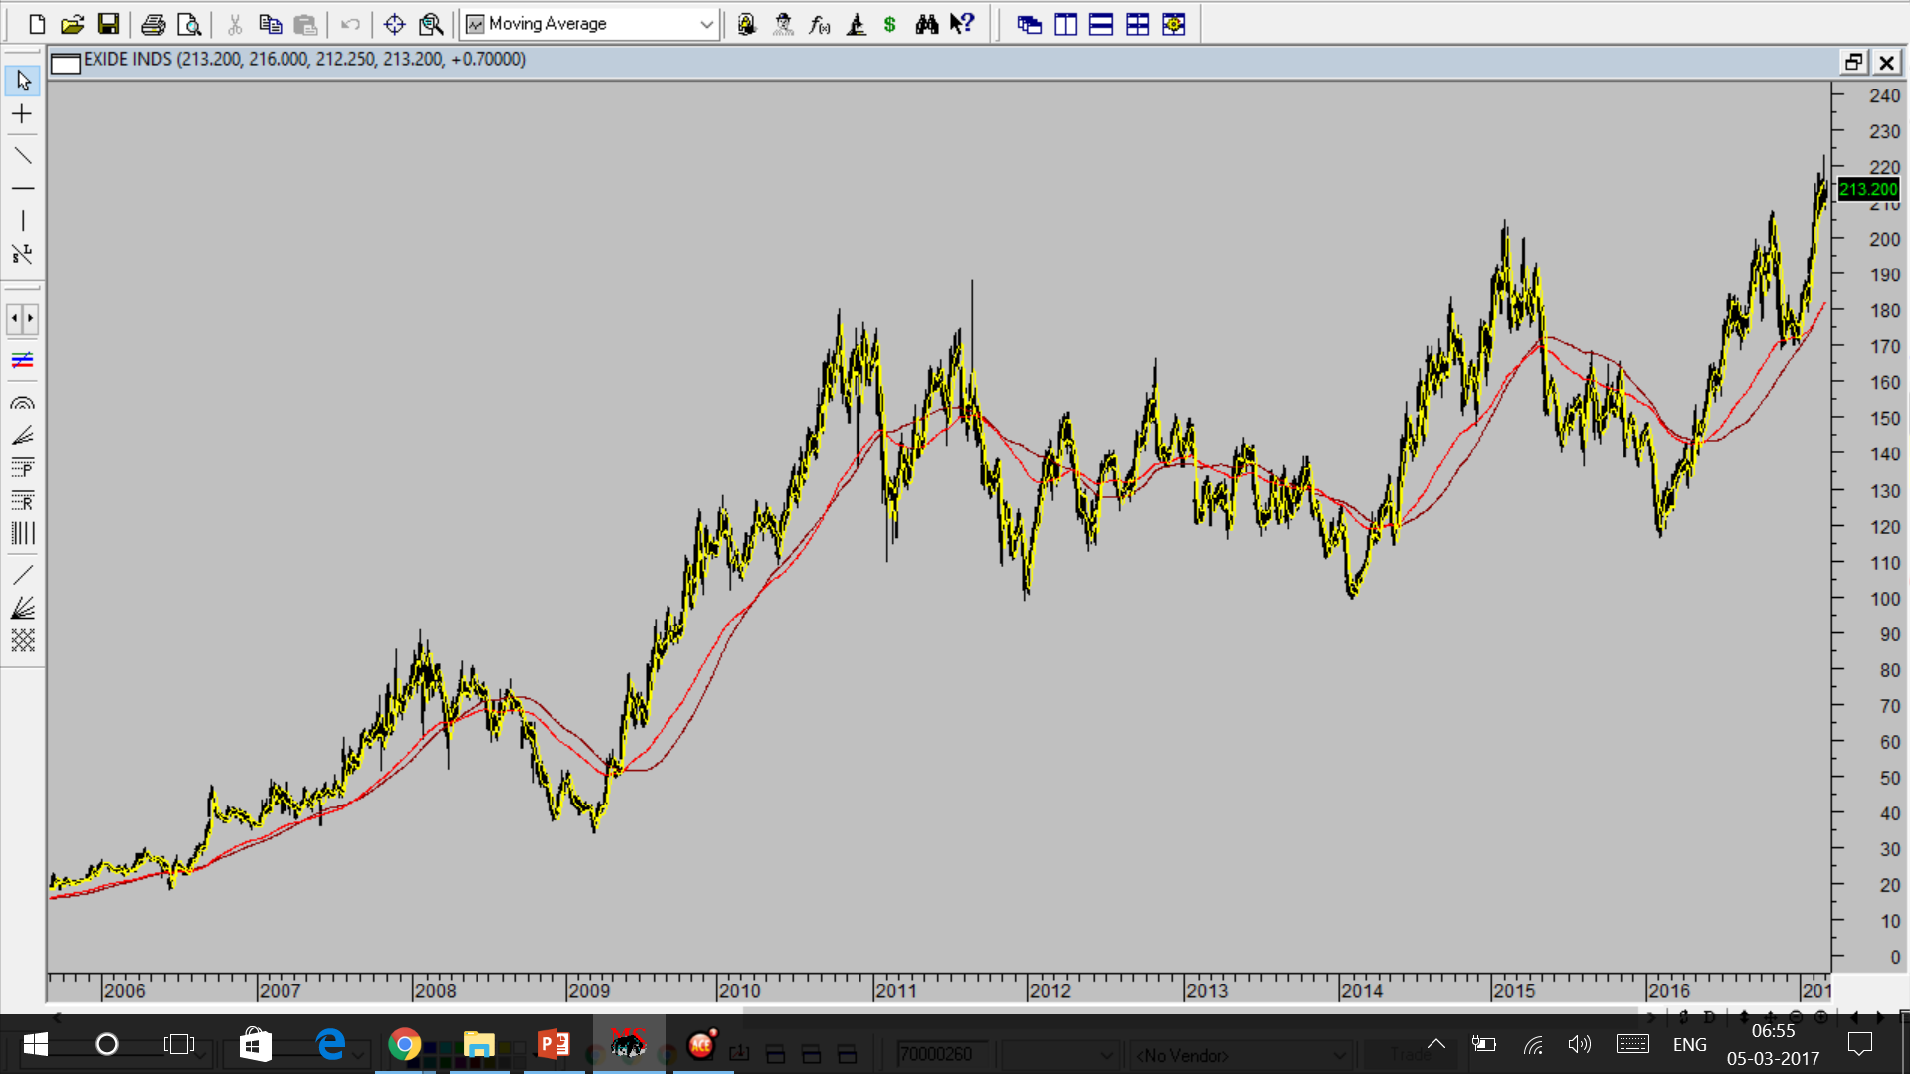

Slide 41
EXIDE’S FINANCIAL PERFORMANCE AND RATIO ANALYSIS OVER THE YEARS
From Ace Equity

Slide 42
SOME INFORMATION BASED ON MY INTERACTION WITH SOME DEALERS AND MANAGEMENT
&
VALUATIONS

Slide 43
THANK YOU!!

