Slide 1
MOSL Wealth Creation Study Summary
Subash Nayak
http://art-of-mental-modelling.blogspot.in/

Slide 2
Outstanding management
Unquestionable Integrity
Focused on core business
First generation entrepreneur
Wealth Creation
Management
Macro
Business
Valuation
Quality
ROE/ROCE > 20%
Growth > 25%
Favorable Tailwind
Huge size of Opportunity
PEG < 1
Payback ratio < 1
Not in commodity business
Non cyclical
High entry barrier business
Leadership market position (1st or 2nd)
Low capital Intensity

Slide 3
DNA of an Wealth Creator - 1
Management
Outstanding management
Unquestionable Integrity
Focused on core business
First generation entrepreneur
Macro
Favorable Tailwind
Huge size of Opportunity
Size
Preferably Midcap
Business
Not in commodity business
Non cyclical
High entry barrier business
Leadership market position (1st or 2nd)
Low capital Intensity
Valuation
PEG < 1
Payback ratio < 2
High ROE/ROCE
Sustained earning growth (>25%)

Slide 4
DNA of an Wealth Destroyer
Commodity Business
Manufacturing of intermediate products
Low ROE

Slide 5
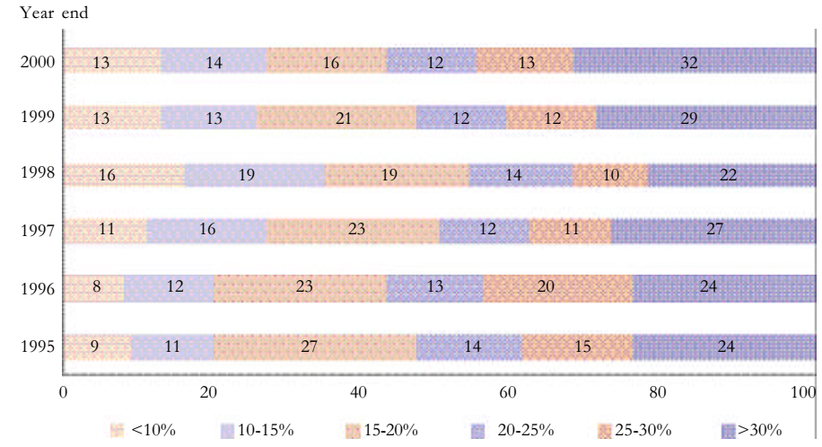
DNA of an Wealth Creator - snippets
1999
2000

Slide 6
DNA of an Wealth Creator - snippets
2004
2004

Slide 7
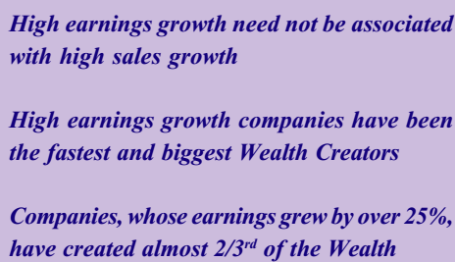
DNA of an Wealth Creator - snippets
2005
2006

Slide 8
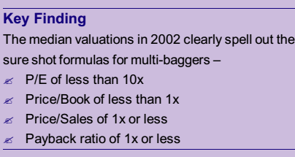
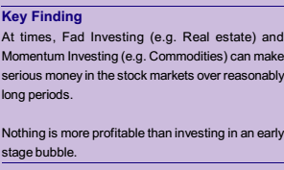
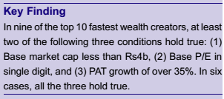
DNA of an Wealth Creator - snippets
2007
2008
2009
2010

Slide 9
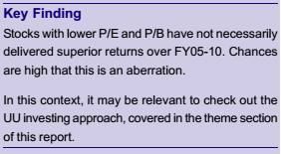
DNA of an Wealth Creator - snippets
2010
2012

Slide 10
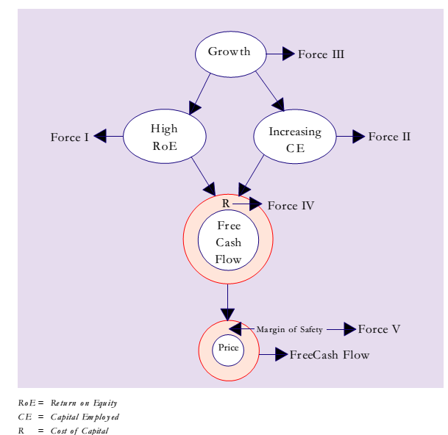
5 forces of Wealth Creation
High ROE
Increasing CE
Growth
Cost of Capital
Margin of Safety

Slide 11
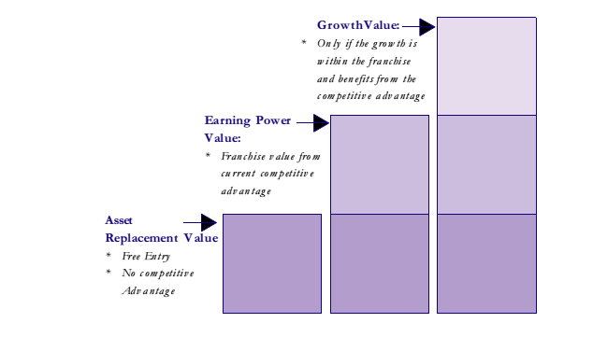
3 Component of Value

Slide 12
Valuation and Growth
Valuation
Consistency of Growth
Profitable Growth (FCF gen capability)
Sustainability of Growth
Non cyclical Secular Growth
How much capital needed for Growth
Longevity of Earning

Slide 13
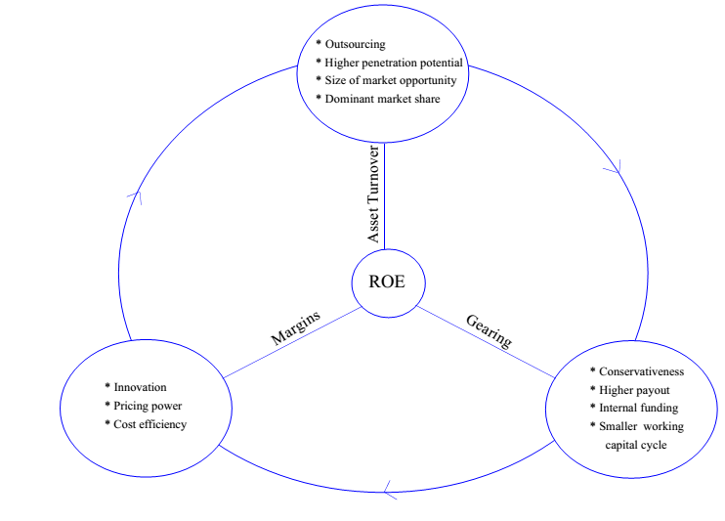
Deconstructing ROE

Slide 14
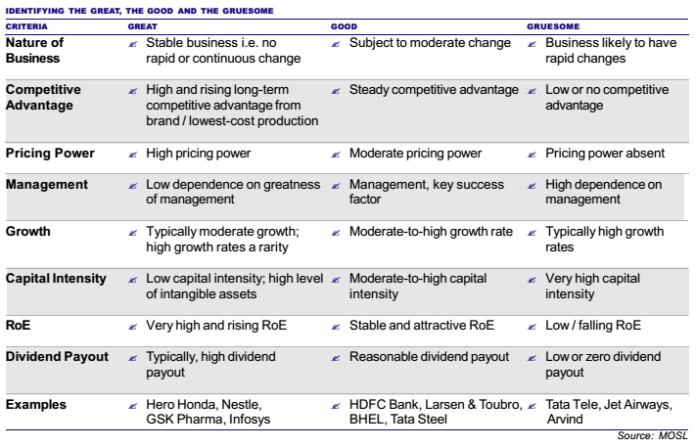
Great, Good, Gruesome

Slide 15
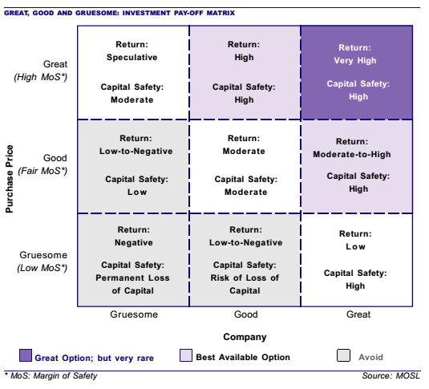
Great, Good, Gruesome

Slide 16
Winning Investment
Winning Investment
Winner Category
Sector growing 1.5x of GDP
Category Winner
Moat + Growth + Management
Reasonable Valuation

Slide 17
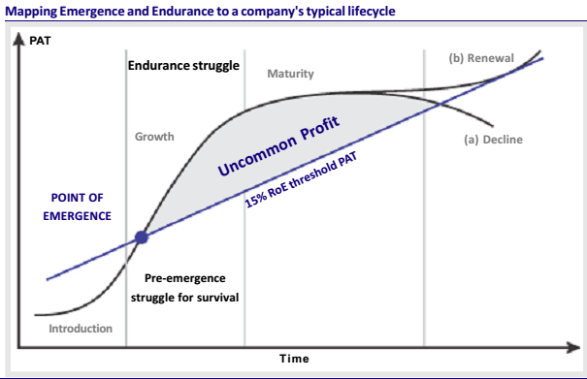
Uncommon Profit

Slide 18
Uncommon Profit

Slide 19
Uncommon Profit

Slide 20
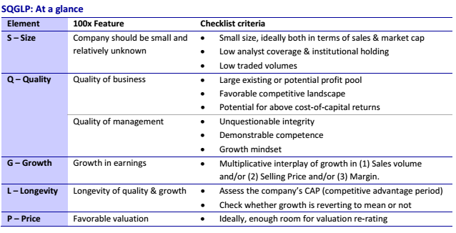
SQGLP Framework

Slide 21
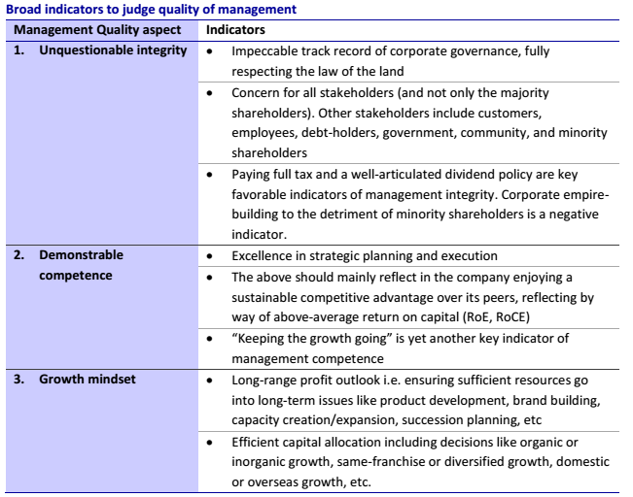
Quality of Management

Slide 22
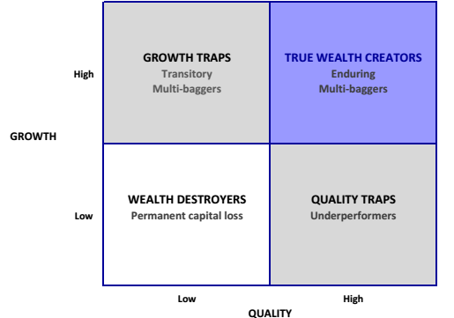
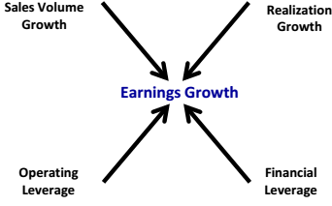
Growth vs Quality

Slide 23
Commodity Investing

Slide 24
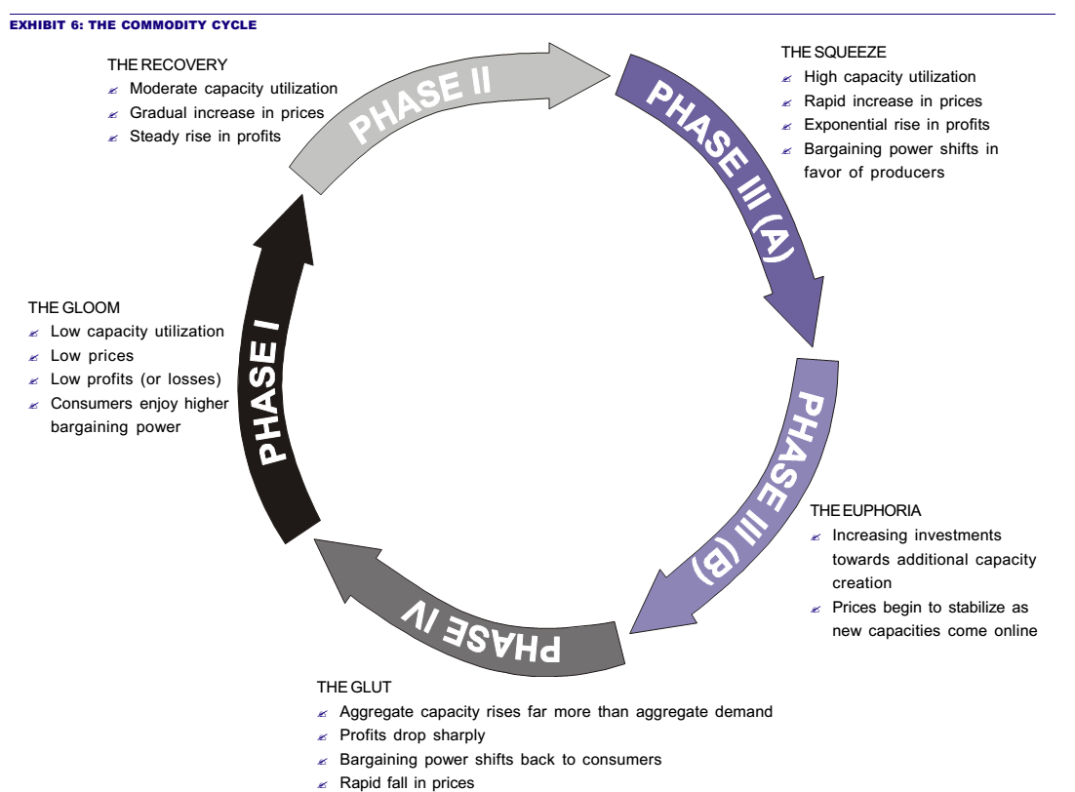
Phases of Commodity Cycle

Slide 25
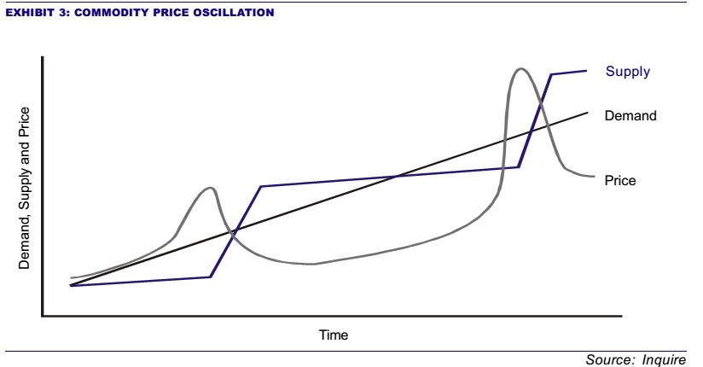
Commodity Investing

Slide 26
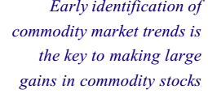
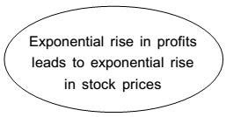
Commodity Investing

