Slide 1
Defence Industry in India
Disha Agarwal Jhunjhunwala
Nikita Mathran Raghav Bhutoria Saurabh Ved

Slide 2
Defence Electronics

Slide 3
Technology / Electronics Beneficiaries

Slide 4
Scope of Work – Technology / Electronics

Slide 5
Defence Electronics
25%-35%
60%
30 ToT
of Cost of Platforms
Foreign Suppliers
Agreements
~5 lakh Crores
Investment in 4-5 years
Defense Platforms, Equipment & Components

Slide 6
Economic Opportunity – Top 100 Companies Study
Country | Revenue (USD in Millions) | Number of Companies in Top 100 |  | Percentage among Top 100 |  | Total Military Expenditure | % of Miltary Exp. Countrywise |  | Targeted Revenue Static | Times the Revenue
Australia | 1239.39 | 1 |  | 0.22%
Brazil | 653.87 | 1 |  | 0.12%
Canada | 921.35 | 1 |  | 0.17%
China | 95626.82 | 7 |  | 17.35%
France | 21426.68 | 4 |  | 3.89%
Germany | 5627.08 | 2 |  | 1.02%
India | 4440 | 2 |  | 0.81% |  | 76.6 | 3.625177 |  | 19982.76 | 4.50
Israel | 10335.28 | 3 |  | 1.87%
Italy | 13385.29 | 2 |  | 2.43%
Japan | 6620.12 | 3 |  | 1.20%
Netherlands | 2,898.06 | 1 |  | 0.53%
Netherlands/France | 12,004.28 | 1 |  | 2.18%
Norway | 1,064.72 | 1 |  | 0.19%
Russia | 8985.94 | 2 |  | 1.63%
Singapore | 1,885.29 | 1 |  | 0.34%
South Korea | 8064.92 | 4 |  | 1.46%
Spain | 1593.57 | 2 |  | 0.29%
Sweden | 3,385.41 | 1 |  | 0.61%
Turkey | 3474.75 | 2 |  | 0.63%
U.K. | 34608.22 | 7 |  | 6.28%
U.S. | 307330.02 | 50 |  | 55.75%
Ukraine | 650.61 | 1 |  | 0.12%
United Arab Emirates | 5,000.00 | 1 |  | 0.91%
Total | 551221.67 |  |  |  |  | 2113

Slide 7
Economic Opportunity – Top 100 Companies Study
2
0.81%
3.62%
Only out of
Top
100
Revenue Generation
Military Expenditure
4.5
Times the Revenue

Slide 8
Case Study 1 : Mishra Dhatu Nigam Limited

Slide 9
About The Company
MIDHANI, incorporated in 1973 is a PSU located at Hyderabad.
Tier 2 and tier-3 raw material supplier in Defence, Aerospace and energy.
It is a leading manufacture of
High Value Specialty Steel
Super Alloys
High Value, low volume and high margin products.
Production doubled over the years.
Precision based.
High end application.
Titanium Alloys
Monopoly
It has a high strength to low weight ratio.
Used in fighter crafts, bio medical implants, exhaust systems in auto, etc.

Slide 10
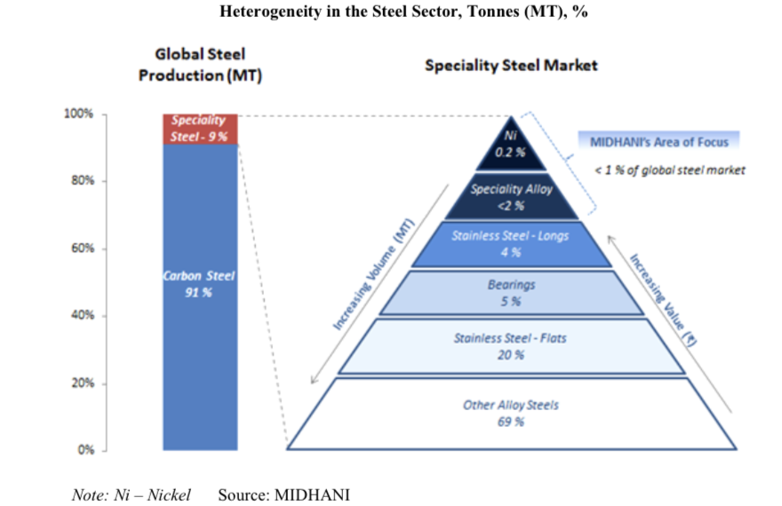
Industry
High Performance alloys market is forecasted to grow at a rate of approximately 5% from an estimated 9Bn in 2019 to 13 Bn in 2027.

Slide 11
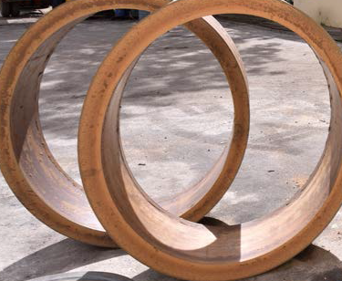
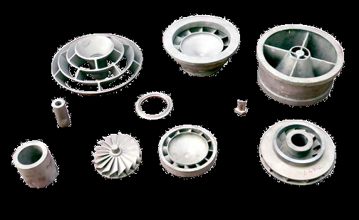
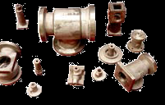
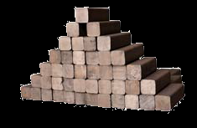
Products
Midhani is the only co in in India to carry out vacuum based melting and refining through best in class melting furnace. It manufactures wide variety of special metals and alloys in various forms such as forged bars/flats, rings, near net shapes hot rolled bars/sheets, cold rolled sheets, strips, foils, wires, castings, tubes and fasteners.

Slide 12
Customers
Titanium alloys
Akash missiles
Gaganyaan
They are enhancing their capabilities to to enter new markets of oil and gas, mining, power and railways.
Missiles
Power reactors

Slide 13
Financials
5 year CAGR 17.48%
5 year CAGR 27.42%
The company aims to increase its revenue through increased exports. Highest ever export of Rs. 87 cr recorded this year compared to 19 cr in the previous year.

Slide 14
Financials
D/E = 0.15
ROE = 16%
ROCE = 21%
ROIC = 15%
Net Fixed Assets Turnover = 1.9x
Market Cap = Rs. 3322 cr

Slide 15
Order Book
The orderbook as on date is Rs.1900cr. The FY2021-22 had highest ever sales of Rs.861 Cr. The topline can double up from here in the next few years. Maximum order is expected to come from space.

Slide 16
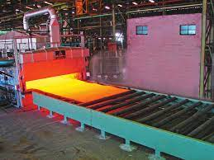
Wide Plate Mill- Game Changer?
First of its kind mill in India that can process plates of titanium alloy and special steel alloy which are very high margin business.
30000 tons p.a capacity. Currently running at 60% capacity.
Customer funded project. Rs.450cr funded by 2 customers – DRDO & Ordnance factory. Rs. 50cr by Midhani.
What can be a game changer by the end of Q4FY22?
Improved product mix- Currently it is supplying to railways, LNG at a very low margin at 60% capacity. The Capacity is expected to peak by the end of Q4FY22 after which the facility can be used for commercial purpose. The company plans to improve the product mix by producing high end alloys. They plan to increase exports as well produce value-added products by integrating it with their new armour facility at Rohtak.
Cost savings -Some of the products that are currently being outsourced will be manufactured in-house now. This will result in savings in terms of 1) outsourcing cost (25cr this year). 2) transportation cost and reduced production timings.
Import substitution - Some of the plates are currently being imported into the country. Here, there is no competition in India. Co. is building inventory to takeover any order of those plates which are currently being imported.

Slide 17
Future Growth Triggers
Armour unit at Rohtak- 50cr capex.
Utkarsha Aluminium Dhatu Nigam Ltd- 50:50Joint Venture with NALCO- Incorporated in2019 with a capex of Rs. 4000cr. It will have a capacity of 60000 tons p.a high end aluminium alloy production plant at Nellore, Andhra Pradesh. UADNL products will consist of flat-rolled products, forgings, extrusions etc to meet the growing demand in defence, aerospace and transportations. It is expected to commence in FY23.
Spring manufacturing plant with a capex of Rs. 25 crore

Slide 18
Future Growth Triggers
Co is developing new products through R&D initiatives.
MOU with HAL – for development and production of composite raw materials mainly used in fighter aircrafts/helicopter because of their high strength to low weight ratio (unlike metallic raw materials). These are currently imported in India.
Good orderbook inflow is expected from ISRO. Midhani is the only company providing raw material like titanium alloy used in satellites. Orders for Gaganyaan has already been placed. Midhani has an exclusive portfolio to serve the upcoming space launch programs.
Midhani is a partner in development stage for the manufacturing of missiles.

Slide 19
Valuations
 | Base case | Bull case
Sales | 1500 | 1,587.74
 | at 1.5x | at 1.8x
Net Profit | 300 | 365.18
 | at 20% | at 23%
EPS | 11.8 | 14.37
P/E | 20x | 20x
Price (Rs.) | 236 | 287
The company expects to improve its margin by improving the product mix once the wide plate mill is commissioned fully at peak capacity. Based on the current order book, it can be assumed that turnover can be 2x. The upcoming quarters need to be tracked to see if the management walks the talk.

Slide 20
Risks
The contracts entered into are fixed price contracts. Any escalation in RM cost cannot be passed on.
The working capital requirement is too high.
Midhani is dependent on orders from other PSUs like HAL, OFB and may get delayed and slow orders.
Competition from private players and imports, which may in some cases, be cheaper.
RM like Nickel, Cobalt, Molybdenum are imported.

Slide 21
Case Study 2 : Solar Industries India Ltd

Slide 22
ABOUT
Solar Industries (SIL) is the largest manufacturer of industrial explosives and explosive initiating systems in India
Has a capacity of > 300K MT/year.
Holds a reasonable market share in India of 27-30% in India. Up from 17-18% in 2018.
Leads the exports share from India, which is around 70% in industrial explosive and initiating system
Exports to 55 countries in the world and has recently expanded its base to many African Countries

Slide 23
ABOUT
In recent years it has expanded its manufacturing base to Nigeria, Zambia, South Africa, Turkey, Ghana and Australia
Economic Explosives Limited (EEL), a 100% subsidiary, works on products for Defence and Military applications
EEL manufactures Military Explosives, Bombs & Warheads, Ammunitions, Rocket Systems, Initiating systems and Pyrotechnic ammunition
SIL also has interests in the coal mines (in Chhattisgarh) through two JVs
SIL went public in 2006. Only time they raised equity capital post issue was in 2012, when they did a preferential issue to Oman India Joint Investment Fund.

Slide 24
REVENUE SEGMENTS
Industrial Explosives
Solar provides complete blasting solutions which includes packaged, bulk explosives and initiating systems
The explosives manufactured by the company are used by a wide range of segments from the Mining Industry to the Housing and Real estate industry and with its presence spread across 51+ nations
Defence
Indigenising technology and developing new products for Defence and Military
SIL is also the first private player to establish a facility to manufacture RDX, HMX and TNT, which is used by the defence industry to produce propellants, war heads and Rockets. The company's defence portfolio also includes manufacturing of war heads, grenades along with Rocket assembly.

Slide 25
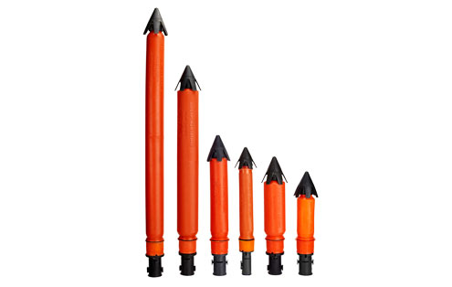
INDUSTRIAL EXPLOSIVES BUSINESS
Seismic Explosives
Packaged Explosives

Slide 26
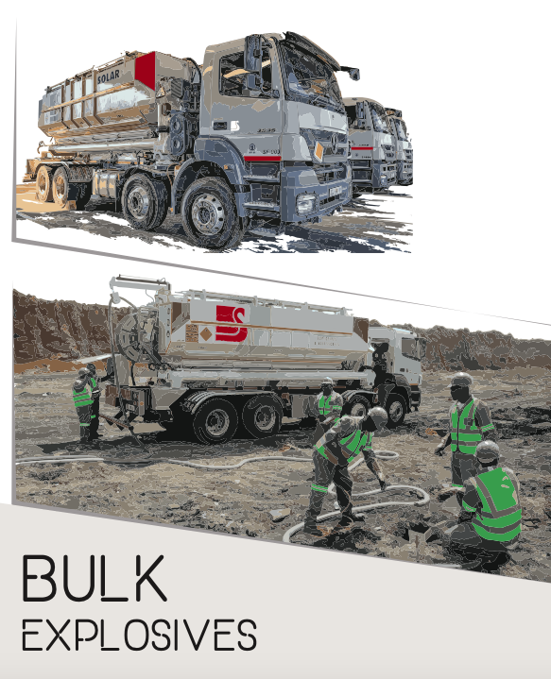
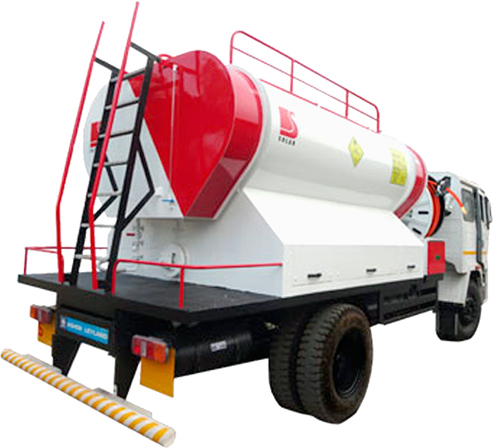
INDUSTRIAL EXPLOSIVES BUSINESS

Slide 27
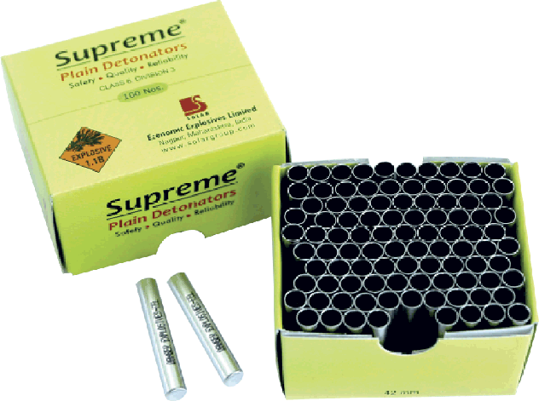
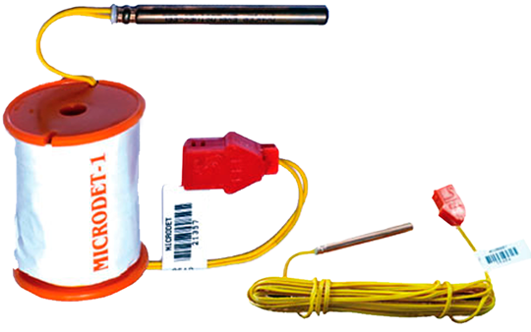
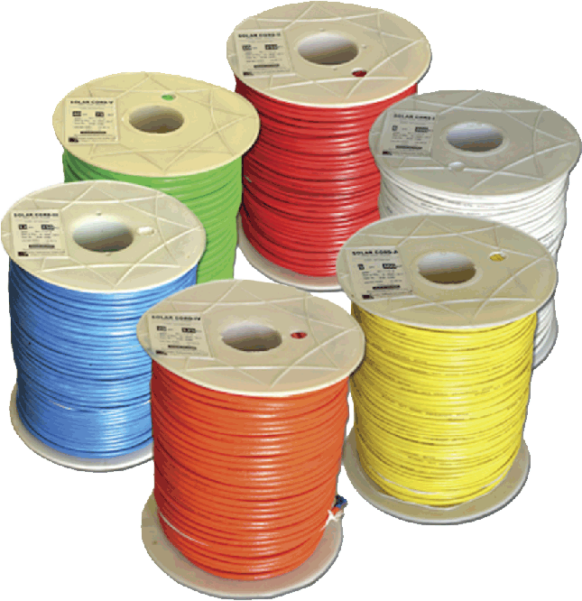
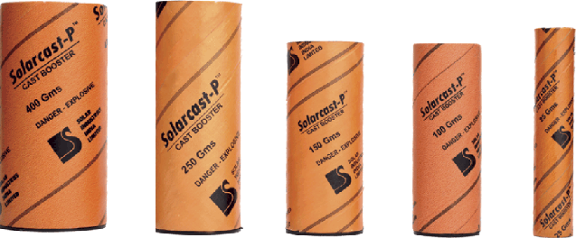
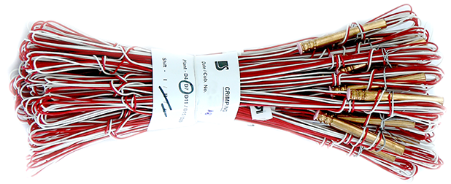
INDUSTRIAL EXPLOSIVES BUSINESS
Initiating Systems and Detonators

Slide 28
DEFENCE BUSINESS
Pinaka multi-barrel rocket launcher, developed by DRDO
Solar has co-developed the artillery rocket system along with the ARDE and High Energy Materials Research Laboratory (HEMRL)
Pinaka Missile Systems
Pinaka Mk-II - completed User Assisted Technical Trial, waiting for RFP
Pinaka Guided - Range and accuracy demo complete, waiting for RFP
Pinaka ER (Enhanced Range) Rocket System
Invar Warhead
Multimodal Hand Grenades (MMHG)
Solar has been key beneficiary of three negative import list (310 items) published by MoD
Solar management has plans to possibly benefit out of domestic procurement of 23 items

Slide 29
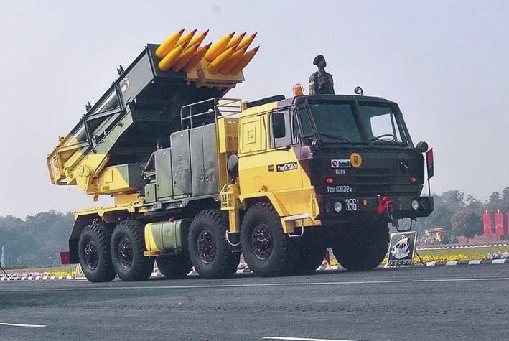
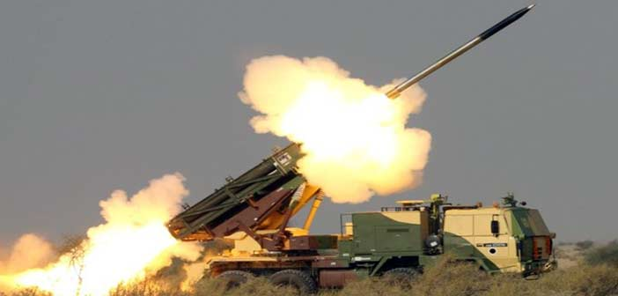
DEFENCE BUSINESS

Slide 30
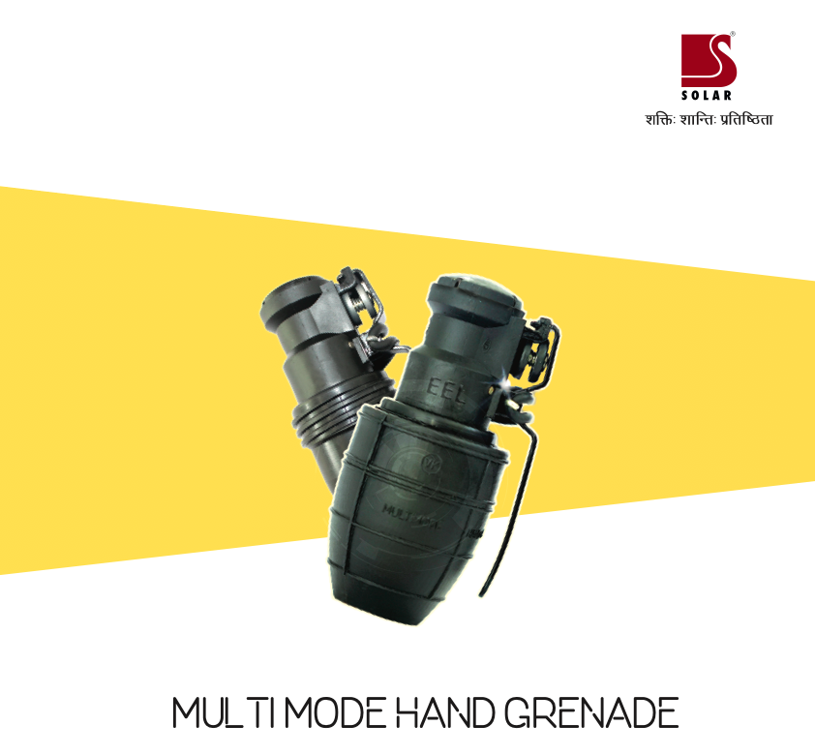
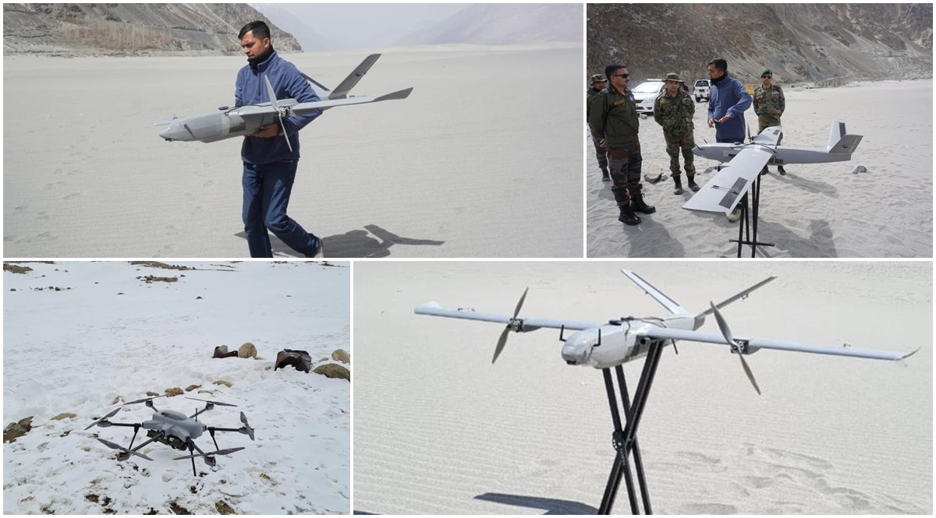
DEFENCE BUSINESS

Slide 31
DEFENCE BUSINESS

Slide 32
DEFENCE BUSINESS

Slide 33
DEFENCE BUSINESS

Slide 34
STRATEGIC INVESTMENTS
Z Motion Autonomous Pvt. Ltd. (45% equity stake)
Solar’s initiative of developing weaponized Unmanned Aerial Vehicles (UAV) for offensive and Counter Drone systems for defensive roles
ZMotion has diversified into the design and development of weaponised drones and UAVs as the strategic ammunition delivery systems
Several systems which are under development includes Loitering Munitions, Missiles on Drones, Drone based Gravity Drop Bombs, and more which can carry a variety of explosive warheads which can be used to neutralize tank and combat vehicles, civil fortifications, soft skinned targets in open, etc.
Also under development is Counter Drone Systems which can be used for engaging swarms of hostile drones.

Slide 35
STRATEGIC INVESTMENTS
Skyroot Aerospace
Skyroot Aerospace, which became the first Indian private company to demonstrate the capability to build a home-grown rocket engine and successfully test-fired an upper-stage rocket engine, was founded by Pawan Kumar Chandana and Naga Bharath Daka, former scientists at the state-owned Indian Space Research Organisation (ISRO)
The aerospace startup plans to build a family of rockets and is preparing to launch the first rocket that can hurl satellites of 250-700 kilograms into lower earth orbit by end 2022 from Sriharikota
Skyroot Aerospace has designed in-house software for launch vehicle guidance, navigation and control functions and is testing onboard its avionics modules.

Slide 36
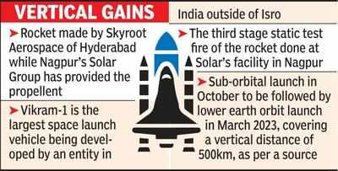
STRATEGIC INVESTMENTS

Slide 37
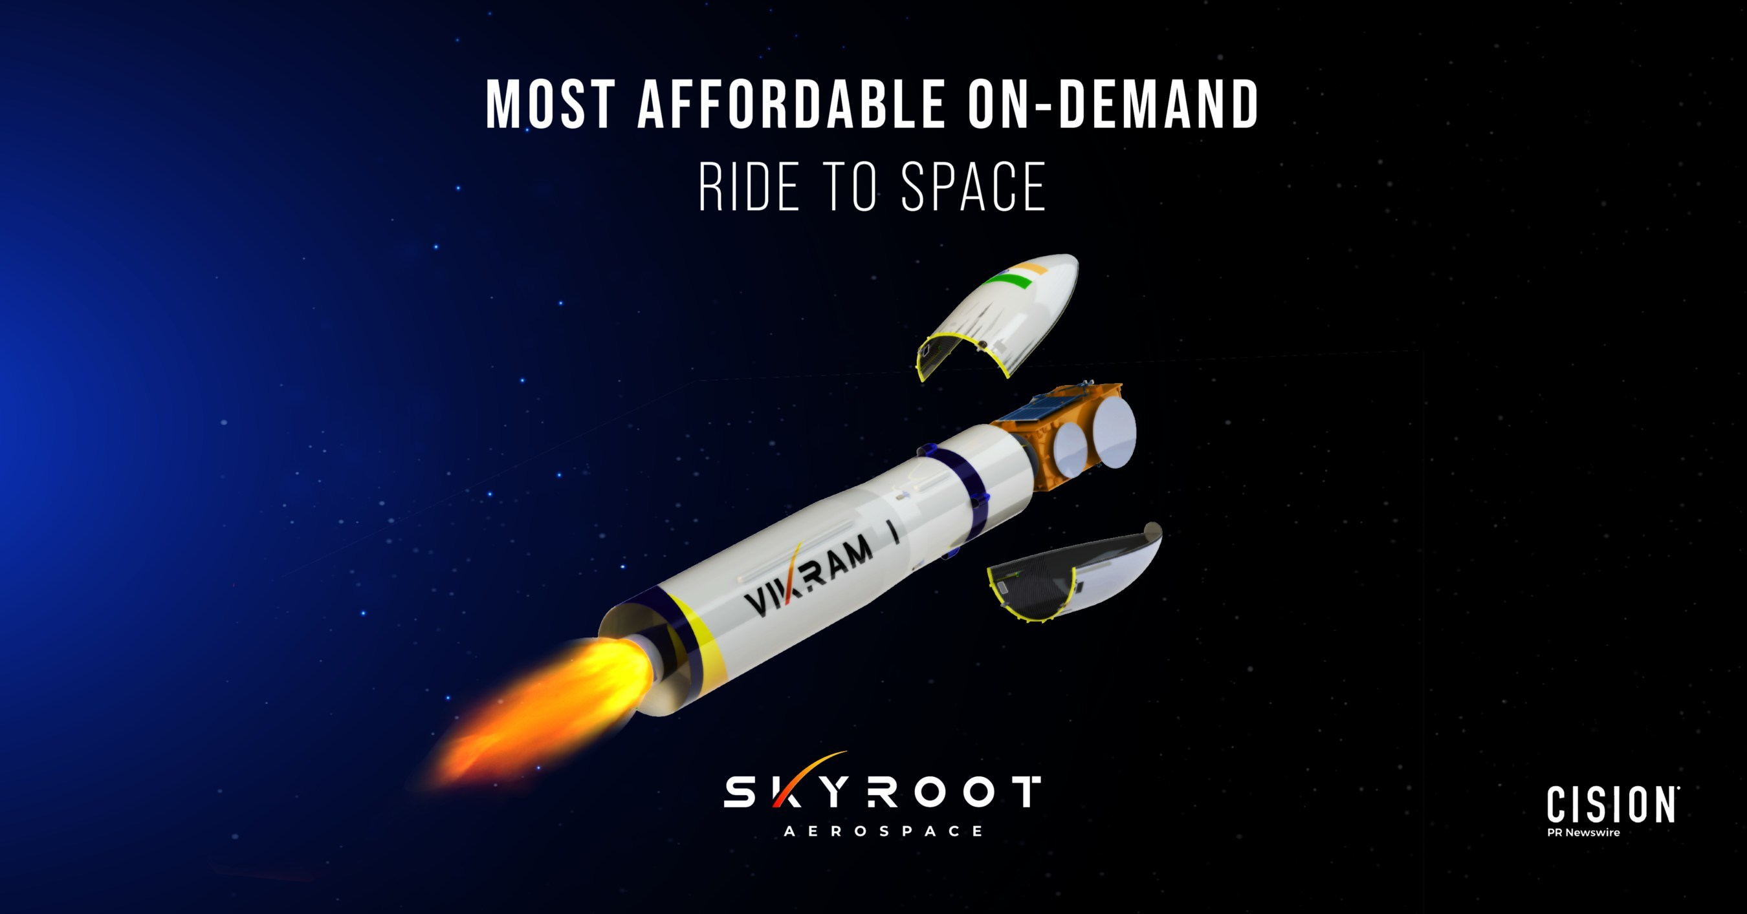
STRATEGIC INVESTMENTS

Slide 38
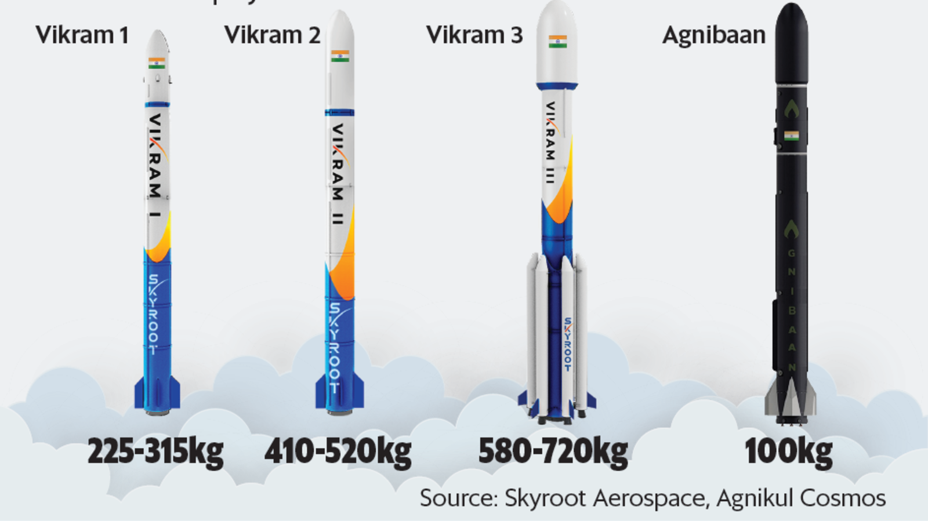
STRATEGIC INVESTMENTS

Slide 39
MANAGEMENT COMMENTARY
Targeting a business growth of 30% plus in FY23
“We are targeting a volume growth of around 15% and we are expecting that around 15% will be a price increase”
“With the Government of India’s substantial increase in allocation and policy support for housing, roads, railways and different sectors we will see a very good opportunity for sustained growth in our businesses”

Slide 40
MANAGEMENT COMMENTARY
“Our optimism is based on expected growth from all the operating sectors like mining, housing and infra, defence and other overseas business
Export and overseas revenues increased 33% YoY and 3% QoQ
Capex of 400-450 crore this year including strategic investments like ZMotion
Management guidance: Management expects Industrial segment demand to grow by 7-8%; Housing & Infra segment demand to grow at ~10-11%; whereas Mining segment is expected to grow by 6-7%. Size of the domestic explosives industry is estimated to be ~₹60-65bn (6000 - 6500 crore INR)

Slide 41
KEY TRIGGERS FOR GROWTH
Aatma Nirbhar Bharat Abhiyan and Make In India
Order book is 2982 Cr - strong revenue visibility
Better performance from overseas subsidiaries on the back of strong demand and economic activities returning to normal
Defence and export segments picking up due to addition of new products
Margins will be maintained due to:
Escalation clause with all customers
Key proximity to mines
In house production of RM except Ammonium Nitrate

Slide 42
WHY I LIKE THE BUSINESS
Strong operating efficiencies with significant backward integration
Strong Earnings Momentum
Entry Barriers
Strong tailwinds - Increased spending on mining/ infrastructure/ defence
Moat
They’ve successfully worked and delivered projects for DRDO under the technology transfer process
Takes up products where it has the expertise of delivering near 100% indigenisation, and which have to be imported
Already years ahead in R&D and working relationship with DRDO
Aggressive promoter, who knows the industry well and has a proven track record of delivering
Pick and Shovel Play - High ROE, ROCE business with low requirement of incremental capital

Slide 43
ONE KEY EXAMPLE
Army is replacing its WW-II vintage British M36 grenades
New grenades are to be made by Solar Industries and Munitions India Limited (MIL), one of the companies restructured and split from Ordnance Factory Board (OFB)
Army has asked OFB to prove shelf life of 15 years before giving order
The only method approved by the army will take two years
Solar has proposed new method that will take 4 months

Slide 44
MANY FIRSTS
First domestic supplier of RDX, HMX & TNT, key components used in propulsion in missile warheads and rocket systems, to the Ministry of Defence
First rockets produced by a private sector company successfully test fired - Pinaka multi-barrel rocket launcher system
First instance of ammunition being manufactured by a private sector company - Multi Mode Hand Grenades (MMHG)
First Indian Company to cross annualized production of 300k MT of explosives
First Indian Company to make fully indigenous Weaponised Drones and Loitering Munitions
First private sector company to export ammunition from India - Indonesia government has placed an order for the first batch of grenades. Indian Govt. has already given in-principle approval to supply these to Indonesia.

Slide 45
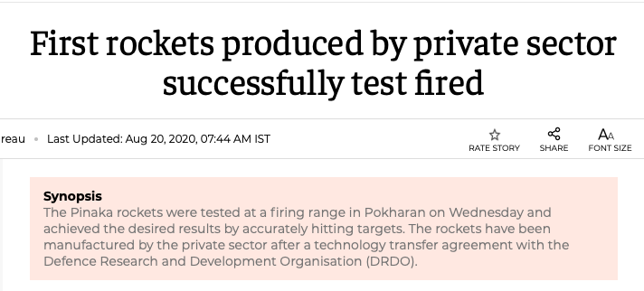
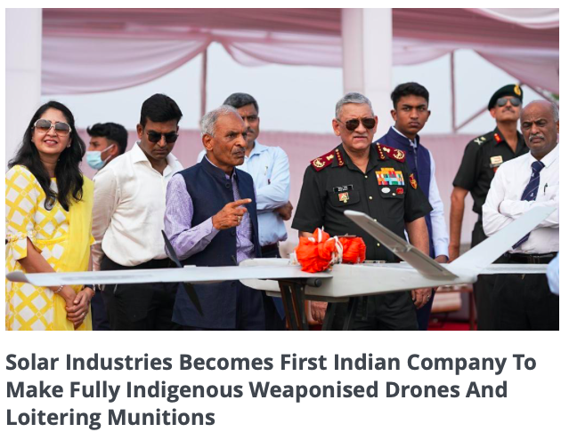
MANY FIRSTS

Slide 46
KEY RISKS
Key RM: Ammonium Nitrate, prices have increased 80% YoY
Long gestation period in Defence contracts - meaningful traction yet to be seen
Domestic demand slowing down
Ramp up in overseas operations gets delayed

Slide 47
COMPETITIVE LANDSCAPE

Slide 48
Thank You!

