Slide 1
Mastek
A niche play in the cloud migration and digital space catering mainly to the UK Government & E-Commerce space in US
M. Cap (As on 28/11/19): ~Rs. 960 Crs.
Outstanding shares: 2.41 Crs. (FV: Rs. 5)
CMP (As on 28/11/19): Rs. 398/-
Stock P/E: 9.40
Stock P/B: 1.15
Div. Yield: 2.15%
ROIC: 27.25%
ROCE: 18.67%
Promoter Holding: 45.61% of which 57% is pledged for refinance of a subsidiary loan

Slide 2
Digitalization and cloud spending to increase going forward
IT spend towards Infra-as-a-Service (IaaS) to increase

Slide 3
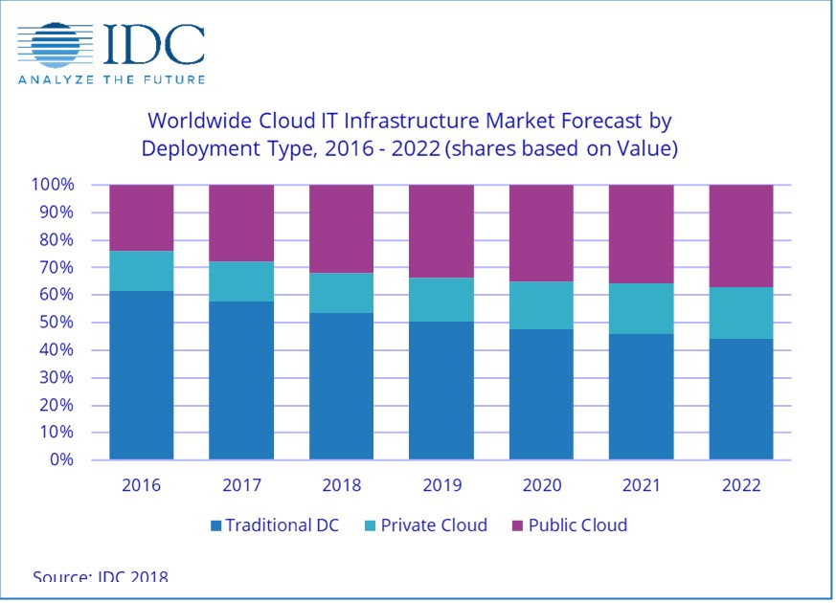

Slide 4
Similar trends in UK Market

Slide 6
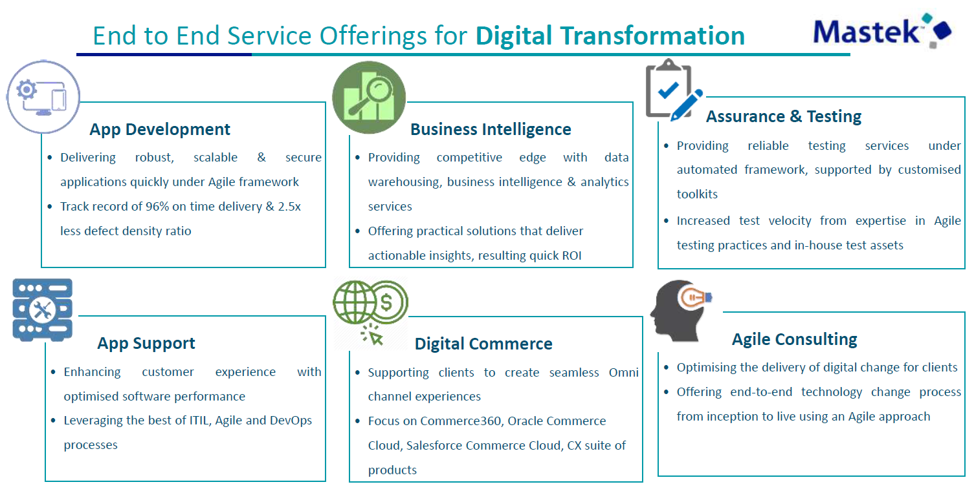
What the company does

Slide 7
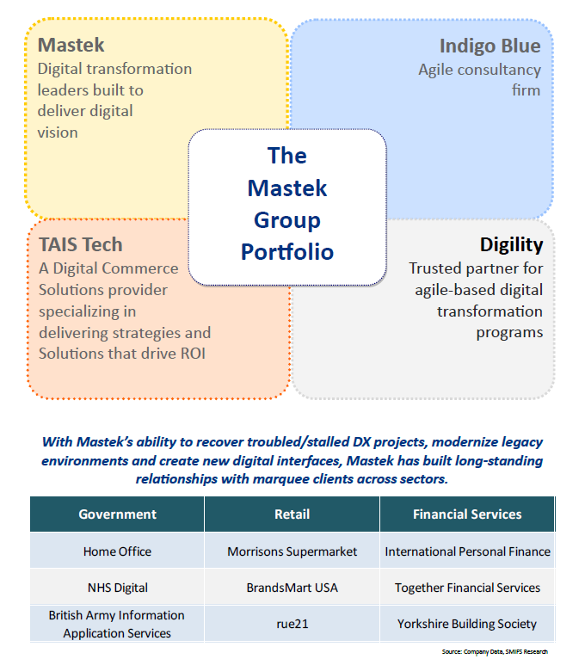
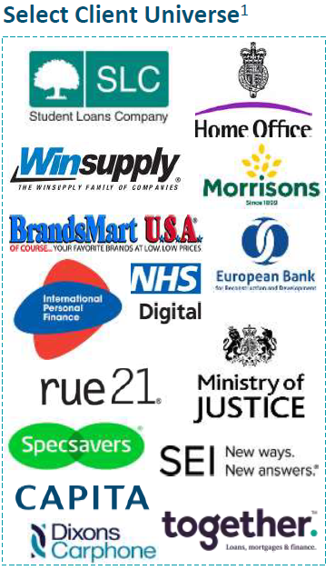
U.S.

Slide 8
Consolidated Financial Performance

Slide 9
Recent Financial Performance (₹ Crs.)
What is holding the performance back…?

Slide 10
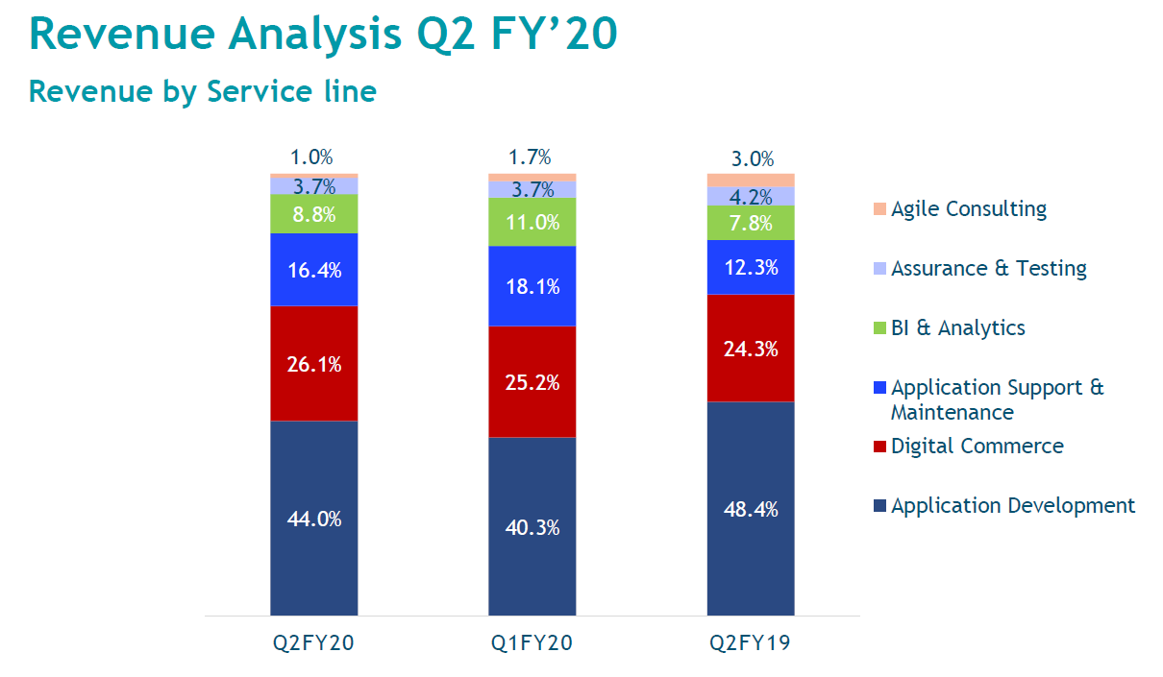

Slide 12
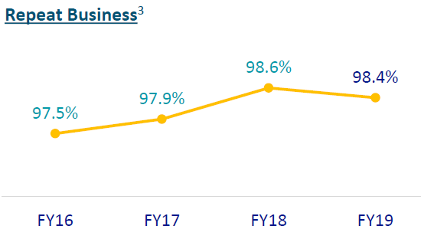
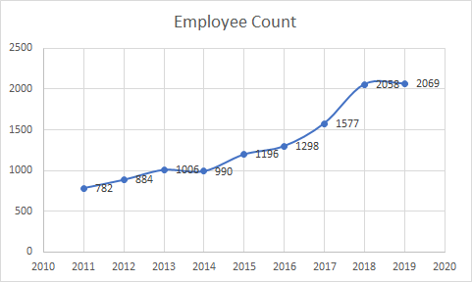

Slide 13
Recent Developments
Demerged from Majesco (insurance solutions business - primarily US based) in 2016
New CEO, John Owen, in 2017
Finally it is finding its feet in terms of revenue sustainability after a 2-year period of transition
Total value of net cash and non-core assets: ~Rs. 500 Crs ; Rs. 207 per share
Net cash and liquid investments (as on 30/09/19) : Rs. 198.7 Crs.
Holds 12 % stake (5,044,875 shares) in Majesco US worth ~ Rs. 300Crs (to be sold)

Slide 14
Given the above info, what do you think are key value drivers?

Slide 15
Key Risks
Government business is difficult
Brexit is complex and disruption shock might be greater than anticipated
Client concentration risk
Top customer: 40% of revenues (As of Q2FY20)
Top 5 customers: 57% of revenues (As of Q2FY20)
Churn in CXO level management
The senior leadership has seen some churn in the past and this might effect the company's strategic execution going forward
Glassdoor reviews - could be biased towards dissatisfied employees
Recent (few months old) reviews complain of lack of work, lack of exposure to new technologies and HR dept. becoming bad
https://www.glassdoor.co.in/Reviews/Mastek-Reviews-E32594.htm
Appendix Link

Slide 16
Other considerations
Will the management use the cash wisely?
Why not buyback?

Slide 17
Appendix

Slide 18
Peer Comparison

Slide 19
Management Team

Slide 20
Select Glassdoor Reviews
Go Back

Slide 21
Strategic Focus

Slide 22
Useful links
https://www.digitalmarketplace.service.gov.uk/
https://www.business-standard.com/article/pti-stories/mastek-looks-to-exit-majesco-to-use-proceeds-for-acquisitions-119041400223_1.html
http://bwcio.businessworld.in/article/Mastek-Focuses-On-Doubling-Engineering-Jobs-In-India-By-2021/05-04-2019-168891/
https://www.insightssuccess.in/john-owen-driving-transformations-deliver-results/
ICRA Credit Rating Report, September 2019
FT article on contra views of Brexit

