Slide 1
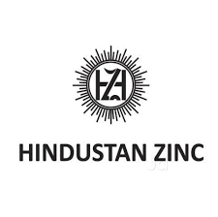
CASE STUDY – PREMIUM ZINC-LEAD COMPANY (RISKY DIVIDEND PLAY)

Slide 2
Hindustan Zinc (HZL) - Summary
HZL is one of the largest zinc-lead producers globally and largest in India. 10th largest silver producer globally. It enjoys strong free cash flows, is debt free, strong profitability and high ROEs. It is also amongst the lowest cost producers and has transitioned to underground mining from open cast mining.
Historically a PSU, but acquired in FY03 by the Vedanta group who subsequently expanded zinc capacity from 0.2 mtpa to 1 mtpa currently. Promoter holding is ~65%
It operates in a commodity business. Commodities are cyclical and dependent on demand-supply. Zinc (~75% of PBIT profits in FY19) is turning into surplus from 2022 (deficit in 2016). International zinc LME prices (USD per tonne) have softened by 35% to ~ USD 2,343 currently from the peak prices of USD 3606 in Jan 2018
Share returns since Jan 2011 have been impressive with aggregate returns of 550%; however, returns have been cyclical. Currently share price has fallen to Rs 215 per share from ~ Rs 325 in March 2018.
At current valuations, the stock is trading at mid-point of historical P/BV levels and higher range of EV/EBITDA valuations. Given that zinc prices are likely to remain volatile with a downward bias, further share price correction is possible.
HZL dividends have sharply risen since FY16 when its cash & cash equivalents were Rs 352.7 bn. Cash balances as on March 2019 are Rs 169.5 bn. Recent dividend payout in FY19 was Rs 20 per share or ~ 9% dividend yield.
Rationale for dividend payout in the past includes paying off debt to group parent companies (Vedanta Resources and Volcan Investments). This may continue in the future and provide dividend income to investors in the interim, but could come at a risk of initial investment in the medium term.

Slide 3
HINDUSTAN ZINC (HZL)
HZL is 2nd largest Zinc-Lead miner worldwide (75% of PBIT profit in FY19), 4th largest zinc smelter and 9th largest silver producer globally. Silver as a precious metal is a natural hedge during an economic slow-down
HZL has a ~79-85% market share of primary zinc in India
HZL is ranked 1st in environment and 5th overall in global metal & mining sector in Dow Jones Sustainability Index
HZL’s 5 ore mines and 4 smelter capacities are located in Rajasthan
Mined metal capacity ~1 mtpa (mn tonnes per annum)
Smelter capacity - Zinc (8.94 lakh tpa); Silver (600 tpa)
(Rajasthan is endowed with the largest reserves/ resources of lead-zinc ore amounting to 670 million tonnes. HZL has fully transitioned into underground mining by converting and commissioning all its open cast mines into underground mines. CARE Report).
Silver used in industrial applications and as a precious metal (25% of PBIT profits in FY19)
Promoters:
Vedanta Group (64.9%); Govt (29.6%); Institutional holding is low at ~ 4%
Please note that zinc ore which is mined in mines contains 5-15% of zinc concentrate
Ore (mine)
Zinc concentrate
SMELTER
pyrometallurgy or hydrometallurgy process
Zinc ingots
Applications
Galvanised Steel (57%)
Coatings (16%)
Dye Cast Alloys (14%)
Oxides & Chem (7%)
Extruded products (6%)
Dry batteries

Slide 4
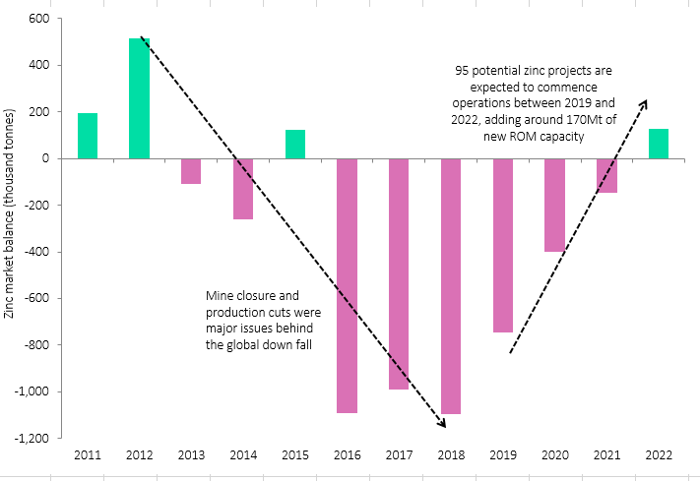
Global zinc inventory levels at 5 days, lowest since 2007; Demand-supply turning to surplus by 2022
GLOBAL ZINC MARKET – ~ 14 mt
Since 2016: Severe deficit, impacted by several mine closures and production cuts over prices concerns.
2019: Current deficit is 1.1 mn tonnes
From 2019–2022, global zinc supply is expected to grow at a compound annual growth rate of 3.8%, to 15.7Mt in 2022.
By 2022, market to be in surplus, due to almost 100 new projects commencing operations between 2019 and 2022 where zinc is either a primary or a secondary commodity being produced.
Source: https://www.mining-technology.com/comment/zinc-outlook-2019/

Slide 5
Zinc prices softening, after peaking in 2018; prices currently volatile
Zinc prices are influenced by
Mine and metal demand-supply dynamics
inventory levels, currency fluctuations
Steel and iron-ore industry as 50% of zinc end use consumption is used for galvanising steel
China accounts for almost 48% of the world consumption and has a direct bearing on zinc prices
Zinc's price have been volatile in 2019 so far; prices have ranged from USD/tonne 2370 to 2900. This stems from its shifting fundamentals and the physical bottlenecks which is expected to result in future oversupply from an acute deficit situtation.
Source: CARE report on Zinc; HZL commands a USD 150 -200 premium over LME zinc prices

Slide 6
HZL: Current Product Profile Zinc - Lead ~ 75% of PBIT profits & Balance is Silver

Slide 7
HINDUSTAN ZINC: SWOT ANALYSIS
STRENGTHS
S
W
WEAKNESSES
One of the worlds largest and India’s only integrated Zinc-Lead and Silver producer
Silver, a precious metal acts as a natural hedge during an economic slowdown
Cyclical business - Commodity, impacted by global demand –supply and price trends; Prices set globally LME a key price indicator
SWOT
OPPORTUNITIES
O
T
THREATS
Production entirely shifted to underground mining from open-cast mining.
Volume growth with proposed mining capacity additions
By 2022, zinc surplus imminent; supply to begin easing from 2019 onwards (currently yet in deficit)

Slide 8
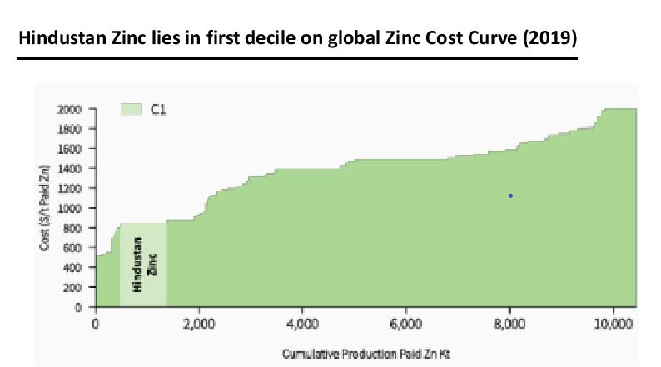
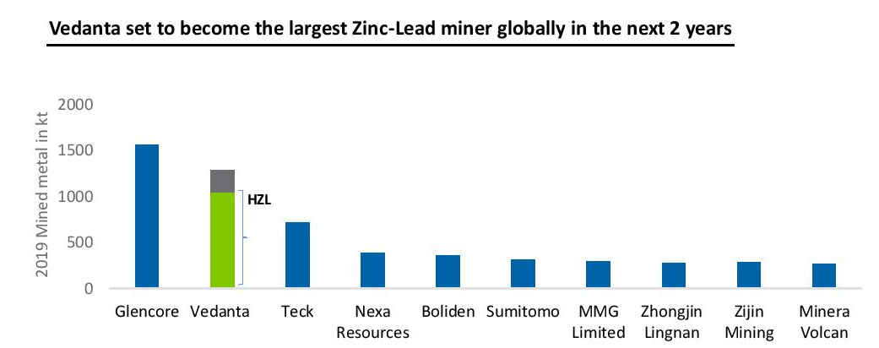
Hindustan Zinc – Economic Moats
Strong Intangible Asset
Zinc: 2nd largest player globally & ~85% market share in India. Vedanta owns Hindustan Zinc, and also owns zinc mines globally. Please note that HZL charges USD 150-200 per tonne premium over the LME price, due to its superior quality & service features.
Silver: 9th largest player globally
Low Cost Advantage

Slide 9
HINDUSTAN ZINC – Future Plans
Zinc demand has potential to increase - India
(historically, demand grew by 4-5%)
Railways: Galvanising of railway tracks as a safety initiative will continue
Cars: In India, only 25% of car components are galvanised, the proportion is 75% globally
Roofing: Galvanising component is low at 18-20% and is expected to rise
(Zinc consumption in India is 0.5 kg/capita as compared to China's consumption of around 5.0 kg/capita and the average global consumption- 1.9 kg/capita)
HZL proposes to expand zinc and silver output
Zinc mined metal capacity to reach 1.2 mtpa by end FY20 and further proposes to expand to 1.35 mtpa
Silver output proposed to increase to 750-800 tonnes in FY20 (670 tonnes in FY19). Propose to become one of the top 5 silver producers (9th position currently) in the long term with ~ 1000 tonnes of output in the next 3 years.
Source: Company interviews

Slide 10
HINDUSTAN ZINC – Shareholder Returns Cyclical
 | Share Price (Rs) | 1 yr rolling returns | 3 yr rolling returns (CAGR) | Net Profit (Rs bn)
Mar 2010 | 120 |  |  | 40.4
Mar 2011 | 138 | 14% |  | 49.0
Mar 2012 | 132 | -4% |  | 55.3
Mar 2013 | 121 | -8% | 0% | 69.0
Mar 2014 | 129 | 6% | -2% | 69.0
Mar 2015 | 162 | 26% | 7% | 81.8
Mar 2016 | 184 | 13% | 15% | 81.8
Mar 2017 | 289 | 57% | 31% | 83.2
Mar 2018 | 301 | 4% | 23% | 92.8
Mar 2019 | 277 | -8% | 15% | 79.6
Key Corporate Action
Date | Action
7th March 2011 | Split 10 : 2
7th March 2011 | Bonus 1:1
Source: Moneycontrol (Advanced charts)
Total Absolute Returns: 550% (post March 2011)
10x increase in no of shares owned (For every share owned prior to 7th March 2011, 10 shares recd)
Returns rose by ~ 55% (Rs 138 to 215 per share -current price)
Current Share price is Rs 215
Source: screener.in (share price & net profit)

Slide 11
HINDUSTAN ZINC: Key Financials & Business Risks
Parameters | Remarks
Earnings per Share | EPS doubled in the last decade to Rs 18.47 per share; though lower than the cyclical peak of Rs 21.95 in FY18
Free Cash Flow | Positive, ranging from Rs 53 -71 bn in last 3 years
Return on Equity | Yes, 23 to 27.8% in last three years
Interest Coverage | >10, Negligible debt
Economic Moat | 2 Moats (Intangible Asset, Low cost Advantage)
Net Margin | Consistently over 38%
Dividends | Yes, dividend yield of 9% last year
Risks
Supply overhang risk
Environmental risk of banning mining

Slide 12
HINDUSTAN ZINC: VALUATION MATRIX
Market Parameters | As on 11.9.2019
Market price | Rs 215
Market cap | Rs 906 bn
P/E TTM | 11.6
P/E vs recent Growth | 11.6/NA = EPS growth declined in FY19
P/B | 215/80 = 2.7 exceeds 0.8x
Dividend Analysis
Dividend payout | Exceeded 100% in three of the last 4 years
Dividend yield | Indicative dividend yield of 2.7% to 15% in the last 4 years
Dividend yield is higher than 7.5% dividend yield criteria in 3 of the last 4 years
Hindustan Zinc is a commodity company, P/BV is expensive and P/E is not possible since EPS growth can become negative due to cyclical nature of business
Notes:
On Oct 2018 price corrected to Rs 282 – great buying opportunity

Slide 13
Rationale for HZL’ consistent dividends – To repay debt in Vedanta Resources & Volcan Investments. Likely to be the reason in future as well
Vedanta Resources (London) is 100% owned by Volcan Investments (privately held promoter company/ family office of Agarwal family)
Debt levels of group
Vedanta: Rs 595 bn (June 2019)
(Parent company of HZL)
Vedanta Resources : 16 bn $ (Mar 2019)
(Parent company of Vedanta)
Volcan Investments: 13 mn $ (Mar 2019)
(Ultimate parent company of HZL)
Vedanta Resources and Volcan Investments are largely dependent on dividend income from Vedanta and its operating subsidiary Hindustan Zinc Limited to meet their debt servicing requirement.
Vedanta Ltd distributed dividends of Rs 58 bn,79 bn, 70 bn per year during FY17 to FY19

Slide 14
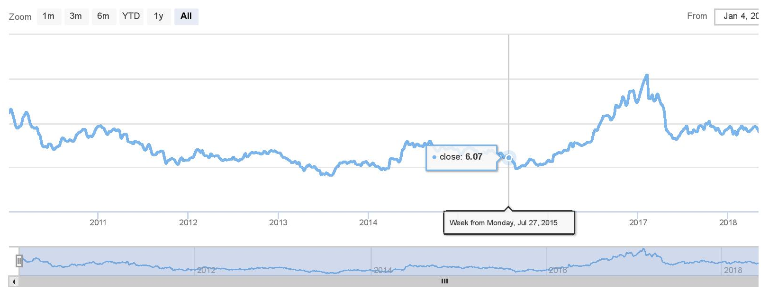
HZL – Historical EV/EBITDA valuation trends Suggests scope for stock prices to correct further
Current EV/EBITDA = 7.58
Since Jan 2010, EV/EBITDA has ranged from 5 to 10
(EV/EBITDA outliers 4.1 to 15.4)
EV/EBITDA multiples have risen from 2016 onwards in line with zinc deficit globally
EV/EBITDA = 15
EV/EBITDA = 10
EV/EBITDA = 5
EV/EBITDA = 0
Source: ratestar.in

Slide 15
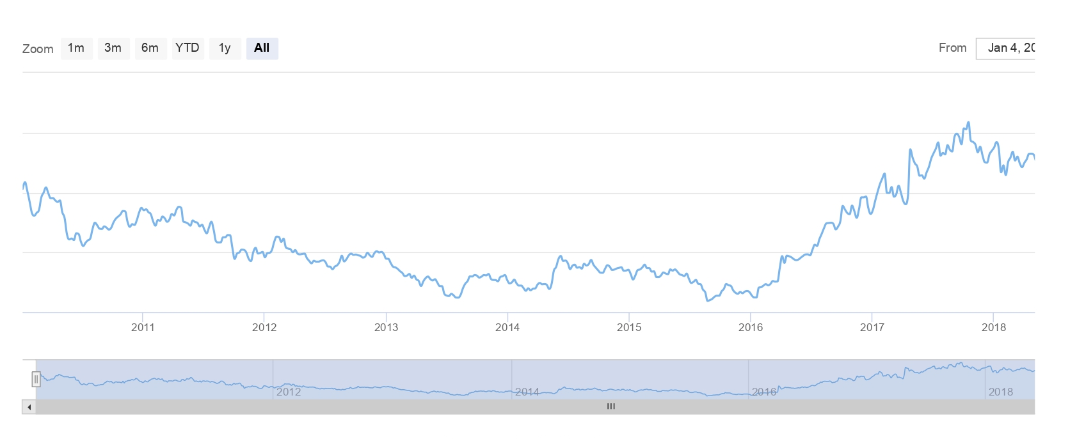
HZL – Historical P/BV valuation trends Suggests scope for stock prices to correct further
Current P/BV = 2.7
From Jan 2010 onwards, P/BV has ranged from 1.5 to 3
(P/BV outliers 1.2 to 4.2)
P/BV multiples have risen from 2016 onwards in line with zinc deficit globally
P/BV = 4
P/BV = 3
P/BV = 2
P/BV = 1
Source: ratestar.in

Slide 16
HINDUSTAN ZINC: Recommendation Dividend play in next 1-2 years at the risk of capital loss
 | Dividend Payout | Dividend per share (Rs) | Dividend (Rs bn)
FY10 | 6% | 0.6 | 2.5
FY11 | 9% | 1.0 | 4.2
FY12 | 18% | 2.4 | 10.1
FY13 | 19% | 3.1 | 13.1
FY14 | 21% | 3.5 | 14.8
FY15 | 23% | 4.4 | 18.6
FY16 | 144% | 27.8 | 117.5
FY17 | 149% | 29.4 | 124.2
FY18 | 36% | 8.0 | 33.8
FY19 | 106% | 20.0 | 84.5
Current Dividend per share (Rs) = 20
Historical dividend per share (Rs)= 18(average of last 5 years).
Dividends are usually announced in October & March.
Dividend (assumption)(Rs) = 18
CURRENT SHARE PRICE = 215
Recommendation - Stock capital appreciation unlikely as zinc moves into surplus; Dividend play in the short term possible

Slide 17
Appendix: Zinc Overview
Zinc is the fourth most widely used metal globally after steel, aluminium and copper and the third most-used non-ferrous metal. According to ILZSG, global key zinc producers for CY17 include - China (39%), Peru (11%), India (10%), Australia (8%), USA (6%) etc.
Australia is the leading storehouse of zinc reserves with 64,000 KT (28% of the world reserves) followed by China with 41,000 KT (18% of the world reserves). India ranks 6th and is endowed with 11,000 KT of zinc reserves (5% of the world reserves).
ILZSG: International Lead & Zinc Study Group

Slide 18
Appendix: Zinc Production Process

Slide 19
Appendix: About HZL
1966: HZL was incorporated as a public sector company.
FY03: GoI divested 26% of its equity in HZL to Sterlite Industries Ltd (Sterlite Industries), which later made an open offer for a further 20%.
FY04: Sterlite Industries acquired an additional 18.92% by exercising an option granted by GoI to increase the stake to 64.9%.
After the restructuring of the Vedanta group in India, HZL became a 64.9% subsidiary of Vedanta Ltd (rated 'CRISIL AA/Positive/CRISIL A1+’).
The Company is headquartered in Udaipur, Rajasthan in India and has zinc and lead mines at Rampura Agucha (4MT), Sindesar Khurd (5MT) (also produces silver), Rajpura Dariba (1.3MT), Zawar (3MT) and Kayad (1.2MT); primary smelter operations at Chanderiya, Dariba and Debari, all in the state of Rajasthan; and finished product facilities in the state of Uttarakhand. Crisil Rated AAA/Stable

