Slide 1
GST For Investors and Traders
Anandh Sundar
Presented at EIN Meetup, CCI(Mumbai)-3 Feb 2018
Disclaimer: This presentation reflects my individual views on general market conditions/fiscal policy and is not investment advice. Please act at your own risk . While copy-left permission to share freely applies, the contents may not be published in any media source without prior consent.

Slide 2
Agenda
GST imposed on a sector-good or bad (Eg Renewable Energy)
GST Rate increase/decrease on Sector(eg Restaurents-18% to 5%)
Imposition/Change of ‘Luxury’ cess (eg Auto, Cigarretes)
Fiscal Revenue/Tax Collection Numbers
Overall Numbers vs Centre/State Split
Contingent Liabilities/Transition Credit
SMEs
Consumers
Unorganized Sectors
Others
In Conclusion

Slide 3
GST imposed on a sector-good or bad-Food
In scenario of labour intensive industry or where inputs less taxed than outputs, GST results in consumer price inflation

Slide 4
GST Rate increase/decrease on Sector(eg Restaurents-18% to 5%)
Company will achieve 6.3% growth in sales without improving its margins, just to offset lost input tax credit
Company J reported double digit SSG growth on back of tepid earlier growth. Some bit of this is due to GST, and is not highlighted by company

Slide 5
GST Cess
The cess goes to a fund meant to compensate states for revenue losses in the first five years of the GST regime.
“Sin Goods” such as aerated drinks, coal, tobacco, automobiles and the ambiguous category of “other supplies”
Jul 2017-Increase Cess on cigarettes to pre-GST rates
Sep-2017- The goods and services tax (GST) Council on Saturday raised the cess on mid-sized to large cars and SUVs in the range of 2-7 percentage points but kept the tax burden lower than pre-GST levels
Dec 2017- The Lok Sabha has approved a bill to hike Cess on luxury vehicles from 15 per cent to 25 per cent.

Slide 6
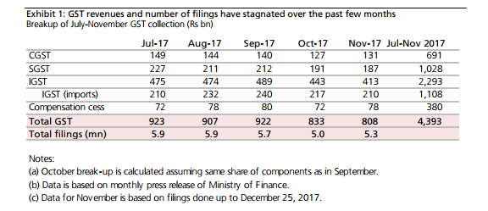
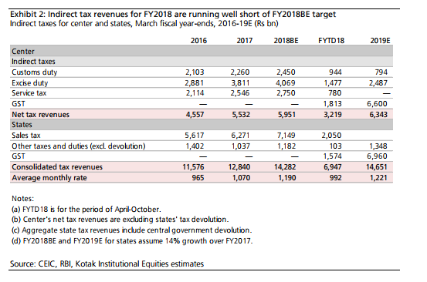
Fiscal Revenue
Cross Matching with all statutory data(IEM/PAN/IEC) & Aadhar
Linkage with customs data(Shipping bill); E-Way Bill & acceptance clause-Game changer for evasion
Potential Linkages for employee data, electricity, direct tax data
Initial Revenue boost lower so compliance focus. Also, impact of transition credit not fully done

Slide 7
SMEs
Positives
6 month period for customer to pay or risk losing input credit
Composition Scheme
Reliable Record for lending-Erode NBFC moat for SMEs
Negatives
Practically large customers/transporters insist on GST to avoid additional work of reverse charge or generating E-way bill. So threshold less meaning
Returns/Compliances-Need to upgrade accounting system as well

Slide 8
Consumers
Able to complain about perceived ‘profiteering’
Anti dumping duties now data backed so lesser chance of industries fudging data to protect their profit pools->Positive for consumer
“Under GST rules, the central government notified in June last year that any excess profit a manufacturer makes by charging a higher price should be credited to the Consumer Welfare Fund. But there is little clarity on how this transfer should happen and under what circumstances”
EXAMPLE: India’s largest packaged consumer goods maker earmarked Rs119 crore in the December quarter to be paid to the government because it could not immediately lower prices after the goods and services tax (GST) on several products was reduced on 15 November.

Slide 9
Unorganized Sector
Brought into the limelight due to reverse charge compliances especially during import of goods
E Way Bill Introduced Wef 1 Feb 2018 will ensure EWB for movement of goods
If above Rs 50,000 value
For any purpose (Including repairs/jobwork)
Between any premises(even if owned by same person)
To be prepared by transporter if not done by supplier or customer
Potential to compare EWB data with GST filings and detect lapses
However, composition scheme is a bonus for first time tax payers

Slide 10
Other points
GST Input Credit restriction (eg Restaurents/Energy/BFSI)
Procedural Relaxation/Issues
Composition Scheme, WayBill, Returns
Boost to Digital India
Easier Lending- Digital Transaction trail of Gross Profit (Ex Employee Costs/Utilities)
E-Payment/E-Ledger/E-Filing-Make people conversant with it
Cloud based working of professional firms

Slide 11
Conclusion
Second Order effects relevant Eg Imports value chain
Cascading effect still relevant due to impact of other duties/cess
Anti Dumping duties included in taxable value of imported goods
Earnings volatility due to anti profiteering(Eg HUL)
Ease of doing business not yet fully visible unless visibility on
Transition Credit(Pre GST Credit)
Input Credit Matching
Way Bill
Tax Hikes/Cess changes

