Slide 1
For educational purpose only
Motilal Oswal – Making of a financial services behemoth !!!

Slide 2
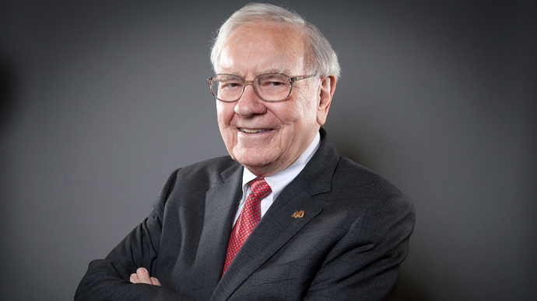
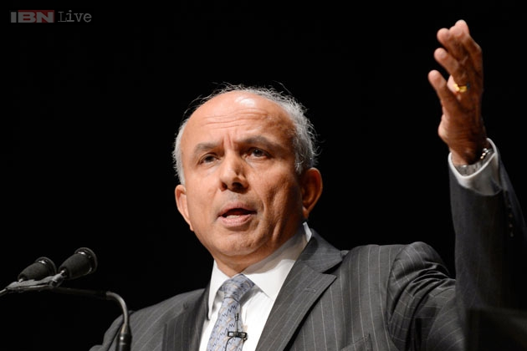
Returns of the Marquee Investors
21.4%
…
Returns CAGR%
~21%
$1000 investment
$11 million
(since 1964)
202,000
(since 1985)
Absolute Returns
11000 X
202 X

Slide 3
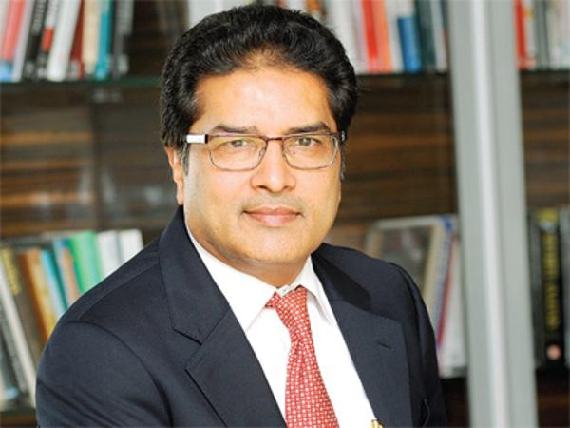
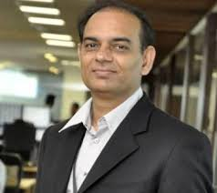
Can they be the Buffet and Watsa's of India?
Value Investors
Cash generating Assets
Fantastic personal track record
PE Style approach
Sponsor Commitments
High growth businesses

Slide 4
What does the numbers say?

Slide 5
What would you say after looking at these numbers?
A
B
C
D
D
Metrics
10 Years
5 years
3 Years
TTM
Sales CAGR
12.69%
12.82%
31.64%
53.94%
Net Profit CAGR
9.36%
4.62%
20.34%
84.53%
ROE
13.4%
9.6%
10.25%
12.38%

Slide 6
Evolution of Motilal from a brokerage firm to a financial firm

Slide 7
Brokerage and Investment banking
a
2% market share in brokerage business
Investment banking looks promising with opportunities in ECM (IPO, QIP, etc) and M&A
1
Brokerage and Investment Banking
b
c
2
MOFSL
Asset Management – Private Equity, Mutual funds, PMS
3
Aspire Home FInance

Slide 8
Asset Management
a
Strong investment focus in building scale
1
b
Segment is at inflection point
Brokerage and Investment Banking
c
Mutual funds getting good traction
Private Wealth
2
MOFSL
Asset Management – Private Equity, Mutual funds, PMS
Mutual funds, PMS
3
Private Equity
Aspire Home FInance

Slide 9
Aspire Home Finance
a
Building affordable housing finance business from scratch
1
Loan value < 10 lacs per customer, also participating in govt subsidy programs
Brokerage and Investment Banking
b
c
Housing finance is 12 lac crore with 36% share of HFCs
2
MOFSL
Asset Management – Private Equity, Mutual funds, PMS
3
Aspire Home Finance

Slide 10
Valuation

Slide 11
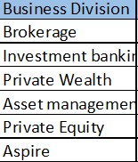
Future Valuation - SOTP based

Slide 12
To Summarize
1
Great value investors at the helm
…
2
Firing all cylinders – all businesses are showing good traction
…
3
Investment phase towards completion and businesses are at inflection point
…
4
Demonetization will provide further boost to its businesses
…
5
Value unlocking opportunities in future through stake sale/demergers etc.
…

Slide 13
Disclaimer
This presentation is for educational purpose only. Please use your own discretion before making any investment decision. It is always advisable to consult advisors for the investment decisions. The author disclaims any liability, loss, or risk taken by individuals who directly or indirectly act on the information contained herein. All readers must accept full responsibility for their use of this material.

